Slide 1
Medical Cannabis:
Update
James Westphal, MD
May 2, 2023

Slide 2
Educational Objectives
At the end of this session, physicians will be able to:
Describe how the changing legal status of cannabis has affected the prevalence of cannabis use and cannabis use disorder in the United States.
Identify the conditions that that have evidence support for medical cannabis use.
List common adverse effects of cannabis.
Describe the effects of cannabis on cognition, psychosis risk, depression and suicide ideation and attempts among adolescents and early adults.

Slide 3
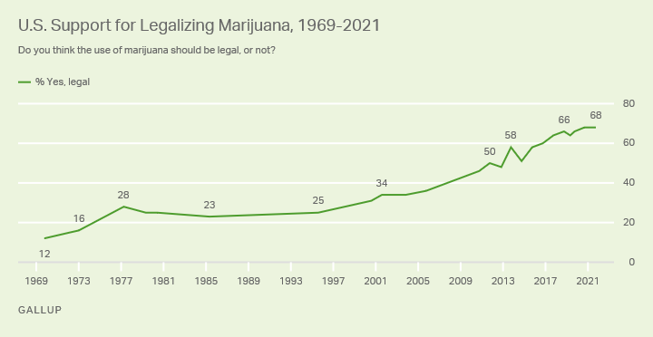
Support for Legal Cannabis May Have Peaked at Record High of 68%
On November, 2021
Gallup has documented increasing support for legalizing cannabis over more than five decades,
Sharp increases occurred in the 2000s and 2010s.
In 2013, a majority of Americans, for the first time, supported legalization.
Solid majorities of U.S. adults in all major subgroups by gender, age, income and education support legalizing cannabis.
https://news.gallup.com/poll/356939/support-legal-marijuana-holds-record-high.aspx

Slide 4
Changes in US Marijuana Use 2001 Through 2013
To present nationally representative information on the past-year prevalence rates of marijuana use and marijuana use disorder among marijuana users in the US adult general population and whether this has changed between 2001-2002 and 2012-2013.
The prevalence of marijuana use more than doubled between 2001-2002 and 2012-2013, and there was a large increase in marijuana use disorders during that time.
While not all marijuana users experience problems, nearly 3 of 10 marijuana users manifested a marijuana use disorder in 2012-2013.
The prevalence of marijuana use disorder among marijuana users has more than tripled since 1994 (Anthony, Warner, Kessler, 1994).
The increase in prevalence of marijuana use disorder is owing to an increase in prevalence of users in the US adult population (Hasin, Saha, Kerridge et al., 2015).

Slide 5
Marijuana is Commonly Used, Especially By Adolescents
Drug use disorders are observed primarily among adolescents and younger adults.
Marijuana is the most commonly used addictive drug after tobacco and alcohol (SAMSHA, 2018).
Among people aged 12 or older in 2020, 17.9% (or about 49.6 million people) reported using cannabis in the past 12 months (2020 National Survey on Drug Use and Health).
In 2021, an estimated 7.1% of 8th graders, 17.3% of 10th graders, and 30.5% of 12th graders reported using cannabis/hashish in the past 12 months (2021 Monitoring the Future Survey).
Among people aged 12 or older in 2020, an estimated 5.1% (or about 14.2 million people) had a cannabis use disorder in the past 12 months (2020 National Survey on Drug Use and Health).
        https://www.drugabuse.gov/publications/research-reports/marijuana/what-scope-marijuana-use-in-united-states

Slide 6
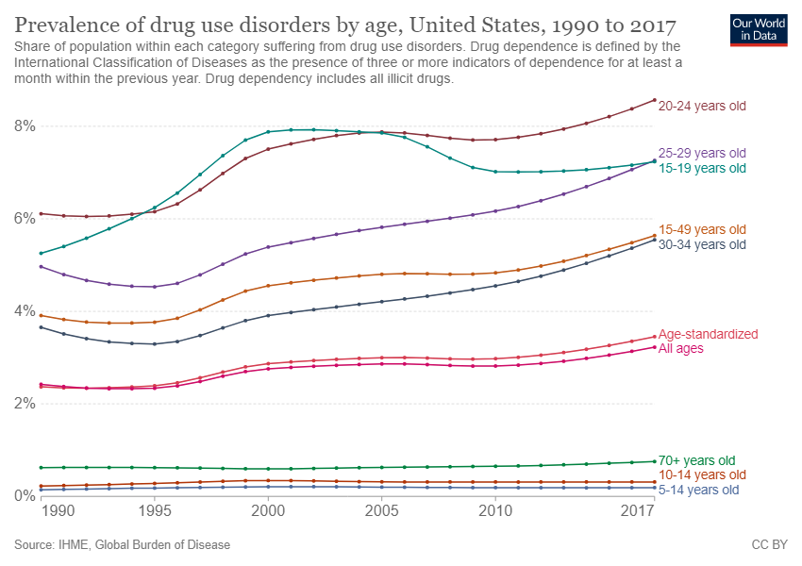
Ritchie & Roser. 2019
Drug Use
Disorders
Are
Observed
Primarily
Among
Adolescents
And
Younger
Adults.
https://ourworldindata.org/illicit-drug-use

Slide 7
Recreational Cannabis
Countries that have legalized recreational use of cannabis are Canada, Georgia, Malta, Mexico, South Africa, Uruguay and one Australian state, Capital Territory.
In the US, recreational use of cannabis is legalized in 18 states, the District of Columbia, the Northern Mariana Islands, and Guam.
Another 13 states and the U.S. Virgin Islands have decriminalized its use.
National Conference of State Legislatures, 2019

Slide 8
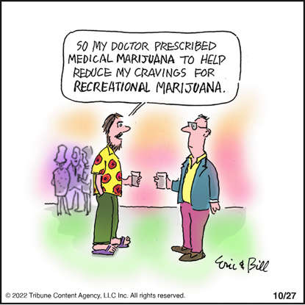
Medical Cannabis

Slide 9
Medical Cannabis
World wide, thirty countries legalized medical cannabis use, mostly in Europe. (see Appendix for list).
In the United States, the use of cannabis for medical purposes is legal in 39 states, as of December 2022.
There is significant variation in medical cannabis laws from state to state, including how it is produced and distributed, how it can be consumed, and what medical conditions it can be used for (National Conference of State Legislatures, 2018).
Public opinion has evolved in the US regarding the legal status of marijuana for medical purposes, but this change has not been guided by advances in scientific knowledge.
Wright, 2015;
https://worldpopulationreview.com/state-rankings/states-with-medical-marijuana

Slide 10
Cannabis Is Chemically Complex
Unlike pharmaceutical medications, marijuana is not a single-agent compound but a complex combination of more than 100 different chemicals, which include cannabinoids, flavonoids, and terpinoids.
The primary psychoactive component of marijuana is delta-9- tetrahydrocannabinol (THC).
However, other cannabinoid compounds—including cannabidiol (CBD), cannabinol, cannabichromene, cannabidivarin, cannabigerol, and tetrahydrocannabivarin—have their own actions on the central nervous system and may modify the effects of THC (“entourage effects”).
The concentration of these compounds can vary substantially (Potter, Clark, Brown, 2006), making it difficult to characterize the specific positive or negative health effects of marijuana, especially in uncontrolled and epidemiological studies.
Wilkinson, Yarnell, Radhakrishnan et al., 2016

Slide 11
Cannabis THC Content Has Increased Over Since The 80’s
The average content of THC in marijuana (as measured in confiscated marijuana samples in the United States) has increased substantially from ∼1% in the 1980s to ∼9% in 2008 (ElSohly, Ross, Mehmedic et al., 2000; Mehmedic, Chandra, Slade et al., 2010).
As THC is thought to be related to many of marijuana's adverse effects, this increase in potency means that relying on older studies for data about marijuana's safety profile may be problematic.
Furthermore, given that individual cannabinoids present in whole-plant marijuana have different pharmacological effects, data on individual cannabinoids cannot necessarily be extrapolated to whole-plant marijuana and vice versa.
More research is urgently needed in light of the changing legal landscape and the increasing potency of marijuana.
Wilkinson, Yarnell, Radhakrishnan et al., 2016

Slide 12
The Endocannabinoid System (ECS) Is Complex
The ECS is a widespread neuromodulatory system that plays important roles in CNS development, synaptic plasticity, and the response to endogenous and environmental insults.
The ECS is comprised of cannabinoid receptors, endogenous cannabinoids (endocannabinoids), and the enzymes responsible for the synthesis and degradation of the endocannabinoids.
The most abundant cannabinoid receptor is the CB1 cannabinoid receptors, however CB2 cannabinoid receptors, transient receptor potential (TRP) channels, and peroxisome proliferator activated receptors (PPAR’s) are also engaged by some cannabinoids.
Exogenous cannabinoids produce their biological effects through their interactions with cannabinoid receptors.
2-arachidonoyl glycerol (2-AG) and arachidonoyl ethanolamide (anandamide) are the best-studied endogenous cannabinoids.
Despite similarities in chemical structure, 2-AG and anandamide are synthesized and degraded by distinct enzymatic pathways, which impart fundamentally different physiological and pathophysiological roles to these two endocannabinoids.
Lu and Mackie, 2016

Slide 13
Location of CB1 Receptors and Functions
Zou and Kumar, 2018

Slide 14
Medical Marijuana - Hawaii
Passed in 2000, oversight transferred to Department of Health in 2015.
Estimated 13,800 registered patients during 2015 (Pacific Business News: 7/2015).
Enrollment flattened at approximately 34,000 registered patients from June, 2021 through December, 2022, (4% of Hawaii adults, 80% of the estimated adult prevalence of cannabis use disorder in Hawaii).
Originally only PCPs allowed to certify, as of 7/1/15, any physician must obtain a bona fide physician-patient relationship with a qualifying patient.
https://health.hawaii.gov/medicalcannabisregistry/2021-data-reports/

Slide 15
Hawaii Medical Cannabis: Eligible Diagnoses
Amyotrophic Lateral Sclerosis (added effective Dec. 19, 2017 per petition process)
Cancer
Glaucoma
Lupus (added effective June 29, 2017 as per Act 041, SHL 2017)
Epilepsy (added effective June 29, 2017 as per Act 041, SHL 2017)
Multiple Sclerosis (added effective June 29, 2017 as per Act 041, SHL 2017)
Rheumatoid Arthritis (added effective June 29, 2017 as per Act 041, SHL 2017)
Positive status for human immunodeficiency virus
Acquired immune deficiency syndrome
Post-traumatic stress disorder (added effective July 1, 2015 as per Act 241, SLH 2015)
https://health.hawaii.gov/medicalcannabisregistry/providers/debilitating-medical-conditions/

Slide 16
Hawaii Medical Cannabis: Eligible Diagnoses (2)
The treatment of these conditions”, or “A chronic or debilitating disease or medical condition or its treatment that produces one or more of the following:
  Cachexia or wasting syndrome
  Severe pain
  Severe nausea
  Seizures, including those characteristic of epilepsy
  Severe and persistent muscle spasms, including those characteristic of multiple sclerosis or Crohn’s disease
  https://health.hawaii.gov/medicalcannabisregistry/providers/debilitating-medical-conditions/

Slide 17
Medical Cannabis Evidence Review
The National Academies of Sciences, Engineering and Medicine conducted a comprehensive review of recent medical literature on The Health Effects of Cannabis and Cannabinoids.
Considered 10,000 recent abstracts to determine their relevance.
The committee categorized the weight of evidence regarding whether Cannabis or cannabinoids use for therapeutic purposes are an effective or ineffective treatment.
The report concluded that there was conclusive or substantial evidence that Cannabis or cannabinoids are effective for the treatment of pain in adults; chemotherapy-induced nausea and vomiting and spasticity associated with multiple sclerosis.
Abrams, 2018

Slide 18
Medical Cannabis Evidence Review (2)
Moderate evidence was found for secondary sleep disturbances.
The evidence supporting improvement in appetite, Tourette syndrome, anxiety, posttraumatic stress disorder, cancer, irritable bowel syndrome, epilepsy and a variety of neurodegenerative disorders was described as limited, insufficient or absent.
Abrams, 2018

Slide 19
Medical Cannabis Evidence Review: Mental Health
The utility of cannabinoids and cannabinoid-based products (CBPs) as a pharmacological aid to treat psychiatric disorders in adulthood is still poorly understood.
This review and meta-analysis aimed to aggregate and evaluate all current high-quality research that specifically assessed the effectiveness of a CBP on a diagnosed adult psychiatric disorder.
thirty-one RCTs met criteria for inclusion.
This review finds limited evidence for the effectiveness of CBPs to acutely treat a narrow range of psychiatric symptoms.
McKee, Hmidan, Crocker et al., 2021

Slide 20
Medical Cannabis Evidence Review: Mental Health (2)
We report no evidence supporting the mid- to long-range effectiveness of any currently available CBP.
In general, quality of the evidence was assessed as low- to moderate.
Importantly, none of the studies discussed in this review presently endorse the use of cannabis flower as a method of treatment for any recognized psychiatric disorder.
Larger, hypothesis driven RCTs are required prior to making further therapeutic recommendations
Hoch, Niemann, Keller et al., 2019; McKee, Hmidan, Crocker et al., 2021

Slide 21
Mental illness Among Medical Cannabis Users
Lifetime prevalence of mental illness in this cohort was high, and a large proportion of subjects endorsed psychological symptoms.
The proportion of subjects who met criteria for classification of a current psychiatric disorder was low for mood disorders, but high for anxiety disorders and substance abuse/dependence.
Cannabis use differed between the main psychiatric conditions.
Conclusions: The present results indicate that rates of mental illness may be high in medical cannabis dispensary users.
Yau, Yu, Panenka et al., 2019

Slide 22
Medical Cannabis May Benefit But Adverse Effects Are Common
In the general population, there is substantive evidence for statistical associations between:
Cannabis use and increased risk of motor vehicle crashes;
The development of psychoses with the highest risk among the most frequent and high potency cannabis users;
Increased cannabis use frequency and the progression to developing problem cannabis use;
Adverse birth outcome in the offspring of mothers with cannabis smoking habits; and
Worse respiratory symptoms and more frequent chronic bronchitis episodes with long-term cannabis smoking.
National Academies of Sciences, 2017

Slide 23
Cannabinoids Adversely Affect Human Cognition
Verbal learning and memory and attention are most consistently impaired by acute and chronic exposure to cannabis.
Psychomotor function is most affected during acute intoxication, with some evidence for persistence in chronic users and after cessation of use.
Impaired verbal memory, attention, and some executive functions may persist after prolonged abstinence,
But persistence or recovery across all cognitive domains remains under researched.
Broyd, van Hell, Beale, et al., 2016

Slide 24
Cannabinoids Adversely Affect Human Cognition (2)
This study tested that long-term cannabis use is associated with cognitive deficits and smaller hippocampal volume in midlife, important because midlife cognitive deficits and smaller hippocampal volume are risk factors for dementia.
Participants are members of a representative cohort of 1,037 individuals born in Dunedin, New Zealand, in 1972-1973 and followed to age 45, with 94% retention.
Cannabis use and dependence were assessed at ages 18, 21, 26, 32, 38, and 45. IQ was assessed at ages 7, 9, 11, and 45. Specific neuropsychological functions and hippocampal volume were assessed at age 45.
Results: Long-term cannabis users showed IQ decline from childhood to midlife (mean=-5.5 IQ points), poorer learning and processing speed relative to their childhood IQ, and informant-reported memory and attention problems (Meier, Caspi, Knodt et al., 2022).
.

Slide 25
Cannabinoids Adversely Affect Human Cognition (3)
These deficits were specific to long-term cannabis users because they were either not present or were smaller among long-term tobacco users, long-term alcohol users, midlife recreational cannabis users, and cannabis quitters.
Cognitive deficits among long-term cannabis users could not be explained by persistent tobacco, alcohol, or other illicit drug use, childhood socioeconomic status, low childhood self-control, or family history of substance dependence.
Long-term cannabis users showed smaller hippocampal volume, but smaller hippocampal volume did not statistically mediate cognitive deficits.
Conclusions: Long-term cannabis users showed cognitive deficits and smaller hippocampal volume in midlife.
Research is needed to ascertain whether long-term cannabis users show elevated rates of dementia in later life (Meier, Caspi, Knodt et al., 2022).

Slide 26
Cannabis and Driving
Cannabis is the most prevalent illicit drug identified in impaired drivers.
Review the current literature on cannabis’ effects on driving, highlighting the epidemiologic and experimental data.
Epidemiologic data show that the risk of involvement in a motor vehicle accident increases approximately 2-fold after cannabis smoking.
The adjusted risk of driver culpability also increases substantially, particularly with increased blood THC concentrations.
Experimental data show that drivers attempt to compensate by driving more slowly after smoking cannabis, but control deteriorates with increasing task complexity.
Hartman and Huestis, 2013

Slide 27
Cannabis and Driving (2)
Cannabis smoking increases lane weaving and impaired cognitive function.
Critical-tracking tests, reaction times, divided-attention tasks, and lane-position variability all show cannabis-induced impairment.
Despite purported tolerance in frequent smokers, complex tasks still show impairment.
Combining cannabis with alcohol enhances impairment, especially lane weaving.
Summary: evidence suggests recent smoking and/or blood THC concentrations 2–5 ng/mL are associated with substantial driving impairment, particularly in occasional smokers.
Hartman and Huestis, 2013

Slide 28
Cannabis and Driving (3)
Most driving-related cognitive skills would recover (Hedges' g=-0.25) within 5 hours and almost all within 7 hours of inhaling 20 mg of Δ⁹-THC;
Oral Δ⁹-THC-induced impairment may take longer to subside.
These results suggest individuals should wait at least 5 hours following inhaled cannabis use before performing safety-sensitive tasks (McCartney, Arkell, Irwin et al., 2021).
Medical cannabis use does not currently exempt patients from mobile (roadside) drug testing and associated legal sanctions (Arkell, McCartney, McGregor, 2021).

Slide 29
Cannabis Use and Risk of Psychosis
Cannabis use has been reported to induce long-lasting psychotic disorders and a dose-response relationship has been observed.
Systematic review of studies that investigate the association between the degree of cannabis consumption and psychosis and a meta-analysis to quantify the magnitude of effect.
18 studies fulfilled inclusion criteria for the systematic review and 10 were used in the meta-analysis, enrolling a total of 66, 816 individuals.
Higher levels of cannabis use were associated with increased risk for psychosis in all the included studies.
Marconi, Di Forti, Lewis et al., 2016

Slide 30
Cannabis Use and Risk of Psychosis (2)
A logistic regression model gave an OR of 3.90 (95% CI 2.84 to 5.34) for the risk of schizophrenia and other psychosis-related outcomes among the heaviest cannabis users compared to the nonusers.
Current evidence shows that high levels of cannabis use increase the risk of psychotic outcomes and confirms a dose-response relationship between the level of use and the risk for psychosis.
Although a causal link cannot be unequivocally established, there is sufficient evidence to justify harm reduction prevention programs.
Marconi, Di Forti, Lewis et al., 2016

Slide 31
Human Adolescent Brain Development Is
Crucial To Adult Functioning
The brain’s physical growth occurs before adolescence but it undergoes extensive remodeling in the adolescent years.
Brain imaging done since the 1990s has shown that brain development progresses in a wave from areas at the back that look after older and more basic functions, such as vision, movement and processing, to the evolutionarily newer and more complex thinking areas at the front of the brain.
Children’s brains process information in a less efficient, location-specific way.
One of the key differences that come with adolescent maturation, is that processing occurs in a more efficient, connected, and integrated way.
Cognitive processing becomes more distributed and long range connections increase, allowing integration between distant brain regions. This leads to increased processing resources and greater efficiency (Griffin, 2017).

Slide 32
Human Adolescent Brain Development Is Crucial To Adult Functioning (2)
The brain’s wiring changes. The brain’s axons gradually become more insulated by myelin. Myelin changes are dramatic during adolescence, with the amount of myelin doubling in some brain regions.
Less used synapes, gradually diminish, known as synaptic pruning and it causes the brain’s cortex to become thinner and more efficient.
Stronger links develop between the prefrontal cortex and other brain regions. For example, connections between the hippocampus and frontal areas are strengthened, enabling adolescents to become gradually better at integrating memory and experience into their decision making.
Many of the same structures are involved in emotional processing, in evaluating risk and in controlling impulsivity. These include the hippocampus, the amygdala, the nucleus accumbens and the prefrontal cortex, all of which undergo change during adolescence (Griffin, 2017).

Slide 33
Human Adolescent Brain Development
Is Crucial To Adult Functioning (3)
The defining feature of our human brain is our late-evolving pre-frontal cortex. One of the key functions of the pre-frontal cortex is to become skilled at reconciling internal emotional states with the demands of external reality.
While the deeper subcortical areas have done most of their development by adolescence, the prefrontal cortex enters a critical period; it may not fully mature until the mid-twenties or even later. It is central to empathy, decision-making, and the regulation of complex social behaviors.
As the pre-frontal cortex develops, utilizing feedback from the environment to shape its progress, we learn how to manage long term planning, monitoring what is going on and adjusting smoothly while keeping our emotions and behaviors appropriate to the context. This ability is assisted by the growing inhibitory influence of the prefrontal dopamine system, which gradually improves the ability of teens to ‘apply the brakes’ (Griffin, 2017). https://www.ncbi.nlm.nih.gov/pmc/articles/PMC5746696/

Slide 34
Cannabis Use May Disrupt Adolescent Brain Development
Animal studies show the adolescent brain is sensitive to disruptions in endocannabinoid signaling, resulting in altered neurodevelopment and lasting behavioral effects. The regular use of cannabis during adolescence is concerning (Volkow, Baler, Compton et al., 2014).
Use in this age group is associated with an increased likelihood of deleterious consequences,
Such as, diminished scholastic achievement,
Lower degree attainment and school abandonment,
Liability to addiction (Silins, Horwood, Patton et al, 2014).
Earlier onset of psychosis (Di Forti, Sallis, Allegri et al., 2014) and
Neuropsychological decline (Meier, Caspi, Ambler et al., 2012).

Slide 35
Cannabis Use and the Adolescent Brain
Few studies have investigated cannabis use and human brain development.
To examine the degree that cerebral cortical thickness is associated with cannabis use in a longitudinal sample of adolescents.
Data were obtained from the IMAGEN cohort study, conducted across 8 European sites. A total of 799 IMAGEN participants reported being cannabis naive at study baseline and had behavioral and neuroimaging data available at baseline and 5-year follow-up.
The study evaluated 1598 MR images from 799 participants (450 female participants [56.3%]; mean [SD] age, 14.4 [0.4] years at baseline and 19.0 [0.7] years at follow-up).
At 5-year follow-up, cannabis use (from 0 to >40 uses) was negatively associated with thickness in left prefrontal and right prefrontal cortices.
Albaugh, Ottino-Gonzalez, Sidwell et al., 2021

Slide 36
Cannabis Use and Adolescent Brain (2)
There were no significant associations between lifetime cannabis use at 5-year follow-up and baseline cortical thickness, suggesting that the observed neuroanatomical differences did not precede initiation of cannabis use.
Longitudinal analysis revealed that age-related cortical thinning was modified by cannabis use in a dose-dependent fashion such that greater use, from baseline to follow-up, was associated with increased thinning in left prefrontal and right prefrontal cortices.
The spatial pattern of cannabis-related thinning was associated with age-related thinning (r = 0.540; P < .001), and a PET assessed CB 1 receptor map.
Analysis revealed that thinning in right prefrontal cortices, from baseline to follow-up, was associated with attentional impulsiveness at follow-up.
Results suggest that cannabis use during adolescence is associated with altered neurodevelopment (Albaugh, Ottino-Gonzalez, Sidwell et al., 2021).
Attentional impulsivity is a factor in impaired academic performance and progression to dependence.

Slide 37
Cannabis Use and Adolescent Brain (2)
There were no significant associations between lifetime cannabis use at 5-year follow-up and baseline cortical thickness, suggesting that the observed neuroanatomical differences did not precede initiation of cannabis use.
Longitudinal analysis revealed that age-related cortical thinning was modified by cannabis use in a dose-dependent fashion such that greater use, from baseline to follow-up, was associated with increased thinning in left prefrontal and right prefrontal cortices.
The spatial pattern of cannabis-related thinning was associated with age-related thinning (r = 0.540; P < .001), and a PET assessed CB 1 receptor map.
Analysis revealed that thinning in right prefrontal cortices, from baseline to follow-up, was associated with attentional impulsiveness at follow-up.
Results suggest that cannabis use during adolescence is associated with altered neurodevelopment (Albaugh, Ottino-Gonzalez, Sidwell et al., 2021).

Slide 38
Adolescent Cannabis Use and Mental Health
Cannabis is the most commonly used drug by adolescents in the world.
Little is known about the impact of cannabis on mood and suicidality in young adults.
Provide an estimate of cannabis use during adolescence association with the risk of developing subsequent major depression, anxiety, and suicidal behavior.
Longitudinal and prospective studies, assessing cannabis use in adolescents younger than 18 years (at least 1 assessment point) and then ascertaining development of depression in young adulthood (age 18 to 32 years) were selected, and odds ratios (OR) adjusted for the presence of baseline depression and/or anxiety and/or suicidality.
Gobbi, Atkin, Zytynski et al., 2019

Slide 39
Adolescent Cannabis Use and Mental Health (2)
11 studies comprising 23,317 individuals were included.
The OR of developing depression for cannabis users in young adulthood compared with nonusers was 1.37. The pooled OR for suicidal ideation was 1.50, and suicidal attempt was 3.46.
Conclusion: the high prevalence of adolescents consuming cannabis generates a large number of young people who could develop depression and suicidality attributable to cannabis.
This is an important public health problem, which should be properly addressed by health care policy (Gobbi, Atkin, Zytynski et al., 2019).
Attentional impulsivity is consistent with increased risk of suicide attempts and prefrontal lobe dysfunction is consistent with risk of increased depressive symptoms.
This study is consistent with disruption in neurodevelopment found in previous study.

Slide 40
Main Points
Marijuana is not a single-agent compound but a complex combination of more than 100 different chemicals that affects a complex and poorly understood neurotransmitter system.
Public support for legalizing marijuana has increased steadily since the 1970’s and possibly peaked during 2022.
The prevalence of marijuana use among US adults more than doubled between 2001-2002 and 2012-2013, and there was a large increase in marijuana use disorders during that time.
Currently, marijuana is commonly used in the US, especially by adolescents.
Recreational cannabis has been legalized or decriminalized in 31 US states and medical cannabis is available in 36 US states.
Medical cannabis has strong evidence for the treatment of pain in adults; chemotherapy-induced nausea and vomiting and spasticity associated with multiple sclerosis.

Slide 41
Main Points (2)
There is insufficient evidence to presently endorse the use of cannabis as a method of treatment for any recognized psychiatric disorder.
Surveys of medical cannabis users find elevated levels of mental health symptoms and mental health diagnoses among people who use medical cannabis.
There is substantial evidence of adverse effects of cannabis on cognition and mental health, especially for adolescents.
The cognitive and mental health effects of cannabis on adolescents is consistent with preliminary studies that document disruption in brain development when cannabis is used by adolescents.

Slide 42
Thank you!

Slide 43
Appendix

Slide 44
Countries with Legalized Medical Cannabis
Europe: (18) Croatia, Cyprus, Czech Republic, Denmark, Finland, Germany, Greece, Italy, Luxembourg, Macedonia, Malta, Netherlands, Norway, Poland, Romania, San Marino, Switzerland and Turkey.
South America: (5) Argentina, Chile, Colombia, Peru and Uruguay.
North America: (3) Canada, Jamaica and Mexico.
Africa: (2) Lesotho and Zimbabwe.
Australia: (1)
Asia: (1) Israel
Canada, Netherlands, Australia and Israel are only countries that are allowed to export medical cannabis.
https://www.fool.com/investing/2018/07/21/these-30-countries-have-legalized-medical-marijuan.aspx

