Slide 1
Contingency Management for the Treatment of Stimulant Use Disorder
James Peck, PsyD
Clinical Psychologist/Clinical Trainer
UCLA Integrated Substance Abuse Programs

Slide 2
Learning Objectives
Identify at least three (3) acute and three (3) chronic effects of stimulant drugs on the brain
Formulate a list of the four (4) essential elements of an evidence-based, Contingency Management intervention for addressing stimulant use

Slide 3
National Stimulant Use Data

Slide 4
Drivers of Drug Poisoning Deaths Evolve from Opioids to Stimulants
Notes:
Trainer Notes:
Mention that we prefer to use the term “drug poisoning” though these data were collected using the term “overdose”. Note that heroin-related deaths declined from about 2016-2019 while both synthetic opioids like fentanyl and stimulants increased dramatically.
REFERENCE:
Hedegaard, H., & Spencer, M. R. (2021). Urban–rural differences in drug overdose death rates, 1999–2019. National Center for Health Statistics. Retrieved April 25, 2022, from https://dx.doi.org/10.15620/cdc:102891.

Slide 5
Increased Drug Poisoning Death Rates During COVID-19 12-months Ending June 2020 Compared to 12-months Ending June 2019
 | ALL DRUGS | HEROIN | NAT & SEMI –SYNTHETIC | METHADONE | SYNTHETIC OPIOIDS | COCAINE | OTHER PSYCHO-STIMULANTS (mainly meth)
June-19 | 68,711 | 14,856 | 12,148 | 2,863 | 33,164 | 14,894 | 14,583
June-20 | 83,335 | 14,480 | 12,966 | 3,195 | 48,006 | 19,215 | 20,318
% Change | 21.3% | -2.5% | 6.7% | 11.6% | 44.8% | 29.0% | 39.3%
*Predicted Number of Deaths
Notes:
Trainer Notes:
These data show the 12 month-ending provisional number of drug overdose deaths by drug or drug class in the United States in the periods ending in June 2019 and June 2020. These are predicted provisional counts which represent estimates of the number of deaths adjusted for incomplete reporting.” Highlight the fact that cocaine and methamphetamine are second only to opioids.
REFERENCE:
Ahmad, F. B., Rossen L. M., & Sutton P. (2021). Provisional Drug Overdose Death Counts. National Center for Health Statistics. Retrieved January 18, 2021, from https://www.cdc.gov/nchs/nvss/vsrr/drug-overdose-data.htm.

Slide 6
U.S. Drug Poisoning Deaths Involving Methamphetamine in People Ages 25-54
Notes:
Trainer Notes:
Again, the term “overdose” was used here, and we encourage people to use the term “drug poisoning”. Highlight the fact that methamphetamine-related deaths rose among all racial/ethnic groups, but dramatically so among the American Indian/Alaska Native population. Might also mention that California has the highest Native American population in the country.
REFERENCE:
National Institute on Drug Abuse. (2021). Methamphetamine overdose deaths rise sharply nationwide. Retrieved April 25, 2022, from https://nida.nih.gov/news-events/news-releases/2021/01/methamphetamine-overdose-deaths-rise-sharply-nationwide.

Slide 7
National Overdose Deaths Involving Psychostimulants with Abuse Potential (Primarily Meth)*, by Opioid Involvement
Notes:
Trainer Notes:
Highlight both the dramatic rise in all methamphetamine-related deaths from about 2013-2020 and also the sharp rise among deaths related to the combination of methamphetamine with synthetic opioids (i.e., fentanyl) from 2019-2020. Many people using methamphetamine are not aware that the drug is now frequently laced with fentanyl.
REFERENCE:
National Institutes of Health. (2021). Overdose Death Rates. Retrieved April 25, 2021, from https://nida.nih.gov/drug-topics/trends-statistics/overdose-death-rates.

Slide 8
Steep Rise in Stimulant/Opioid Mortality Rates
Combination of cocaine/opioid mortality from 2007-2019 increased 184% among White people but 575% among Black people
Combination of methamphetamine/opioid mortality during this period rose 3200% among White people and an astounding 16,200% among Black people
Cocaine/opioid mortality rates also rose sharply among Latinx people and Asian-Americans during this period
Notes:
Trainer Notes:
This slide makes several points regarding the combination of stimulants and opioids resulting in death. Highlight the point that cocaine/opioid mortality from 2007-2019 rose 184% for White people but 575% among Black folks. Also note that methamphetamine/opioid mortality during this period rose 3200% among White people, which is bad enough, but rose an unbelievable 16,200% among Black people. The Latinx and Asian-American populations were not spared from these increasing rates.
REFERENCE:
Townsend, T., Kline, D., Rivera-Aguirre, A., Bunting, A. M., Mauro PM, Marshall BDL, …, Cerdá M. (2022). Racial/ethnic and geographic trends in combined stimulant/opioid overdoses, 2007-2019. American Journal of Epidemiology, 191(4), 599–612. doi: 10.1093/aje/kwab290. PMID: 35142341.

Slide 9
Acute and Chronic Stimulant Effects
Notes:
Trainer Notes:
This is a transition slide to a section on the acute and chronic effects of stimulants.
IMAGE CREDIT:
Purchased Image, Adobe Stock, 2020.

Slide 10
Acute Physical Effects of Stimulants
Increases
Heart rate
Blood pressure
Pupil size
Respiration
Sensory acuity
Energy
Decreases
Appetite
Sleep
Reaction Time
Notes:
At the outset, stimulants are seductive because the effects during the early stages of use are mostly pleasurable and have positive effects such as reduced appetite and fatigue. People take the drug to help them work longer hours, lose weight, study longer, become more athletic, and have more and better sex. When a person uses stimulants, heart rate and blood pressure increase, as do pupil size, sensory acuity, and energy. Concomitantly, it decreases appetite, sleep, and reaction time. People find these effects useful.
REFERENCE:
National Institute on Drug Abuse. (2019, October 16). Methamphetamine. Retrieved June 11, 2020, from https://www.drugabuse.gov/publications/research-reports/methamphetamine/overview.

Slide 11
Acute Psychological Effects of Stimulants
Increases
Confidence
Alertness
Mood/Euphoria
Sex drive
Energy
Talkativeness
Decreases
Boredom
Loneliness
Timidity
Notes:
Similar to the initial medical effects, the initial psychological effects of stimulants are also generally pleasant. Stimulants increases confidence, alertness, positive mood, sex drive, energy, and talkativeness. It also decreases boredom, loneliness, and timidity.
REFERENCE:
National Institute on Drug Abuse. (2019, October 16). Methamphetamine. Retrieved June 11, 2020, from https://www.drugabuse.gov/publications/research-reports/methamphetamine/overview.

Slide 12
Chronic Physical Effects of Stimulants
Tremor
Weakness
Dry mouth
Weight loss
Cough
Sinus infection
Dental Problems
Sweating
Burned lips; sore nose
Oily skin/complexion
Headaches
Diarrhea
Anorexia
Notes:
Over time, the effects of stimulants change. As stimulants are repeatedly applied to the brain, it changes brain chemistry, structure, and function. Some structures of the brain develop tolerance to the drug’s effects and require an increased dosage to produce the desired effects. However, other areas of the brain become sensitized to the effects, causing even small doses to produce very powerful reactions. Simply put, over time, part of the brain reacts to the drug by needing more of it, while other parts of the brain respond in exactly the opposite manner. Stimulants can causes the heart to work harder and strains the vascular system. Chronic use can cause heart attacks and strokes. They increase blood pressure and thickens heart valves. Some of the effects listed in the right column of the slide are due to the method in which individuals administer the drug (smoking, snorting). And what started as a weight loss of a few pounds ends up being an uncontrollable level of weight loss.
Infective Endocarditis (i.e., staphylococcus aureus) is frequent among people who inject drugs (PWID). About 8-16% of hospital admissions for PWIDs are accounted for by infective endocarditis. Essentially, an organism colonizes the heart (mostly the right side). Most common symptoms of endocarditis are chest pain, cough, fever, chills, and arthralgia. The condition can be treated with antibiotics or surgery.
REFERENCE:
National Institute on Drug Abuse. (2019, October 16). Methamphetamine. Retrieved June 11, 2020, from https://www.drugabuse.gov/publications/research-reports/methamphetamine/overview.

Slide 13
Chronic Psychological Effects of Stimulants
Confusion
Concentration
Hallucinations
Fatigue
Memory loss
Insomnia
Irritability
Paranoia
Panic reactions
Depression
Anger
Psychosis
Notes:
The chronic psychological effects are also profound. During initial stages of use, stimulant use produces feelings of optimism, enthusiasm, and sociability. Over time, however, these positive effects are replaced with much more troublesome and pathological symptoms. In fact, the major presenting problems associated with stimulant use are psychological symptoms such as confusion, depression, anxiety, delusions, paranoid reactions, hallucinations, and suicidal ideation. Anhedonia, or the inability to feel pleasure, is a significant chronic effect of prolonged stimulant use.
REFERENCE:
National Institute on Drug Abuse. (2019, October 16). Methamphetamine. Retrieved June 11, 2020, from https://www.drugabuse.gov/publications/research-reports/methamphetamine/overview.

Slide 14
Acute Stimulant Overdose
Severe hyperthermia
Convulsions
Severe dehydration
Anxiety/panic
Paranoia
Delirium
Rhabdomyolysis → acute renal failure
Stroke
Myocardial infarction
Notes:
Acute overdose from use of stimulants is associated with a variety of medical complications. Hyperthermia refers to a group of heat-related conditions characterized by an abnormally high body temperature — in other words, the opposite of hypothermia. The condition occurs when the body's heat-regulation system becomes overwhelmed by outside factors, causing a person's internal temperature to rise. A convulsion is a medical condition where body muscles contract and relax rapidly and repeatedly, resulting in uncontrolled actions of the body. Because epileptic seizures typically include convulsions, the term convulsion is sometimes used as a synonym for seizure. Myocardial Infarction is another name for a heart attack.
REFERENCE:
National Institute on Drug Abuse. (2019, October 16). Methamphetamine. Retrieved June 11, 2020, from https://www.drugabuse.gov/publications/research-reports/methamphetamine/overview.

Slide 15
Chronic Stimulant Use
Organ system damage
Respiratory (pulmonary hypertension, difficulty breathing, pleuritic chest pain, decreased capacity)
Neurological (stroke, seizure, hemorrhage, cerebral vasculitis)
Renal failure (resulting from rhabdomyolysis)
Hepatic failure (resulting from rhabdomyolysis)
Cardiac (tachycardia, arrhythmia, reduced heart rate variability, myocardial infarction, heart failure)
Psychological Effects
Psychosis (hallucinations, delusions)
Affective (depression, suicidal ideation, mania)
Notes:
Note: The information on this slide condenses information on slides 98-102 in the Daylong Curriculum.
Chronic stimulant use causes damage in structure and/or function. Specific examples of problems caused are listed here for specific organs, including some severe psychological effects.
REFERENCE:
National Institute on Drug Abuse. (2019, October 16). Methamphetamine. Retrieved June 11, 2020, from https://www.drugabuse.gov/publications/research-reports/methamphetamine/overview.

Slide 16
Limitations of Existing Treatments for Stimulant Use Disorder
No FDA-approved pharmacotherapy for stimulant use disorder
Few evidence-based practices available, including MI, CBT, CRA (some evidence for efficacy)
Contingency management strongest evidence-based treatment for methamphetamine use, but has not been widely adopted outside of the VA, due to regulatory challenges
People who use stimulants are less likely to report the desire to reduce or stop use (Banta-Green et al., 2020), seek treatment (McMahan et al., 2020), or be retained in treatment (Lappan, Brown, & Hendricks, 2020; Tsui et al., 2020) than people who use other substances
Notes:
Trainer Notes:
Make the following points: there are no FDA-approved medications to treat stimulant use disorders; there are few evidence-based psychosocial/behavioral treatments that have show robust efficacy for stimulant use disorders; CM has the strongest evidence base for methamphetamine use disorder, but it has not been widely adopted outside the VA healthcare system, mainly due to regulatory issues but also to funding issues.
REFERENCES: Banta-Green, C., Newman, A., Kingston, S., Glick, S., Tinsley, J., & Deutsch, S. (2020). Washington State Syringe Exchange Health Survey: 2019 Results. Seattle, WA: Addictions, Drug, and Alcohol Institute, University of Washington. Retrieved April 25, 2022, from https://adai.uw.edu/wa-state-syringe-exchange-health-survey-2019-results/.
Lappan, S. N., Brown, A. W., & Hendricks, P. S. (2020). Dropout rates of in-person psychosocial substance use disorder treatments: A systematic review and meta-analysis. Addiction, 115(2), 201–217. doi: 10.1111/add.14793.
McMahan, V. M., Kingston, S., Newman, A., Stekler, J. D., Glick, S. N., & Banta-Green, C. J. (2020). Interest in reducing methamphetamine and opioid use among syringe services program participants in Washington State. Drug and Alcohol Dependence, 216, 108243. https://doi.org/10.1016/j.drugalcdep.2020.108243
Tsui, J. I., Mayfield, J., Speaker, E. C., Yakup, S., Ries, R., Funai, H., … Merrill, J. O. (2020). Association between methamphetamine use and retention among patients with opioid use disorders treated with buprenorphine. Journal of Substance Abuse Treatment, 109, 80–85. https://doi.org/10.1016/j.jsat.2019.10.005

Slide 17
Meta-Analysis of Substance Targeted and Dropout Rates
Treatment Target | Dropout Rate
Heroin | 25.1
Tobacco | 25.5%
Alcohol | 26.1%
Cocaine | 48.7%
Methamphetamine | 53.5%
Notes:
Trainer Note:
Make point that there are very high treatment drop-out rates for cocaine and meth use; more than with any other substance. One of the benefits of using Contingency Management is the effect of increasing treatment retention.
REFERENCE:
Lappan, S. N., Brown, A. W., & Hendricks, P. S. (2020). Dropout rates of in-person psychosocial substance use disorder treatments: A systematic review and meta-analysis. Addiction, 115(2), 201–217. doi: 10.1111/add.14793.

Slide 18
Underlying Psychological/Behavioral Principles of Contingency Management

Slide 19
Types of Learning/Conditioning
Classical conditioning
Association between a stimulus and a response
In substance use, this explains the development of “triggers”, which are stimuli that produce a conditioned response (thoughts/cravings of the substance)
Operant conditioning
Positive reinforcement (increases targeted behavior)
Negative reinforcement (increases targeted behavior)
Punishment (decreases targeted behavior)
Contingency Management utilizes positive reinforcement
Notes:
Trainer Notes:
Explain that both classical conditioning and operant conditioning play a role in sustaining substance use. Explain the concept of the development of triggers as part of classical conditioning. Then explain that operant conditioning consists of positive reinforcement, negative reinforcement, and punishment. Contingency Management makes use of positive reinforcement.

Slide 20
Operant Conditioning
Behavior → Consequence → Behavior Change
Reinforcement
(Increase / maintain behavior)
Positive
(add stimulus)
Add pleasant stimulus
to Increase / maintain behavior
The euphoria and any other pleasant experiences while high (i.e., sex) positively reinforce substance use
Negative
(remove stimulus)
Remove aversive
stimulus to
Increase / maintain behavior
Withdrawal symptoms are experienced as unpleasant and increase substance use because using makes them go away
Notes:
Trainer Notes:
Explain the concepts of positive and negative reinforcement. Might mention here the dopamine release caused by cocaine and especially meth being very powerfully reinforcing, and so we need a powerful reinforcement paradigm to combat it.

Slide 21
Characteristics of Effective Reinforcement
Clearly defined and achievable behavior
Desirable and tangible incentive
Timely pairing of behavior and recovery incentive
Contingent (incentives provided only when behavior is demonstrated)
Consistent (behavior is frequently observed and incentivized)
Notes:
Trainer Note:
Present these bullet points as the necessary components to effectively implement a CM program.
The target behavior must be clearly defined and reasonably achievable.
The incentive must be something tangible that the participant finds valuable.
The presentation of the incentive must be as close to the performance of the behavior as possible.
The “contingency” is that the incentive is only provided when the behavior is performed.
The target behavior must be able to be consistently and frequently observed and incentivized.

Slide 22
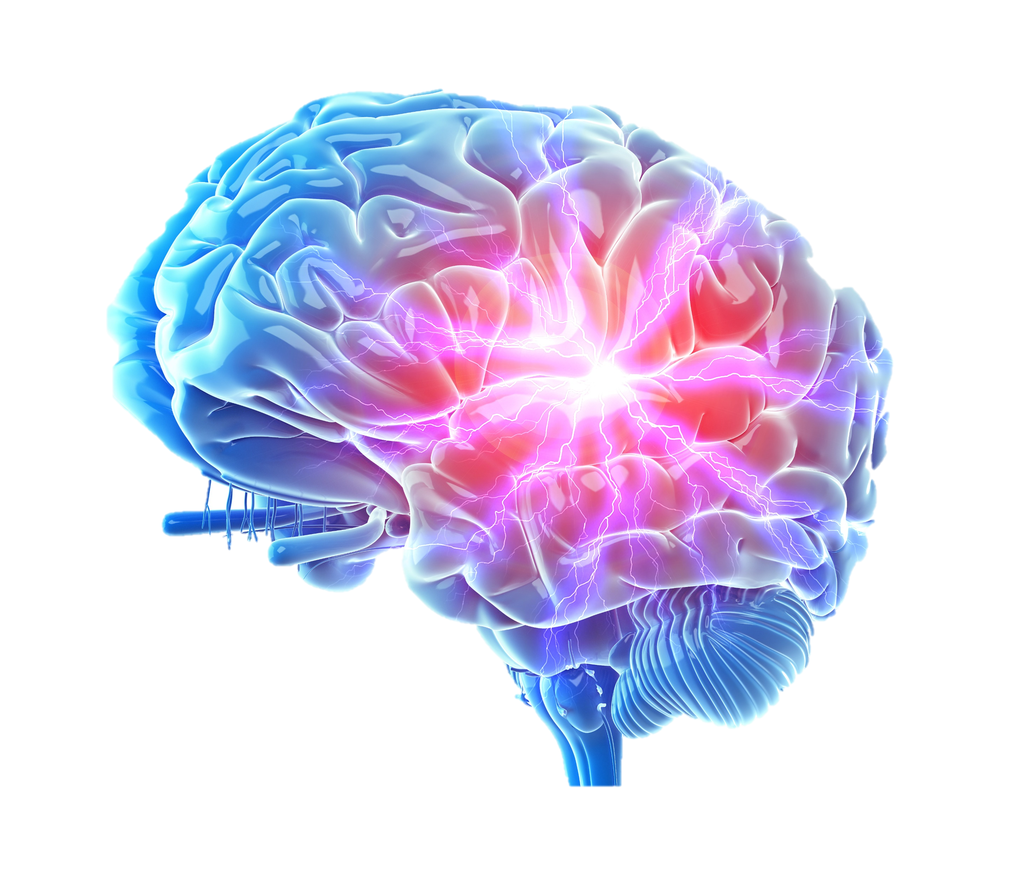
Pharmaco-Behavioral Theory of Substance Use
Psychoactive drugs:
Feel good (positive reinforcement)
Remove negative feelings i.e., anxiety, depression (negative reinforcement)
Drug use results in loss of many other reinforcers (job, family, friends)
Conclusion: drugs are highly reinforcing and hijack the reward pathway in our brain
Notes:
Trainer Notes:
Drugs hijack the reward pathway- actually rewires the brain
The power of natural reinforcers we all take for granted is lost
Drugs are the only reinforcer left to feel good or take away problems
CM uses tangible, strong reinforcers to help rewire the reward pathway back to normal
Image Credit:
Purchased image, Adobe Stock, 2022.

Slide 23
Cocaine vs. Reward
Notes:
Trainer Notes:
This study demonstrated that:
People who use drugs are rational and will choose abstinence over use if we offer them an alternative reinforcer
The non-drug reinforcer does not need to be large in order to be effective
The study has been replicated over and over for many drugs
Cocaine users were brought into an inpatient hospital and were offered a line of cocaine or an amount of money. As you can see on this chart, participants were offered 5 cents, $1, or $2 . When participants were offered 5 cents, most of them took the cocaine. At $1, you can see that most people will still take that line of cocaine, but at $2, many will choose the money instead of the cocaine. Studies like this gave credence to the idea that if you offer substance users money for not using, they often opt to not use. The premise of CM is that substance users will make rational choices. They will often choose the money to buy something else that they need versus using substances and it doesn’t have to be a lot of money.
Notably, this is only one of many choice studies with substance users that have similar results. Choice studies have been done with nicotine users, methamphetamine users, and others.
REFERENCE:
Higgins, S. T., Bickel, W. K., & Hughes, J. R. (1994). Influence of an alternative reinforcer on human cocaine self-administration. Life Sciences, 55(3), 179–187.

Slide 24
CM Uses Positive Reinforcement
CM offers a non-drug reinforcer in exchange for evidence of drug abstinence
Small rewards can be effective, but over time the reward must be large enough to offset the rewarding effect of the substance
Methamphetamine triggers a release of dopamine that is over 1000% of our baseline dopamine levels – this is highly reinforcing, so we need a reinforcement paradigm that is powerful enough to compete with it
Notes:
Trainer Notes:
Highlight the fact that both cocaine and methamphetamine trigger a flood of dopamine, which is what makes the user feel good and is highly reinforcing. Therefore we need a reinforcement paradigm powerful enough to compete with the release of dopamine.
Image Credit:
Purchased image, Adobe Stock, 2022.

Slide 25
Essential “Ingredients” of Effective Contingency Management

Slide 26
The Four Essential “Ingredients” of CM
Clearly define target behavior
Frequently measure behavior
Provide tangible incentives soon after behavior is observed
Withhold incentive when behavior is not observed while maintaining supportive attitude
Notes:
Trainer Notes:
Explain that these four characteristics are the essential “ingredients” of CM and that they will each be discussed further on the following slides.
Image Credit:
Purchased image, Adobe Stock, 2022.

Slide 27
1. Clearly Define the Behavior Goal
Goal: Stimulant abstinence measured by
point-of-care Urine Drug Test (UDT)
Focused: does not require abstinence from other substances, only stimulants
Objective: does not rely on self-report, relies on UDTs
Immediate results: essential for positive reinforcement
Feasible: cost effective for frequent use, does not take specialized training
Achievable: a 2 to 4-day stimulant metabolite detection window means rewards can be earned within first few days of abstinence
Notes:
Trainer Notes:
Make these points:
We need to clearly define the target behavior, and in our case, it will be stimulant abstinence measured by point-of-care urine drug tests (UDTs).
The target behavior must be objectively measured, so no self-reports, only UDTs.
Again, the incentive should be presented immediately upon submission of the stimulant-free UDT.
It shouldn’t be expensive to measure the target behavior frequently and CLIA-waived point-of-care UDTs don’t require specialized training.
The target behavior should be achievable: the 2 to 4-day stimulant metabolite detection window means that the first incentive can be earned within the first few days of abstinence.

Slide 28
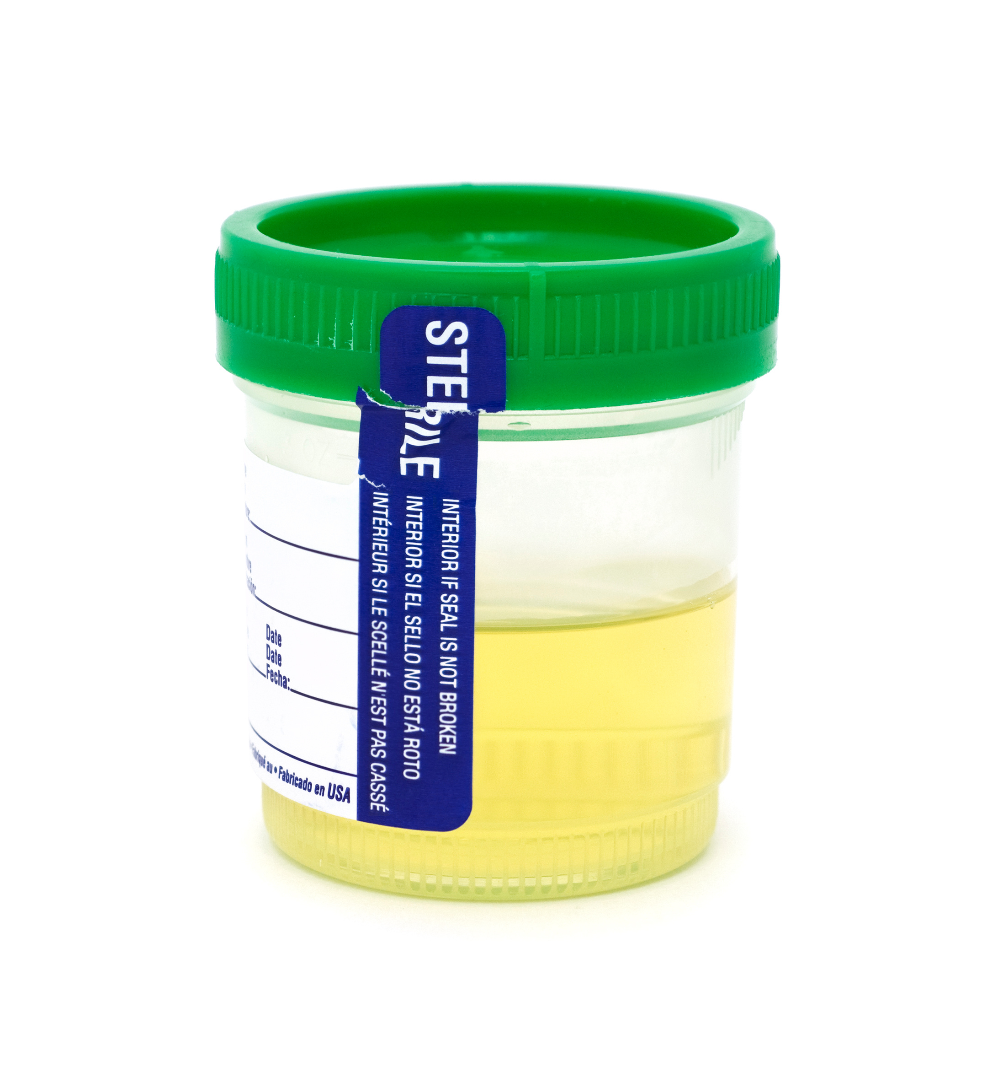
2. Frequently Measure the Behavior
Collect urine tests and provide recovery incentives:
Should be done 2-3 times/week to detect stimulant use
Communicate attendance requirements (missed visit means missed opportunity for reward and reset of recovery incentive value to baseline)
Schedule on non-sequential days (e.g., Mon/Wed/Fri)
Notes:
Trainer Notes:
The target behavior must be measured frequently, i.e., twice-weekly for the first 12 weeks of the program.
It is crucial to clearly and accurately communicate the attendance requirements to each participant, i.e., a missed scheduled visit means the loss of the opportunity to receive an incentive and the reset of the incentive value to $10.
It is essential to schedule CM visits several days apart, i.e., Monday/Thursday or Tuesday/Friday.
Image Credit:
Purchased image, Adobe Stock, 2022.

Slide 29
3. Provide Desirable/Immediate Rewards
Desirable:
Clinic provides a wide array of options for recovery incentives
Use escalating reinforcement schedule, i.e., starting value of $10 per stimulant-negative UDT, increasing by $1.50 for every week of non-use of stimulants (i.e., two or three consecutive stimulant-negative UDTs, depending on how often you are testing)
Immediate:
Recovery incentives can be delivered electronically with the option to print gift cards onsite for those without reliable access to technology
Notes:
Trainer Notes:
The incentives must be both desirable and immediately delivered.
The Incentive Manager will provide options for receiving the recovery incentive amounts.
The incentive value will start at $10 in the first week, increasing by $1.50/week for every consecutive week of stimulant-free UDTs.
The Incentive Manager will deliver the incentives electronically, i.e., by email, for instance, and programs will have the ability to print gift cards onsite for participants who do not have access to a mobile phone or email.

Slide 30
Incentive Delivery Schedule – Escalation
Graph shows weeks 1-9 with all stimulant-negative samples. By week 12, each sample would receive $26.50 with continued stimulant-negative samples each week.
$22
$22
$20.50
$20.50
$19
$19
$17.50
$17.50
$16
$16
$14.50
$14.50
$13
$13
$11.50
$11.50
$10
$10
Neg
Neg
Neg
Neg
Neg
Neg
Neg
Neg
Neg
Neg
Neg
Neg
Neg
Neg
Neg
Neg
Neg
Week 1
Week 2
Week 3
Week 4
Week 5
Week 6
Week 7
Week 8
Week 9
Notes:
Trainer Notes:
Graph shows weeks 1 to 9 with all negative samples.
Note that by the time the beneficiary reaches their second visit in week 9 (assuming that they’ve tested negative at all visits), they can receive an incentive amount of $22.
Notes on animation: Visits in weeks 1-4 emerge one-by-one; by the time you reach week 5, the rest of the bars emerge.

Slide 31
Incentive Delivery Schedule with a Single Stimulant-Positive UDT
$22
$20.50
$20.50
$19
$19
$17.50
$17.50
$16
$16
$14.50
$13
$13
$11.50
$11.50
$10
$10
$0
$10
Neg
Neg
Neg
Neg
Neg
Neg
Pos
Neg
Neg
Neg
Neg
Neg
Neg
Neg
Neg
Neg
Neg
Week 1
Week 2
Week 3
Week 4
Week 5
Week 6
Week 7
Week 8
Week 9
Notes:
Trainer Notes:
Notes on animation: Weeks 1-4 emerge all at once; by the time you reach visit 2 in week 4, the “reset” visit emerges. Then visit 1 in week 5 emerges, followed by visit 2 in week 5.
On their second visit during week 4, the beneficiary tests positive for stimulants, so they do not receive an incentive on that visit. The next time they test negative for stimulants(in week 5), a reset occurs and the incentive returns to baseline ($10).
After a reset occurs in week 5, the client tests negative and they recover their previous escalations (as shown in weeks 5/6 where the client gets $16)
Merely mention that the schedule continues to escalate from this point -- After testing negative twice in a row following the reset, they start gaining subsequent escalations (we see this in week 6 where the client gets $17.50).

Slide 32
4. Contingent AND Positive
Contingent:
No incentive given when urine test is not submitted or is positive for stimulants
Positive:
Encouragement/support is offered without punishment even if the urine drug test is positive for stimulants
Notes:
Trainer Notes:
The incentive is contingent upon providing a stimulant-free UDT – none will be given if a scheduled test is missed or is stimulant-positive.
It is essential to use a supportive, encouraging style of interaction, especially if the UDT is positive for stimulants. Praise the participant for coming in that day and remind them that they can earn their next incentive within just a few days.

Slide 33
CM’s “Special Sauce”: Escalation, Reset, Recovery (1)
Escalation: participants earn escalating recovery incentives with continuous abstinence from stimulants
Research shows that using an escalating schedule of reinforcement, which includes reset, leads to longer periods of abstinence
Notes:
Trainer Notes:
An essential element of CM is using an escalating schedule of incentives for continuous abstinence from stimulants. Research has shown that using an escalating schedule leads to longer periods of abstinence.
REFERENCE:
Roll, J., & Shoptaw, S. (2006). Contingency Management: Schedule effects. Psychiatry Research, 144(1), 91–93.

Slide 34
CM’s “Special Sauce”: Escalation, Reset, Recovery (2)
Reset: temporary return to initial recovery incentive level i.e., $10
Stimulant-positive or missed UDT results in no recovery incentive that day
The next stimulant-negative UDT resets the recovery incentive to its initial level
Because ‘reset’ is discussed ahead of time, participants know they have a lot to gain from keeping up their great work
The desire to “maintain their progress” may be as motivating as the actual monetary value of the escalated recovery incentives
Notes:
Trainer Notes:
A second essential element of CM is the “reset” feature. If a scheduled UDT is missed or is positive for stimulants, the participant receives no incentive that day (but should be praised for coming into the clinic and encouraged to continue in the program).
At the next stimulant-negative UDT, the incentive amount is reset to the original $10.
Reset is carefully explained to the participant at intake, so they know that maintaining continuous abstinence will be beneficial to them.
A participant’s desire to maintain their progress/achievement may be as motivating as the actual monetary value of the incentives and may become a source of intrinsic motivation.

Slide 35
CM’s Special Sauce: Escalation, Reset, Recovery (3)
Recovery: The escalated recovery incentive value is recovered after two stimulant-negative UDTs
2 consecutive stimulant-negative UDTs triggers immediate “recovery” of the previously earned, escalated incentive amount
Clients do not need to work their way back up the escalation schedule to where they were when they tested positive for stimulants
With ‘recovery,’ participants regain their hard-earned, escalated recovery incentive values quickly so that one use of a stimulant does not lead to giving up
Notes:
Trainer Notes:
With “recovery”, the value of the incentive is recovered after one week of abstinence.
In other words, after two consecutive stimulant-negative UDTs the value of the participant’s incentive goes back up to where it was when they had the stimulant-positive UDT, so they do not need to work their way back up the escalation schedule.
Part of the purpose for this is that if the participant knows they will get back to where they were after only a week, it may reduce discouragement and the chance that the participant will give up and go back to using. It won’t feel like they have lost all the progress they made.

Slide 36
Use a Positive, Encouraging Approach Regardless of UDT Result

Slide 37
Use a Positive Approach
Reframe the use of UDTs (rewards vs. punishment)
Stay encouraging by focusing on next opportunity to earn a recovery incentive
Emphasize the lack of punishment/ negative consequences
Gets clients excited about treatment – they have something to look forward to
Helps build the therapeutic alliance
Notes:
Trainer Notes:
Note that this positive approach may seem very different and refreshing for both providers and clients. Providers have shared that they love being the “good guys” in their clients’ lives (handing out rewards is the opposite of shooting the messenger– it’s being the bearer of GOOD news!)
Image Credit:
Purchased image, Adobe Stock, 2022.

Slide 38
Encourage Success
UDT is negative for stimulants
Celebrate!
Remind them they will earn even more next time if they keep up the good work.
(Remember, the recovery incentive itself is doing the heavy lifting!)
UDT is positive for stimulants
Praise honesty and effort for coming to the visit
Remind them their next opportunity is very soon
Ask if there’s anything you can do to support, i.e., refer them to a counselor to help analyze the substance use and develop coping strategy
Notes:
Trainer Notes:
It’s easy to celebrate success with your clients when you literally reward them for their success. But there will be times where you will not be delivering rewards. You can still stay positive with the following tips:
Let them know that the urine test results mean that they can’t receive rewards today, but that they have another opportunity to earn rewards in just 3-4 more days!
If they’ve achieved some rewards already in the program, remind them of their previous accomplishments.
If they are still working toward their first reward but haven’t gotten there yet, remind people that it can take time. It might not happen overnight, but that you’ll be here ready to cheer them on twice a week.
If the person delivering the CM is trained in other treatment modalities, such as Motivational Interviewing, you are welcome to incorporate those skills here, but remember, CM can be delivered by anyone, so these specialized skills are not required. And keep in mind, some clients may have shied away from other counseling-based treatment programs, so keeping the CM simple may be best for them. Or in other cases, it might be best to refer clients back to their counselors to work on their recovery skills, so that the CM provider can just focus on keeping expectations clear and the outlook positive and non-judgmental.

Slide 39
Make Use of Motivational Interviewing Concepts
Empathy: Understanding the world from another person’s perspective; being genuinely curious about how they see and experience the world, and being able to communicate that understanding to the client
Compassion: Having a genuine sense of “unconditional positive regard” for another person; what this person experiences matters to you
Notes:
Trainer Notes:
Emphasize that if the CM Coordinator and backup person don’t have training in Motivational Interviewing, they should contact UCLA staff, and we will help them to access MI training.
Image Credit:
Purchased image, Adobe Stock, 2022.

Slide 40
Helpful Phrases to Foster Encouragement, Engagement, and Retention in Treatment
“Sounds like you had a tough weekend. I’m so glad you came in today and told me about it. You’ll have another opportunity to earn incentives on Thursday! Is there anything I can do to support you until then?”
“You earned your first recovery incentive today! Nice job!! Remember you’ll earn even more the longer you stay abstinent!”
“Wow… you’ve attended 8 visits in a row and tested negative at all those visits. That is outstanding work. I bet you are enjoying all the recovery incentives you have earned. What are you planning to do with your future earnings?”
“You sound disappointed today because it was the first positive test you’ve had in a while. You still came in today, which shows a lot of commitment and motivation, so pat yourself on the back. And don’t forget, you can get right back to the incentive level you were at before in just a week! What do you have planned for your next week or two of earnings?”
Notes:
Trainer Notes:
Again, emphasize that it is vital to remain positive and encouraging even in the face of a stimulant-positive test. It is also important to orient the client to future earnings so that they have a tangible reward in mind to work toward.

Slide 41
CM for Stimulants: Research Summary (1)
CM is the most effective way to help people stop using stimulant drugs (AshaRani et al., 2020; Dutra, et al., 2008)
Over 60 studies demonstrating that CM works to reduce stimulant use for people who are receiving MOUD (Medications for Opioid Use Disorder) treatment (Bolivar et al., 2021)
CM has a higher retention rate than other stimulant use disorder treatments (Higgins et al., 1994)
The effects of CM can last for up to one year after the intervention ends (Ginley et al., 2021)
CM that targets stimulant abstinence leads to reduced alcohol use, cigarette smoking, depressive symptoms, and psychiatric hospitalizations (Higgins et al., 1994; McDonell et al., 2020)
CM is cost effective (Olmstead & Petry, 2009)
Notes:
Trainer Notes:
Read through the bullet points one at a time and describe each study in a little detail, if you can.
REFERENCES:
AshaRani, P. V., Hombali, A., Seow, E., Ong, W. J., Tan, J. H., & Subramaniam, M. (2020). Non-pharmacological interventions for methamphetamine use disorder: a systematic review. Drug and Alcohol Dependence, 212, 108060.
Bolívar, H. A., Klemperer, E. M., Coleman, S. R. M., DeSarno, M., Skelly, J. M., & Higgins, S. T. (2021). Contingency management for patients receiving medication for opioid use disorder: A systematic review and meta-analysis. JAMA Psychiatry, 78(10), 1092–1102.
Dutra, L., Stathopoulou, G., Basden, S. L., Leyro, T. M., Powers, M. B., & Otto, M. W. (2008). A meta-analytic review of psychosocial interventions for substance use disorders. The American Journal of Psychiatry, 165(2), 179–187.
Ginley, M. K., Pfund, R. A., Rash, C. J., & Zajac, K. (2021). Long-term efficacy of contingency management treatment based on objective indicators of abstinence from illicit substance use up to 1 year following treatment: A meta-analysis. Journal of Consulting and Clinical Psychology, 89(1), 58–71.
Higgins, S. T., Bickel, W. K., & Hughes, J. R. (1994). Influence of an alternative reinforcer on human cocaine self-administration. Life Sciences, 55(3), 179–187.
McDonell, M. G., Skalisky, J., Burduli, E., Foote, A., Sr, Granbois, A., Smoker, K., … McPherson, S. M. (2020). The rewarding recovery study: A randomized controlled trial of incentives for alcohol and drug abstinence with a rural American Indian community. Addiction (Abingdon, England), 116(6), 1569–1579.
Olmstead, T. A., & Petry, N. M. (2009). The cost-effectiveness of prize-based and voucher-based contingency management in a population of cocaine- or opioid-dependent outpatients. Drug and Alcohol Dependence, 102(1-3), 108–115.

Slide 42
CM for Stimulants: Research Summary (2)
Cultural factors:
CM has demonstrated efficacy in the US, Brazil, China, and other countries. (Hser, 2011; Miguel, 2022)
CM has been adapted, tested, and found to be effective in partnership with American Indian and Native communities (McDonell 2021a; McDonell 2021b)
CM has demonstrated efficacy for reducing methamphetamine use among Men Who Have Sex With Men (MSM) (Shoptaw et al., 2006)
Other Populations:
CM is associated with reductions in substance use in populations with co-occurring serious mental illness (McDonell, 2013; Bellack, 2006)
Notes:
Trainer Notes:
Read through the bullet points and make the overall point that CM has demonstrated efficacy in reducing stimulant use in a variety of sociocultural groups, including in other countries, with the American Indian and Alaska Native communities, with MSM, and with individuals with co-occurring serious mental illness.
REFERENCES: Bellack, A. S., Bennett, M. E., Gearon, J. S., Brown, C. H., & Yang, Y. (2006). A randomized clinical trial of a new behavioral treatment for drug abuse in people with severe and persistent mental illness. Archives of General Psychiatry, 63(4), 426–432.
Hser, Y. I., Li, J., Jiang, H., Zhang, R., Du, J., Zhang, C., Zhang, B., Evans, E., Wu, F., Chang, Y. J., Peng, C., Huang, D., Stitzer, M. L., Roll, J., & Zhao, M. (2011). Effects of a randomized contingency management intervention on opiate abstinence and retention in methadone maintenance treatment in China. Addiction (Abingdon, England), 106(10), 1801–1809.
McDonell, M. G., Srebnik, D., Angelo, F., McPherson, S., Lowe, J. M., Sugar, A., … Ries, R. K. (2013). Randomized controlled trial of contingency management for stimulant use in community mental health patients with serious mental illness. The American Journal of Psychiatry, 170(1), 94–101.
McDonell, M. G., Hirchak, K. A., Herron, J., Lyons, A. J., Alcover, K. C., Shaw, J., … HONOR Study Team (2021a). Effect of Incentives for Alcohol Abstinence in Partnership With 3 American Indian and Alaska Native Communities: A Randomized Clinical Trial. JAMA Psychiatry, 78(6), 599–606.
McDonell, M. G., Skalisky, J., Burduli, E., Foote, A., Sr, Granbois, A., Smoker, K., … McPherson, S. M. (2021b). The rewarding recovery study: a randomized controlled trial of incentives for alcohol and drug abstinence with a rural American Indian community. Addiction (Abingdon, England), 116(6), 1569–1579.
Miguel, A., McPherson, S. M., Simões, V., Yamauchi, R., Madruga, C. S., Smith, C. L., … Mari, J. J. (2022). Effectiveness of incorporating contingency management into a public treatment program for people who use crack cocaine in Brazil. A single-blind randomized controlled trial. The International Journal on Drug Policy, 99, 103464.
Shoptaw, S., Klausner, J. D., Reback, C. J., Tierney, S., Stansell, J., Hare, C. B., … Dang, J. (2006). A public health response to the methamphetamine epidemic: the implementation of contingency management to treat methamphetamine dependence. BMC Public Health, 6, 214.

Slide 43
Additional Reading on CM for Methamphetamine
Brown, H. D., & DeFulio, A. (2020). Contingency management for the treatment of methamphetamine use disorder: A systematic review. Drug and Alcohol Dependence, 216, 108307.
Notes:
Trainer Notes:
Simply state that this article is a recent, excellent review article on CM for methamphetamine if they would like to read more. If they are unable to access it, we can send them a copy.
REFERENCE:
Brown, H. D., & DeFulio, A. (2020). Contingency management for the treatment of methamphetamine use disorder: A systematic review. Drug and Alcohol Dependence, 216, 108307.

Slide 44
The VA CM Program: A National Implementation of CM
As of 2018, 126 VAs have implemented CM
58% of CM sessions attended
95% of UDTs tested negative
For more on the Veterans Canteen Service, see: https://www.sunshinebehavioralhealth.com/veterans/
Notes:
Trainer Notes:
Make the points that 126 VA health centers around the country have implemented CM, that during that implementation period veterans attended 58% of all scheduled CM sessions, and that 95% of urine drug tests were negative for whatever drug each VA was targeting. Might also mention the Rash & DePhillipis article as an excellent resource if they want to learn more about the VA program.
REFERENCE:
Rash, C. J., & DePhilippis, D. (2019). Considerations for implementing contingency management in substance abuse treatment clinics: The Veterans Affairs initiative as a model. Perspectives on Behavior Science, 42(3), 479–499.

Slide 45
What Clients Say about CM
“When I’m at home and see them [prizes] I think ‘hey I got this for staying sober.’ ”
“Something to do besides thinking about everything wrong with the world, and being negative... it gave me a little peace of mind”
“I didn’t care about the prizes and much as I cared about seeing myself get away from using [stimulants]”
“I wanted to stop [using stimulants] but I was glad it wouldn’t be held against me if I did test positive and it wouldn’t be shared. I was conscious of that.”
“It gave me something to look forward to, a schedule.”
“[CM] makes me feel ‘powerful’ not ‘powerless.’”
“I used my gift cards to buy cologne and a nice jacket. Thanks to the gift cards I got in this study I don’t have to LOOK homeless.”
Notes:
Trainer Notes:
Present these as some direct quotes from CM participants. State that they contain a couple of terms we now consider to be stigmatizing, but they are direct quotes from real clients, so we decided to keep them.

Slide 46
Common Challenges of Implementing CM
Resistance to the idea of recovery incentives, i.e., “Why do clients need extrinsic motivation?”
Overcome with education and testimony from clients
Working twice- or thrice-weekly visits into clinic workflow
CM visits only take 10-15 mins
Notes:
Trainer Notes:
Present the bullet points on this and the following slide as four commonly-mentioned challenges of implementing CM and potential solutions.
The idea that SUD clients shouldn’t need extrinsic motivation, that the benefits of abstinence should provide enough intrinsic motivation to attain and sustain them in recovery. This can be overcome with education (i.e., the dopamine release is incredibly rewarding and rewires the brain in such a way that intrinsic motivation to change is very difficult to generate); and testimony from CM clients.
Working twice-weekly clinic visits into what may already be a very busy workflow. CM visits only take 10-15 minutes and could be scheduled around other treatment activities such as group attendance.
Trying to keep track of incentive amounts along with the escalation schedule, reset and recovery in the event of a stimulant-positive UDT. UCLA and the Incentive Manager will provide you with tools that make this much easier than if you were to do it all on your own.
The federal anti-kickback regulations. The California CM program has been designed to comply with federal regulations, and Medi-Cal (our version of Medicaid) is covering the costs of CM visits and incentives.

Slide 47
Common Challenges of Implementing CM (2)
Challenges of tracking recovery incentive escalation, reset, and recovery and recovery incentive distribution
UCLA will provide Recovery Incentive Program sites with the tools to accomplish this
Office of the Inspector General (OIG) prohibits the use of incentives to pay clients for billable encounters. Anti-kick back regulations
Use of any kind of recovery incentive (no matter the source of funding) must comply with OIG-defined Safe Harbor requirements, and in the case of the CA program, Medi-Cal is covering costs of CM visits
Notes:
Trainer Notes:
Present these as four commonly-mentioned challenges of implementing CM and potential solutions.
The idea that SUD clients shouldn’t need extrinsic motivation, that the benefits of abstinence should provide enough intrinsic motivation to attain and sustain them in recovery. This can be overcome with education (i.e., the dopamine release is incredibly rewarding and rewires the brain in such a way that intrinsic motivation to change is very difficult to generate); and testimony from CM clients.
Working twice-weekly clinic visits into what may already be a very busy workflow. CM visits only take 10-15 minutes and could be scheduled around other treatment activities such as group attendance.
Trying to keep track of incentive amounts along with the escalation schedule, reset and recovery in the event of a stimulant-positive UDT. UCLA and the Incentive Manager will provide you with tools that make this much easier than if you were to do it all on your own.
The federal anti-kickback regulations. The California CM program has been designed to comply with federal regulations, and Medi-Cal (our version of Medicaid) is covering the costs of CM visits and incentives.

Slide 48
CM and Safe Harbor Requirements
Under the OIG Safe Harbor requirements, use of recovery incentives as part of treatment may not be advertised
Must document need for CM in treatment plan, i.e., client has a moderate or severe StimUD
Use a research-based Contingency Management Program
Carefully document that recovery incentives are linked to client outcomes
Must closely document each UDT result and the corresponding recovery incentive that was given for that negative test
Notes:
Trainer Notes:
Make the point that this topic will be covered in more detail in the implementation training and in DHCS policy documents and that adherence to guidance and requirements of DHCS and UCLA will ensure that their program is in compliance with federal regulations.

Slide 49
CM and Safe Harbor Requirements (2)
Regularly evaluate the impact of CM on client outcomes
Do quality improvement to document CM effectiveness
Avoid tying CM visit with another Medi-Cal/Medicare billable encounter
Notes:
Trainer Notes:
Make the point that this topic will be covered in more detail in the implementation training and in DHCS policy documents and that adherence to guidance and requirements of DHCS and UCLA will ensure that their program is in compliance with federal regulations.

Slide 50
Thank You!
For further questions about Contingency Management for Stimulant Use Disorders, please don’t hesitate to contact me:
James A. Peck, Psy.D.
jpeck@mednet.ucla.edu

