Slide 1
Jeffrey H. Chester, DO
Board Certified American Board of Addiction Medicine
&
Board Certified American Board of Physical Medicine and Rehabilitation
drchester@ponohealthcare.com
No financial Disclosures

Slide 2
Jeffrey H. Chester, DO
Outpatient Withdrawal Management
drchester@ponohealthcare.com
No financial Disclosures

Slide 3
DSM-5 Addiction Definition vs. ASAM’s definition
drchester@ponohealthcare.com

Slide 4
DSM-5 Criteria for use disorders
Use larger amounts or longer duration than one intended
Not able to cut down
Using is taking a lot of one’s time
No fulfilling obligations
Continued use despite known problems from use
Giving up activities because of use
Using in physically hazardous situations
Social/interpersonal problems from using, but continued using
Building tolerance
Craving for substance or activity
0-1: no diagnosis AUD 2-3: mild AUD 4-5: moderate AUD > 5: severe AUD
drchester@ponohealthcare.com

Slide 5
ASAM 2019 Definition of Addiction
“Addiction is a treatable, chronic medical disease involving complex interactions among brain circuits, genetics, the environment, and an individual’s life experiences. People with addiction use substances or engage in behaviors that become compulsive and often continue despite harmful consequences.”
drchester@ponohealthcare.com

Slide 6
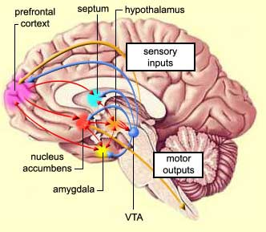
drchester@ponohealthcare.com
http://www.addictscience.com/why-drugs-can-be-addicting/

Slide 7
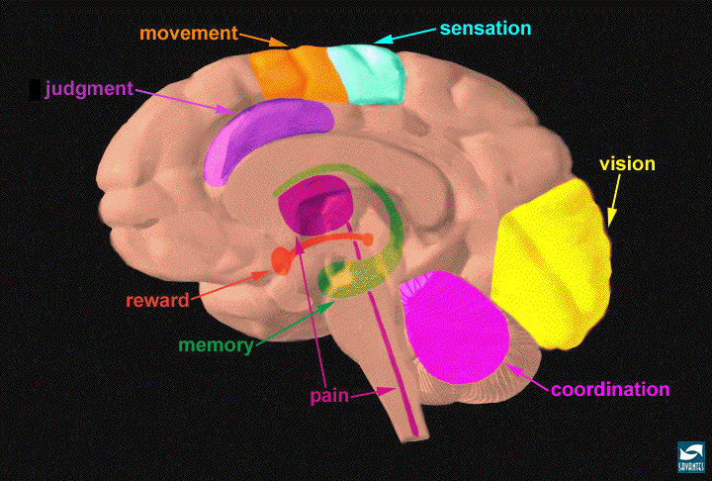
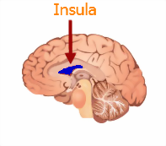
Mahalo!
drchester@ponohealthcare.com
https://nida.nih.gov/publications/teaching-addiction-science/neurobiology-drug-addiction
https://www.inner-light-in.com/2013/06/yoga-and-meditation-for-insula-of-your-brain/
drchester@ponohealthcare.com
https://www.npr.org/sections/health-shots/2016/01/11/462390288/anatomy-of-addiction-how-heroin-and-opioids-hijack-the-brain

Slide 8
Baseline level of dopamine output at the nucleus accumbens: 100
Food level: 150
Sex level: 200
Nicotine level: 200
Alcohol level: 200
Morphine level: 200
Cocaine level: 300-350
Amphetamines: over 1000
When drugs stimulate mu opioid receptors in the brain, cells in the ventral tegmental area (VTA) produce dopamine and release it into the nucleus accumbens (NAc)
drchester@ponohealthcare.com
https://www.ncbi.nlm.nih.gov/pmc/articles/PMC281732/

Slide 9
Addiction overlapping risk factors:
Biology- genetics (rapid metabolizers CYP2D6) and epigenetics
Psychology- escape vs. engagement
Sociology- nature vs. nurture
Spirituality- mutual help groups, higher power
Exposure/use
drchester@ponohealthcare.com

Slide 10
SBIRT
Counseling
Mutual Help Groups (Alcoholics Anonymous)
FDA-approved and FDA non-approved medications
drchester@ponohealthcare.com

Slide 11
Alcohol- When to admit for withdrawals
Recurrent unsuccessful attempts
maybe side effects to outpatient medications?
perhaps kindling?- history of withdrawal-related seizures or DTs
Pregnancy
CIWA > 10
Thought disorders such as major depression, cognitive issues, psychosis, schizophrenia
Living environment poses a risk
houseless
domestic violence
associating with other users
Anticipated/expected harm to self or others
Other medical conditions/surgical conditions to be/recently addressed
ASAM Criteria for placement (next slide)
Clinical Judgement
drchester@ponohealthcare.com

Slide 12
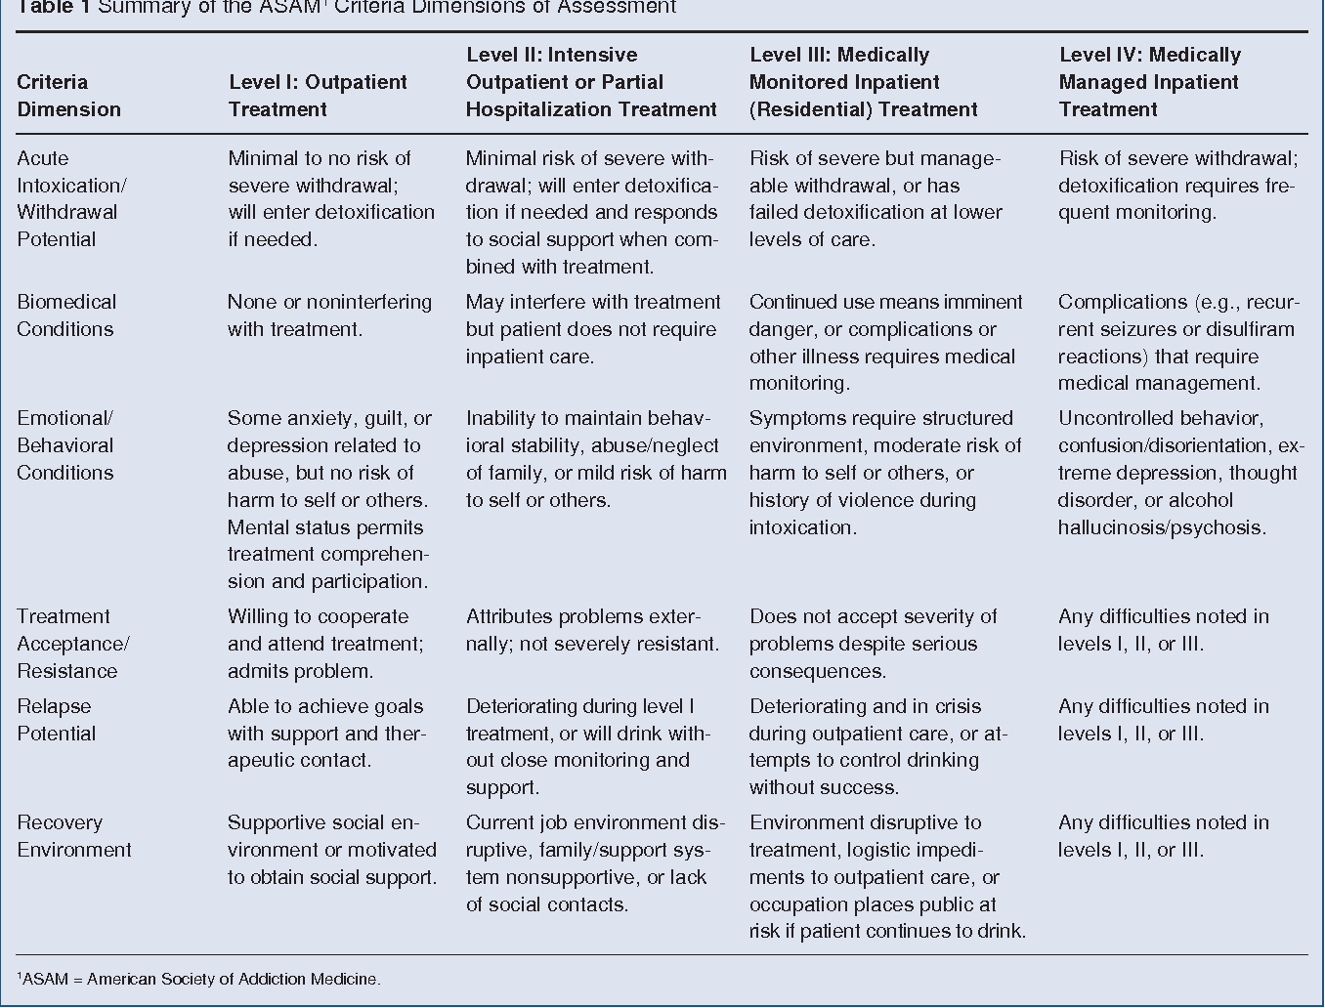
dr

Slide 13
ASAM Clinical Practice Guideline on Alcohol Withdrawal Management
Patients experiencing signs and symptoms of mild alcohol withdrawal such as mild or moderate anxiety, sweating and insomnia, but no tremor (generally associated with a CIWA-Ar <10) can be managed in Level 1-WM or Level 2- WM settings.2,39,62,72 While providing withdrawal management is within the scope of practice for many clinicians including primary care physicians, an addiction specialist can be consulted, if needed.72
Patients experiencing signs and symptoms of moderate alcohol withdrawal such as moderate anxiety, sweating, insomnia, and mild tremor (generally associated with a CIWA-Ar 10–18) can be managed in Level 2-WM settings.
Moderate withdrawal is not a reason to exclude patients from Level 1-WM settings, but the risk for such patients should be carefully considered. It should only be undertaken by experienced clinicians.
Patients experiencing signs and symptoms of severe withdrawal such as severe anxiety and moderate to severe tremor, but not confusion, hallucinations, or seizure (generally associated with a CIWA-Ar 19) should not be managed in Level 1-WM settings.58
Severe uncomplicated withdrawal is not a reason to exclude patients from Level 2-WM settings. The risk for such patients should be carefully considered.
Level 1-WM: Ambulatory withdrawal management
without extended on-site monitoring
Level 2-WM: Ambulatory withdrawal management
with extended on-site monitoring.
Inpatient
Level 3.2-WM: Clinically managed residential withdrawal management
Level 3.7-WM: Medically monitored inpatient withdrawal management
Level 4-WM: Medically managed intensive inpatient
withdrawal management
drchester@ponohealthcare.com
Copyright © 2020 American Society of Addiction Medicine. Unauthorized reproduction of this article is prohibited.

Slide 14
Alcohol
When I start drinking
GabaA receptor (calming) gets activated
Glutamate (EXCITER) gets inhibited
drchester@ponohealthcare.com

Slide 15
When I keep drinking (Chronic ETOH users)
GabaA (calm) receptor production in the body reduces (gabaA receptor downregulation)
Glutamate (EXCITER) receptors get more active/body makes more of them (glutamate receptor upregulation and conformational changes)
→ now take away the ETOH and excitation continues
Kindling- withdrawals get worse, the more times I drink, so I am more likely to have seizures/need medication for withdrawals (CYP2E1 pathway induction)
drchester@ponohealthcare.com

Slide 16
Alcohol Withdrawals
Central nerve system is overexcited
Decreased gaba (decreased relaxer activity)
Increased glutamate (increased EXCITER activity)
More calcium channel activity and increase noradrenergic activity

Slide 17
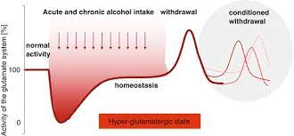
When I keep drinking

Slide 18
Alcohol Withdrawals
Clinical Institute Withdrawal Assessment of Alcohol, Revised (CIWA-Ar)
Quick and easy to do
Gives you a score that predicts ETOH withdrawal severity
drchester@ponohealthcare.com

Slide 19
Alcohol Withdrawals- CIWA-Ar
Nausea: 0-7
Sweats: 0-7
Anxiety: 0-7
Agitation: 0-7
Tremor: 0-7
Headache: 0-7
Auditory disturbances: 0-7
Visual disturbances: 0-7
Tactile disturbances: 0-7
Orientation and clouding: 0-4
Total score is a sum of each item score (maximum score is 67)
Score:
<10: Very mild withdrawal
10 to 15: Mild withdrawal
16 to 20: Modest withdrawal
>20: Severe withdrawal Reference: Uptodate

Slide 20
Alcohol Withdrawals
Wernicke’s encephalopathy
Ophthalmoplegia, ataxia, confusion, nystagmus
treatment is thiamine, then replace glucose
untreated death rate = 10-20%.
Korsakoff’s Psychosis
drchester@ponohealthcare.com

Slide 21
Alcohol Withdrawals
(mostly visual) hallucinations
autonomic hyperactivity (tremors, sweats, anxiety, N/V, 6-48 hours after last drink)
nerve excitement (general tonic-clonic seizures, usually within 1-2 days),
delirium tremens
drchester@ponohealthcare.com

Slide 22
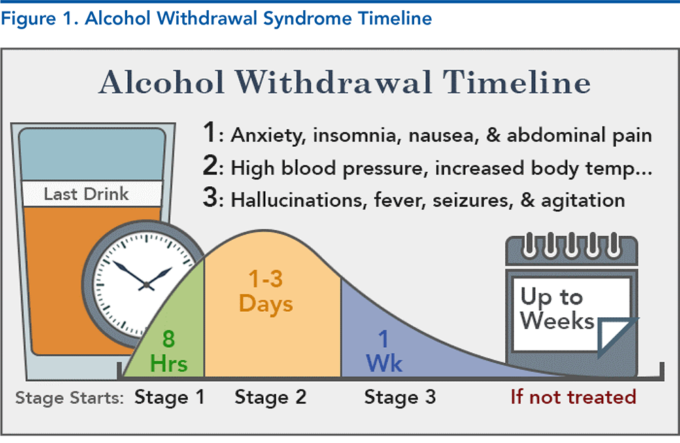
Alcohol Withdrawals
https://foamed.ebmedicine.net/rapid-reference/alcohol-withdrawal-treament-ciwa-ar/

Slide 23
FDA-approved treatments for Alcohol Use Disorder
benzodiazepines
oral and injectable naltrexone
acamprosate
disulfiram
drchester@ponohealthcare.com

Slide 24
FDA-approved treatments for Alcohol Use Disorder
Benzodiazepines- for short-term withdrawals (calms the over-excited central nervous system, decreases chance of complications, such as seizures
oral and injectable naltrexone- also an opioid blocker
Acamprosate- keeps people from relapsing (studies are +/-)
Disulfiram- makes you feel sick, if you ingest ETOH
drchester@ponohealthcare.com

Slide 25
What are some non-FDA-approved treatments for Alcohol Use Disorder
Gabapentin, topiramate, valproic acid, carbamazepine, baclofen (gabaB), doxazosin (alpha 2 adrenergic blocker) clonidine (alpha 1 adrenergic blocker), ondansetron (serotonin), mirtazapine (serotonin), sertraline or fluoxetine (SSRIs), varenicline
drchester@ponohealthcare.com

Slide 26
Opioids:
Neurotransmitters of choice: endorphins and dopamine
drchester@ponohealthcare.com

Slide 27
FDA-approved treatments for Opioid Use Disorder
naloxone
oral and injectable naltrexone
buprenorphine
methadone
drchester@ponohealthcare.com

Slide 28
Naloxone (not naltrexone)
https://www.hhhrc.org/overdose
4mg nasal spray- give one in each nostril. Do not wait to give the 2nd dose.
911 → spray → spray → DO NOT LET THEM LEAVE
Good samaritan law
Never give yourself naloxone
drchester@ponohealthcare.com

Slide 29
Buprenorphine
Induction
conventional vs. overlapping (microdosing, Bernese method)
Avoiding Precipitated Withdrawals
Chronic Use/Illicit Fentanyl - can’t wait!!
necessitates overlapping induction. Half-lives
Pregnancy
drchester@ponohealthcare.com

Slide 30
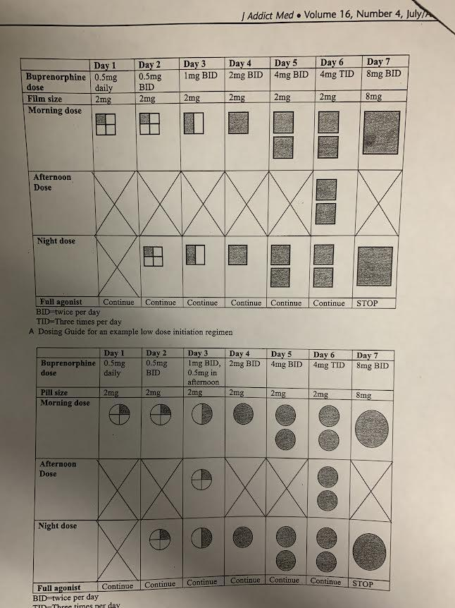
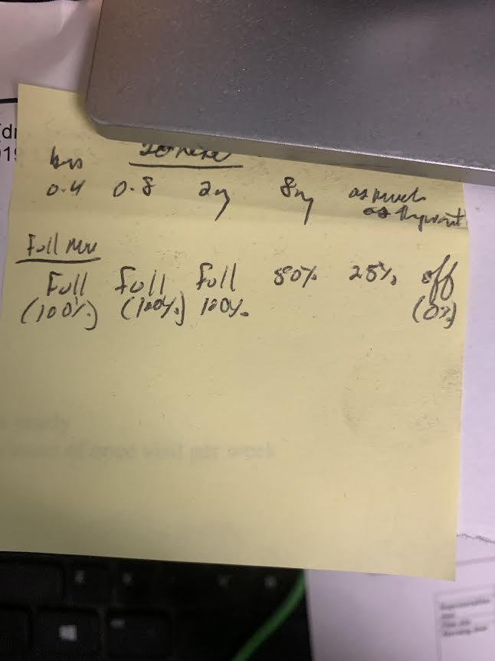
Buprenorphine overlapping induction
drchester@ponohealthcare.com
Andrew Byrne, M.D. Redfern Clinic, Australia

Slide 31
Illicit Fentanyl
Overdoses: was it “wooden chest syndrome?”
intentional vs. accidental overdoses
added to, substituted for and contaminated other illicit drugs
drchester@ponohealthcare.com

Slide 32
Illicit Fentanyl
rainbow fentanyl
DEA Warns of Brightly-Colored Fentanyl Used to Target Young Americans
Big Island police seize more rainbow fentanyl in Kona | KHON2
drchester@ponohealthcare.com

Slide 33
Benzodiazepines
Sedative Hypnotics
Barbiturates
Butalbital
GHB → gabaB
drchester@ponohealthcare.com

Slide 34
Stimulants
Cocaine
Methamphetamines/Amphetamines
Caffeine
Low-dose Kratom
MDMA (Ecstasy/Molly)
Nicotine
drchester@ponohealthcare.com

Slide 35
Prednisone, testosterone and other steroids
drchester@ponohealthcare.com

Slide 36
Cannabis
drchester@ponohealthcare.com

Slide 37
Inhalants
drchester@ponohealthcare.com

Slide 38
gabapentinoids
drchester@ponohealthcare.com

Slide 39
Candy Dish Study
Results: There were main effects for both proximity and visibility. People ate an average of 2.2 more candies each day when they were visible, and 1.8 candies more when they were proximately placed on their desk vs 2 m away.
drchester@ponohealthcare.com
https://pubmed.ncbi.nlm.nih.gov/16418755/

Slide 40
Harm Reduction
drchester@ponohealthcare.com

Slide 41
How do we measure success with addiction?
drchester@ponohealthcare.com

Slide 42
Treatment adherence (compliance) and success rates are the same for other chronic medical diseases
drchester@ponohealthcare.com

Slide 43
Mahalo!
drchester@ponohealthcare.com

