Slide 1
Co-occurring Substance Use and Mental Health
Tiana Fontanilla, MPH
Epidemiologist
Adult Mental Health Division, Behavioral Health Administration
Hawaii State Department of Health
Behavioral Health ECHO Webinar
Hawaii Rural Health Association
January 24, 2023

Slide 2
Past Month Substance Use Among People Aged 12 or Older; 2021
Source: 2021 National Survey on Drug Use and Health
Notes:
Rx = prescription.
Note: The estimated numbers of current users of different substances are not mutually exclusive because people could have used more than one type of substance in the past month.

Slide 3
Past Year Illicit Drug Use Among People Aged 12 or Older; 2021
Source: 2021 National Survey on Drug Use and Health
Notes:
Rx = prescription.
Note: The estimated numbers of past year users of different illicit drugs are not mutually exclusive because people could have used more than one type of illicit drug in the past year.

Slide 4
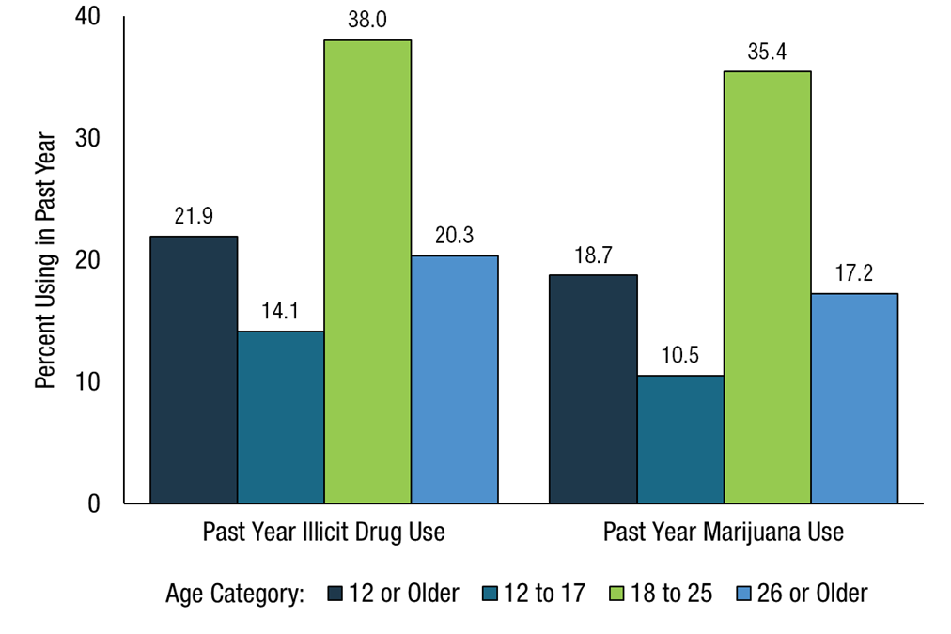
Illicit Drug and Marijuana Use in Past Year Among People Aged 12 or Older; 2021
Source: 2021 National Survey on Drug Use and Health

Slide 5
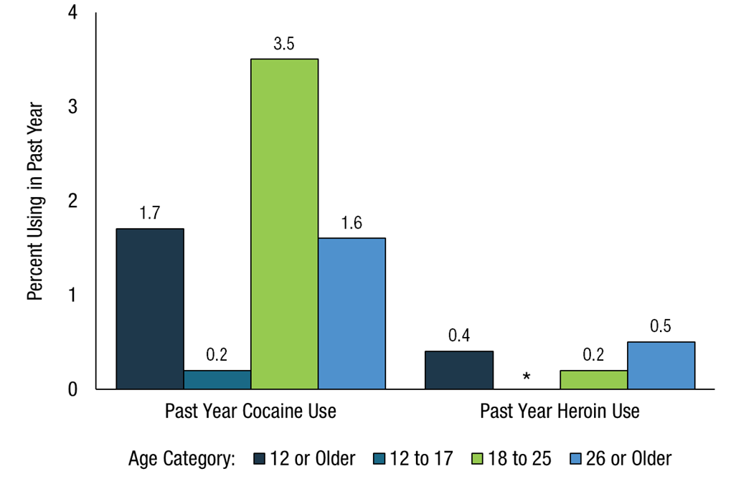
Percent Using in Past Year – Cocaine, Heroin by age category; 2021
Source: 2021 National Survey on Drug Use and Health

Slide 6
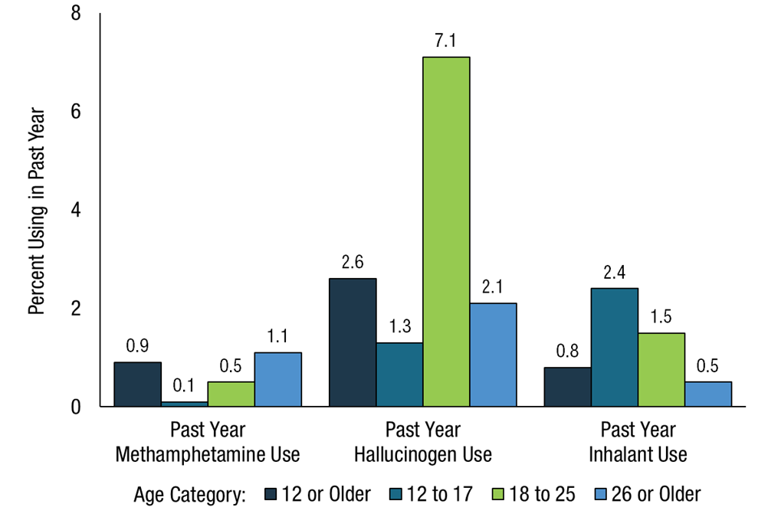
Percent Using in Past Year – Meth, Hallucinogen, and Inhalants by age category; 2021
Source: 2021 National Survey on Drug Use and Health

Slide 7
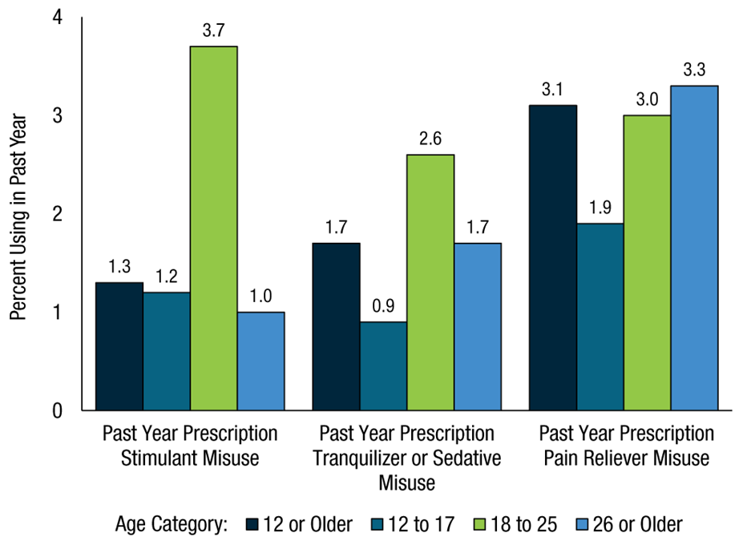
Percent Using in Past Year – Prescription Misuse by age category; 2021
Source: 2021 National Survey on Drug Use and Health

Slide 8
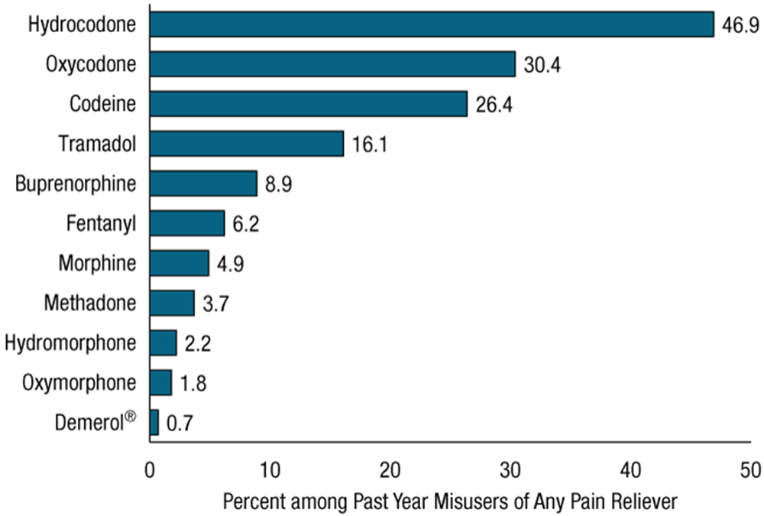
Past Year Misuse – Prescription Pain Reliever Among People Aged 12 or Older Who Misused Any Rx Pain Reliever; 2021
Source: 2021 National Survey on Drug Use and Health

Slide 9
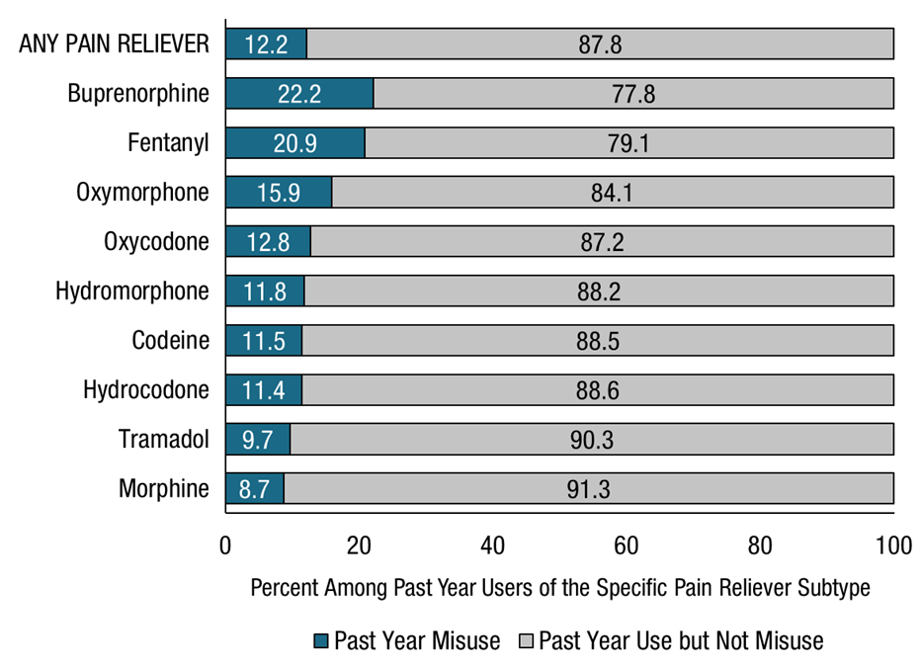
Past Year Prescription Pain Reliever Misuse Among People Aged 12 or Older Who Used the Specific Rx Pain Reliever Subtype for Any Reason in the Past Year; 2021
Source: 2021 National Survey on Drug Use and Health

Slide 10
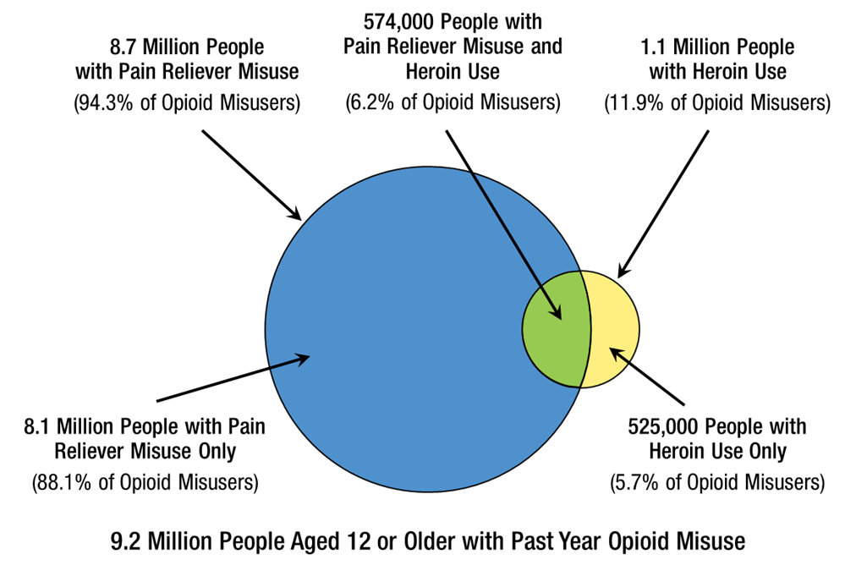
Past Year Opioid Misuse Among People Aged 12 or Older; 2021
Source: 2021 National Survey on Drug Use and Health

Slide 11
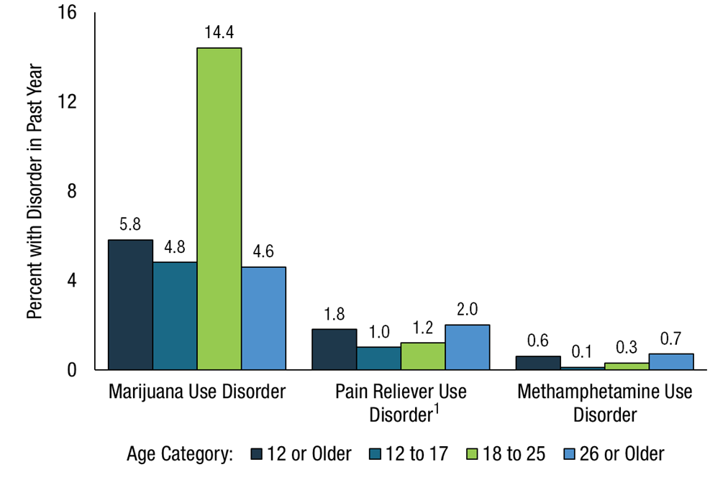
Disorder in Past Year – Marijuana, Rx Analgesics, Meth Use Among People Aged 12 or Older; 2021
¹ Includes data from all past year users of prescription pain relievers.
Source: 2021 National Survey on Drug Use and Health

Slide 12
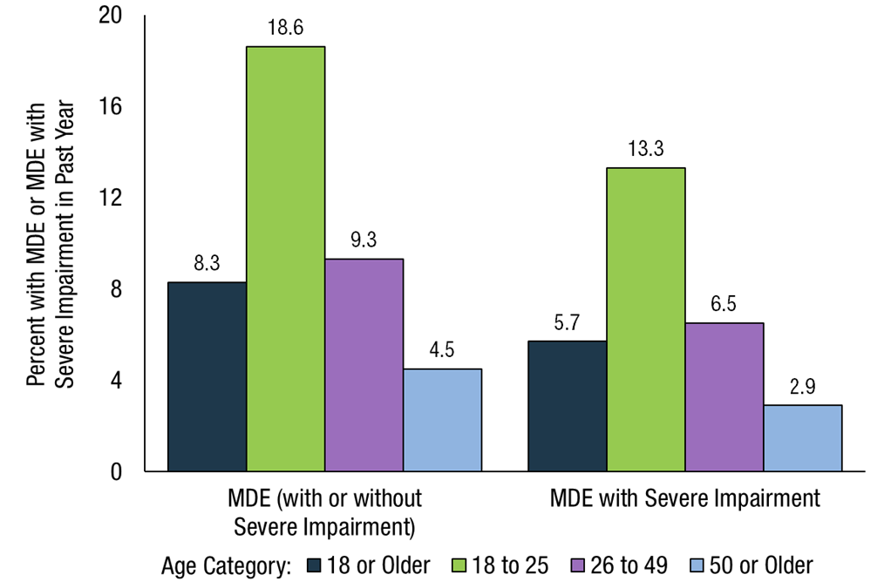
Major Depressive Episode (MDE) and MDE with Severe Impairment Among Adults Aged 18 or Older; 2021
Source: 2021 National Survey on Drug Use and Health

Slide 13
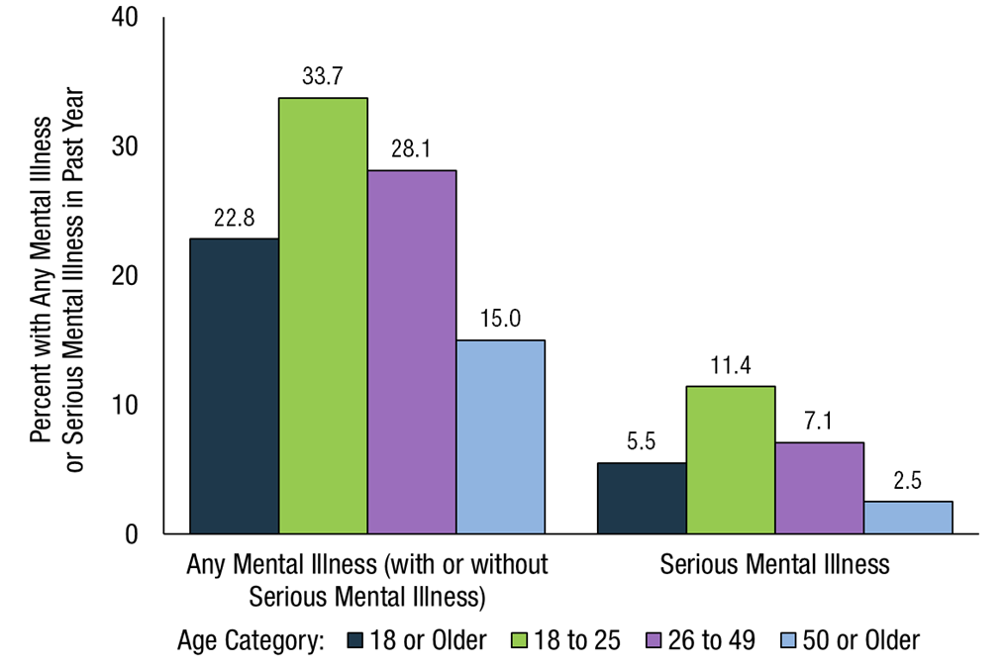
Any Mental Illness (AMI) and Serious Mental Illness (SMI) Among Adults Aged 18 or Older; 2021
Source: 2021 National Survey on Drug Use and Health

Slide 14
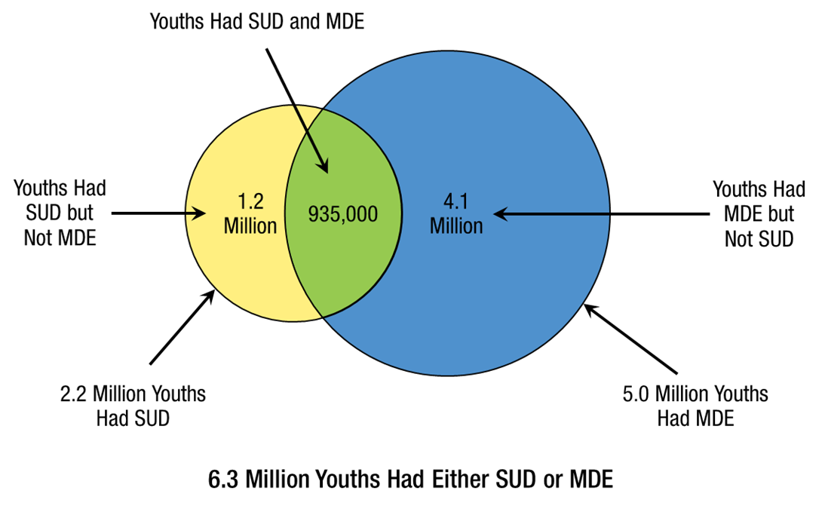
Past Year Substance Use Disorder and Major Depressive Episode Among Youths Aged 12 to 17; 2021
SUD = substance use disorder, MDE = major depressive episode. Excludes those with unknown MDE data.
Source: 2021 National Survey on Drug Use and Health

Slide 15
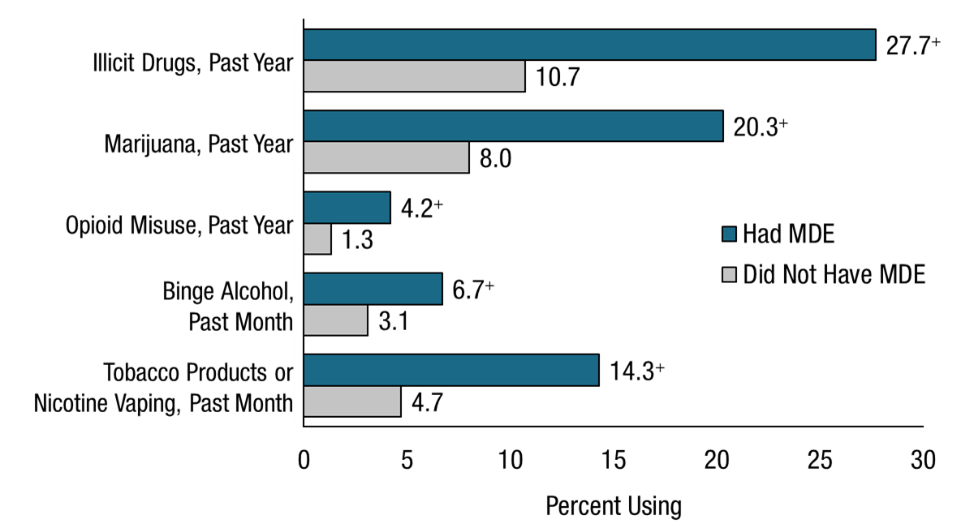
Substance Use by Major Depressive Episode Status Among Youths Aged 12 to 17; 2021
MDE = major depressive episode. Excludes those with unknown MDE data. + Difference between this estimate and the estimate for youths without MDE is statistically significant at the .05 level.
Source: 2021 National Survey on Drug Use and Health

Slide 16
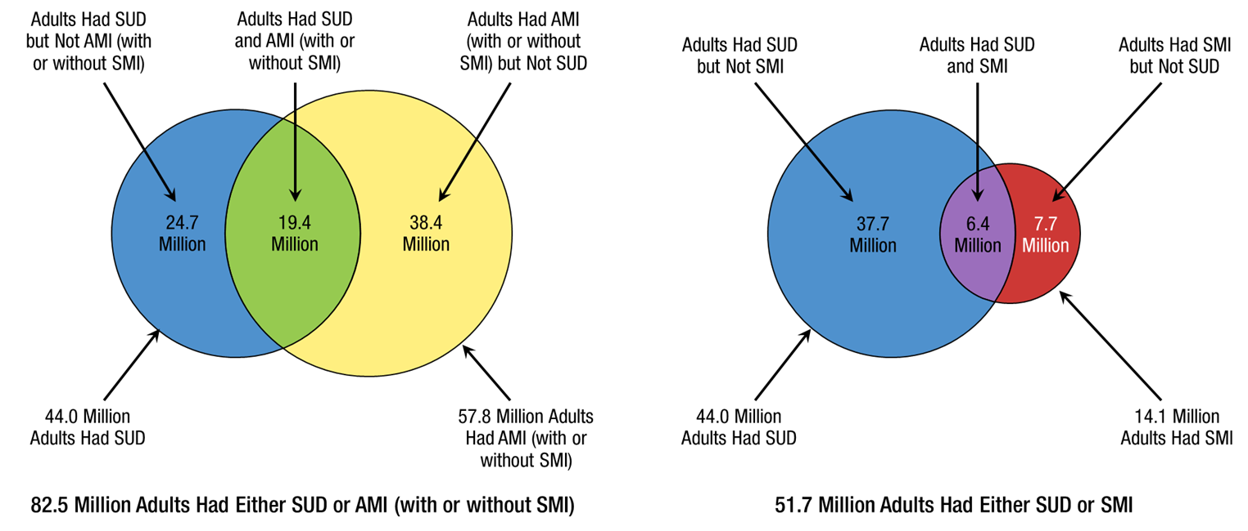
Substance Use Disorder and Mental Illness Among Adults Aged 18 or Older; 2021
SUD = substance use disorder, AMI = any mental illness, SMI = serious mental illness.
Source: 2021 National Survey on Drug Use and Health

Slide 17
Substance Use Disorder and Mental Illness Among Adults Aged 18 or Older; 2021
SUD = substance use disorder, AMI = any mental illness, SMI = serious mental illness.
Source: 2021 National Survey on Drug Use and Health

Slide 18
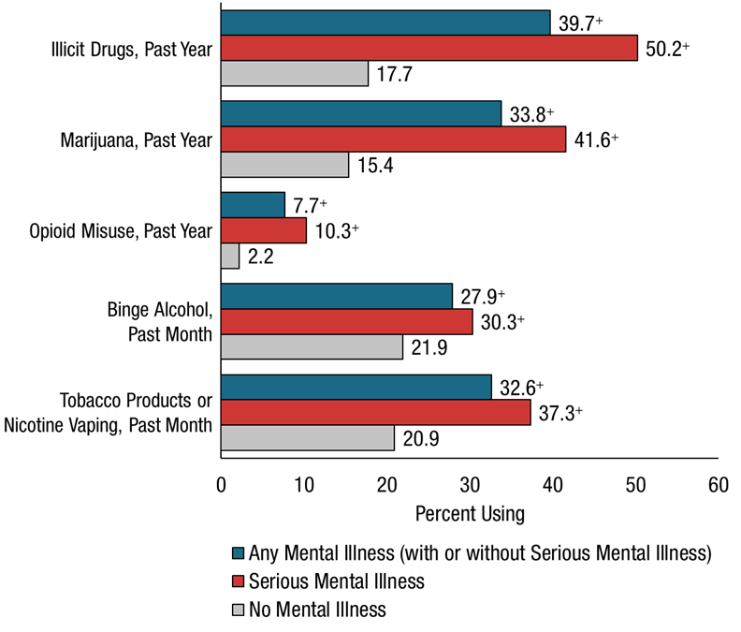
Substance Use by Mental Illness Status Among Adults Aged 18 or Older; 2021
+ Difference between this estimate and the estimate for adults aged 18 or older without mental illness is statistically significant at the .05 level.
Source: 2021 National Survey on Drug Use and Health

Slide 19
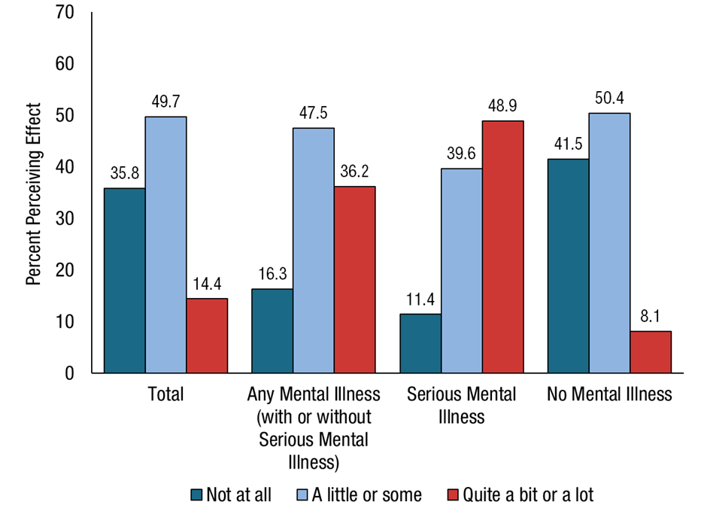
Perceived COVID-19 Pandemic Negative Effect on Emotional or Mental Health by Past Year Mental Illness Status Among Adults Aged 18 or Older; 2021
Note: The percentages may not add to 100 percent due to rounding.
Source: 2021 National Survey on Drug Use and Health

Slide 20
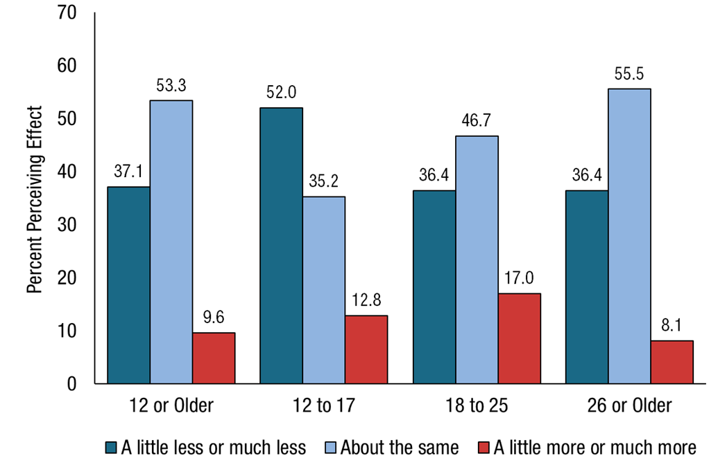
Perceived COVID-19 Pandemic Effect on Drug Use Among Past Year Drug Users Aged 12 or Older; 2021
Notes: Drug use includes marijuana, cocaine (incl. crack), heroin, hallucinogens, inhalants, or methamphetamine use in the past year or any use (i.e., not necessarily misuse) of prescription pain relievers, tranquilizers, stimulants, or sedatives in the past year; excludes tobacco products or nicotine vaping. The percentages may not add to 100 percent due to rounding.
Source: 2021 National Survey on Drug Use and Health

Slide 21
Emergency Dept Discharges Related to Substance Use and Mental Health Disorders, Hawaii, 2018 - 2021
Source: Laulima Data Alliance
Notes:
Not shown: Hallucinogen and inhalants were suppressed

Slide 22
Emergency Dept Discharges Related to Substance Use and Mental Health Disorders (per 10K discharges), Hawaii, 2018 - 2021
Source: Laulima Data Alliance
Notes:
Not shown: Hallucinogen and inhalants were suppressed

Slide 23
Percentage of Emergency Dept Discharges Related to Substance Use and Mental Health Disorders, Hawaii, 2018 - 2021
Source: Laulima Data Alliance
Notes:
Not shown: Hallucinogen and inhalants were suppressed

Slide 24
Emergency Dept Discharges with Co-occurring Primary and Secondary Diagnoses of Substance Use and Mental Health Disorders, Hawaii, 2018 - 2021
Source: Laulima Data Alliance
Notes:
Not shown: Hallucinogen and inhalants were suppressed

Slide 25
Emergency Dept Discharges with Co-occurring Primary and Secondary Diagnoses of Substance Use and Mental Health Disorders (per 10K discharges), Hawaii, 2018 - 2021
Source: Laulima Data Alliance
Notes:
Not shown: Hallucinogen and inhalants were suppressed

Slide 26
Emergency Dept Discharges with Co-occurring Primary and Secondary Diagnoses of Substance Use and Mental Health Disorders (per 10K discharges), Hawaii, 2018 - 2021
Source: Laulima Data Alliance
Notes:
Not shown: Hallucinogen and inhalants were suppressed

Slide 27
Emergency Dept Discharges with Primary Diagnosis of Substance Use Disorder and Secondary Diagnosis of Mental Health Disorder, Hawaii, 2018 - 2021
Source: Laulima Data Alliance
Notes:
Not shown: Hallucinogen and inhalants were suppressed

Slide 28
Emergency Dept Discharges with Primary Diagnosis of Substance Use Disorder and Secondary Diagnosis of Mental Health Disorder (per 10K discharges), Hawaii, 2018 - 2021
Source: Laulima Data Alliance
Notes:
Not shown: Hallucinogen and inhalants were suppressed

Slide 29
Emergency Dept Discharges with Primary Diagnosis of Mental Health Disorder and at least one Secondary Diagnosis of Substance Use Disorder, 2018 - 2021
Anxiety, Dissociative, Stress-Related, Somatoform, or Other Nonpsych
Schizophrenia, Schizotypal, Delusional, or Other Non-Mood Psych
Source: Laulima Data Alliance
Notes:
Mood (Affective) Disorder (includes Major Depressive and Bipolar Disorders)
Anxiety, Dissociative, Stress-Related, Somatoform, or Other Nonpsychotic Disorder (includes Adjustment and Post-Traumatic Stress Disorders)
Schizophrenia, Schizotypal, Delusional, or Other Non-Mood Psychotic Disorder
Childhood/Adolescent Onset Behavioral and Emotional Disorders (includes Conduct, Oppositional Defiant and Attention Deficit Hyperactivity Disorder (ADHD))
Adult Personality and Behavioral Disorder (includes Borderline Personality and Anti-Social Personality Disorders)
Mental Disorder Due to Physiological Condition (includes Post-Concussional Syndrome)
Behavioral Syndromes Associated with Physiological Disturbances or Physical Factors (includes Insomnia-related Disorders)

Slide 30
Emergency Dept Discharges with Primary Diagnosis of Mental Health Disorder and at least one Secondary Diagnosis of Substance Use Disorder (per 10K discharges), 2018 - 2021
Anxiety, Dissociative, Stress-Related, Somatoform, or Other Nonpsych
Schizophrenia, Schizotypal, Delusional, or Other Non-Mood Psych
Source: Laulima Data Alliance
Notes:
Mood (Affective) Disorder (includes Major Depressive and Bipolar Disorders)
Anxiety, Dissociative, Stress-Related, Somatoform, or Other Nonpsychotic Disorder (includes Adjustment and Post-Traumatic Stress Disorders)
Schizophrenia, Schizotypal, Delusional, or Other Non-Mood Psychotic Disorder
Childhood/Adolescent Onset Behavioral and Emotional Disorders (includes Conduct, Oppositional Defiant and Attention Deficit Hyperactivity Disorder (ADHD))
Adult Personality and Behavioral Disorder (includes Borderline Personality and Anti-Social Personality Disorders)
Mental Disorder Due to Physiological Condition (includes Post-Concussional Syndrome)
Behavioral Syndromes Associated with Physiological Disturbances or Physical Factors (includes Insomnia-related Disorders)

Slide 31
Adult Mental Health Division consumers with co-occurring mental health and substance use disorders, by service type and year, 2018 – 2022
Source: Adult Mental Health Division , Behavioral Health Administration, Hawaii State Dept of Health

Slide 32
Percentage of Adult Mental Health Division consumers with co-occurring mental health and substance use disorders, by service type and year, 2018 – 2022
Source: Adult Mental Health Division , Behavioral Health Administration, Hawaii State Dept of Health

Slide 33
Percentage of Hawaii State Hospital consumers with co-occurring mental health and substance use disorder diagnosis status, by year, 2018 – 2022
Source: Adult Mental Health Division , Behavioral Health Administration, Hawaii State Dept of Health
Notes:
Number of psychiatric beds = 202, since 2018

Slide 34
Mahalo!
Tiana Fontanilla, MPH
Epidemiologist
Adult Mental Health Division, Behavioral Health Administration
Hawaii State Department of Health
808-586-8275
tiana.fontanilla@doh.hawaii.gov

Slide 35
Alcohol and Drug Abuse Division clients with co-occurring mental health and substance use disorders, by service modality and calendar year, Jan 1, 2018 – Nov 14, 2022*
Source: Alcohol and Drug Abuse Division, Behavioral Health Administration, Hawaii State Dept of Health

Slide 36
Child and Adolescent Mental Health and Developmental Disabilities Division clients with co-occurring mental health and substance use disorders, by year, Jan 1, 2019 – Aug 31, 2022*
Source: Child and Adolescent Mental Health and Developmental Disabilities Division, Behavioral Health Administration, Hawaii State Dept of Health

