Slide 1
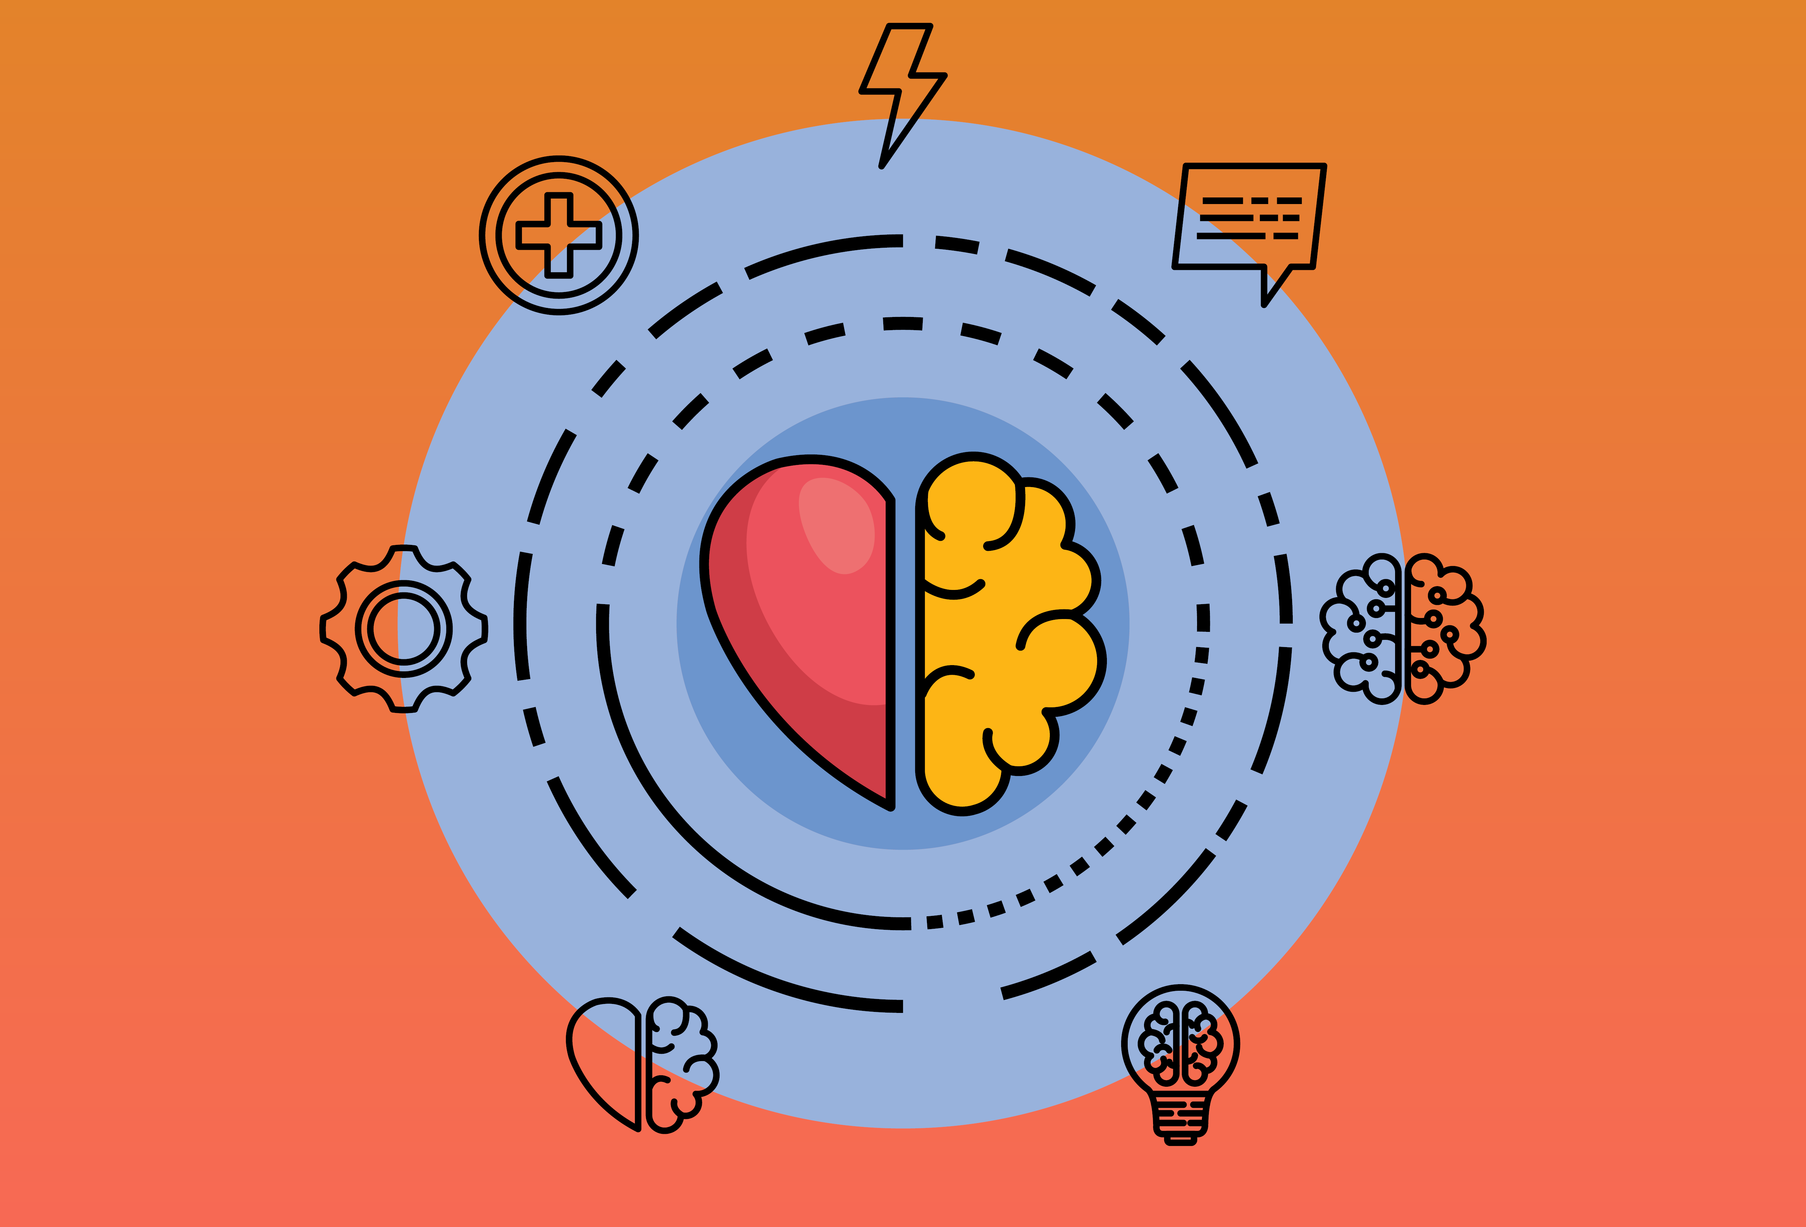
Synchronicity Lifestyle Medicine & Integrated Behavioral Health: Practices that add value to one another
Cathy Moonshine, PhD, DipACLM, CSAC
Benjamin Wing, MD, MSc

Slide 2
IT IS estimated That less than 10% of New Year's resolutions are achieved. (University of Scranton Psych Professor John C. Norcross, Ph.D.)
CM

Slide 3
CM
Safeguarding
New Year’s Resolutions
Choose SMART goals.
Identify successful people & habits.
Develop daily rituals.
Tap into encouraging supports.
Expect success.
Making
New Year’s Resolutions Stick
The idea and reality of change are not the same.
Some patients never quite get started.
Come February, the reality of the year sets in and resolutions can lose their sparkle.
Safeguard resolutions & change plans by adopting a sustainable approach for success.

Slide 4
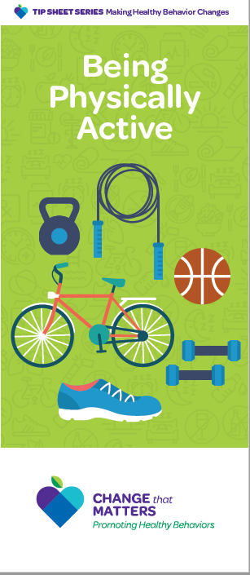
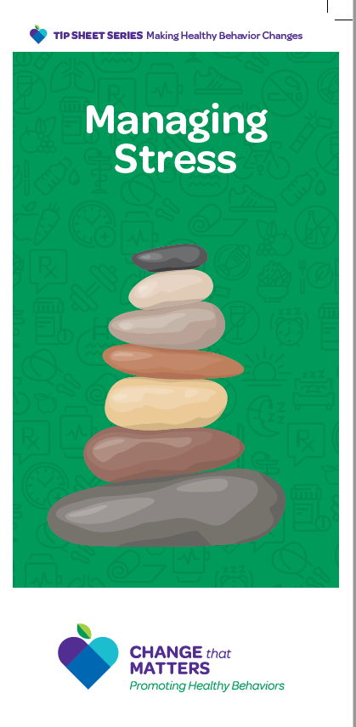
CM
changethatmatters.umn.edu

Slide 5
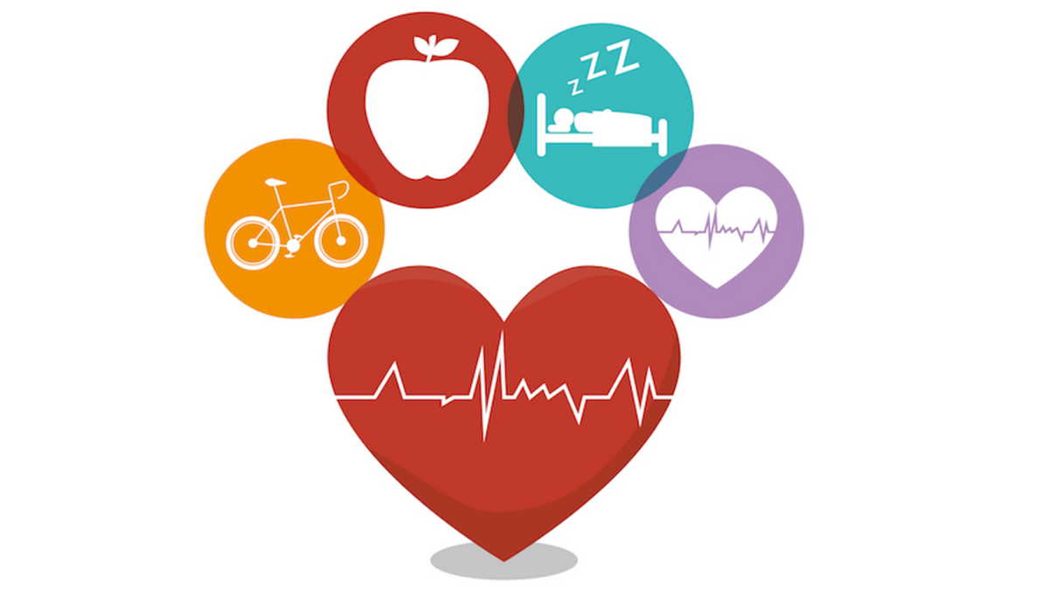
Lifestyle Medicine
CM
Chronic illnesses like hypertension, diabetes, obesity, and cardiovascular disease are aggravated by poor health habits such as inadequate physical activity, poor nutrition, smoking, and problematic substance use.
Primary care settings are uniquely positioned to screen and support individuals with physical and behavioral health needs through team-based care embedded in Lifestyle Medicine.
Members of the Lifestyle Medicine team may include physicians, integrated behavioral health clinicians, medical specialists, pharmacists, nutritionists, PT/OT, and health coaches, among others.
Lifestyle Medicine professionals work on health promotion and lifestyle changes to optimize physical and psychological health.
Notes:
EXPLAIN: This slide gives an overview of the full continuum of integration. Represented at one end of the continuum is completely separate (Siloed) behavioral health and primary care services, whereas at the other end is a model for seamlessly integrated care. In this module, you will focus on three distinct points along this continuum (American Hospital Association, 2014),² contrasting the level of communication between disciplines, the level of shared record keeping, and the level of focus on the entire population through mechanisms such as universal behavioral health screening. Truly integrated care reflects the provision of comprehensive primary care and behavioral health services provided in one site.
REFERENCES:
¹Heath, B., Wise Romero, P., & Reynolds K. A. (2013). A review and proposed standard framework for levels of integrated healthcare. Washington, DC: SAMHSA-HRSA Center for Integrated Health Solutions.
²American Hospital Association. (2014, February). Integrating behavioral health across the continuum of care. Retrieved from http://www.hpoe.org/resources/hpoehretaha-guides/1588

Slide 6
What is Lifestyle Medicine?
BW
Lifestyle medicine is a medical specialty that uses therapeutic lifestyle interventions as a primary modality to treat chronic conditions including, but not limited to, cardiovascular diseases, type 2 diabetes, and obesity.
Lifestyle medicine certified clinicians are trained to apply evidence-based, whole-person, prescriptive lifestyle change to treat and, when used intensively, often reverse such conditions.
Applying the six pillars of lifestyle medicine—a whole-food, plant-predominant eating pattern, physical activity, restorative sleep, stress management, avoidance of risky substances, and positive social connections—also provides effective prevention for these conditions.

Slide 7
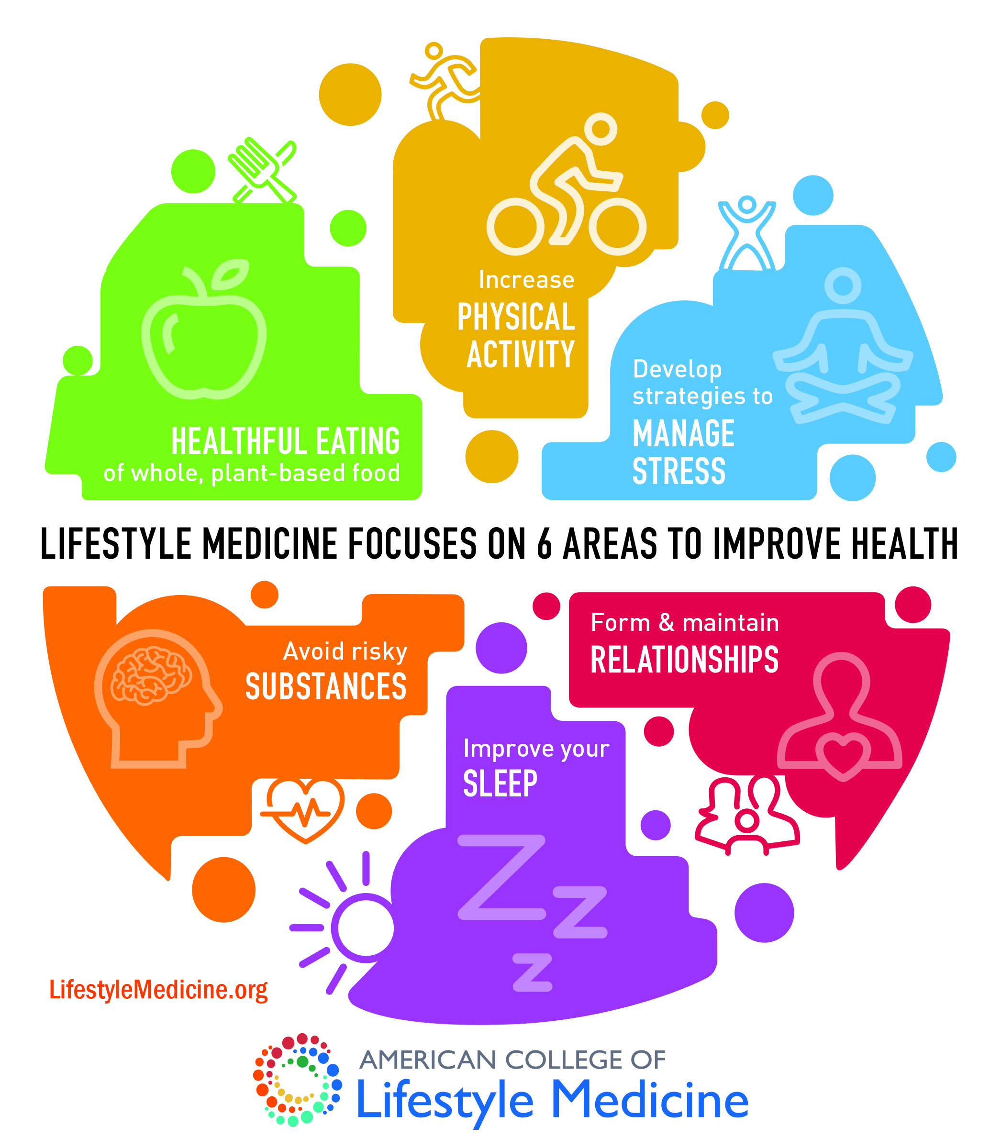
BW
Pillars of
Lifestyle Medicine

Slide 8
Holistic Care as a Primary Care Physician
BW
Authoritative Approach vs. Shared-Decision Making Model
Managing Chronic Disease
First line treatment?
“There’s a pill for that”
Holistic and more conservative approach
Introducing myself as their new Primary Care Provider
Our patient population
Lifestyle Modification
Physiology
Prescription
Surgery
Low Risk & Cost, Natural
High Risk & Cost, Foreign, Invasive
Notes:
Shared-Decision Making Model, Late 1980s

Slide 9
Lifestyle Medicine for Primary Care Physicians
BW
Chronic Disease
Diet, Exercise
Behavioral Health
Stress management, Sleep, Meaningful connections
Routine Screening
Reducing substances
Notes:
HTN, DM, High Cholesterol, Obesity
30%
Healthcare Maintenance

Slide 10
The value of IBH for PCPs
BW
Who does it benefit or apply to?
Why is it valuable from a LM perspective?
Multiple providers reinforcing lifestyle modification
Accountability to goals
Encourages maintenance
Measure | Average | Improvement
Value | 0 | 0%
Satisfaction | +1.5 | 15%
Engagement | +1 | 6.31%
Comfort | +1 | 11.07%
Accountability | +0.75 | 29.64%
SMART Goals | +1 | 15.83%

Slide 11
Lifestyle Medicine IBH Clinicians
CM
Review health histories and support adherence to medical treatment plans
Provide health coaching
Encourages breathing deeply, hydrating often, eating well, moving regularly, sleeping effectively, often laughing, making connections, & limiting substances
Screens for many MH conditions (Dep/Anx/SUD)
Provide short-term psychotherapy focusing on overall health
Utilize Stages of Change & Motivational Interviewing
Engage in education and clarification
Reinforce messages from PCP and healthcare team

Slide 12
Lifestyle Medicine IBH Clinicians
CM
Consider bio/psycho/social factors that impact health.
Use psychological science to promote health, prevent illness and improve health care systems.
Explore motivation and barriers to embracing health promotion and illness prevention.
Examine patients’ health behavior and lifestyle choices.
Explore the factors that allow people to be healthy, recover from an illness or cope with a chronic condition.
Notes:
EXPLAIN: This slide gives an overview of the full continuum of integration. Represented at one end of the continuum is completely separate (Siloed) behavioral health and primary care services, whereas at the other end is a model for seamlessly integrated care. In this module, you will focus on three distinct points along this continuum (American Hospital Association, 2014),² contrasting the level of communication between disciplines, the level of shared record keeping, and the level of focus on the entire population through mechanisms such as universal behavioral health screening. Truly integrated care reflects the provision of comprehensive primary care and behavioral health services provided in one site.
REFERENCES:
¹Heath, B., Wise Romero, P., & Reynolds K. A. (2013). A review and proposed standard framework for levels of integrated healthcare. Washington, DC: SAMHSA-HRSA Center for Integrated Health Solutions.
²American Hospital Association. (2014, February). Integrating behavioral health across the continuum of care. Retrieved from http://www.hpoe.org/resources/hpoehretaha-guides/1588

Slide 13
Lifestyle Medicine Assessment & Intervention: The 5 A’s
CM
ASSESS
ADVISE
AGREE
Assess physical symptoms, emotions, thoughts, behaviors, sociocultural factors, risks, attitudes, and preferences
Discuss intervention options and expected outcomes given presenting symptoms, strengths, and circumstances
After patient chooses course of action, psychologist and patient agree on goals
ASSIST
ARRANGE
Help patient develop new skills, problem solve, and overcome barriers
Establish follow-up plans (e.g., future visit, phone call, referral)

Slide 14
CM

Slide 15
CM
Diet
Lifestyle Medicine
Exercise & Movement
Sleep
Stress
Connections
Reducing substances

Slide 16
BW & CM
Diet:
Whole food plant-based diets
Eating fresher and less processed
Lifestyle Medicine
Notes:
Patient e.g. KS, new onset DM A1c 11.0

Slide 17
BW & CM
Lifestyle Medicine
Exercise & Movement:
150 minutes of moderate or 75 minutes vigorous
Reduce sedentary periods
Notes:
Patient e.g. TAD, chronic LBP, poor posture, ESRD on HD, improvement s/p stretching

Slide 18
BW & CM
Lifestyle Medicine
Sleep:
7 hours or more
Optimizing the best sleep, they can get
Notes:
Patient e.g. JPS, anxiety, poor sleep hygiene

Slide 19
BW & CM
Lifestyle Medicine
Stress:
Increasing stress management and coping skills
Practicing mindfulness, gratitude and having a meaning full life
Notes:
Patient e.g. SP, homeless, abusive relationship, reunited with children, deep breathing/product vs process goals, positive focus

Slide 20
BW & CM
Lifestyle Medicine
Connections
Ourselves, family, friends
Pets, nature, and perhaps the spirit
Notes:
Patient e.g. ??, unprovoked DVT, little movement and poor engagement with parents

Slide 21
BW & CM
Lifestyle Medicine
Reducing substances
Sugar, caffeine, and nicotine
Alcohol and other drugs
Notes:
Patient e.g. MM, reducing caffeine intake to improve BP

Slide 22
LM Interventions for BH
Anxiety:
Stress Management: breathing, gratitude, positive self-talk, avoiding the avoiding etc.
Sleep: Hygiene strategies, can’t will yourself to sleep
Exercise: Regular movement as tolerated
Diet: Avoid caffeine, sugar, and other activating food; hydrate well
Connections: Utilize relationships with others, pets, and themselves to cope effectively
Substances: little to no alcohol or other drugs

Slide 23
LM Interventions for BH
Depression:
Exercise: Cardio has an anti-depressant quality
Stress Management: Leverage previous strengths and success to deal with depression
Sleep: Avoid hyper/hypersomnia
Diet: Healthy eating, especially protein and limiting comfort foods; Hydrating well
Connections: Utilize relationships with others, pets, and themselves to reduce isolation
Substances: Alcohol makes depression worse and disrupts healthy sleep

Slide 24
LM Interventions for BH
Bipolar:
Sleep: Consistent sleep hygiene
Stress Management: Coping skills, managing impulsivity, rating energy level and mood regularly, taking medications even if they seem unnecessary
Exercise: Regular movement for stress management and burning off excessive energy
Diet: Hydrate and eat well while avoiding excesses
Connections: Utilize relationships for grounding and notice if moods shift
Substances: 50% of individuals self-medicate; little to none is recommended

Slide 25
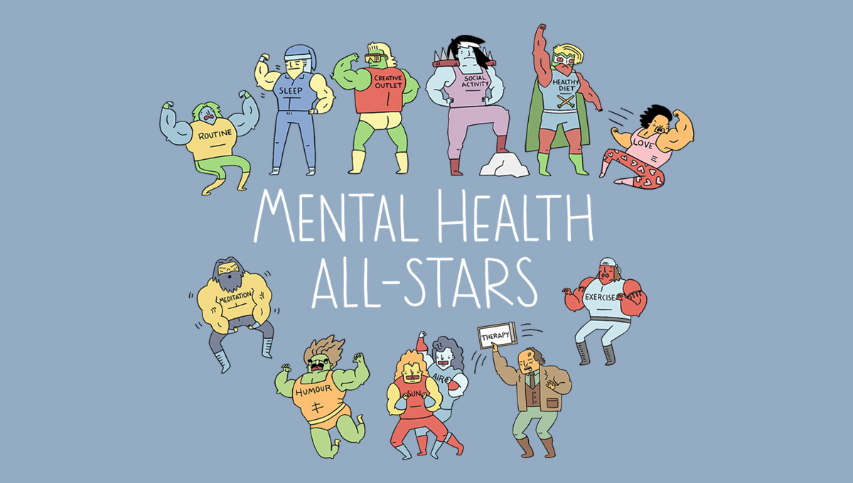
CM

Slide 26
My Private Practice:
moonshine-therapy.com
moonshinephd@gmail.com

