Slide 1
Lethal Means Safety
Wendy Schwartz, LCSW
Community Engagement and Partnerships Coordinators, Department of Veterans Affairs

Slide 2
Before We Begin:
Suicide is an intense topic for some people.
If you need to take a break, or step out, please do so.
Immediate Resources:
National Suicide Prevention Lifeline: 988
Text ALOHA to 741741
Service members and Veterans: Press 1 to connect with the Veterans Crisis Line.
Notes:
Today we will discuss ways that everyone can contribute to a safer environment for those at risk for suicide. We understand that this is a sensitive topic and that people in attendance today may have had personal experiences involving suicide. If you find you need to take a break, please do so. Feel free to reach out to me at the end of the presentation if you need support. If you find you need to talk to someone at any time, you can call the National Suicide Prevention Lifeline at 988 (service members and Veterans should press 1 to connect with the Veterans Crisis Line). Why don’t we all put this number into our phone contacts right now?

Slide 3
Overview
What is lethal means safety?
Why does means matter?
How can we help our communities prevent suicide deaths?

Slide 4
What is Lethal Means Safety?
The shift from thinking about suicide to a suicide attempt can happen quickly, like right after a fight with a loved one.
Easy access to lethal means, such as firearms, prescription medications, and hanging materials, significantly increases the risk for suicide and subsequent death.
It doesn’t allow the person enough time to use other coping mechanisms to reduce distress and speed recovery
Guns are the most lethal suicide attempt method, with approximately 9 out of 10 firearm suicide attempts resulting in death. (1)
Suicide by ligature has a high case fatality rate, similar to firearms (7)
Notes:
Suicidal crises are difficult to predict, can escalate rapidly, and are often brief. Putting time and distance between people at risk and lethal methods can save lives.
Not having lethal means quickly at hand is like keeping the keys to the car away from a person who’s been drinking.
It reduces bad outcomes in volatile situations.

Slide 5
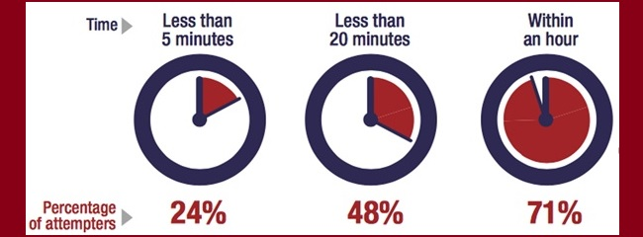
FACTS
While some suicidal crises last a long time, most last minutes to hours. In one study of suicide attempt survivors:
71% said it took less than one hour between their decision to attempt suicide and their actual attempt.
24% said it took less than five minutes for them to act (5)
Simon OR, Swann AC, Powell KE, Potter LB, Kresnow MJ, O'Carroll PW. Characteristics of impulsive suicide attempts and attempters. Suicide Life Threat Behav. 2001;32(1 Suppl):49-59. doi: 10.1521/suli.32.1.5.49.24212. PMID: 11924695.)

Slide 6
Means Matter
The lethality of the method used in a suicide attempt is one of the biggest factors determining whether the person lives or dies.
If the method a person wants to use for suicide is not available when they are actually ready to go through with an attempt, one of two things is likely to occur:
They will delay the attempt as they try to get access to the method they want to use. The greater the delay, the greater the chance the suicidal crises will pass.
They will substitute another method. If the substituted method is less lethal, this increases the chance the person will not die.
90% of people who survive an attempt do not go on to die by suicide
If we can help people survive a suicidal crisis, we have likely prevented suicide for their lifetime. (4)
Notes:
Firearms are used in more suicide deaths in the U.S. than all other methods combined. They are also highly lethal, irreversible, and frequently easily accessible in many homes with guns due to unsafe storage practices. (4) It is important to note that the majority of suicide deaths in Hawai’i and throughout the Pacific Islands are by strangulation.

Slide 7
Veteran’s Access to Firearms
Veterans have a high degree of familiarity with firearms and are more likely than other members of the U.S. general population to have access to firearms.
Half of Veterans own at least one firearm (8)
One-third store a firearm loaded and unlocked (8)
For some veterans, firearms may bring a sense of safety.

Slide 8
Kids and Guns – Creating safer homes and why safe storage matters
One in three homes with children in the US has a gun. (6)
Children as young as 3 years old may be strong enough to pull the trigger on a handgun. (6)
Three out of four children (including children less than 10 years old) living in a house with a gun know where the gun is, even if their parents think they don’t. (6)
Studies found that most children will handle a gun if they find one, even if they have been taught not to. Research shows limited retention of information from gun safety trainings over time. (6)

Slide 9
Who benefits from lethal means safety counseling?
People who experience thoughts of suicide
People who are in distress and have made a suicide attempt or experienced an interrupted attempt in the past.
People who are struggling with mental health or substance use, especially if they are coping with painful life crisis.
Relationship break ups, legal problems, financial crises, housing dislocation, job loss

Slide 10
Mental Health Professionals provide lethal means safety counseling through direct counseling with individuals and their families, usually through the Safety Planning Intervention.
Good clinical practices indicate that follow up should be provided to see if the individual was able to implement the plan or explore barriers to implementing; check in on the plan
Limitations: Once the individual walks out of our office, implementing the plan is entirely on them.
Questions about gun ownership can raise fears about losing gun rights.
Discussions should focus on strategies that are under the individual’s control, not a question about their decision to own guns. We’re simply addressing short-term safety and storage options to protect them during this vulnerable period. (2)
Notes:
Direct with client; with parents of children who are experiencing thoughts of suicide,
Emergency room settings
Mental Health individual sessions when determined to be at high risk for suicide
Discussions about creating a safer home, should they or their loved one struggle with thoughts of suicide.

Slide 11
Lethal Means Safety Counseling is Part of Effective Safety Planning
Safety planning is recognized by SAMHSA as a best practice brief intervention for anyone who is at increased risk for suicide
How do we present the safety plan to our clients?
“Would you like to create a safety plan?” or “Do you have safe people and places in your life?” – most people will opt out
Try to describe the safety plan as a tool or strategy that someone can use when they’re in crisis. Even most people who are reluctant to believe that such a tool might work will likely agree to try.
Step 6: Making the environment safe
This step is tailored to the means or method that the client identifies.
If the client doesn’t identify a means or method, or they report not having considered:
provide psychoeducation about the impulsivity often associated with suicide attempts
Discuss the importance of limiting access to lethal means of suicide when they or someone they love are in crisis (can point out the necessity of securing medications – both over the counter and prescription; ligature safety such as ropes and tie downs, as well as firearms)

Slide 12
Lethal Means Safety Counseling is Part of Effective Safety Planning
Every Safety Plan, Step 6 should include:
Education about impulsivity and suicide.
Collaborative problem solving with the individual and their available support system on how to increase safety and decrease risk
Make the plan and write it down
Check in on the plan
Always ask about firearms – Offer a gun lock and discuss how and why to use it
Contact Wendy Schwartz if you need gun locks: wendy.schwartz@va.gov
Most people who are thinking about suicide and who have thought about a plan are focused on one particular method.
Research shows us that people are unlikely to substitute one method with another if the target method is not available, particularly because our thinking patterns are rigid during periods of crisis. This also creates more TIME.

Slide 13
Making the environment safe
Sometimes, when people are struggling in the ways you are describing, they decide to use a gun lock and give someone the key.
Assess whether an individual has a specific method or plan for suicide
Discuss access to lethal means – this doesn’t mean do an inventory
Collaborate to find acceptable, voluntary options that eliminate, reduce, or slow access to these means
Do not limit the discussion of lethal means to the one identified as most likely
Explore who the individual can enlist to help them
Adding items (pictures, quotes, etc) to individual’s environment to remind of reasons for living
What can we do to make your home safer for those times when you’re thinking about suicide?
Notes:
Discussions around lethal means safety should be geared towards the risk that the client presents with.
Example of lethal means safety counseling done with safety planning intervention.

Slide 14
How would I ask someone these questions?
Patient has screened positive in initial suicide screen
Step 6 on the Safety Plan
Clinician: “I know you talked about having intense thoughts about wanting to die. Have you thought of a plan or started to work out the details?”
Patient: “Yeah, I’ve been thinking about using the tie down in the back of my truck.”
Clinician: “Do you have the location picked?”
Patient: “No, not yet. I been looking around when I go hiking, but I haven’t found one yet.”
Clinician: Begin to provide the psychoeducation about impulsivity associated with suicide and the idea of creating time and space in between self and the means to make an attempt on one’s life.
Start to discuss ways that the patient could limit access. Would he be willing to get rid of the tie-downs in his truck and any others he has stored in his garage or carport? Would he be willing to not go to the locations he has been going to look for the “spot?” Perhaps pick places to hike or walk that would be more populated. Let the client lead the discussion. They know what they will be willing to do or what just sounds good to you.
Notes:
It is important to note that the majority of people dying by suicide in Hawai’I are dying by hanging.

Slide 15
How would I ask someone these questions?
Patient has screened positive in initial suicide screen
Step 6 on the Safety Plan
Clinician: “I know you talked about wanting to die. Have you started to work out what that might look like?”
Patient: “I have a gun I keep under my mattress in case something happens. It’s always a back-up.”
Clinician: Begin to provide the psychoeducation about impulsivity associated with suicide and the idea of creating time and space in between self and the means to make an attempt on one’s life.
Start to discuss ways that the patient could limit access. Would he be willing to remove the ammunition and let someone else hold onto it until the crisis passes? Would he be willing to lock the firearm and give the key to someone he loves or put the key in the freezer in a glass of water?
It’s important that you don’t just focus on the firearm that the patient identifies. If they identify themselves as a firearm owner, bring up the possibility of other firearms and discuss secure storage. The idea is to increase safety, not judge the person for their decision to own firearms.
Notes:
It is important to note that the majority of people dying by suicide in Hawai’I are dying by hanging.

Slide 16
How would I ask someone these questions?
Patient has screened positive in initial suicide screen
Step 6 on the Safety Plan
Clinician: “I know you talked about feeling like you wanted to go to sleep and not wake up. Have you started to think about or make a plan to not wake up?”
Patient: “I have been saving up my medication for the last couple months. I have a pretty good supply.”
Clinician: Begin to provide the psychoeducation about impulsivity associated with suicide and the idea of creating time and space in between self and the means to make an attempt on one’s life.
Start to discuss ways that the patient could limit access. Would they be willing to gather the medication stockpile and drop it off at the dropbox at Long’s or the Police Department? Would they be willing to lock it up in a lockbox and give the key to someone they love, or freeze the key in a glass of water? Would they be willing to talk to their pharmacist about getting pills in bubble-packs?

Slide 17
How would I ask someone these questions?
Patient has screened positive in initial suicide screen and has a caregiver. Ideally, include the caregiver in the safety plan, but definitely include the caregiver in Step 6
Step 6 on the Safety Plan
Clinician: “I know you talked about feeling like you wanted to go to sleep and not wake up. Have you started to think about or make a plan to not wake up?”
Patient: “I was thinking that I could use the stuff in the medicine cabinet at home. There is a big bottle of ibuprofen in there.”
Clinician: Begin to provide the psychoeducation to the client and caregiver about the impulsivity associated with suicide and the idea of creating time and space in between self and the means to make an attempt on one’s life.
Start to discuss ways that the caregiver could assist in limiting access. Would they be willing to get rid of the large bottle of ibuprofen and get a 20 tab bottle instead? Would they be willing to lock up any additional, yet necessary medications for the household?

Slide 18
How would I ask someone these questions?
I was at my doctor’s office yesterday and they were talking about how it’s good to keep less medication around the house, especially if you’re going through a rough time. I know the divorce has been hard, and you’ve been talking about feeling hopeless. I love you and I’m concerned about you. I want to help you stay safe.
Can we go through the medicine cabinet and see what’s in there? I can help safely get rid of the things you don’t need anymore.
You have lots of medication. Can I help you pack up your old medications and drop them off at the medication dropbox at the police station so they can be disposed of?
Can we get rid of the big Costco sized Tylenol and buy a 20 tab bottle from Longs?
I’m concerned about you. You’ve been drinking a lot more lately and you were talking about wanting to die the other day. Do you still have that gun you always kept under your mattress?
I have this gun lock that the VA gave me that you can have. Can we use it to secure your gun? If you don’t want to give me the key, what about putting it in a glass of water and putting that in the freezer? (this creates time and space). Let’s do it together.
Can I store your ammunition until you’re feeling better?

Slide 19
How would I ask these questions?
Grandma has been so sad since Grandpa died. She hardly talks anymore and she barely eats. I am worried about her. I was reading that older people can experience high rates of depression, especially after losing a spouse. The article suggested that we be proactive and secure household goods that could be harmful to someone who might be suicidal, like ropes and pesticides in the shed. Make sure that you find a new place for the key. Let’s talk to her about starting to manage her medications and filling a weekly pill box for her. We can keep the rest of the medications locked up.
You shared that your daughter is having a hard time right now and that you went to the emergency room yesterday to get her help. I was in a meeting last week where they were talking about ways we can keep our homes safe, and our teens safe, from suicide. They suggested locking up prescription medications, while also limiting supplies of over the counter medications. In the meeting it was also suggested to check our garages for ropes and pesticides (which could also be harmful in the hands of someone who is suicidal). They also stressed the importance of securing firearms and ammunition, making sure that our teens don’t know where we keep the keys.
I can get you the information and we can make a plan.

Slide 20
Firearms
Safe Storage Practices:
Guns should be stored UNLOADED and LOCKED
Ammunition should be stored separately or away from the home.
Be sure the keys and combinations to the locks are kept away from the person at risk. If the person doesn’t want to consider giving someone the keys to the gun lock, brainstorm ways to put time and distance between the individual and their firearm (freeze the key in a glass of water).
If you already lock your guns but the person at-risk has access, change the combinations or get new locks and don’t disclose the location of the keys.
Remember: This does not guarantee safety. Family members often know each other’s hiding places.
Another good option is to disassemble your guns, and lock up a key component, like the slide, or the firing pin, separately from the gun.
What if a Family Member Carries Firearms as Part of the Job?
Store the gun at work if possible. If not, then…
Follow the above steps and ensure that keys and combinations are secured at all times.
Remember: Using locking devices or locked storage does not guarantee absolute safety but does present a barrier to an impulsive act.
Means Matter | Harvard T.H. Chan School of Public Health
Notes:
Strategies to

Slide 22
Medications – Prescription and Over the Counter
Safely dispose of unused, expired, and unwanted medications (American Association of Poison Control Centers - Safe Medicine Disposal (aapcc.org))
Lock abuse-prone medications like opioids (prescription pain pills), anxiety pills, muscle relaxants, amphetamines, sedatives, and barbiturates.
A pharmacist can advise on specific medications and quantities. For example, if the individual is at risk for overdose but must take a regular prescription, they may be safer with weekly or monthly refills
Blister pack medications
Keep small quantities of those medications the family needs on hand. Lock the rest. The goal is to limit medicines on hand to a quantity that even if taken together would not cause serious harm.
Consider limiting the amount of over-the-counter medications that are easily accessible (like in a medicine cabinet)
Instead of a 500 tab bottle of ibuprofen, get the 20 tab bottle.
Limit cold medication
Means Matter | Harvard T.H. Chan School of Public Health

Slide 23
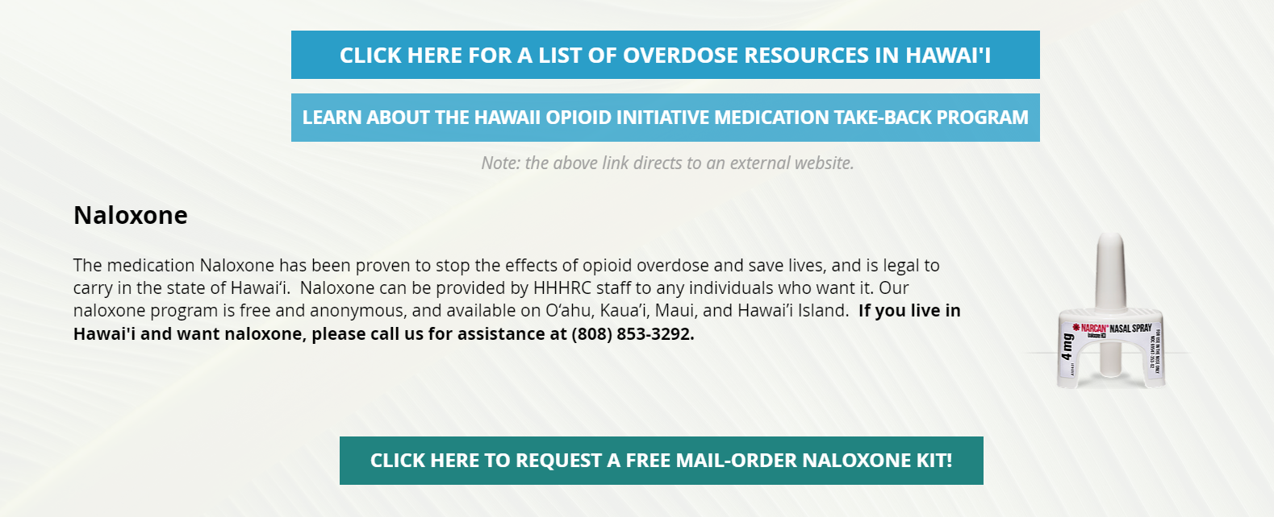
Opioids OVERDOSE PREVENTION | HHHRC – Hawai’i Health and Harm Reduction Center If you live in Hawai'i and would like a naloxone kit, please call (808) 853-3292.
Notes:
Discuss benefits of having access to Naloxone for a person who is prescribed or uses opiates as well as for those who love someone who is prescribed or uses opiates.

Slide 24
Common Household Items – Ropes and Pesticides / Alcohol and knives
Strangulation is the most common means of suicide death in Hawai’i.
Secure ropes and other strong cords, like clothesline, in a shed or place that locks.
Ensure that the key is kept secure and that the person who is at-risk does not have access to the key.
Remember that most family members know our hiding places, so consider finding a new place.
Secure pesticides in the same manner, especially large quantities.
It may be important to lock alcohol and knives when teens are in crisis.

Slide 25
Suicide Prevention Is Everyone’s Business
Some people who are experiencing thoughts of suicide don’t seek care with a mental health provider.
Even more impactful than a provider or case manager having the conversation with me, is when someone I love does.
https://youtu.be/NIIYHYJcUrQ
If one of your loved ones is having thoughts of suicide, asking questions about access to lethal means can help save their life.
Safe storage of firearms, prescription medications, and household goods like pesticides and ropes, creates safer homes for our families and our kids.
Remember: these crises come on quickly. It’s important to have these conversations with those we love as we notice something seems wrong, and especially if we know that they are thinking about suicide.
Don’t wait.
Notes:
Most people who die by suicide (except with pills) do so on their first attempt. Many never sought treatment for suicidal feelings. As a helper, you may encounter people who experience thoughts of suicide over some other issue–marriage counseling, court-remanded anger management, substance abuse treatment, Police, counseling providing services to perpetrators of domestic abuse, defense attorneys, homeless service providers, school truancy officers, primary healthcare providers, case workers in State Medicaid programs, case workers in foodshare and benefit officers, veterans service officers, educators, case managers for insurance companies etc. This underlines the importance of including suicide assessment with all clients. - Clinicians | Means Matter | Harvard T.H. Chan School of Public Health
Who else could provide LMSC?
Other firearm owners, shooting clubs, hunting organizations, motorcycle clubs, suicide prevention coalitions
Stress the importance of educating all community members about suicide prevention, including lethal means safety.

Slide 26
Resources
Guns & Suicide | Harvard Public Health Magazine | Harvard T.H. Chan School of Public Health Means Matter | Harvard T.H. Chan School of Public Health
Lethal Means Safety Counseling - The Educational Fund to Stop Gun Violence (efsgv.org)
CALM: Counseling on Access to Lethal Means | Suicide Prevention Resource Center (sprc.org)
Simon TR, Swann AC, Pwell KE, Potter LB, Kresnow M, and O’Carroll, PW. Characteristics of impulsive suicide attempts and attempters. SLTB. 2001; 32(supp): 49-59.
Firearm Safety Tips - Johns Hopkins All Children's Hospital (hopkinsallchildrens.org); Children and gun safety: What to know and do - Harvard Health
Cleveland EC, Azrael D, Simonetti JA, Miller M. Firearm ownership among American veterans: findings from the 2015 National Firearm Survey. Injury epidemiology. 2017;4(1):33. [PMC free article] [PubMed]
Baker, S.P. et al. (2013) Increase in suicide by hanging/suffocation in the U.S., 2000-2010. American Journal of Preventative Medicine, 44(2), 149-149.

Slide 27
If anyone is interested in additional training on lethal means safety, safety planning, or other clinical interventions for suicide prevention, please contact:
Wendy Schwartz, LCSW
808-758-4129
wendy.schwartz@va.gov
Chris Lopa LCSW, CSAC
808-260-6632
christopher.lopa@va.gov

Slide 28
Thank You
Notes:
New Slide
Thank you for your investment, support and commitment to eliminating Veteran Suicide. We value the opportunity to work together with you.

Slide 29
VHA Suicide Prevention Resources

Slide 30
Free, Confidential Support 24/7/365
Veterans
Service members
Family members
Friends
Coworkers
Notes:
Veterans Crisis Line: The Veterans Crisis Line connects Veterans in crisis and their families and friends with qualified, caring VA responders through a confidential toll-free hotline, online chat, or text. Veterans and their loved ones can call 1-800-273-8255 and Press 1, chat online, or send a text message to 838255 to receive confidential crisis intervention and support 24 hours a day, 7 days a week, 365 days a year. More information is available at https://www.veteranscrisisline.net/.

Slide 31
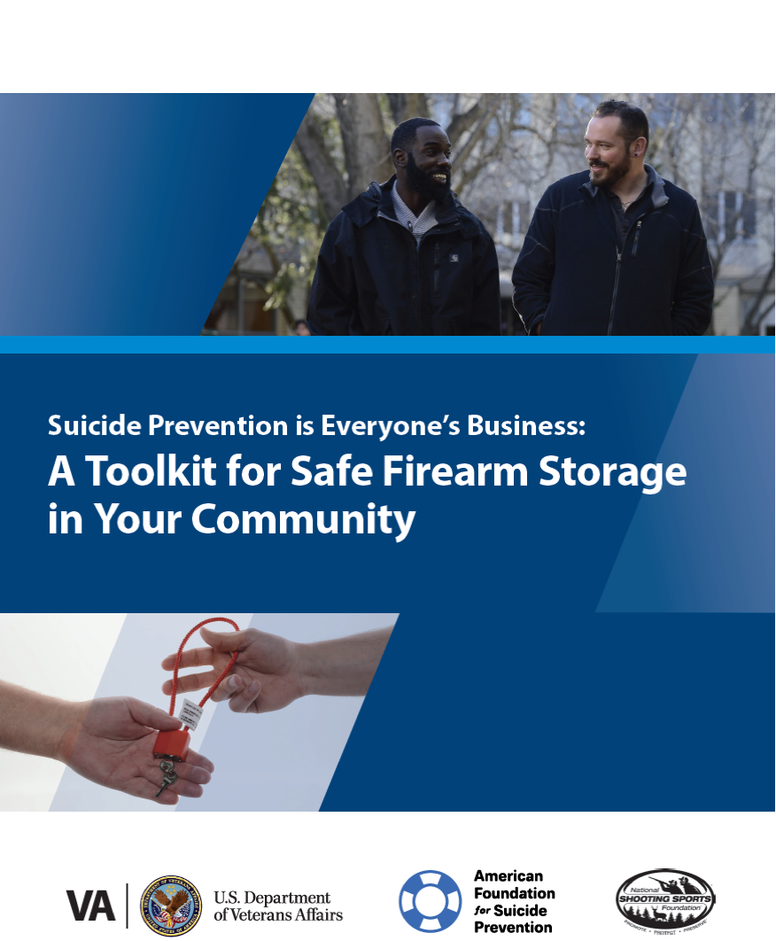
Lethal Means Safety Toolkit
Developed in partnership with the American Foundation for Suicide Prevention (AFSP) and the National Shooting Sports Foundation (NSSF), the trade association for the firearms industry.
Toolkit guides communities through the process of building coalitions to raise awareness about safe storage and its connection to suicide prevention.
Safe storage can put time and space between an individual and a firearm during suicidal crisis and shows promise for reducing rates of suicide.
VA respects the important role firearms play in many Veterans’ lives and is dedicated to providing safe storage options that are consistent with each Veteran’s values and priorities. Help Veterans and their loved ones make their homes safer and share these resources with your network.
Access the toolkit online:
Safe Firearm Storage Toolkit

Slide 32
Social Media Safety Toolkit
As discussed in the National Strategy for Preventing Veteran Suicide, social media is an important intervention channel and a key piece of VA’s comprehensive, community-based suicide prevention strategy.
The Social Media Safety Toolkit for Veterans, their families, and friends equips everyone with the knowledge needed to respond to social media posts that indicate a Veteran may be having thoughts of suicide.
The toolkit includes best practices, resources, and sample responses.
Download at https://www.mentalhealth.va.gov/suicide_prevention/docs/OMH-074-Suicide-Prevention-Social-Media-Toolkit-1-8_508.pdf
Notes:
The Social Media Safety Toolkit for Veterans, Their Families, and Friends equips everyone with the knowledge needed to respond to social media posts that indicate a Veteran may be having thoughts of suicide. The toolkit includes best practices, resources, and sample responses.
As discussed in the National Strategy for Preventing Veteran Suicide, social media is an important intervention channel and a key piece of VA’s comprehensive, community-based suicide prevention strategy.
Many service members and Veterans are active on social media platforms, and some have posted to express emotional distress or thoughts of suicide. Social media has become a critical channel for VA and partners like you to reach Veterans in crisis with safe messaging and resources.
VA is sharing the Social Media Safety Toolkit among VA employees, with partner organizations, and throughout communities nationwide to help ensure that people who live and work with Veterans every day are equipped to reach Veterans with safe messaging and lifesaving resources.
Download the Social Media Safety Toolkit at https://www.mentalhealth.va.gov/suicide_prevention/docs/OMH-074-Suicide-Prevention-Social-Media-Toolkit-1-8_508.pdf.

Slide 33
VA SAVE Training
Suicide prevention training video available to everyone, 24/7
Less than 25 minutes long
Offered in collaboration with the PsychArmor Institute
Available online for free: psycharmor.org/courses/s-a-v-e/
Notes:
Double Check to see if there aren't updated #'s
Updates from February 2019:
Number of VA employees who have taken the training (through 2/11/19) from our VA TMS system:
SAVE course: 111,044
SAVE Refresher: 181,620
Our current metrics show the SAVE course has been viewed 18,076 times since it was launched in mid-2018.
S.A.V.E. training video: An online suicide prevention training video launched in collaboration with PsychArmor Institute. The training video is designed to help equip anyone who interacts with Veterans to demonstrate care, support, and compassion when talking with a Veteran who could be at risk for suicide. The 25-minute training video is available for free at: https://psycharmor.org/courses/s-a-v-e/.

Slide 34
Coaching into Care
National VA telephone service which aims to educate, support, and empower family members and friends who are seeking care or services for a Veteran
CALL 888-823-7458
Notes:
Coaching into Care (1-888-823-7458): A national telephone service of the VA, Coaching into Care aims to educate, support, and empower family members and friends who are seeking care or services for a Veteran. More information is available at https://www.mirecc.va.gov/coaching/.

Slide 35
Be There Prevention Initiative
Notes:
#BeThere Prevention Initiative: The #BeThere prevention initiative teaches members of the community how simple acts can help save a Veteran in crisis. More information is available at https://www.veteranscrisisline.net/BeThere.aspx.

Slide 36
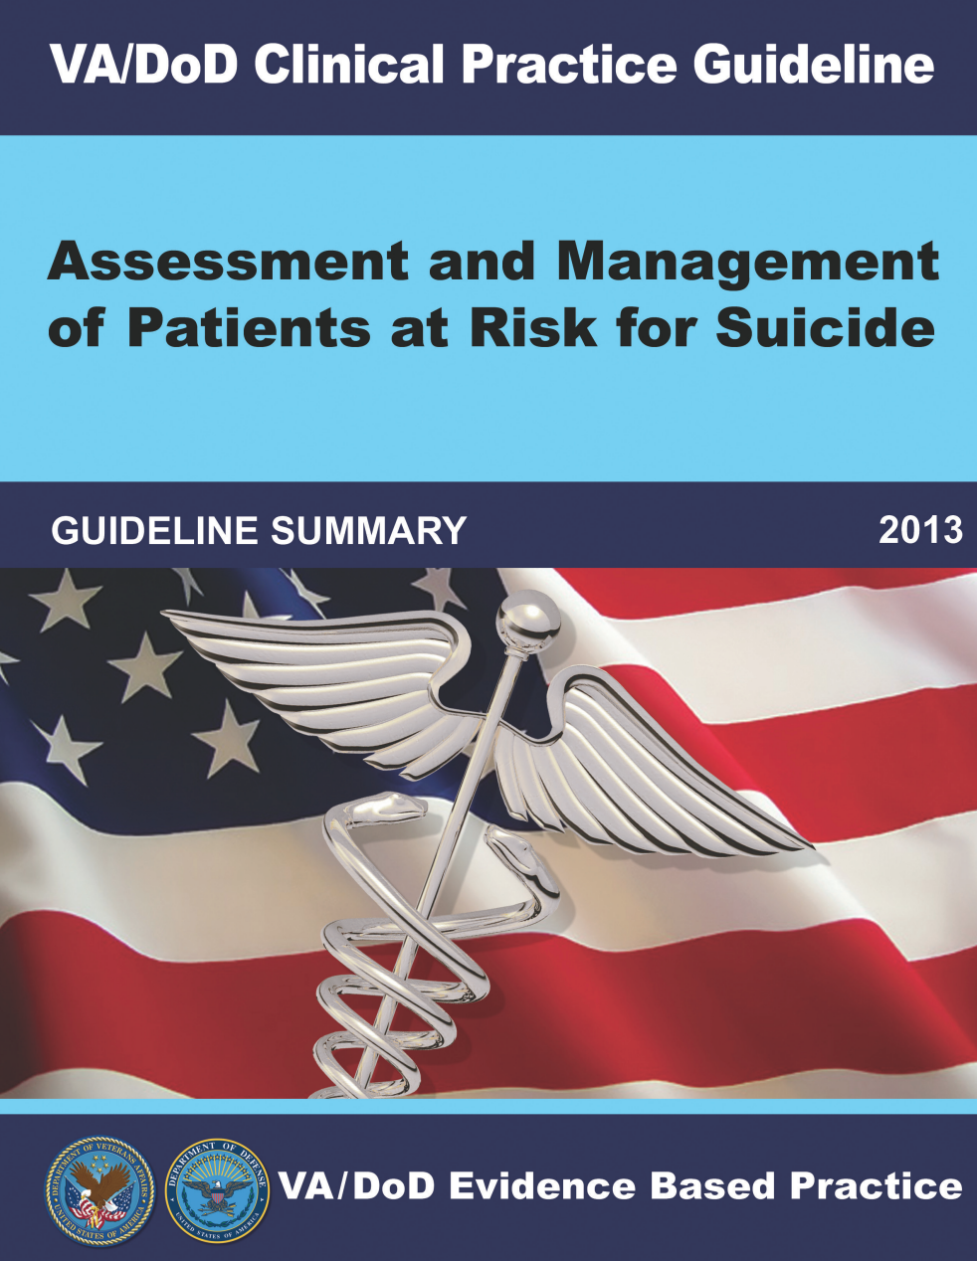
Resources for Clinicians
www.healthquality.va.gov/guidelines/MH/srb
Notes:
VA knows that local Veteran leaders know your populations best, and we cannot prevent suicide without local support.
Your voice and local expertise in reaching your peers, their families, and their caregivers in your community is invaluable.
Reaching Veterans where they live, work, and thrive requires collaborative community leaders like you.
You know the risk and protective factors of your community.
You know your community’s natural strengths and areas for improvement.
You know popular organizations in your area that may be open to suicide prevention partnerships.
You know your local data, research, and best practices.
We also know that local Veteran leaders create a sustainable future for Together with Veterans, so efforts can continue to be carried out by the community in the future.
We are grateful for your guidance and initiative in advancing our shared goal of suicide prevention and ability to generate impactful change.
The Suicide Prevention Program strives to equip leaders at different levels – and in different roles – with the ability to advance our shared goals. Please let me know if there is anything I can do to better support your efforts.

Slide 37
TRAIN Learning Network
TRAIN is a national learning network that provides quality training opportunities to over 1.8 million professionals who protect and improve the public's health.
Many of the trainings used for internal VA staff and clinicians are included on this public portal as an opportunity to train community providers.
The Suicide Prevention Program wants to ensure the high level of training provided to VA employees is also accessible to those assisting Veterans in their communities.
Notes:
TRAIN: TRAIN is a national learning network Public Health Foundation (PHF) that provides quality training opportunities to over 1.8 million professionals who protect and improve the public's health. More information is available at https://www.train.org/.
Suicide Prevention Courses: https://www.train.org/main/search?type=course&query=suicide

