Slide 1
Hawaii UTelehealth
Presentation to BH Echo
July 18, 2023
Wesley Palmer, MD
wpalmer@hawaii.edu

Slide 2
Goal
Our goal is to provide tele-mental health services to the residents of Hawaii who experience time constraints, financial burdens, and transportation barriers when trying to access services.
Started in 2020
Provided at NO COST from grant funding though 2026 for rural residents.
Urban Oahu support ends in September 2023 (unless other funding identified).

Slide 3
Services
Our telehealth services provide appointments with licensed clinicians- psychologist, psychiatrist, family medicine specialist, mental health counselor, or substance use counselor.
HawaiiUTelehealth (HUT) is supported by the Hawaii State Rural Health Association, University of Hawaii John A. Burns School of Medicine (JABSOM), and the Hawaii/Pacific Basin Area Health Education Center (AHEC) focus on our Native Hawaiian/Pacific Islander, and rural communities, as well as our senior citizens.
Provide telepsych visits for those who are suffering from stress, anxiety, depression, self-harm concerns, or substance abuse issues.

Slide 4
Resources required
Computer or smartphone
Internet connection
Email
Mitigation as barriers through CHWs, computer trainer, and computer donation

Slide 6
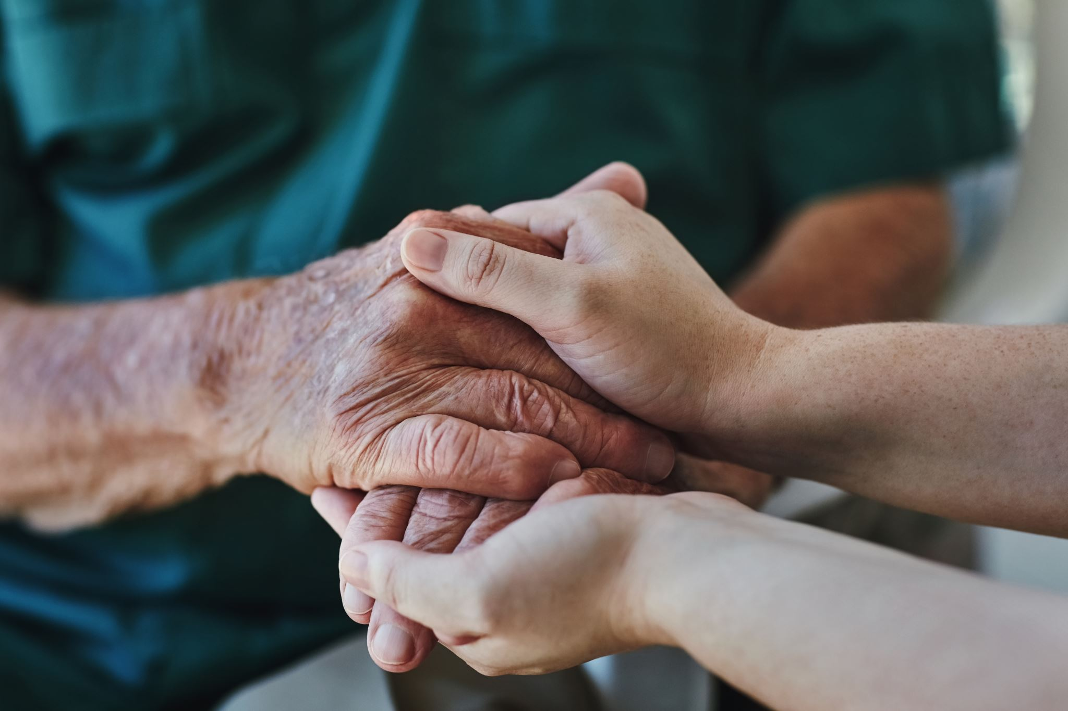
Utilization
Currently providing care to 130 patients
Average about 12 new patients per month
Primarily serving rural patients throughout Hawaii

Slide 7
TOUCH GRANT Utilization 22/23

Slide 8
Special Aims
Expand Telehealth infrastructure to rural individuals and families by providing 300+ sessions per month.
Improve the quality and sustainability of rural behavioral health care services through education and care coordination by supporting 6,000 person-hours of substance use disorder and mental health continuing education, 1,000 hours of rural clinical training for health professions students.
Improve the capacity of rural communities to address risk factors and SDOH by providing outreach and community education to 1,000 community members a year and creating local task forces to develop plans for recovery communities.

Slide 9
ALICE Individuals Served | Total Population | FY 1
 |  | Planned | Actual
Number to Be Reached | 280 | 40 | 46
By Race and Ethnicity
African American | 14 | 2 | 2
American Indian/Alaska Native | 14 | 2 | 1
Asian | 42 | 6 | 3
White (non-Hispanic) | 140 | 20 | 23
Hispanic or Latino/a/e | 28 | 4 | 0
Native Hawai’ian/Other Pacific Islander | 42 | 6 | 11
*Two or More Races | Not Estimating | Not Estimating | 6
Unknown | Not Estimating | Not Estimating | 0
By Gender Identity
Cisgender Woman, Girl, or Female | 210 | 30 | 36
Cisgender Man, Boy, or Male | 70 | 10 | 8
*Transgender Woman, Girl, or Transfeminine (MTF) | Not Estimating | Not Estimating | 1
*Transgender Man, Boy, or Transmasculine (FTM) | Not Estimating | Not Estimating | 0
*Nonbinary, Gender Nonconforming, or Genderfluid | Not Estimating | Not Estimating | 1
Two-Spirit | Not Estimating | Not Estimating | 0
Intersex | Not Estimating | Not Estimating | 0
Other (Please specify.) | Not Estimating | Not Estimating | 0
Unknown | Not Estimating | Not Estimating | 0
*By Sexual Orientation
Heterosexual or Straight | Not Estimating | Not Estimating | 35
Lesbian | Not Estimating | Not Estimating | 3
Gay | Not Estimating | Not Estimating | 1
Bisexual | Not Estimating | Not Estimating | 0
*Same Gender Loving (SGL) | Not Estimating | Not Estimating | 0
*Queer | Not Estimating | Not Estimating | 0
*Asexual | Not Estimating | Not Estimating | 1
*Pansexual | Not Estimating | Not Estimating | 1
Other (Please specify.) | Not Estimating | Not Estimating | 0
Unknown | Not Estimating | Not Estimating | 6

Slide 10
Way Ahead
Expand
Expand provider panel (particularly child and adolescent providers), and increase patient recruitment efforts
Collaborate
Complete design and initial implementation of new EHR platform
Formalize
Formalize collection of data and success stories from grant funding
Strategize
Strategize how to make progress on additional Goals and Objectives

Slide 11
Hawaii Utelehealth (HUT) Success Story
Submitted by Michelle Hyman, LMFT on 5/5/2023
A client sought out therapy to decrease feelings of general anxiety and depression. They had a history of depression as well as current life stressors including changing careers after COVID, moving to a neighbor island, and taking care of a sick family member. Client met with the therapist through the Hawaii Utelehealth platform over the course of 3 months for weekly and biweekly sessions. Therapist worked with client to identify and tailor specific goals to meet their needs. Therapist provided client with psychoeducation about the connections between the nervous system, emotions, and physical sensations.
Through therapeutic engagement the client was able to name and process family of origin issues that contributed to decreased feelings of self-worth. Client was discharged from HUT therapy services after their mood and confidence had significantly improved.

