Slide 1
Trauma-Informed Health Care – Why it Matters
Behavioral Health ECHO
Nancy R. Downing, PhD, RN,
SANE-A, SANE-P, FAAN
June 6, 2023

Slide 2
Objective of primary health care
Primary health care enables health systems to support a person’s health needs – from health promotion to disease prevention, treatment, rehabilitation, palliative care and more.
This strategy also ensures that health care is delivered in a way that is centred (sic) on people’s needs and respects their preferences.
WHO, 2023
Notes:
WHO. (2023). Primary care. https://www.who.int/health-topics/primary-health-care#tab=tab_1

Slide 3
What is trauma-informed care?
Personalized healthcare that recognizes trauma is common, impacts patients’ health and their response to healthcare, and behaviors that prevent further trauma

Slide 4
6 Principles of Trauma-Informed Care
SAMHSA, 2015
Notes:
Hopper, E. K., Bassuk, E. L., & Olivet, J. (2010). Shelter from the storm: Trauma-informed care in homelessness services settings. The Open Health Services and Policy Journal, 3, 80–100.. in homelessness services settings. The Open Health Services and Policy Journal, 3, 80–100
Substance Abuse and Mental Health Services Administration. Tip 57: Trauma-informed care in behavioral health services. 2015. https://store.samhsa.gov/sites/default/files/d7/priv/sma14-4816.pdf

Slide 5
“4 R’s” of trauma-informed care
Realizing
Recognizing
Responding
Resisting
re-traumatization
Notes:
“(1) realizing the prevalence of trauma; (2) recognizing how trauma affects all individuals involved with the program, organization, or system, including its own workforce; and (3) responding by putting this knowledge into practice” (SAMHSA, 2014, p 9). SAMHSA’s Concept of Trauma and Guidance for a Trauma-Informed Approach. https://ncsacw.acf.hhs.gov/userfiles/files/SAMHSA_Trauma.pdf

Slide 6
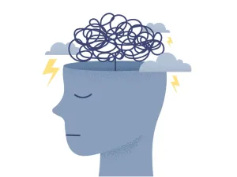
1. Realizing the prevalence of trauma
In 1996, the World Health Organization declared violence a major public health issue.
>10 million living in relationships involving domestic violence.
Over 400,000 sexual assaults in persons aged ≥12 and 60,000 children/year.
19 million U.S. military veterans; ~2-4 million combat-exposed.
Approximately 4.8 million people seriously injured in automobile collisions/year.
>5 million ICU admissions/year.
Notes:
https://pubmed.ncbi.nlm.nih.gov/12384003/
https://ncadv.org/STATISTICS
Department of Justice, Office of Justice Programs, Bureau of Justice Statistics, Female Victims of Sexual Violence, 1994-2010 (2013); ii. National Institute of Justice & Centers for Disease Control & Prevention, Prevalence, Incidence and Consequences of Violence Against Women Survey (1998). (This statistic presents information on the total number of male and female victims in the United States, using a study from 1998. Because the U.S. population has increased substantially since then, it is probable that the number of victims has as well. RAINN presents this data for educational purposes only, and strongly recommends using the citations to review any and all sources for more information and detail.)
Pew Research Center (2021). April 5, 2021. The changing face of America’s veteran population. https://www.pewresearch.org/fact-tank/2021/04/05/the-changing-face-of-americas-veteran-population/
National Safety Council
. https://www.nsc.org/newsroom/motor-vehicle-deaths-2020-estimated-to-be-highest

Slide 7
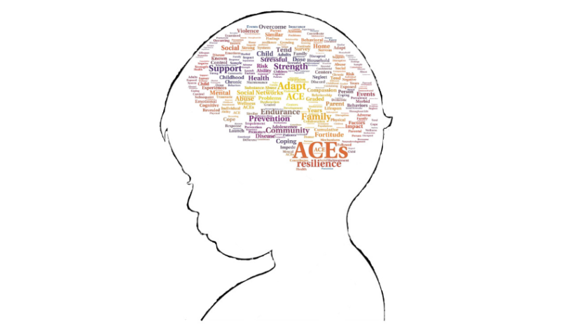
Adverse Childhood Experiences (ACEs)
Developed by Vincent Felitti and Robert Anda at Kaiser Permanente in the 1980’s.
Based on observations from their obesity clinic – high incidence of child sexual abuse in persons trying to lose weight.
Revealed high incidence of ACEs among persons in their primary care clinics.

Slide 8
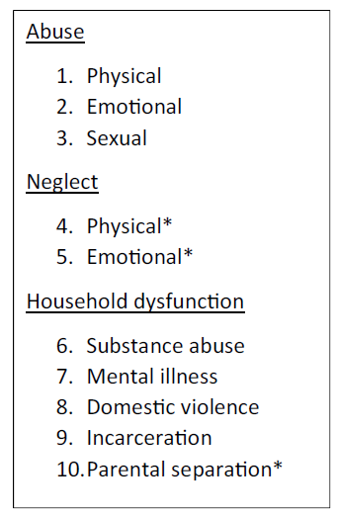
ACE items
Notes:
*Indicates the 3 ACEs which were added during Wave 2 of data collection for the original ACE study by Felitti et al.

Slide 9
ACEs among children in Hawaii
2018-2019 National Survey of Children’s Health
Notes:
Child and Adolescent Health Measurement Initiative (CAHMI), Data Resource Center for Child and Adolescent Health, 2018-2019 National Survey of Children’s Health Interactive Data Query, (www.childhealthdata.org)

Slide 10
Adult ACEs – Hawaii 2015 BRFSS
Notes:
42.0% had no ACEs, 22.6% had one, 11.2% had two, 8.4% had three, and 15.8% had four or more ACEs

Slide 11
2. Recognizing how trauma affects people
ACEs studies: High associations with ACEs and morbidity/mortality.
4+ ACEs higher morbidity in almost every domain measured.
6+ ACEs associated with higher premature death.
1000’s of ACE studies replicated these findings.

Slide 12
Effects of trauma on health
Allostatic load – disruption of normal balance of CNS, endocrine, metabolic, immune systems
Associated with many chronic conditions – CVD, metabolic disorders, cognitive function
Epigenetic alterations
Methylation, telomere length
Social determinants of health
Worse in persons with trauma history – lower income and downstream effects
PTSD and long-term health and life-course consequences

Slide 13
Impact of ACEs on adult health
Notes:
There was a graded relationship of females reporting more ACEs than males; at each ACE level, females were more likely to have that many ACEs and that likelihood was higher at higher ACE levels. While non-white race/ethnicity, low education, and low socioeconomic status were all significantly associated with reporting an ACE (compared to not reporting an ACE), the graded re-lationship at higher levels was not evident.

Slide 14
Impact of ACEs on adult health
Notes:
Petruccelli, K., Davis, J., & Berman, T. (2019). Adverse childhood experiences and associated health outcomes: A systematic review and meta-analysis. Child abuse & neglect, 97, 104127.

Slide 15
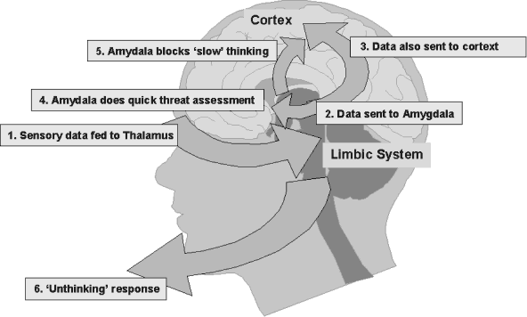
Realizing the impact of trauma on the brain
Acute impacts
Notes:
The Amygdala Bypass System
Six steps to unthinking response
1. Sensory data fed to thalamus
All sensory data (except, curiously, for the sense of smell) is sent by the body first to the thalamus, which acts like a switchboard, sending it to the relevant part of the brain.
2. Data sent to amygdala
The thalamus sends the data both to the relevant part of the cortex and also to a small part of the mid-brain called the amygdala.
3. Data also sent to cortex
When the information is sent to the cortex, we, of course, think about it. The problem is, that sometimes there is no time to think -- in fact too much thinking can sometimes leave you dead.
4. Amygdala does quick threat assessment
The senses are compared in the amydala with our stored fear responses. If any of these are triggered, then the amygdala has to act quickly.
5. Amygdala blocks 'slow' thinking
If the fear response is triggered, then the amygdala floods the cortex with chemicals to stop it taking over. Amygdala stimulates the hypothalamus to produce corticotropin releasing factor which signals the pituitary and adrenal glands to flood the bloodstream with the stress hormones epinephrine, norepinephrine and cortisol. These stress hormones shut down regular body systems and directs the body’s resources toward fighting or fleeing [or freeze]. The heart pounds, the lungs pump and the muscles get a burst of glucose. In the brain, a sense of heightened alertness occurs.
6. Unthinking response
The result is that we act without conscious thought.
(Carter, 2000; Cowley, et al., 2003).
This alternate brain pathway came about by our earliest survival needs. As one researcher puts it, “Conscious thought…is far too slow to beat the leopard” (Lisak, 2002).
Carter, R. (2000), Mapping the Mind, University of California Press.
Cowley, G., Murr, A., Carmichael, M., Scelfo, J., Rosenberg, D., Jefferson, D., Figueroa, A., & Friess, S. (2003). Our bodies, our fears. Newsweek, February 24, 2003.
Lisak, D. (2002). The neurobiology of trauma. Unpublished article.

Slide 16
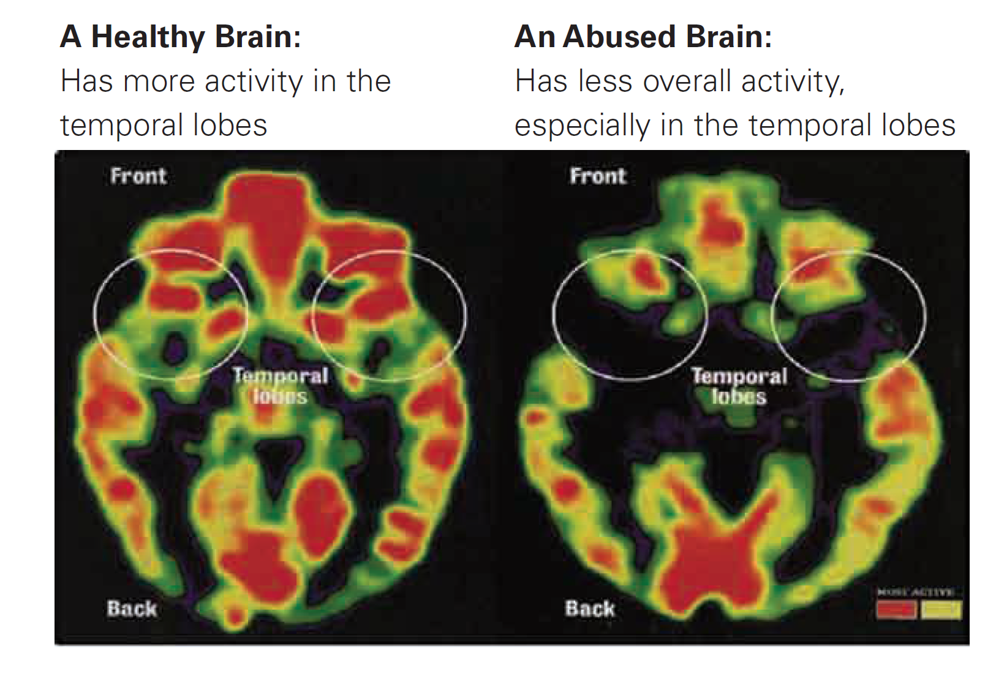
Realizing the impact of trauma on the brain
Chronic impacts
Notes:
Temporal lobes are most commonly associated with processing auditory information and with the encoding of memory. The temporal lobes are also believed to play an important role in processing affect/emotions, language, and certain aspects of visual perception.

Slide 17
Realizing how trauma exposure impacts YOU
Vicarious traumatization, compassion fatigue, burnout
Peer support
Connections
Self-care
Notes:
https://www.tachc.org/Online/Strengthening-Health-Centers/Value--Based-Person--Focused-Care.aspx?hkey=c5d12d48-47bd-4ae4-8d9d-a086c92f880a#tic
Texas Association of Community Health Centers

Slide 18
3. Responding with policies, procedures, practices, and settings that prevent further trauma
ALL staff applying the 6 principles of TIC, ALL day, EVERY day, with ALL patients

Slide 19
Safety
Be attuned to body language that suggests they feel unsafe (e.g., fidgeting, poor eye contact, inattention)
Assure patients you are there for them
Ask what you can do to help them feel safe
Have a plan if they disclose unsafe life situations

Slide 20
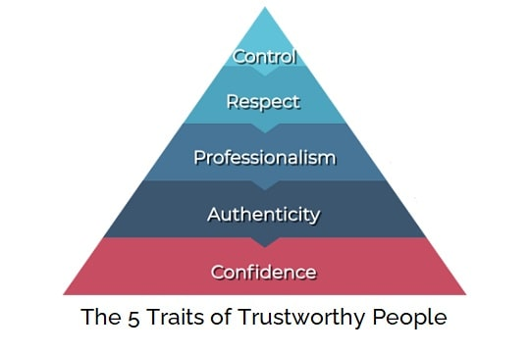
Trustworthiness & transparency
Follow through with care you recommend
Include patient in treatment plans (no surprises!)
Notes:
Image: https://www.crestcomsocal.com/articles/leadership-development/trust

Slide 21
Peer support
Refer patients to support groups, recovery coaches as appropriate
Permit patients to have a support person at appointments
Notes:
Image: http://www.inkwellworkshops.com/news-posts/2020/9/14/the-power-of-peer-support

Slide 22
Collaboration & mutuality
Engage patients in discussions about treatment options as an expert in their own health
Notes:
Image: https://blog.jostle.me/blog/why-collaboration-is-important

Slide 23
Empowerment, voice, & choice
Provide patients with information about their healthcare choices and what consequences might be if they do or do not accept recommendations (without judgment)
ASK patients what they think is best for them
Provide choices whenever possible
Notes:
Image: https://articles.bplans.com/methods-to-grow-your-business/

Slide 24
Cultural, historical, & gender issues
Understand that culture influences the interpretation and meaning of traumatic events and the acceptability of symptoms, support, and help-seeking behaviors
Provide a calm environment: quiet, soothing colors, views of nature, clear and linguistically appropriate signage, space, confidential
Notes:
Image: https://traumainformedoregon.org/a-focus-on-the-trauma-informed-principle-cultural-historical-and-gender-issues/

Slide 25
4. Resisting re-traumatization
Don’t assume you know a person’s cultural influences based only on observable qualities
Don’t shame patients for not doing following your recommendations
Don’t label them (aka, “non-compliant,” “refused treatment,” “frequent flyer”)
Don’t forget to include them in all decisions about their care
Don’t make assumptions – ask them

Slide 26
Case study
Adapted from Gerber, M. R. (Ed.). (2019). Trauma-informed healthcare approaches. Springer.
Visit 1
Mr. J, 56 yo Black male, complaint of headaches
Preferred evening clinic – less people
Came with his wife
HA “sharp,” “severe,” “blinding” over 4 years, getting worse, back of head worst
Old large surgical scar at nape of neck with hardened nodule/object at base
“It’s a bullet, doc.”
Most talking done by wife who states he’s had HA since his “accident” – “We’ve been to a lot of doctors and no one really gives him a chance.”
Patient says, “I don’t want no problems…just give me my pills and I’ll leave.”
HCP encourages him to stay for further evaluation, patient jumps off the table and leaves

Slide 27
Case study
Follow-up visit
Mr. J comes in alone, ready to talk about the “accident”
He and his friend were driving in his friend’s new car – neighbors accused them of “flossing” (showing off)
Two men ran up and shot him and his friend “execution style” and ran off
His friend didn’t make it
He was in hospital over a month and “messed up” for a while after that
Has occasional nightmares still
Still lives in same neighborhood but doesn’t go out much anymore

Slide 28
Case study
Next several visits
Mr. J comes with his wife to evening clinic
Agreed to have medical records released to clinic
Agreed on a course of tramadol and ibuprofen
Arranged for removal of bullet that was still in his neck – Mr J. surprised “no doctor every did anything” for him
Finally agreed to take antidepressants, continues to decline counseling

Slide 29
Contact
Nancy Downing
downing@tamu.edu

