Slide 1
Physical and Social Determinants of Health: Why they matter for autistic children
Lindsey Sneed, PhD, BCBA-D, LBA Vice President Clinical Excellence, Catalight
Brianna Fitchett, MA, BCBA,LBA Vice President of Remote Care and Program Design, Catalight

Slide 2
No disclosure

Slide 3
Learning Objectives
Attendees will be able to:
Name three medical comorbidities commonly seen in people with Autism Spectrum Disorder (ASD) and Developmental Disabilities (DDs)
Describe what Social Determinants of Health (SDOH) are and why they are important
List three Social Determinants of Health (SDOH)
Name two ways that Social Determinants of Health (SDOH) can impact a patient's ability to benefit from behavioral therapy

Slide 4
Behavioral
Individual Behavior
BHT
Overall Health
Multiple Factors Impact Health
Feature Name
Physical
Social
These are scientific commentaries; but the commentaries of the
These are scientific commentaries; but the commentaries of the
Genetics
Healthcare
Physical Env
Social Env
Feature Name
Feature Name
These are scientific commentaries; but the commentaries of the
These are scientific commentaries; but the commentaries of the
Notes:
Brianna

Slide 5
Behavioral
Individual Behavior
BHT
Overall Health
Multiple Factors Impact Health
Feature Name
Physical
Social
These are scientific commentaries; but the commentaries of the
These are scientific commentaries; but the commentaries of the
Genetics
Healthcare
Physical Env
Social Env
Feature Name
Feature Name
These are scientific commentaries; but the commentaries of the
These are scientific commentaries; but the commentaries of the
Notes:
Brianna

Slide 6
ASD Population has a Shorter Lifespan
Accompanying mental and physical health conditions
Difficulty recognizing and communicating symptoms makes diagnosing comorbidities challenging
Physical discomfort may prompt spikes in self-soothing repetitive behaviors, irritability, aggression, self-injury, etc.
Difficult to determine whether behaviors are related to ASD or a physical condition causing discomfort.
Notes:
Brianna

Slide 7
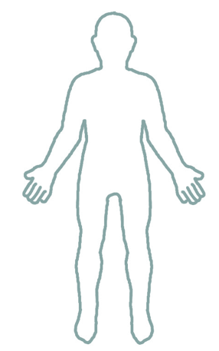
Autism’s Clinical Companions
Epilepsy — 25-40%. Look for repeated, unexplained abrupt changes in behavior such as staring spells, stiffening muscles, involuntary jerking of limbs, or sudden sleepiness or sleep disturbance.
Sleep Disorders — 50-80%. It impacts parents too! Direct impact on daytime behaviors, affecting the quality of life for the entire family. Genetics, medication, and anxiety can all play a role in sleep disturbance.
GI Disorders — up to 85%! Arching back, pressing belly, or gritting teeth. GERD might strain the neck, push out the jaw, tap the throat, avoid lying down, experience sleep disruption, or refuse food.
Feeding/Eating Challenges — 70%. Caused by sensory issues, anxiety, medication side effects, social isolation, and activity level can all be underlying factors.
Obesity — 30%. Poor sensitivity to satiety and aversion to strong flavors/textures leads to overconsumption of calorie-rich, low-nutrient foods. Medications can also cause an increase in appetite.
Notes:
Lindsey
Epilepsy/seizures (25-40% incidence vs 2-3% in gen pop, repeated, unexplained abrupt changes in behavior such as staring spells, stiffening of muscles, involuntary jerking of limbs, or sudden sleepiness or sleep disturbance)
Sleep disorders/disturbance (50-80%...and therefore their parents, Sleep issues go hand in hand with daytime behaviors and affect quality of life for the entire family. Genetics, medication, and anxiety can all play a role in sleep disturbance.)
Gastrointestinal disorders (up to 85%!, arching back, pressing belly, or gritting teeth. GERD might strain the neck, push out the jaw, tap the throat, avoid lying down, experience sleep disruption, or refuse food)
Feeding/eating challenges (Sensory issues, anxiety, medication side effects, social isolation, and activity level can all be underlying factors)
Obesity (30%, 13% in gen pop)
ADHD, Anxiety, Depression, Bipolar disorder

Slide 8
Like asthma, you don’t cure autism
Diagnose, teach parents how to adapt parenting and environment
Self-manage & self-advocate
Notes:
Lindsey

Slide 9
Non-Accidental Trauma (NAT)
Notes:
Lindsey

Slide 10
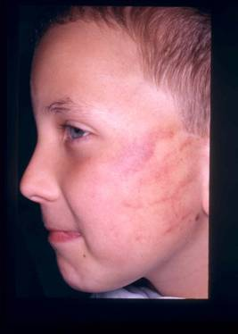
NAT: Background & Incidence
Child abuse and neglect is reported in 3% to 10% of the population with disabilities (3x of typically developing population, likely higher)
Intellectual and communication challenges make ASD/DD population easy targets
Children with milder forms of disability are at higher risk of abuse and neglect than more profoundly affected children.
In children >3 years, almost 50% investigated by child protective services (CPS) were not typically developing.
Adverse childhood experiences, including child abuse and neglect, cause physiologic disruptions that can persist into adulthood and lead to lifelong poor physical and mental health.
Notes:
Lindsey
“Conceptually, we can hypothesize that children with minor impairment are at greater risk because they have a complicated mix of dysfunctionality and functionality. Their dysfunctionality increases the probability that they will act in a way that elicits a negative reaction from parents, while their functionality increases their parents’ expectations of them and increase their ability to take actions that may frustrate their parents.”

Slide 11
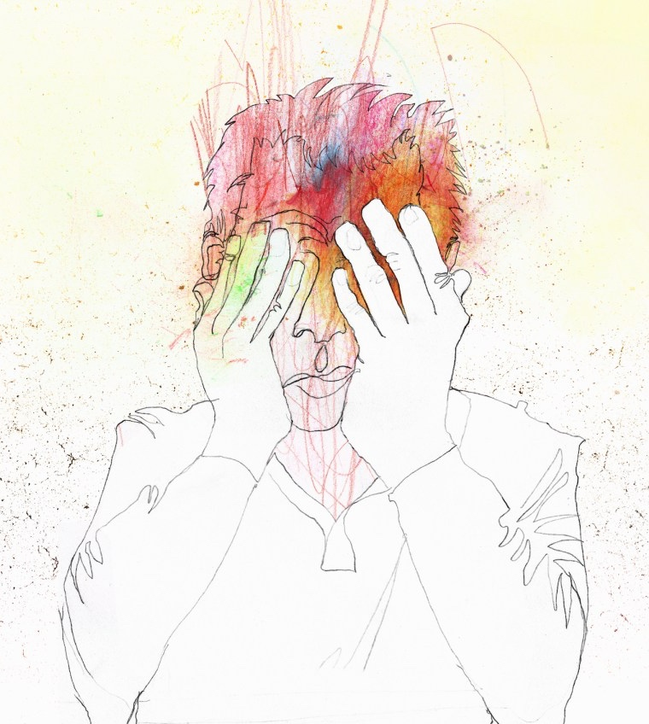
NAT: Parenting a Child With Disabilities is Often Challenging
Families may experience increased stress with higher emotional, physical, economic, and social demands.
Some children with disabilities may not respond to traditional means of reinforcement, and sometimes their behaviors (aggressiveness, noncompliance, and communication problems) can cause caregiver frustration.
Behavioral challenges coupled with increased stress can increase the risk of physical abuse by children’s caregivers.
Notes:
Lindsey/Brianna

Slide 12
NAT: Our Role in Prevention
Parents of children with intellectual or communication problems may sometimes turn to inappropriate physical punishment because of frustration about what they perceive as stubbornness or intentional failure to respond to verbal guidance.
Inappropriate expectations and ignorance of challenges a child with a disability might face can be linked to a higher risk for maltreatment.
Coach parents to have reasonable expectations that are appropriate for the disability and the developmental status of the child. Parents should work with behavior therapists to set meaningful and reasonable goals.
Notes:
Teaching parents stress management strategies in their treatment – Lindsey

Slide 13
Behavioral
Individual Behavior
BHT
Overall Health
Multiple Factors Impact Health
Feature Name
Physical
Social
These are scientific commentaries; but the commentaries of the
These are scientific commentaries; but the commentaries of the
Genetics
Healthcare
Physical Env
Social Env
Feature Name
Feature Name
These are scientific commentaries; but the commentaries of the
These are scientific commentaries; but the commentaries of the
Notes:
Brianna

Slide 14
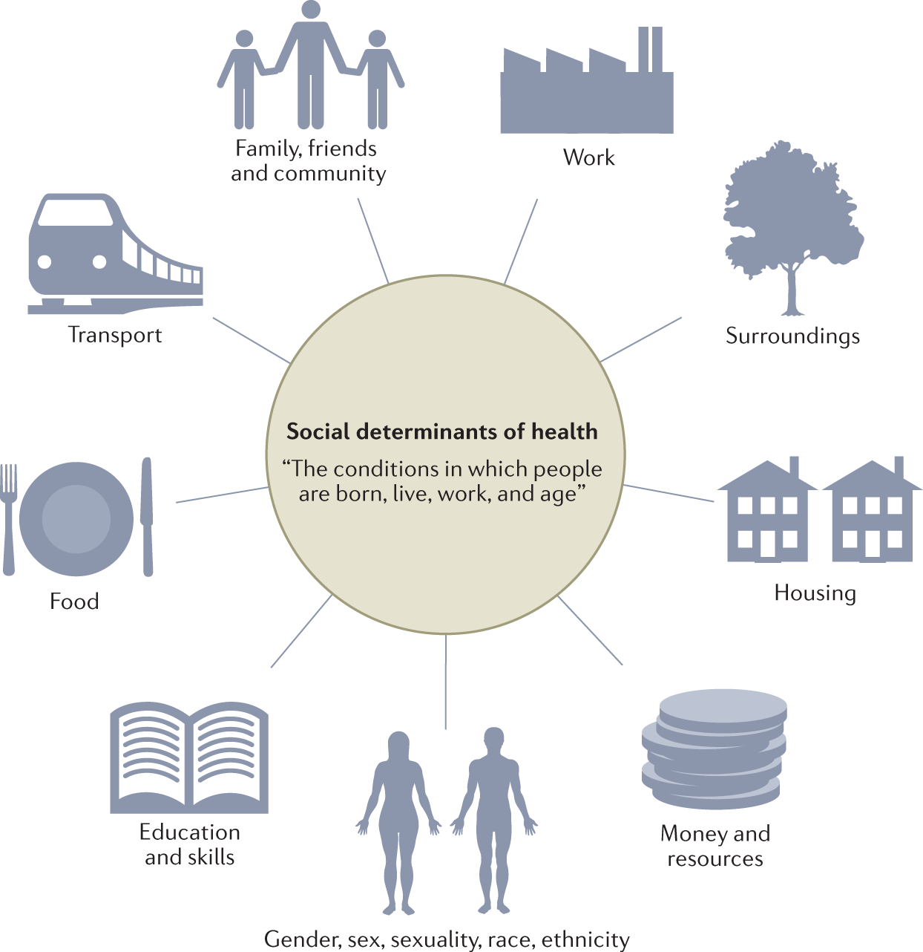
Social Determinants of Health
Feature Name
These are scientific commentaries; but the commentaries of the
These are scientific commentaries; but the commentaries of the
Feature Name
Feature Name
These are scientific commentaries; but the commentaries of the
These are scientific commentaries; but the commentaries of the
Notes:
Brianna

Slide 15
Health Literacy
Literacy*
21% of US adults are have low/no literacy
54% of adults have <6th grade level literacy
California has the lowest adult literacy rate (PIACC 2012-2017)
Health Literacy: The degree to which individuals have the ability to find, understand and use the info and services to inform health-related decisions and actions for themselves and others
Understanding child’s treatment & Advocating for child’s needs
*https://www.thinkimpact.com/literacy-statistics/
Notes:
Brianna
Checking for understanding
Materials are at 6th or below reading level
Using visuals
For patients
Not using metaphors and idioms – common language
Allowing a lot of processing time – longer pauses

Slide 16
Housing Instability & Invisible Homelessness
October 2022
Homeowners: 5.3 million households are behind on their mortgage payments, >40% have annual household income <$50,000.
Renters: 13%, >7.7 million people were behind on rent.
Rent burdened
Eviction
Overcrowding
Violence
Family tensions/separations
Couch surfing
Trades for places to stay
Cars
https://health.gov/healthypeople/priority-areas/social-determinants-health/literature-summaries/housing-instability
https://www.samhsa.gov/practitioner-training
Notes:
Brianna

Slide 17
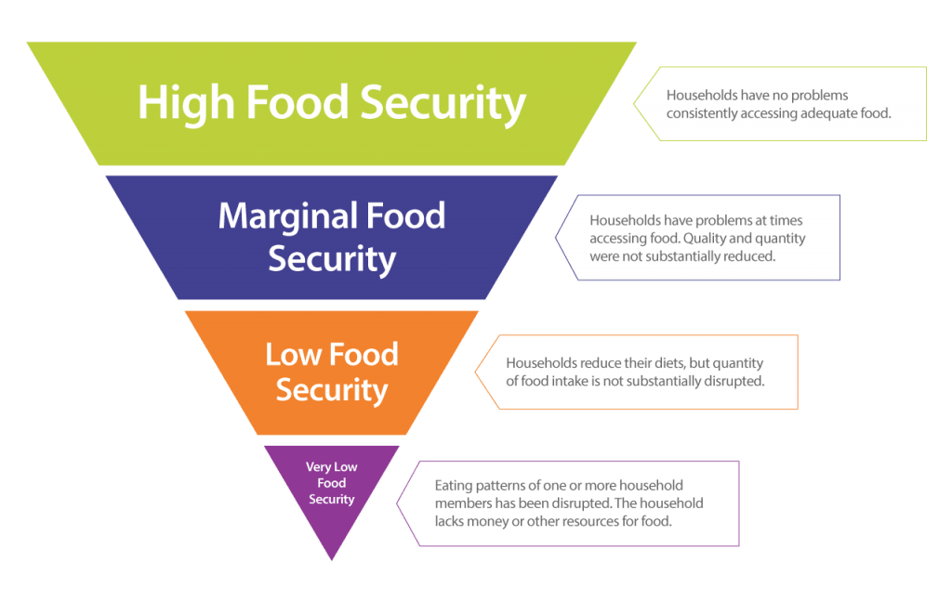
Feeding America estimated that 42 million people (1 in 8), including 13 million children (1 in 6) experienced food insecurity in 2021
Food
Insecurity
Feature Name
These are scientific commentaries; but the commentaries of the
These are scientific commentaries; but the commentaries of the
Feature Name
Feature Name
These are scientific commentaries; but the commentaries of the
These are scientific commentaries; but the commentaries of the
https://www.mtm-inc.net/sdoh-and-the-impact-of-food-insecurity/
Notes:
Brianna – example families asking for goals around food preferences.
Lindsey - Weight loss eating disorder vs food access

Slide 18
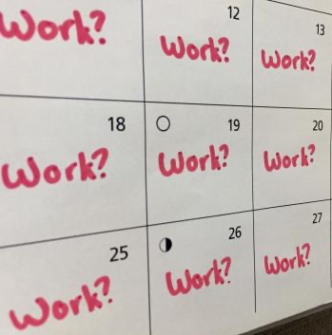
Financial Insecurity
Doctors
Medication
Therapy
Food
Housing
Caregivers
Notes:
Tie back to stress

Slide 19
Takeaways
Physical / Social factor | What we can do
Physical wellness | Ensure child makes their well child check ups
 | Think about physical causes for behavior
 | Identify risk of abuse, parent/caregiver stress
Health literacy | Don’t use jargon
Housing | Communicate with the rest of the child’s medical and behavioral team Refer to social worker if available or other community resources
Food
Financial problems
Notes:
Talk to each other – resources highlighted on the last call example

Slide 20
Question 1
What is a medical comorbidity commonly seen in people with Autism Spectrum Disorder (ASD and Developmental Disabilities (DDs)?
Cardiac Disease
Sleep Disorders
Asthma
Type 1 Diabetes

Slide 21
Question 2
Child abuse occurs at a higher rate for children with disabilities.
True
False

Slide 22
Question 3
It is not important to support the increase of health literacy with patients and caregivers.
True
False

Slide 23
Question 4
Homelessness doesn’t affect treatment if a child/caregiver can make their appointments.
True
False

Slide 24
Thank you.
Lindsey Sneed, PhD, BCBA-D, LBA Vice President Clinical Excellence, Catalight
Brianna Fitchett, MA, BCBA, LBA Vice President of Remote Care and Program Design, Catalight

