Slide 1
Carl Barton
Principal and Founder of Derigo Health
Executive Healthcare Consultant
Blair Grant
RN, MSN, FNP-BC, APRN-Rx
Clinical Transformation Consultant

Slide 2
Objectives
Describe the general components of a care team deployed in Hawaii primary care practices and
Describe how the team operates as integrated primary care
Understand how the team supported patients with chronic diseases (such as hypertension & diabetes) to navigate life stressors and crises and stress related health issues
Describe how the team led patients to become more engaged in their care, self-management, and shared decision-making

Slide 3
AMA Behavioral Health
Behavioral health generally refers to mental health and substance use disorders, life stressors and crises, and stress-related physical symptoms. Behavioral health care refers to the prevention, diagnosis and treatment of those conditions.
What is behavioral health? | American Medical Association (ama-assn.org)

Slide 4
Chronic Disease & Behavioral Health
Milaneschi Y, Simmons WK, van Rossum EF, Penninx BW. Depression and obesity: evidence of shared biological mechanisms. Molecular psychiatry. 2019;24:18-33.
Meng L, Chen D, Yang Y, Zheng Y, Hui R. Depression increases the risk of hypertension incidence: a meta-analysis of prospective cohort studies. Journal of hypertension. 2012;30:842-851.
Egede LE. Effect of comorbid chronic diseases on prevalence and odds of depression in adults with diabetes. Psychosomatic Medicine. 2005;67:46-51.
Carney RM, Freedland KE. Depression and coronary heart disease. Nature Reviews Cardiology. 2017;14:145-155.
Depression is associated risk factors for chronic cardiometabolic conditions (i.e., obesity, hypertension)^{1,2}
Increasing number of comorbid chronic conditions was associated with increased odds of depression³
Individuals with CVD are more likely to develop depression compared to those without CVD⁴
Individuals with a history of depression are more likely to develop incident CVD compared to those without depression⁴

Slide 5
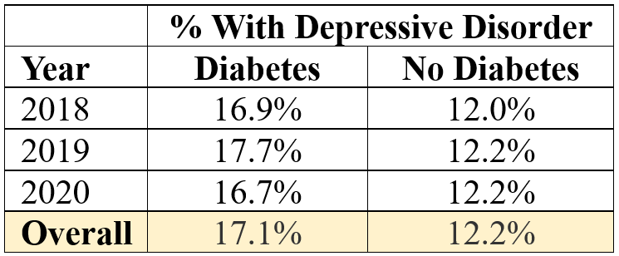
Proportion of Hawaii residents with Depression by Diabetes Status
SOURCE: Hawaii Health Data Warehouse
Notes:
List and physician control
Accurate Blood Pressure Reading:
Training and education materials
2 readings one minute apart
Report time of day
Transmitted to Health Coach Coordinator
Omron 3 Series BP 7100 (https://www.validatebp.org/)
Patient Dashboards
Graphical displays
2 weeks of daily averages with time of day and med adherence
21 days of 7-day averages
Office BPs – baseline and most recent
Patient Panel Dashboard
PHYSICIAN
Leads the Care Team
Selects/refers patients
Letter comes from the physician
Pre-authorizes and/or approves medication changes
JO ENROLLS
Endowment effect
Best practice-based methodology
Scripts
Established workflows
Training

Slide 6
Physician-led team-based care compared to standard care among patients with diabetes
Meta-analysis published 2019
SOURCE: Levengood TW, Peng Y, Xiong KZ, Song Z, Elder R, Ali MK, Chin MH, Allweiss P, Hunter CM, Becenti A. Team-based care to improve diabetes management: a community guide meta-analysis. American journal of preventive medicine. 2019;57:e17-e26.
Associated with greater reductions in
blood glucose levels,
blood pressure, and
lipid levels
Most care teams included the patient, a primary care physician and 1-2 additional members and members were most often nurses (RNs and NPs) or pharmacists
Greater reductions when team included a pharmacist
Improved results with active communication among team compared to passive communication

Slide 7
Care Team
and
Patient Cases

Slide 8
Chronic Disease
Uncontrolled Hypertension
Chronic Inflammation
Leilani
Behavioral health considerations
Work and life stressors
Divorce, joint custody of children
Caring for father on dialysis
Grieving mother’s death
Crisis projects at work, long hours
Frequent illness: rash, allergies, bronchitis
Additional Considerations
Lack of time for self care and healthy socialization
Stress eating, food intake consisting of fast food and take out
Under care of a psychologist and rheumatologist
Notes:
Leilani Feedback (what was the patient’s feedback on their experience with the H2c)
There is no time to exercise
It is more expensive and time consuming to eat healthy
“I love being happy”
Jon Feedback
I will be frail and dependent
Healthy food doesn’t taste good
Medications damage internal organs
I don’t have enough willpower

Slide 9
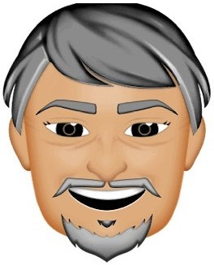
Chronic Disease
Uncontrolled Hypertension
Diabetes, Type 2
Behavioral health considerations
John
Pessimistic about health
Lack of purpose, meaning
Lack of healthy socialization
Multiple friends passing from heart disease
Some ROM limitations to exercise
Notes:
Leilani Feedback (what was the patient’s feedback on their experience with the H2c)
There is no time to exercise
It is more expensive and time consuming to eat healthy
“I love being happy”
Jon Feedback
I will be frail and dependent
Healthy food doesn’t taste good
Medications damage internal organs
I don’t have enough willpower

Slide 10
Care Team Members
Physician
Health
Coach
Coordinator
Clinical
Pharmacist
Notes:
Deleted slide 8 and contents below become talking points
Evidence-basis
Patient Population
Patient Feedback Survey
Analysis
Presentation & appendix has subset of analysis
Upcoming whitepaper includes additional analysis

Slide 11
A Care Team Goal
Non-Clinical
expand capability to simultaneously identify & address
Clinical
DRIVERS OF HEALTH OUTCOMES
Notes:
Very simple way to explain the vast roles that a care team can provide- I like this.
The focus of Derigo’s approach is to increase use of multidisciplinary care teams to address patients' social services and support needs and improve the management and treatment of hypertension and high cholesterol.

Slide 12
A Care Team Goal
Pharmacologic intervention
Lifestyle modification
prevent and treat chronic cardiometabolic diseases
WITH MEDICAL & SOCIAL SUPPORT
Notes:
Very simple way to explain the vast roles that a care team can provide- I like this.

Slide 13
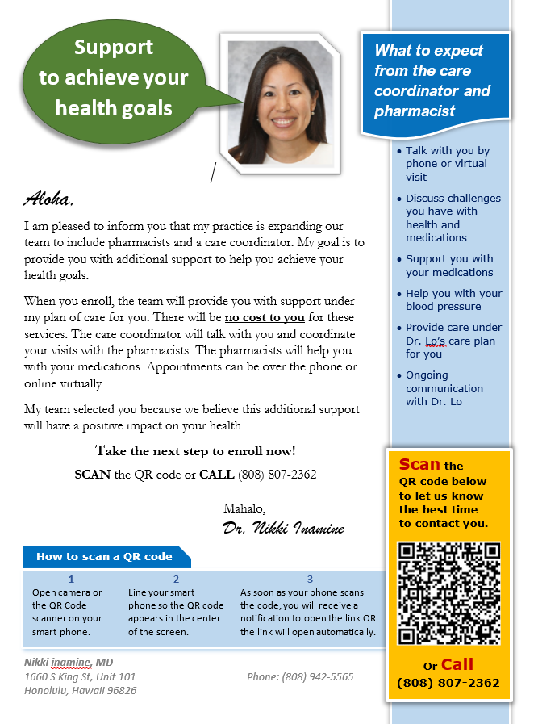
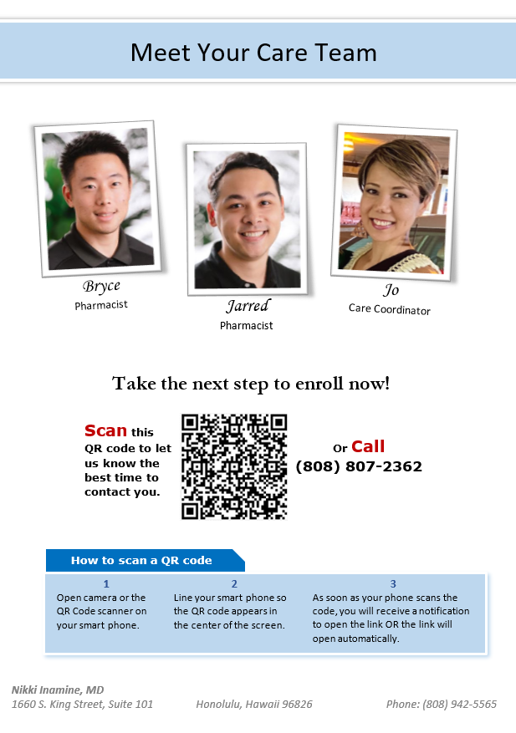
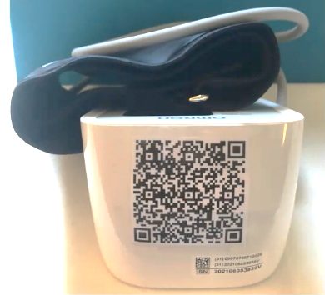
Patient Outreach & Enrollment
Nikki Inamine, MD
1660 S King St, Unit 101
Honolulu, Hawaii 96826
John Doe
2333 Kapiolani Blvd.
Honolulu, Hawaii 96826
Notes:
List and physician control
Accurate Blood Pressure Reading:
Training and education materials
2 readings one minute apart
Report time of day
Transmitted to Health Coach Coordinator
Omron 3 Series BP 7100 (https://www.validatebp.org/)
Patient Dashboards
Graphical displays
2 weeks of daily averages with time of day and med adherence
21 days of 7-day averages
Office BPs – baseline and most recent
Patient Panel Dashboard
PHYSICIAN
Leads the Care Team
Selects/refers patients
Letter comes from the physician
Pre-authorizes and/or approves medication changes
JO ENROLLS
Endowment effect
Best practice-based methodology
Scripts
Established workflows
Training

Slide 14
John & Leilani’s care team supported journey
social needs
and
SDOH
healthy habits
curiosity
accountability
engagement
and
health literacy
empowered to prioritize needs & health
Notes:
What current practices due to enact behavior change vs what a small care team can do to enable behavior change
Patient is put back into the center of care, provided with the resources needed to be able to be apart of the shared decision making team- the patient is an equal team member.
When a provider can come into an office visit with a patient that is committed to their healthcare (they want to and are prioritizing themselves), a patient who is willing a curious about improving their health, it makes it a more pleasurable experience instead of a lecturing at the patient the provider is able to have an engaging conversation where a shared decision can be made as a team (HHC + Provider + PT + CP) to affect real changes
Takes the burden off of the provider- eliminates decision making fatigue
More engaged patients who care about their health come to see a provider because they "want to" compared to they "have to" dialogue shift
John/Gina- did they feel as thought they were apart of the team that was making decisions about their care plan/health plan?

Slide 15
Patient Role What is the responsibility of the patient?
Understand role in lifestyle change
Nutrition
Physical activity
Prioritize health
Ask questions
Take medications as prescribed
Stress management
Sleep quality
Healthy relationships
Keep medical appointments
Measure and monitor health data
Complete recommended screenings
Get immunized
Understand healthy change takes time
Create healthy habits
Start with baby steps
Improve health metrics
First link in
team-based care
Connect health to
what matters most
Improve health literacy

Slide 16
Health Coach Coordinator (H2c)
listening
with curiosity and empathy
identifying
what matters, challenges & strengths
facilitating
creation of SMART goals
Addressing challenges & celebrating wins!
together
Notes:
HHC how has Jo's training as a HC positioned her to be the best fit for this role?
Behavior change – Motivational interviewing, strength based coaching, active listening, SMART goal with follow up and accountability/support
Providers have the skill set to do this type of work but often can not due to the constraints of time, behavior change is more effective when we can understand a patient better- one of the reasons of burn out is just lack of time to make effective change
HCC provides necessary information to the provider to the provider about the patient which then enables shared decision making without the provider having to spend a significant amount of time gather all this information
Where there any barriers to being able to have the patient open up and share to Jo?
Remote vs. Inperson
Accountability and make pt feel like they are being heard (often not enough time in an office visit for the provider to ask open ended questions, and for the patient to fully express themselves)
**Questions that Jo will organically ask Gina and John

Slide 17
Clinical Pharmacist (CP)
medication
medication therapy management
clinical partner
for health coach
disease-related education
lifestyle change
Improving therapeutic & humanistic outcomes!
together

Slide 18
Patient Feedback
With support, Leilani was empowered to prioritize her own health starting with small achievable “baby” steps.
John appreciated the accountability that the team created for him and appreciated the H2c’s patience with him
Leilani
John
After achieving several small wins, she declared to her H2c, “I love being happy!”
The H2c was an integral part of her health transformation
It was a wake-up call to take better care of himself. At one point, he expressed to the H2c, “the care team’s support saved my life.”
Notes:
Leilani Feedback (what was the patient’s feedback on their experience with the H2c)
There is no time to exercise
It is more expensive and time consuming to eat healthy
“I love being happy”
Jon Feedback
I will be frail and dependent
Healthy food doesn’t taste good
Medications damage internal organs
I don’t have enough willpower

Slide 19
H2c Perspective
The H2c acted as a sounding board for Leilani and asked simple questions to support progress towards her health goals.
John needed support with a change in perspective to restore his hope that when it comes to his health – he has options, and he has control.
Leilani
John
Created a space for her to share authentically, feel comfortable with being vulnerable and to say things out loud instead of internalizing her feelings.
As she reconnected with friends and found ways to make exercise and healthy eating more enjoyable, her fitness, resilience, and quality of life improved.
Education improved his understanding of overall health impact of blood pressure and the role of his medication.
Instead on relying on willpower, H2c worked with John on strategies and tools to help make the healthier choice simple and easier to achieve.
Notes:
Leilani Feedback (what was the patient’s feedback on their experience with the H2c)
There is no time to exercise
It is more expensive and time consuming to eat healthy
“I love being happy”
Jon Feedback
I will be frail and dependent
Healthy food doesn’t taste good
Medications damage internal organs
I don’t have enough willpower

Slide 20
Team-based Care Components
Workforce
&
Resources
Community Resources
Trust & Communication
Measuring and
Evaluating Outcomes
Patient Engagement
Evidence-
basis
Medical Policies
Policies
&
Procedures
Funding & Reimbursement
Integrated Care
Access
Technology
Platforms
Patient Experience
Care Team Autonomy
Care
Protocols
Workflows
Patient Reported Measures &
Outcomes

Slide 21
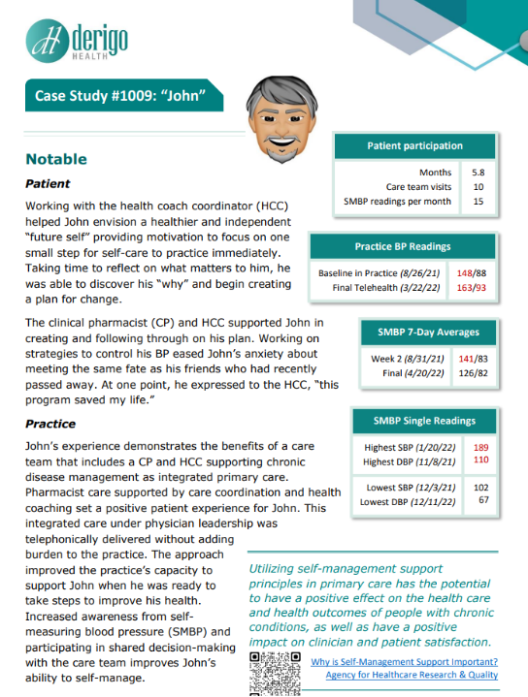
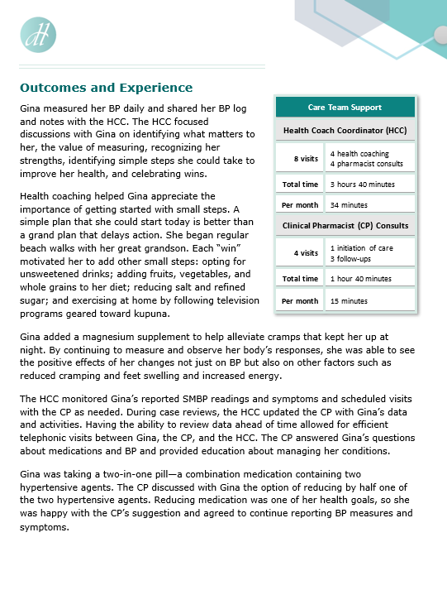
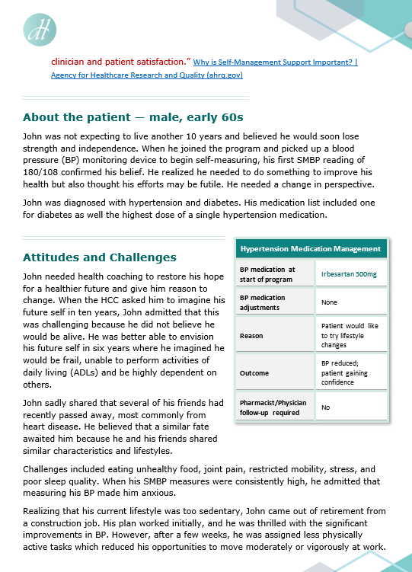
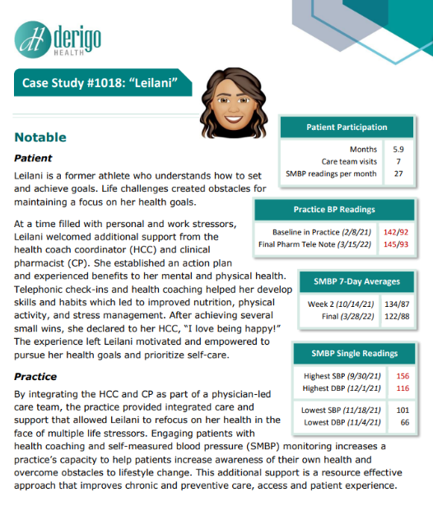
Case Studies
Leilani and John
NOTE: additional available and all case studies included in upcoming whitepaper
e-mail
carl.barton@derigohealth.com
to receive case studies and whitepaper
Notes:
**TRANSITION SLIDE***
Working at the top of their licensee- how was this team with the HHC allowing them to be able to do this?
When a CP + provider work together it allows each clinician to work at the top of their license, CP are not providers and providers are not CP they each have their expertise which when combined can make will create a best outcome for a patient that is on any type of medication.
Most patients have never spoken to a clinical pharmacist before- what has been Jared experience with working with a patient, how does he make them feel comfortable, how does he introduce himself.
How does he best collaborate with a provider while integrating in the patient experience to create a shared decision making model.

Slide 22
State of Hawaiʻi
Department of Health
Chronic Disease Prevention
&
Health Promotion Division (CDPHPD)

Slide 23
Additional Slides

Slide 24
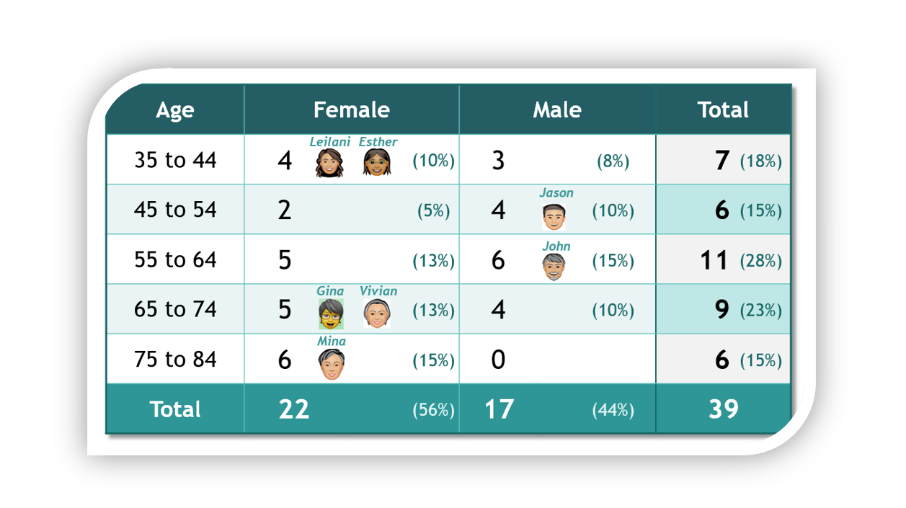
Population

Slide 25
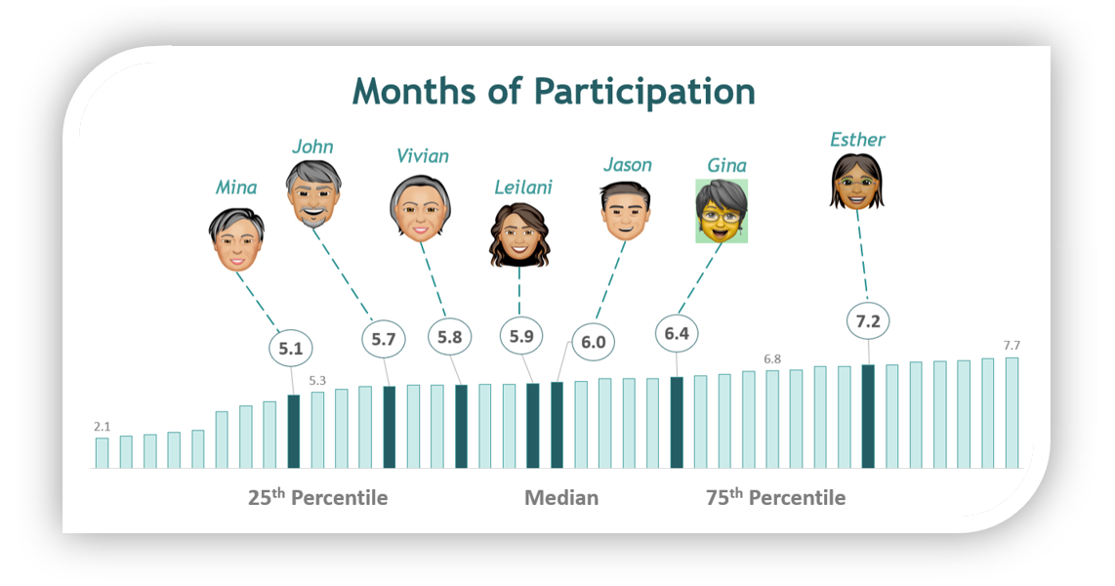

Slide 26
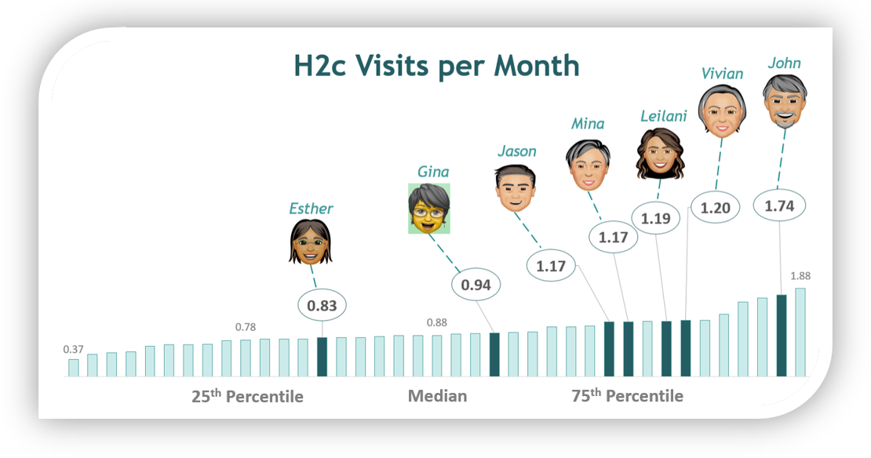
Health Coach Coordinator (H2c)
Joined Clinical Pharmacist (CP) Consults with patient
Scheduled all visits with patients
Gathered information for CP, had case reviews with CP

Slide 27
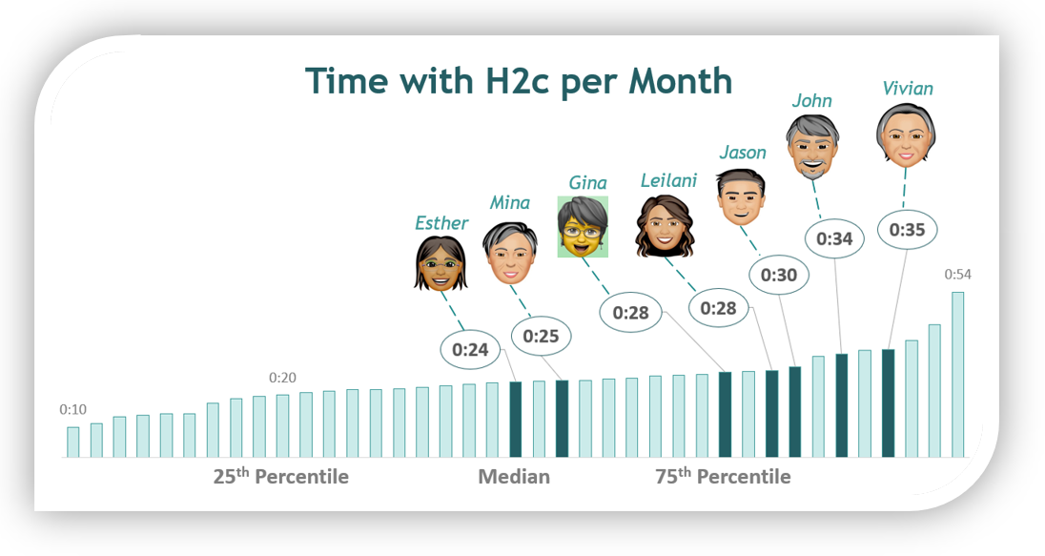

Slide 28
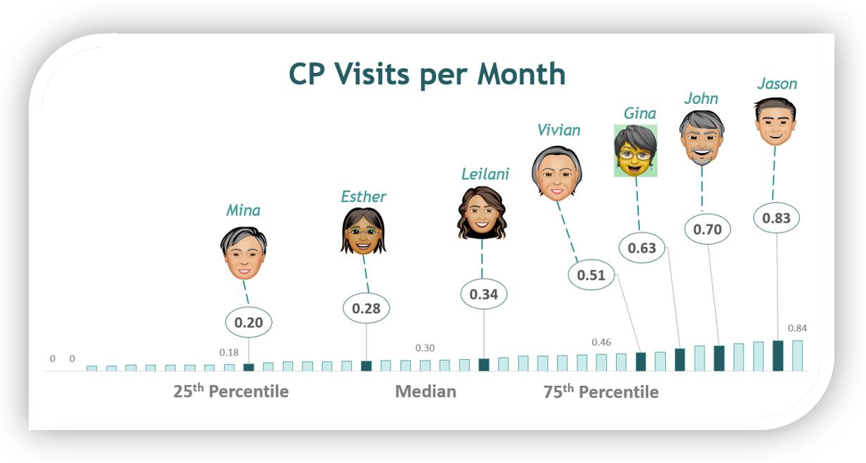
Clinical Pharmacist (CP)
Provided direct care
Medication Therapy Management (MTM)
Comprehensive Medication Management (CMM)

Slide 29
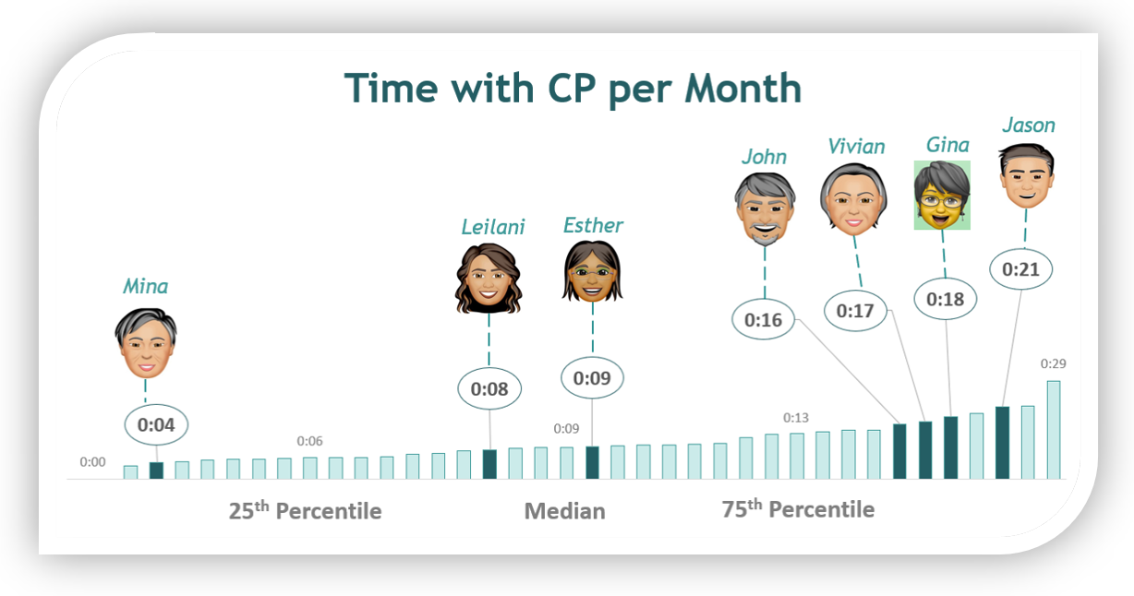

Slide 30
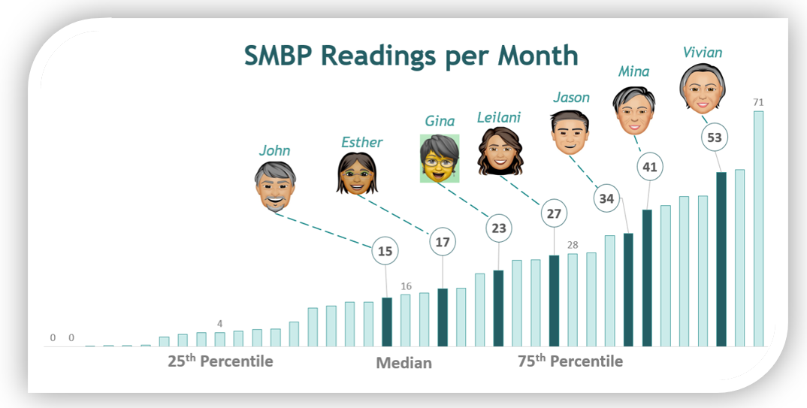
Self-Measured Blood Pressure
Submitted remotely by patients
Engaged patients in self-care and drove accountability
Monitored by H2c and supported health coaching
Supported CP clinical decision making

Slide 31
Preliminary BP Outcomes data still being analyzed, final results may have small variances
patients uncontrolled at baseline (CMS 165 >= 140/90) achieving control
> 70% based on office and telehealth BPs with a clinician
> 85% with a medical policy that measures patient’s remotely submitted BP
With the support of the care team, health risks that indicated rising risk were identified and addressed with 6 patients

Slide 32
Patient Feedback Survey
Likert scale
18 questions
3 domains
Care team
Ability to self manage
Value of SMBP
Open ended feedback
Provide any additional feedback on your experience

Slide 33
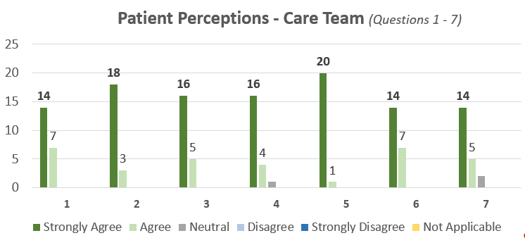
1. | I would recommend my physician’s care team to a friend or family member who has high blood pressure
2. | I was treated with respect, and I felt my opinions mattered
3. | The visits were convenient and fit my schedule
4. | The pharmacist visits were valuable to me
5. | The care coordinator visits were valuable to me
6. | The care team helped me work toward achieving one or more of my health goals
7. | I feel that the care coordinator and pharmacist communicated with my physician about the care I was receiving.

Slide 34
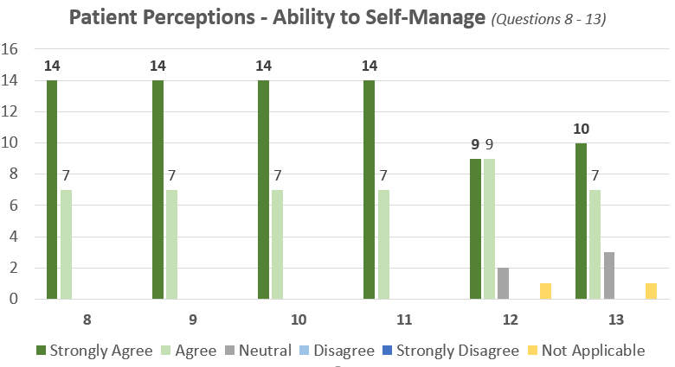
8. | I have a better understanding of my health
9. | I feel I have gained knowledge and skills to improve my health
10. | I feel motivated or empowered to improve my health
11. | I have a better understanding of my role in improving or maintaining my health
12. | I have a better understanding of my medications
13. | I take my medications more consistently

Slide 35
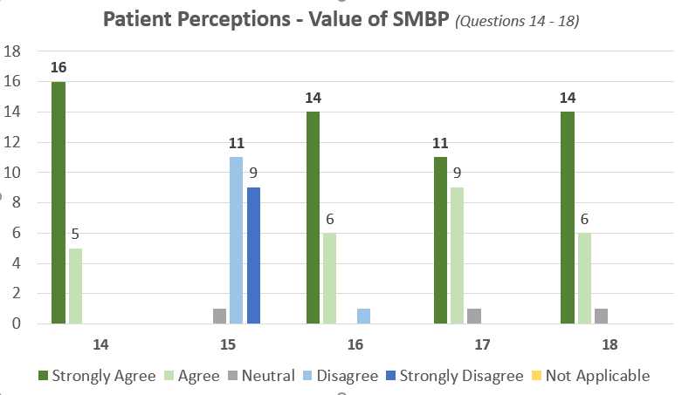
14. | I was provided with everything I needed to measure and report my own blood pressure easily and accurately
15. | Measuring my own blood pressure was upsetting or frustrating to me
16. | Measuring my own blood pressure helped me be more aware of my health
17. | Measuring my own blood pressure motivated me to adopt or continue healthy behaviors
18. | I feel the care team used blood pressure readings I reported to make more informed decisions about my care

Slide 36
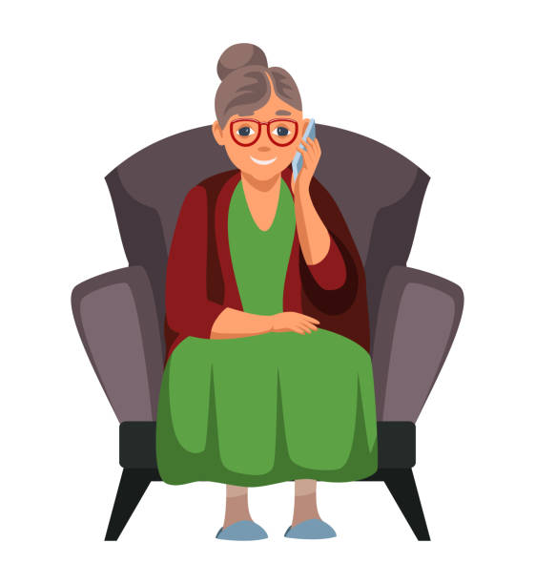
Patient Feedback • medication change
This experience was very useful for me, and I was able to decrease the amount of medication I was on before I started this program. I am more aware of what I can do for myself as far as taking control of my health.
Notes:
As a provider we idenfity a diagnosis and then have a medication to treat this with, but often due to time restraints within a visit there is not enough time to review medication in full detail- side effects, time of day, with or with out food, what other medications they are taking at that time of day, what medications are they taking from a specialist that wasn't fully gathered by the PCP in their visit.
CP takes what the HC has done and put a clinical perspective on it, time focused on medication needs
What are the CP goals that they have when working with a patient.
What is the biggest gap that they see when working with patients and how does the CP role help to close that gap?
Timeliness of making medication changes compared to current model? Able to free up the provider from having to have an appt with the patient to just make a medication change
CP able to support with the medication decision and more frequent calls to the office about medication side effects, understanding how to submit for prior authorization, etc all areas that can take up a lot of the providers time is now more supported by the CP

Slide 37
Patient Feedback • accountability
This program helps to hold you accountable for your health/life.
Knowing that I would be discussing the BP readings held me accountable. Otherwise, I probably would not have taken the readings as often as I did.
Notes:
Affect real change, sustainable change
Improved health of the patient population
Accountable meaning feeling like they matter and are apart of the decision instead of feeling like they are going to be "scolded"
Patients will even cancel appts because they know they haven't been doing well or following what the care plan was told to them and are afraid of what the provider might say or think of them

Slide 38
Patient Feedback • adopt healthy habits
This experience taught me to be more aware of myself and my health, looking at my diet and increasing my exercise. Tried new methods in my diet and exercise to assist in improving my health and how to stay motivated!
Notes:
Can John relate this to his experience
Why does he feel that he was not able to do this prior?
Did john feel as though his provider was informed of his health wins?
Ability to put the patient back to the center of care, empowering them through a team approach.
Ability to effect real change- compared to previous experience?

Slide 39
Dr. Inamine’s Feedback
pharmacist recommendations • expanding CPA scope
When the medication changes were outside of the scope of the CPA, pharmacists made recommendations for medication changes in the EHR note. It was easy for me to see and act upon the recommendations.
I see the benefits of increasing the scope of the CPA, so the pharmacists have more autonomy to manage chronic disease under my leadership.
Notes:
- shared decision making
Timely medication changes = improved patient compliance with medications
CP- speaks on how the CPA allows for a smoother flow of patient care
CP- speaks to importance of HER documentation
Chronic conditions such as HTN, DM, high cholesterol --> having personalized recommendation takes the burden off the provider and allows for shared decision making and actually a conversation around best treatment approaches for the patient

Slide 40
Dr. Inamine’s Feedback
physician-led care team • integrated care • EHR documentation
The clinical documentation in my practice’s EHR gave me confidence that the care team was delivering patient care consistent with my standard of care and adhering to my care plan for each patient.
The care coordinator and pharmacists had access to my practice’s Epic Electronic Health Record (EHR) which was essential.
Notes:
Provider satisfication, decrease burnout
- shared decision making
Timely medication changes = improved patient compliance with medications
CP- speaks on how the CPA allows for a smoother flow of patient care
CP/HCC- speaks to importance of EHR documentation

Slide 41
Dr. Inamine’s Feedback
Pharmacist MTM/CMM • Collaborative Practice Agreement (CPA)
The pharmacists were able to work with autonomy under the scope of practice defined in a Collaborative Practice Agreement (CPA), sending prescriptions to the pharmacy directly from the EHR and documenting in an EHR note that was routed to me.
Notes:
- shared decision making
Timely medication changes = improved patient compliance with medications
CP- speaks on how the CPA allows for a smoother flow of patient care without the provider being a bottle neck. This can take time to create this trusting relationship between provider and CP. This helps to eliminate time burden on the provider.
From my experience we get comfortable prescribing certain medications in each class of meds. Which works for most patients but not all, this has allowed for best prescribing practices.
CP- speaks to importance of HER documentation

