Slide 1



Acute Inflammatory Response via Neutrophil Activation Protects Against Chronic Pain Development
Luda Diatchenko, MD, PhD
Alan Edwards Centre for Research on Pain,
Human Pain Genetics Program
McGill University, Montreal, Canada
Behavioral Health ECHO
April 4, 2023

Slide 3





The Translational Research Clock –
Human Transcriptomics Study
Animal mechanistic study
Clinical trial
???
Human Study –genome –wide transcriptomics
Human Studies-
Data minding
40
30
20
10
0

Slide 4

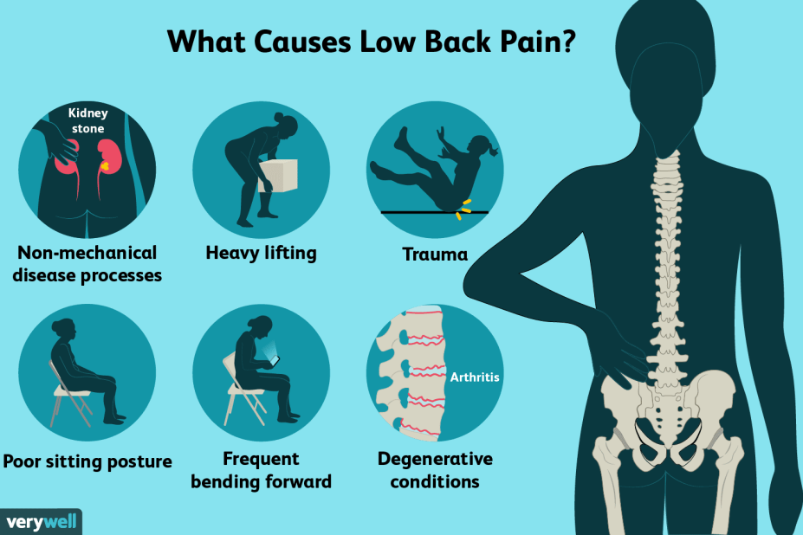
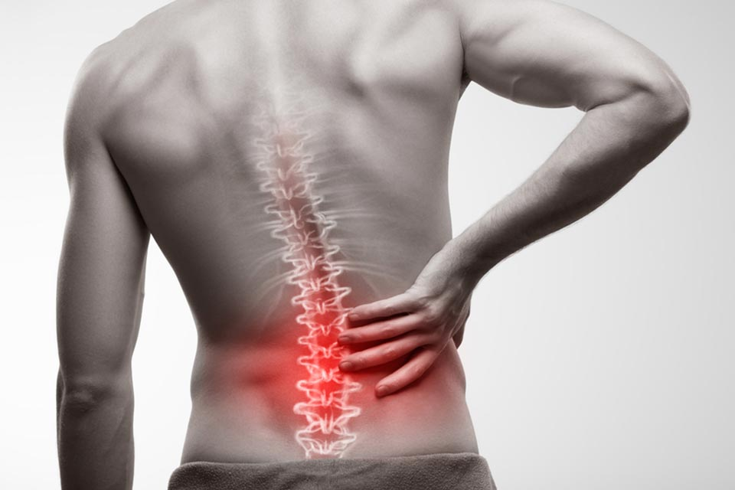
Differential Gene Expression in the Blood of LBP
patients: Study Design
A cohort of 100 Caucasian patients comprised
of males (58%) and females (42%) older than
18 years old with acute LBP.
Whole blood RNA analysis at two time points:
  t₀ = within 6 weeks of acute episode
  t₁ = 3 months after enrollment
3 months
P
pain
R
t₀
time
t₁
Blood sampling
Resolvers (R)
Persistent (P)

Slide 5

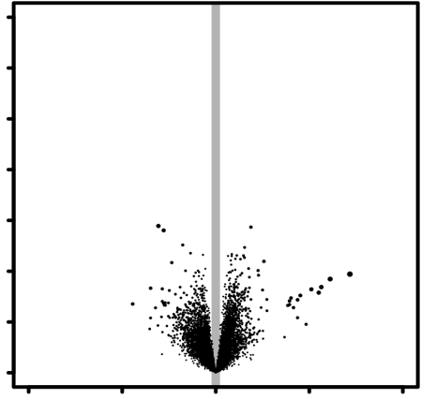
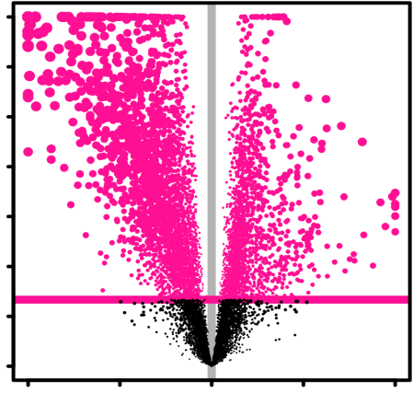
Differential Gene Expression in the Blood of
LBP patients
6
6
3: in P
t₁ vs t₀
4: in R
t₁ vs t₀
4
4
-log₁₀( P )
-log₁₀( P )
2
2
0
0
0
0
3312
2300
-1
0
+1
-1
0
+1
log₂( t₁ / t₀ )
log₂( t₁ / t₀ )
Parisien et al Sci Transl Med, 2022

Slide 6
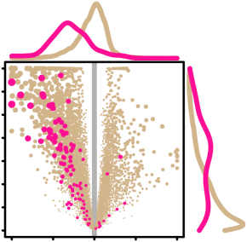
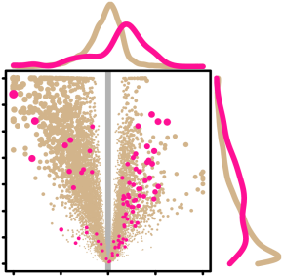
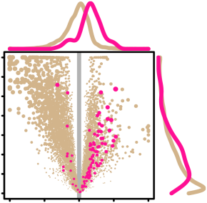
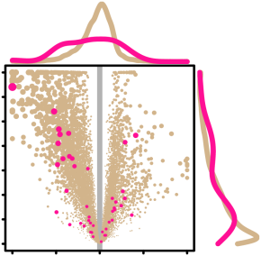
Changes in blood cell composition in patients who resolve pain
in P
t₁ vs t₀
in R
t₁ vs t₀
B
n.s.
1.4x10⁻³
D
n.s.
1.7x10⁻³
70
70
15
15
6
6
Neutrophils
percent cell type
4
NK cells, resting
percent cell type
4
-log₁₀( P )
-log₁₀( P )
2
2
0
0
20
20
-1
0
+1
-1
0
+1
log₂( t₁ / t₀ )
0
0
log₂( t₁ / t₀ )
t₀
t₁
t₀
t₁
t₀
t₁
t₀
t₁
C
n.s.
1.5x10⁻³
E
n.s.
4.4x10⁻²
40
40
4
4
6
6
T cells CD8
percent cell type
4
Mast cells, resting
percent cell type
4
-log₁₀( P )
-log₁₀( P )
2
2
10
10
0
0
-1
0
+1
-1
0
+1
log₂( t₁ / t₀ )
0
0
log₂( t₁ / t₀ )
t₀
t₁
t₀
t₁
t₀
t₁
t₀
t₁
Parisien et al Sci Transl Med, 2022

Slide 7
Functional difference through pathways analysis in LBP patients
I
II
III
@ t₀
P vs R
in P
t₁ vs t₀
in R
t₁ vs t₀
A Inflammatory response
inflammatory response
R
t₀
neuroinflammatory response
R
t₀
acute inflammatory response
R
t₀
chronic inflammatory response
inflammatory response to antigenic stimulus
inflammatory response to wounding
0
7
0
7
0
7
Parisien et al Sci Transl Med, 2022
7
0
7
7
0
7
7
0
7

Slide 8
Functional difference through pathways analysis in LBP patients
I
II
III
@ t₀
P vs R
in P
t₁ vs t₀
in R
t₁ vs t₀
B Cell activation
leukocyte activation
R
t₀
neutrophil activation
R
t₀
t₀
macrophage activation
R
t₀
mast cell activation
R
natural killer cell activation
monocyte activation
dendritic cell activation
eosinophil activation
T cell activation
B cell activation
basophil activation
0
7
0
7
0
7
C Cell type-mediated degranulation
leukocyte degranulation
R
t₀
t₀
neutrophil degranulation
R
t₀
t₀
platelet degranulation
R
NK cell degranulation
R
mast cell degranulation
eosinophil degranulation
cytotoxic T cell degranulation
0
7
0
7
0
7
-log₁₀( FDR )
-log₁₀( FDR )
-log₁₀( FDR )
Parisien et al Sci Transl Med, 2022
7
0
7
7
0
7
7
0
7

Slide 9
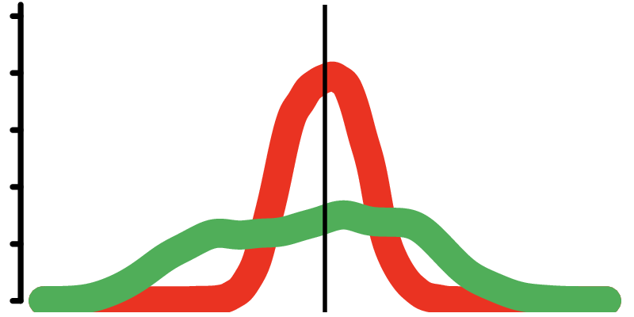
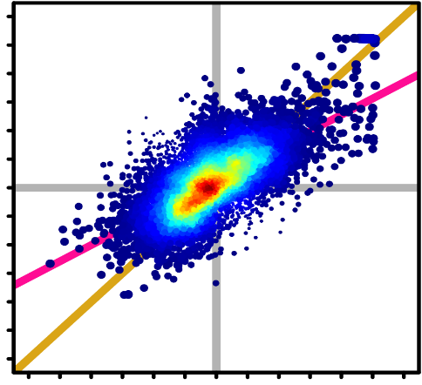
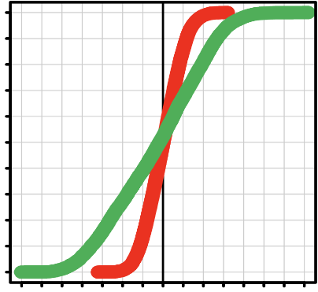
Differential gene expression in patients who resolve pain is correlated with those who don’t resolve
in P
t₁ vs t₀
in R
t₁ vs t₀
+6
Density
0
100%
0
Pathway Test Statistic in P
r²=0.42
m=0.57
P<2.2x10⁻¹⁶
50%
Fraction of Genes
-6
-6
0
+6
P<2.2x10⁻¹⁶
Pathway Test Statistic in R
0%
-7
0
+7
in P
in R
Test Statistic
Parisien et al Sci Transl Med, 2022

Slide 10

Pathways TMD cohort: Contrasting Inflammatory Pathways with HC
Disease development
in P
t₁ vs t₀
in R
t₁ vs t₀
Healthy acute persistent chronic
Controls t0 t1
Pathways | R@t0 | R@t1 | P@t0 | P@t1 | Chronic TMD
Inflammatory response | ↑↑↑ | ↓
Neutrophil activation | ↑↑↑ | ↓
Neutrophil degranulation | ↑↑↑ | ↓
Macrophage activation | ↑↑↑ | ↓

Slide 11
Pathways TMD cohort: Contrasting Inflammatory Pathways with HC
Disease development
in P
t₁ vs t₀
in R
t₁ vs t₀
Healthy acute persistent chronic
Controls t0 t1
Pathways | R@t0 | R@t1 | P@t0 | P@t1 | Chronic TMD
Inflammatory response | ↑↑↑ | ↓ | ↓↓ | ↓
Neutrophil activation | ↑↑↑ | ↓ | ↓↓ | ↓
Neutrophil degranulation | ↑↑↑ | ↓ | ↓↓ | ↓
Macrophage activation | ↑↑↑ | ↓ | ↓

Slide 12
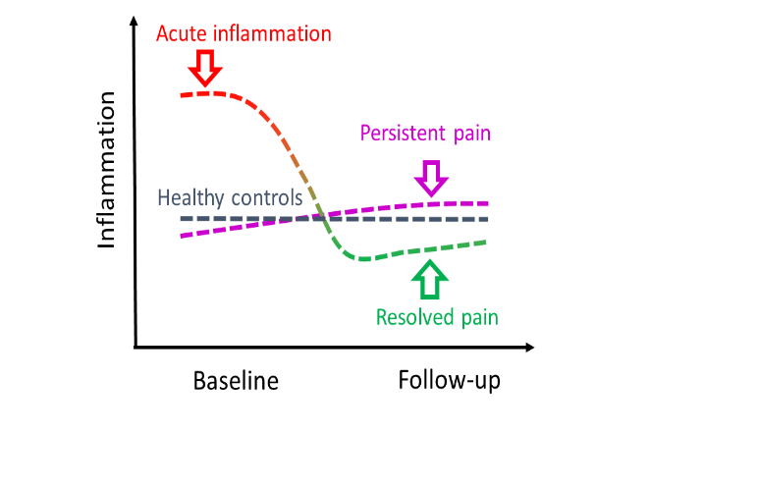
Acute to Chronic Pain Transition: Adaptive Response Model

Slide 13
Pathways TMD cohort: Contrasting Inflammatory Pathways with HC
Disease development
in P
t₁ vs t₀
in R
t₁ vs t₀
Healthy acute persistent chronic
Controls t0 t1
Pathways | R@t0 | R@t1 | P@t0 | P@t1 | Chronic TMD
Inflammatory response | ↑↑↑ | ↓ | ↓↓ | ↓ | ↑
Neutrophil activation | ↑↑↑ | ↓ | ↓↓ | ↓ | ↑
Neutrophil degranulation | ↑↑↑ | ↓ | ↓↓ | ↓ | ↑
Macrophage activation | ↑↑↑ | ↓ | ↓

Slide 14

The Translational Research Clock –
Human Transcriptomics Study
Animal mechanistic study
Clinical trial
???
Human Study –genome –wide transcriptomics
Human Studies-
Data minding
40
30
20
10
0

Slide 15

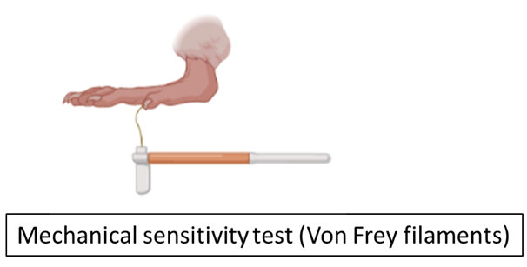
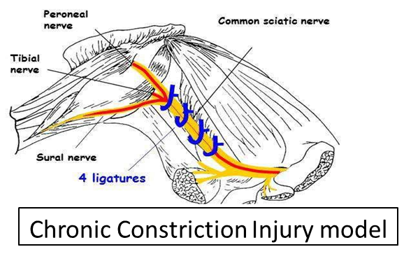
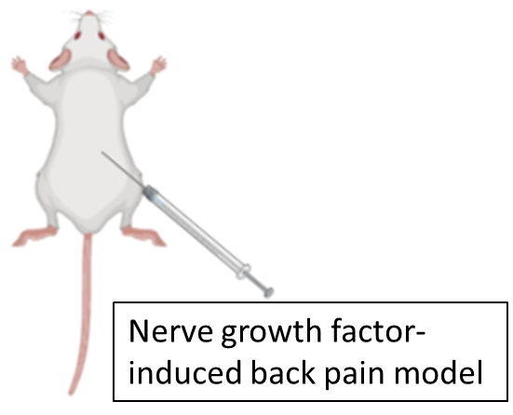
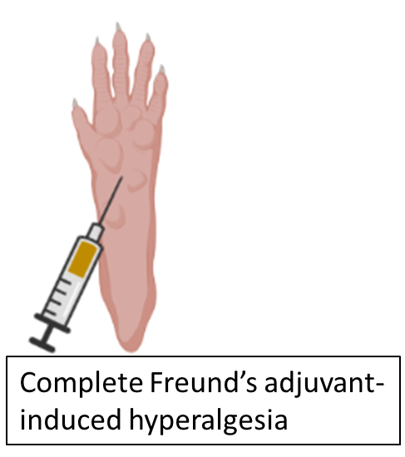


Hindering the inflammatory response in injured mice delays their recovery?
Experiment 1.
Dexamethasone
Vehicle
Treatment period (6 days)
D0
D2
D4
D6
DX
Time course (Days)
(*)
Paw withdrawal threshold test (PWT) (Von Frey filaments)
Notes:
We used three different mouse pain assays, Chronic constriction injury (CCI), Complete freund adjuvant-induced inflammatory pain (CFA model) and Nerve growth factor injection in the lower back muscles (low back pain model). We then treated these mice with dexamethasone, a classic steroidal anti-inflammatory drug, for 6 days and measured their paw withdrawal thresholds with the von frey test for several weeks.

Slide 16

Inhibition of Immune Response in Mouse
Inflammatory Model Produce Pain Chronification
Dexamethasone + CFA
Paw edema delta
)
m
2.0
m
Saline
(
r
CFA
e
t
2.0
Dexamethasone
a
Dexa /
Saline
d
1.5
m
Vehicle
Dexa /
a
l
i
Dexamethasone
o
Vehicle
d
1.5
h
r
s
a
m
e
1.0
l
r
a
1.0
h
p
-
T
o
s
r
0.5
o
0.5
d
n
i
n
0.0
o
0.0
i
t
3
6
2
7
0
3
7
0
5
e
3
6
1
5
0
5
0
5
a
y
y
1
1
2
2
2
3
3
n
y
y
1
1
2
2
3
3
i
i
r
a
a
y
y
y
y
y
y
y
l
a
a
y
y
y
y
y
y
a
D
D
a
a
a
a
a
a
a
e
D
D
a
a
a
a
a
a
D
D
D
D
D
D
D
s
D
D
D
D
D
D
V
a
B

Slide 17

Inhibition of Immune Response in Mouse Inflammatory Model Produce Pain Chronification
Parisien et al Sci Transl Med, 2022

Slide 18
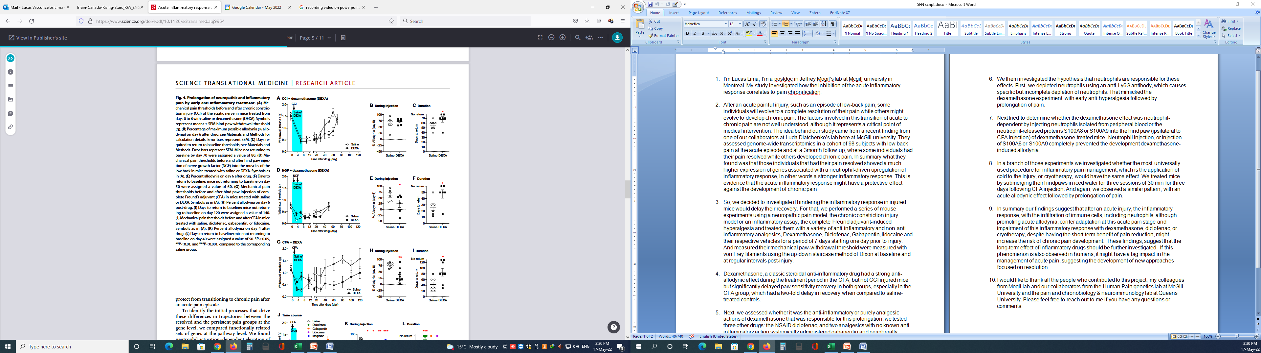

Dexamethasone delays the recovery from CCI, NGF and
CFA-induced hyperalgesia
Dexamethasone produced an acute anti-allodynic effect in the CFA but not CCI and NGF injured mice, but significantly delayed PWT recovery to baseline in all groups
Notes:
Dexamethasone, had a strong anti-allodynic effect during the treatment period in the CFA and NGF, but not CCI injured mice but significantly delayed paw sensitivity recovery in all groups, specially in the CFA group, which had a two-fold delay in recovery when compared to saline-treated controls.

Slide 19
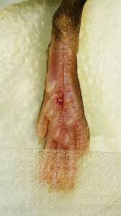
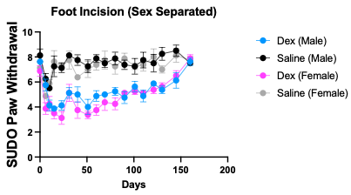

Also True for Mouse Model of Postoperative Pain
Martin, in preparation

Slide 20
Also True for Ice Application in Mouse
Inflammatory Model – Sport Injury Model
Lima, in preparation

Slide 21
Experiment 2.
Diclofenac
Gabapentin
Lidocaine
Morphine
Vehicle
Treatment period (6days)
D0
D2
D4
D6
DX
Time course (Days)
(*)
Paw withdrawal threshold test (PWT) (Von Frey filaments)
Notes:
Next we tested the NSAID diclofenac, and three analgesics with no known anti-inflammatory action, systemically administered gabapentin and morphine, and peripherally administered lidocaine, in the CFA model

Slide 22
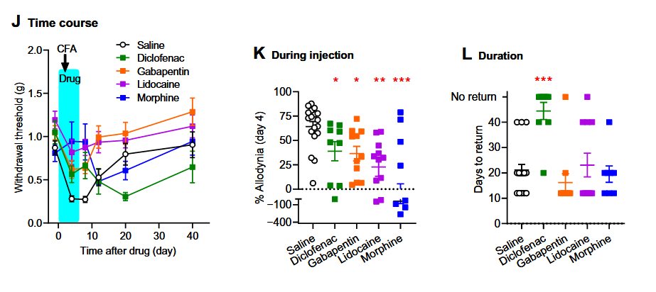
Diclofenac, but not gabapentin and lidocaine, delays the recovery from CFA-induced hyperalgesia
Delay in recovery is due to the reduction of inflammation and independent from analgesic effects
Notes:
All four drugs reduced allodynia during their administration period, but only diclofenac significantly prolonged the duration of the overall allodynia. Suggesting that the delay in recovery is due to the reduction of inflammation and independent from analgesic effects

Slide 23
Experiment 3.
Anti-Ly6G
Isotope control
Antibody Treatment period (20 days)
D0
D2
D4
D6
DX
Time course (Days)
(*)
Paw withdrawal threshold test (PWT) (Von Frey filaments)
Notes:
We them investigated the hypothesis that neutrophils are responsible for these effects. First, we depleted neutrophils using an anti-Ly6G antibody, which causes specific but incomplete depletion of neutrophils

Slide 24
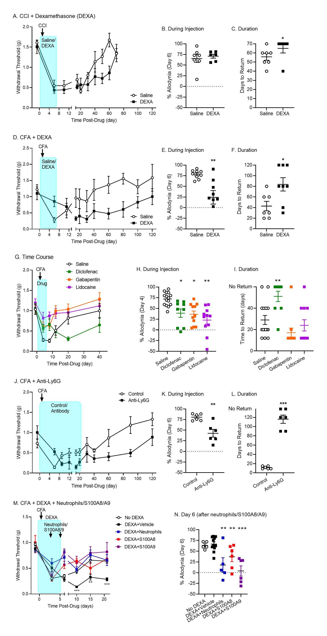
Anti-Ly6G-induced depletion of neutrophils mimics steroid-like pain prolongation
Neutrophils are involved in the resolution of pain after injury
Notes:
That mimicked the dexamethasone experiment, as prolonged administration of the antibody exacerbated allodynia and prolonged its duration.

Slide 25
Experiment 4.
Dexamethasone +
Neutrophils
S100A8
S100A9
Treatment period (Dexa)
D0
D2
D4
D6
DX
Time course (Days)
(*)
Paw withdrawal threshold test (PWT) (Von Frey filaments)
Notes:
Next tried to determine whether the dexamethasone effect was neutrophil-dependent by injecting neutrophils isolated from peripheral blood or the neutrophil-released proteins S100A8 or S100A9 into the hind paw (ipsilateral to CFA injection) of dexamethasone-treated mice.

Slide 26
Injection of neutrophils or neutrophil-specific proteins prevents dexamethasone-induced pain
Dexamethasone delays allodynia recovery by directly affecting neutrophils
Notes:
Neutrophil injection, or injection of S100A8 or S100A9 completely prevented the development dexamethasone-induced allodynia. These experiments indicate that Neutrophils are involved in the resolution of pain after injury.

Slide 27
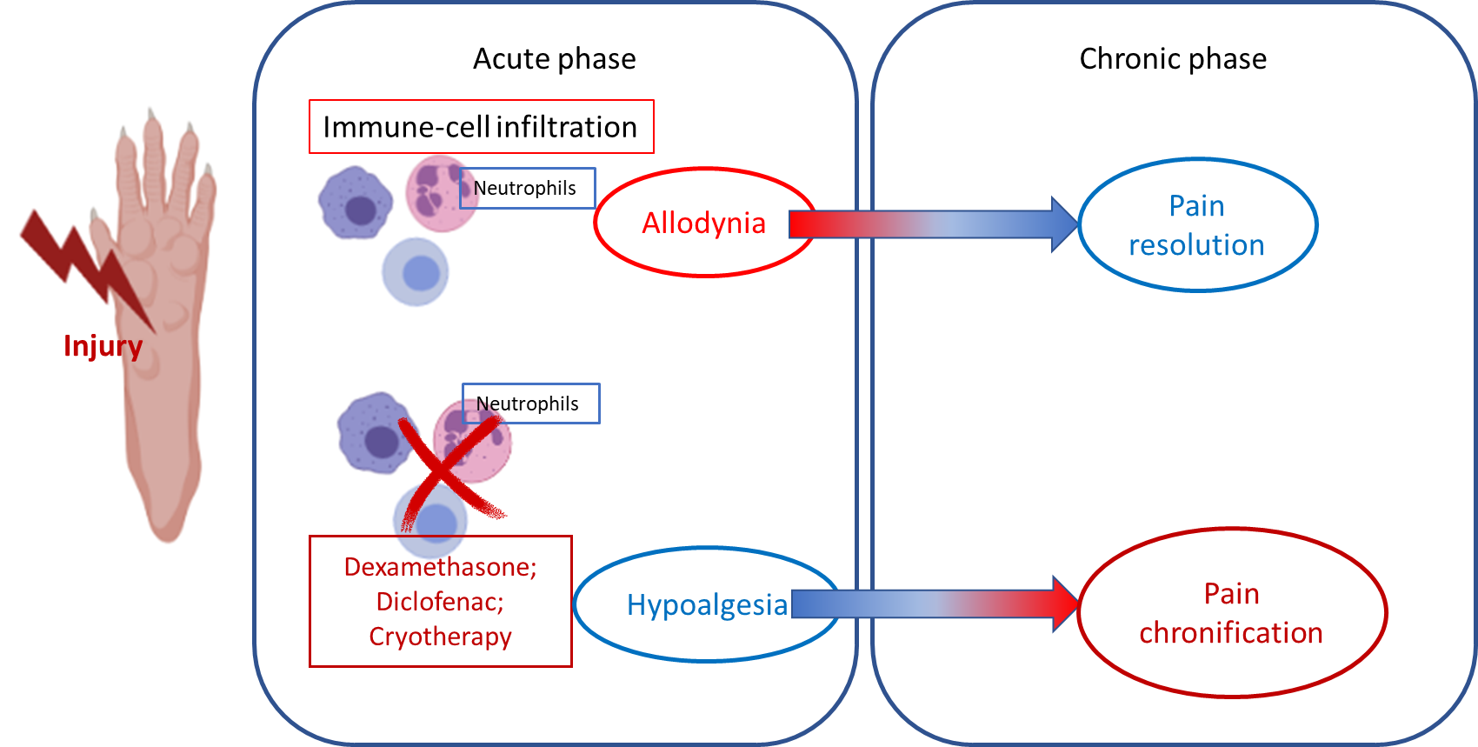
Active immune processes confer adaptation at the acute pain stage, and impairment of such inflammatory responses might increase the risk of chronic pain development.
If this phenomenon is also seen in humans, it could have dramatic implications for the treatment of acute pain.

Slide 28
The Translational Research Clock –
Human Transcriptomics Study
Animal mechanistic study
Clinical trial
???
Human Study –genome –wide transcriptomics
Human Studies-
Data minding
40
30
20
10
0

Slide 29
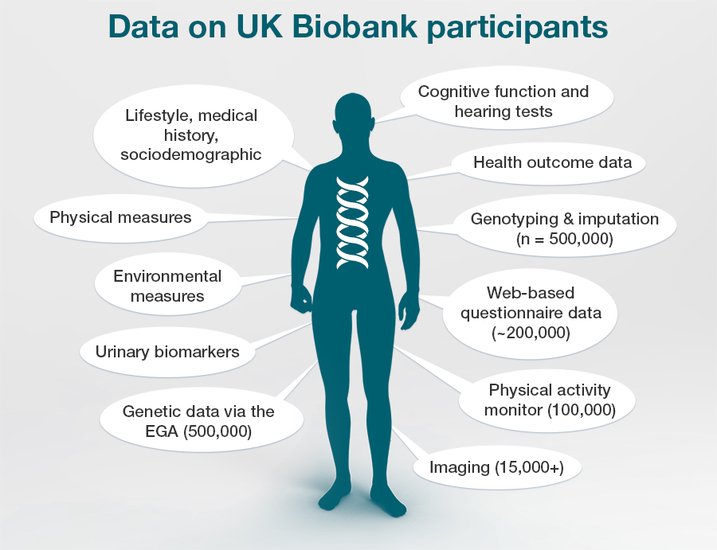
UK Biobank
A cohort that followed the health and well-being of 502,494 volunteer participants from across the UK, aged between 40-69 years
Recruitment took place between 2006-2010 in 22 assessment centers
Subset of the volunteers were brought back for subsequent interview in 2-6 years
Notes:
To understand the underlying genetic architecture of chronic pain conditions, we conducted 8 genome-wide association analyses in a large community cohort, the UKbiobank

Slide 30
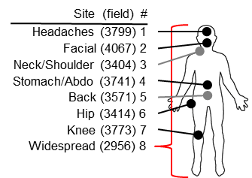
Acute and Chronic Pain phenotypes in UK biobank
Acute pain were assessed using the question: “In the last month have you experienced any of the following that interfered with your usual activities?”
Chronic pain were assessed using the question: “Have you had pains for more than 3 months?“
Phenotypes | Number of Cases
Back pain | 88,320
Knee pain | 83,962
Neck or shoulder pain | 79,660
Headache | 45,426
Hip pain | 43,175
Stomach or abdominal pain | 24,007
Pain all over the body | 7,130
Facial pain | 4,407
2-6 years
Chronic back pain
Acute back pain
Drugs usage

Slide 31



Impact of Analgesic Drug Class on Pain Chronification
model 1
model 2
model 3
model 4
model 5
model 6
NSAIDs
Paracetamol
Anti-Depressants
Age
Male
Time Interval
Psych. Distress
# Pain Sites
Neutrophils %
**
**
**
**
**
**
*
-1
0
+1
log₂( OR )
Parisien et al Sci Transl Med, 2022

Slide 32
Conceptual Breakthroughs
We generally think about chronic pain as an active pathological process, when it can be conceptualized more like absence of active adaptive process
We generally try to find the “Pain Gene”, when it can be conceptualized more like a “Pain Pathway”
We generally think of cellular response as “yes” or “no”, when the magnitude of the response can be as important
We generally measure pain intensity when the most important component is pain duration
We generally think about pain resolution as a linearly developing process when it can be conceptualized more like spirally developing inverted U-shaped process

Slide 33
Conclusion
There is an active adaptive component of immune system in acute to chronic pain transition in low back patients and likely other chronic pain conditions
Inhibiting this immediate active adaptable immune response in the humans with physical injury may lead to pain chronification
In drug development protecting against chronic pain, our animal models should target pain resolution rather than analgesic efficacy
In drug development protecting against chronic pain we may target activation of immune response instead of inhibition
Despite high analgesic efficacy at early time points, the inhibition of acute inflammatory response in pain management may be counterproductive for long-term outcomes of LBP sufferers

Slide 34
The beginning of the list of the remained questions
In which human and animal models this active adaptable immune response take places? Do we have adequate animal pain models?
What is the dynamics of this immune response?
When the anti-inflammatory response starts to take place?
Can we find a trigger for this adaptive immune response?
Which pharmacological target(s) with analgesic effects can be beneficial and safe for people with injury.

Slide 35

Welcome to the Human Pain Genetics Program

Slide 36










Thanks for Funding to

Slide 37

Thank You

