Slide 1
Bupe Made Easy
Kevin Kunz, MD, MPH
(no conflicts to disclose)
March 28, 2023

Slide 2
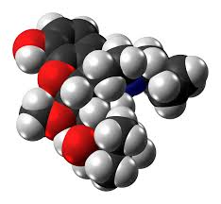
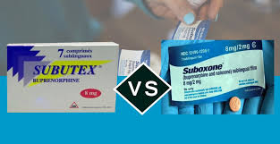
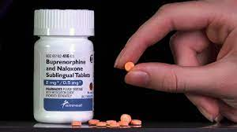
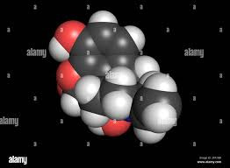
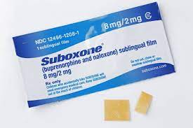
“Bupe”= Buprenorphine
Naloxone (Narcan)

Slide 3
Outline of Talk
Death is a crude measure of health
Systemic Discrimination for persons with SUDs
Basic science of opioid addiction and Bupe
How to start patients on Bupe
General guidance
Bupe for Pain: Yes.

Slide 4
Death is a Crude Measure of Health…
3%
14%
All Other Causes

Slide 5
43 Years of Exponential Drug Overdose Deaths

Slide 6
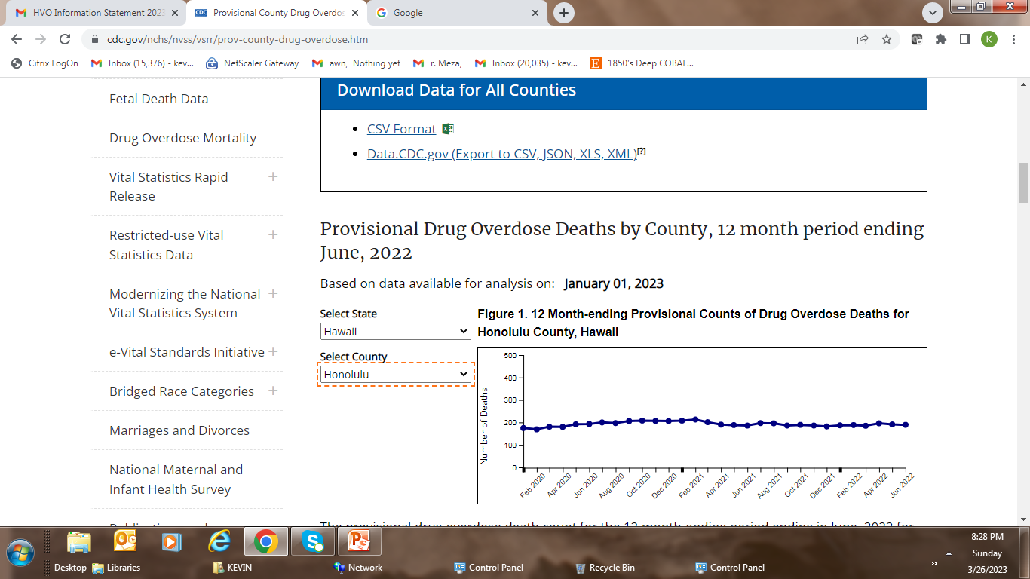
One OD Death
every 36 hours
in Hawaii

Slide 7
Systemic Discrimination for Persons with SUDs
Availability and access to services
Insurance and pharmacy policies
Policies not driven by expert opinion
Limits on length of treatment
Excessive monitoring requirements
Crime vs. Disease: blame vs. care
Language - MAT, MOUD; “induction” vs “start”
Free Choice (moral, behavioral) vs. Addiction
Interacts with all other systemic discriminations against minoritized populations

Slide 8
A Note on Bupe and Methadone
On January 12, 2023 all restrictive Bupe laws and governmental polices were rescinded: it is now just another medication
The Chief of NIDA (Dr. Nora Volkow) and others have called for methadone to be similarly released from restrictive, archaic and discriminatory DEA rules.

Slide 9
Today: Addiction, the Brain Disease
Vulnerabilities for Addiction
Genetic
Environmental
Addiction, the Brain Disease
Sequelae of Addiction
Medical
Social
Other

Slide 10
Understanding basic brain science makes using Bupe easy

Slide 11
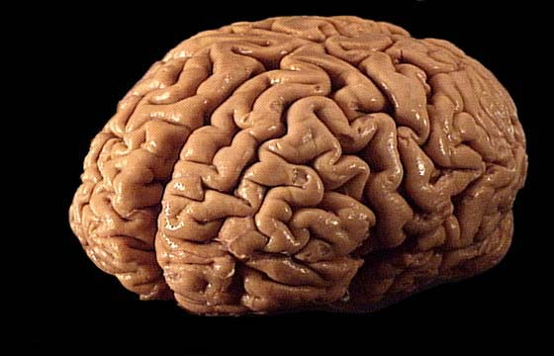

Slide 12
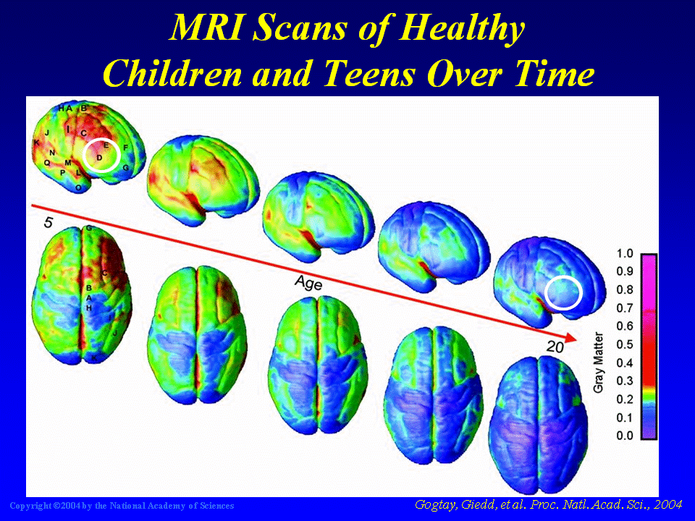

Slide 13
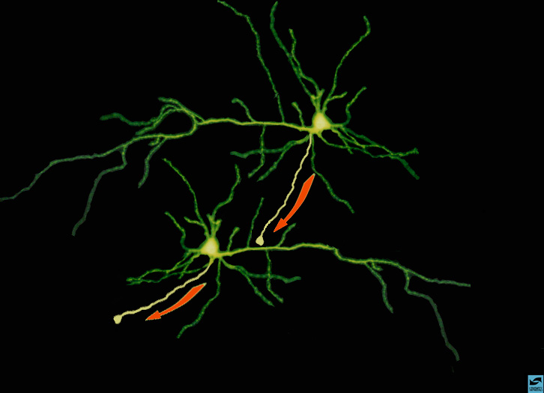
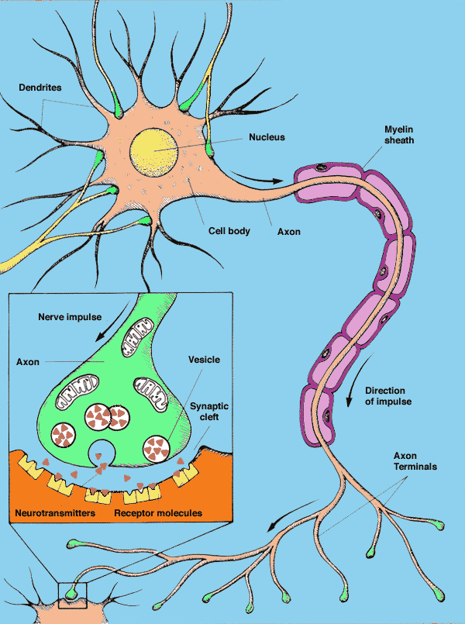
Notes:
Slide 7: Summary of neuronal transmission
Use the example with 2 neurons making contact to summarize neuronal transmission. Point to the cell on the top and indicate that electrical impulses flow in the direction toward the terminal. Remind the students what happens when impulses reach the terminal; neurotransmitters are released, they bind to their receptors, and new impulses are generated in the cell on the bottom. Explain that this is how information travels from neuron to neuron.

Slide 15
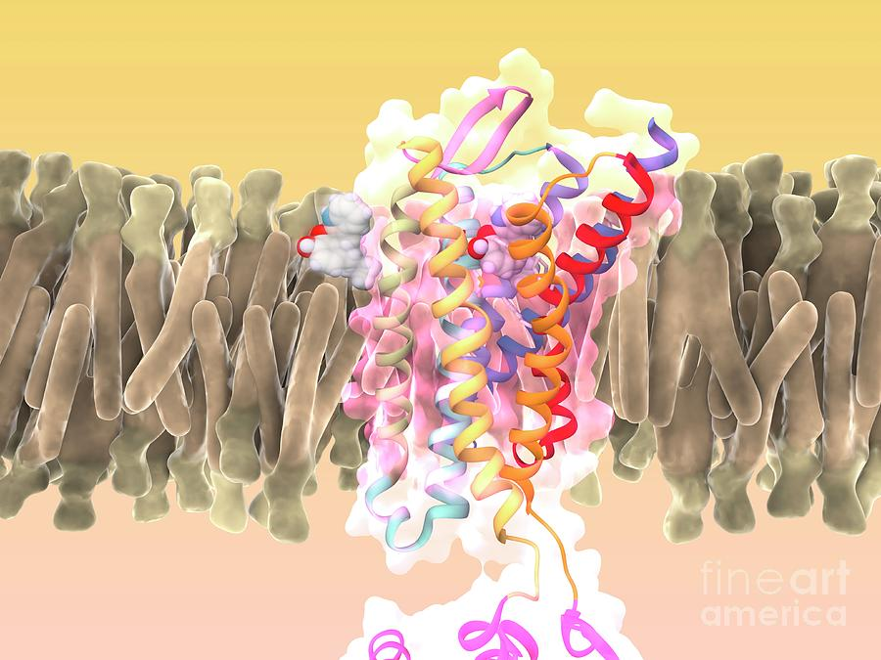

Slide 16
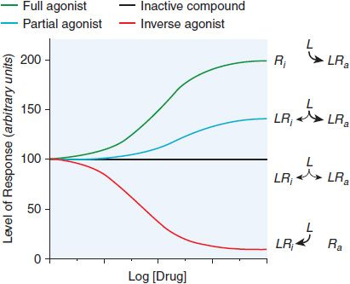
(Antagonist, i.e. naloxone)

Slide 17
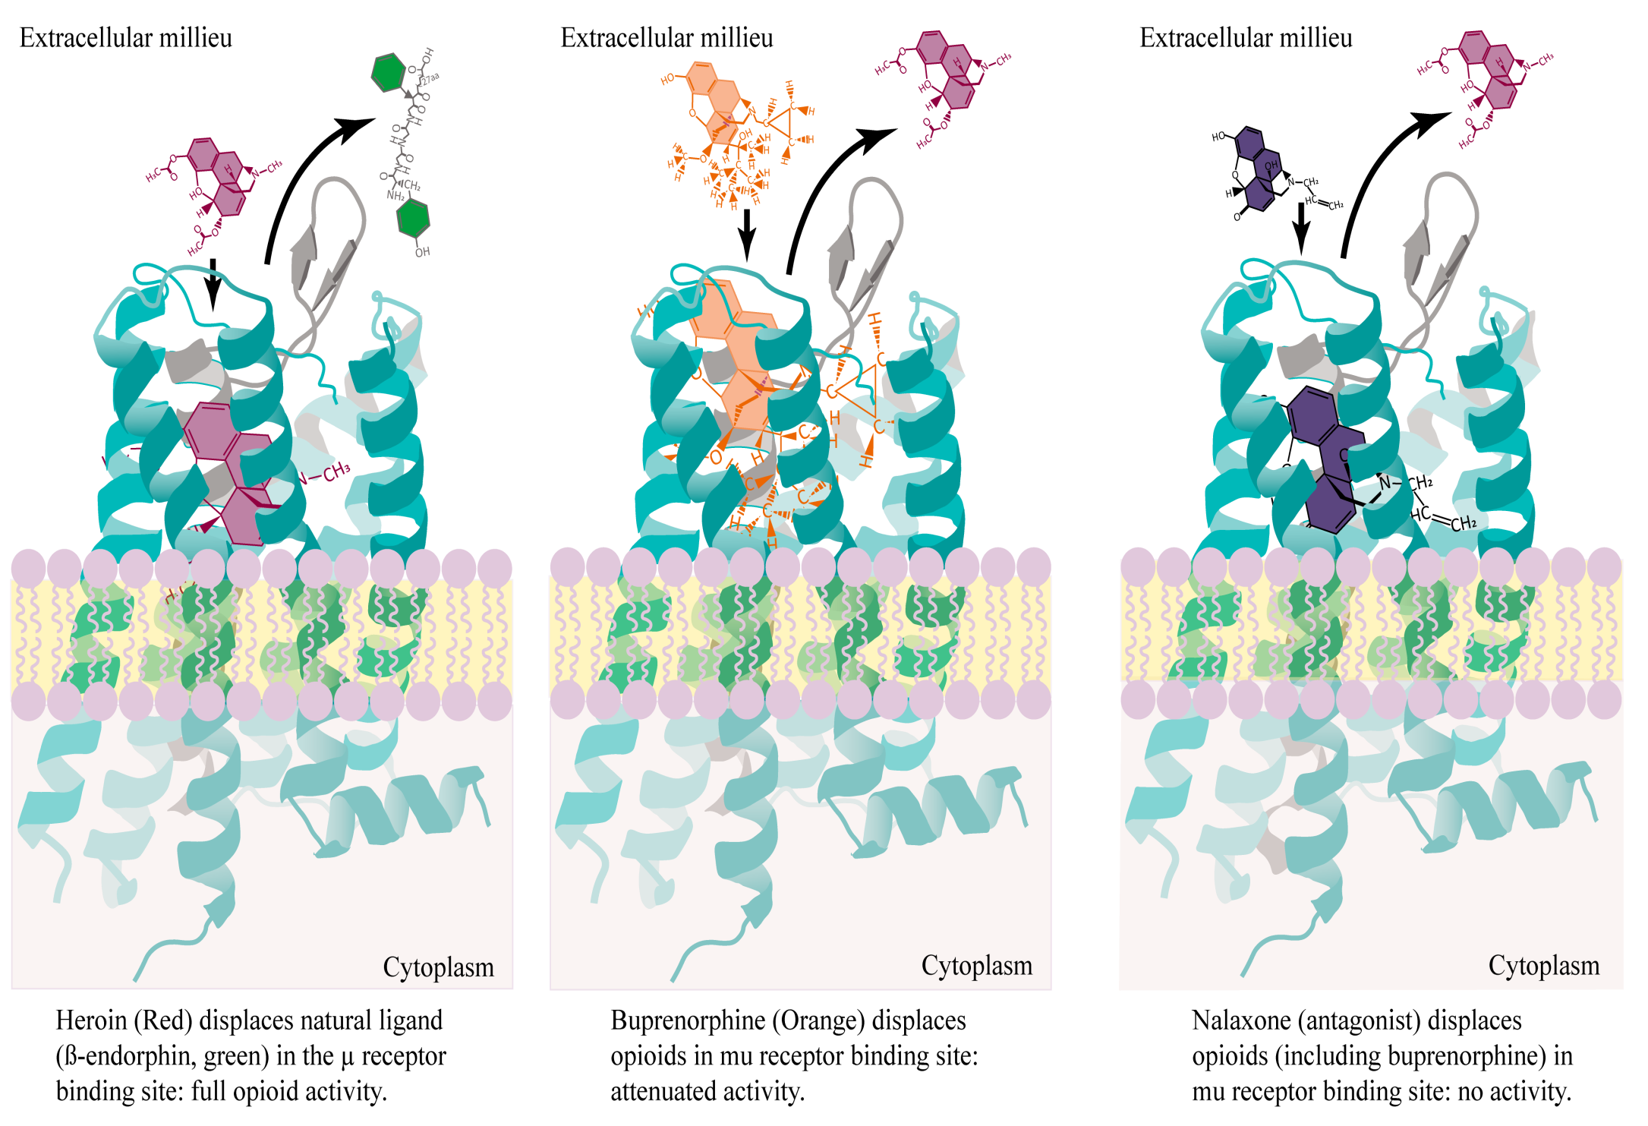
3 measures of a ligand on a receptor:
affinity, activity, dissociation

Slide 18
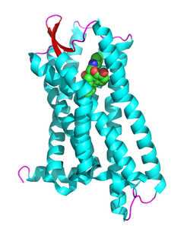
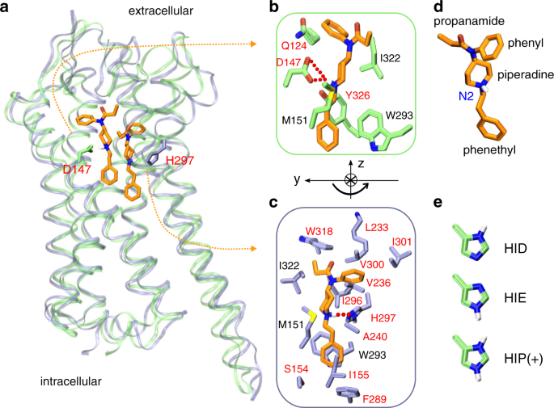

Slide 20
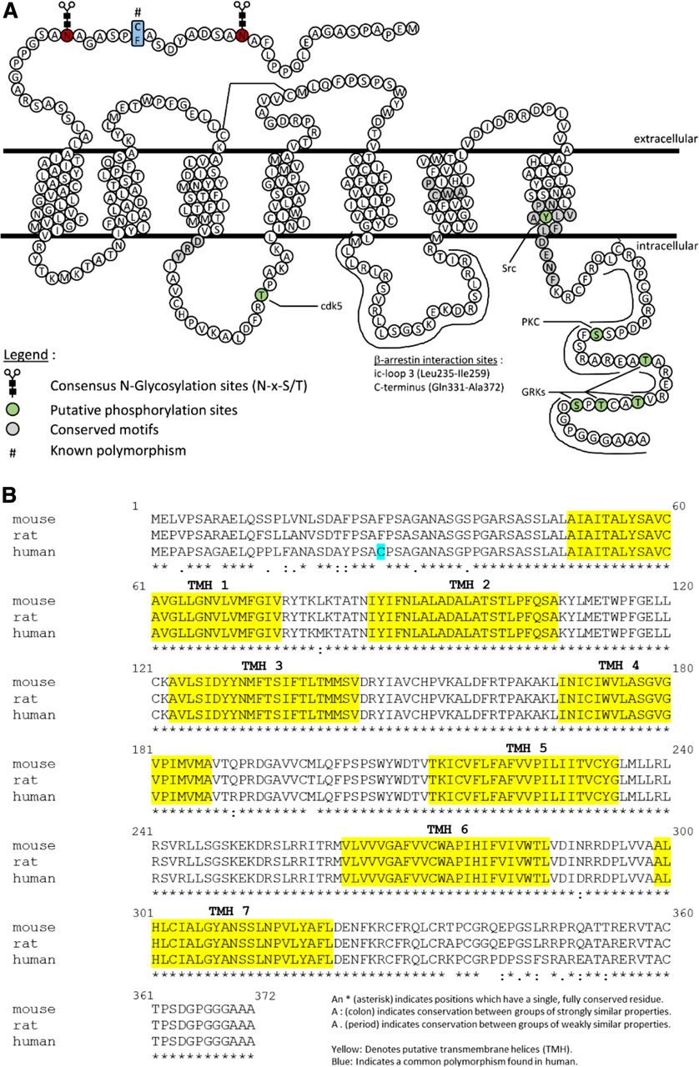

Slide 21
Down Regulation and Up Regulation
Down Regulation: continued stimulation of cells with an agonist results in a state of desensitization – a decrease in receptor availability - also referred to adaptation or refractoriness. This occurs rapidly and is clinically referred to as tachyphylaxis.
Up Regulation: refers to an increase in the number of receptors due to prolonged deprivation of receptors of interacting with their physiological neurotransmitter.

Slide 22
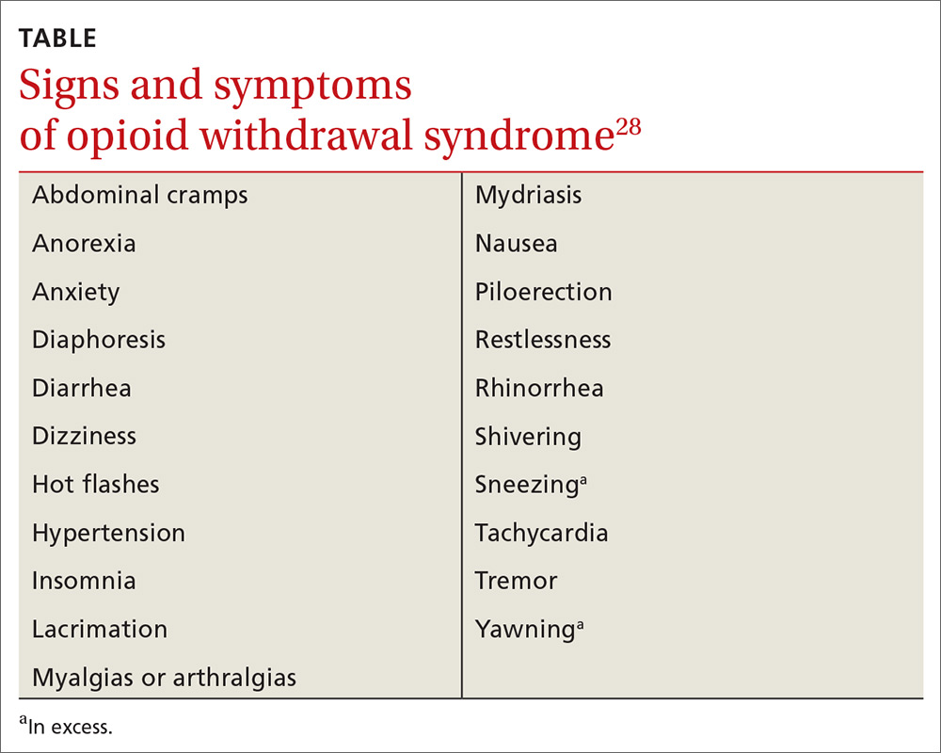
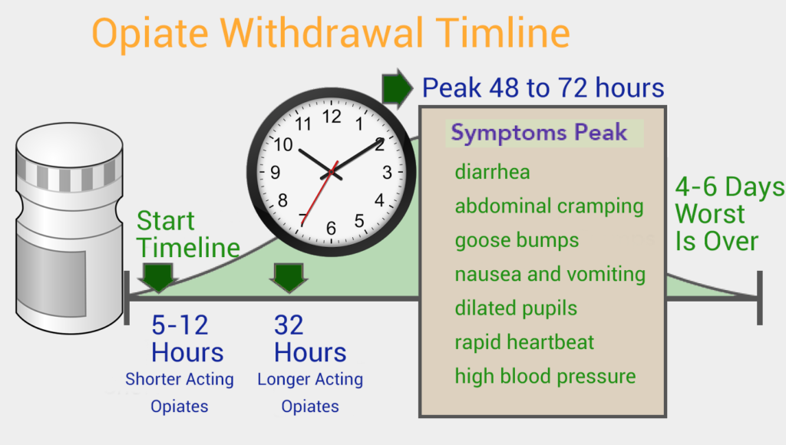
Signs and symptoms
Opioid
Withdrawal
is not fun
Opioid Acute Withdrawal Timeline

Slide 23
Acute withdrawal
Protracted
Withdrawal

Slide 24
Scores:
1-10: Mild Withdrawal
11-20: Moderate Withdrawal
21 +: Severe Withdrawal

Slide 25
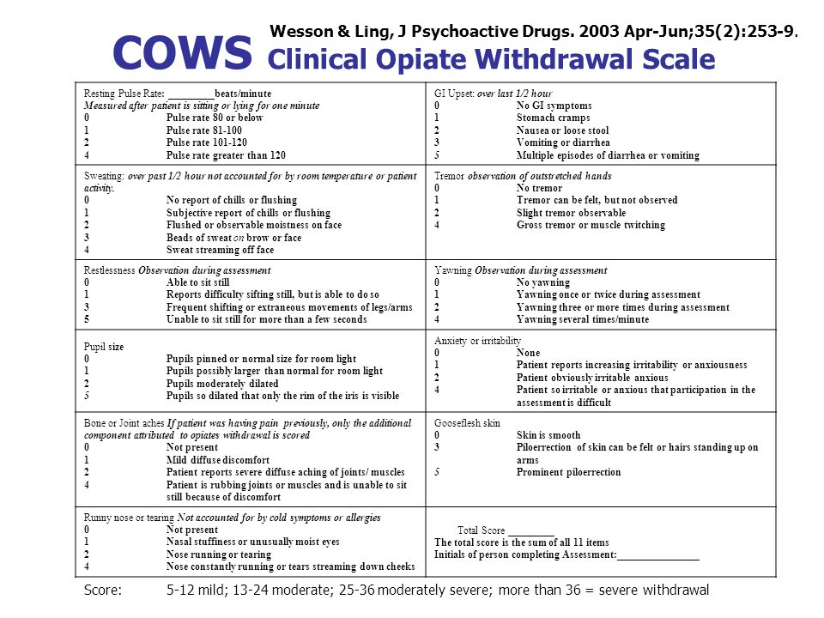
Pulse Rate
GI Upset
Tremor
Sweating
Restlessness
Yawning
Anxiety, irritability
Pupil size
Bone, joint pain
Piloerection, goosebumps
Rhinitis, tearing

Slide 27
How to Start Patients on Bupe

Slide 28
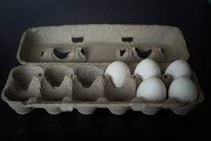
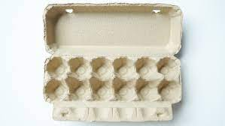
Opioid Withdrawal
Exogenous Opioid

Slide 29
3 Ways to Start Bupe
Traditional Start: COWS = 13; Bupe in 4mg increments over 2 days, to +/- 16 mg
Micro-dosing start: 2mg day 1-2; 4mg day 3-4; 6-8mg day 5-6 etc. up to 24-32mg/day if needed (fentanyl, high dose heroin)
Rapid Start: 4mg increments up to 24-32 mg within 2.5-3 hours

Slide 30
COWS ~13+
Traditional Bupe
Start
Bupe Day 1
8 mg
Bupe Day 2
16 mg
Bupe

Slide 31
3 Easy Ways to Start Bupe
Traditional Start: COWS = 13; Bupe in 4mg increments over 2 days, to +/- 16 mg
Micro-dosing start: 2mg day 1-2; 4mg day 3-4; 6-8mg day 5-6 etc. up to 24-32mg/day if needed (fentanyl, high dose heroin)
Rapid Start: 4mg increments up to 24-32 mg within 2.5-3 hours

Slide 32
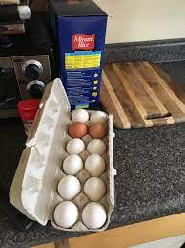
Micro-dose Start
(over 5+ days)

Slide 33
3 Easy Ways to Start Bupe
Traditional Start: COWS = 13; Bupe in 4mg increments over 2 days, to +/- 16 mg
Micro-dosing start: 2mg day 1-2; 4mg day 3-4; 6-8mg day 5-6 etc. up to 24-32mg/day if needed (fentanyl, high dose heroin)
Rapid Start: 4mg increments up to 24-32 mg within 2.5-3 hours

Slide 34
Rapid Start
(over 2-3 hrs)

Slide 35
Death is a crude measure of health…

Slide 36
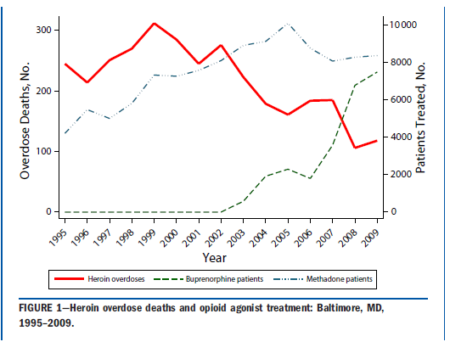
Death is a crude measure of health,
yet it is an undeniable and common OUD endpoint

Slide 37
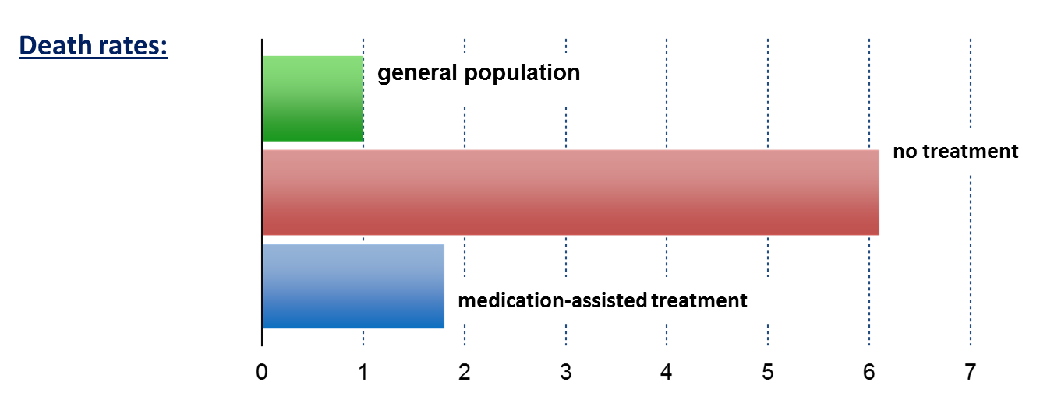
Benefits of Medication for OUD: Decreased Mortality, Etc
Bupe or methadone
Standardized Mortality Ratio
Dupouy et al., 2017
Evans et al., 2015
Sordo et al., 2017 ,and others
Notes:
Speaker Notes:
Key Point #1: Patients out of treatment died at about 6 times the rate of people in the general population, while medication-assisted treatment with methadone brought this to less than 2 times.
Key Point #2: Retention in methadone and buprenorphine treatment is associated with substantial reductions in the risk for all cause and overdose mortality in people dependent on opioids.

Slide 38
If an OUD patient is still living, and taking prescribed Bupe, all of life gets better.

Slide 39
Common Questions, General Guidance
Can you start someone on Bupe if they are using methamphetamine, cannabis etc. YES
Can you start someone on Bupe if they are using alcohol or BNZ? High Risk, proceed with caution. Treat AUD and BNZ ASAP
Can you legally use Bupe for pain? YES, and see November 2022 CDC Pain Guidelines
Start up and follow-up? Initial eval: UDS, labs,treatment agreement; “together is better”. Follow weekly x 4-6 then monthly, then up to q 3 months if progressing well.
Team Approach? Yes! Always better care and outcomes!

Slide 40
Questions, Cases?

Slide 41
References
ACEP, Bupe in the ED: https://www.acep.org/patient-care/bupe/
2022 CDC Opioid/Pain Guidelines:
https://www.cdc.gov/mmwr/volumes/71/rr/rr7103a1.htm
Slide 33: references next page
See Google Scholar, or multiple free online 1 hour video guides for using Bupe

Slide 42
References for “Decrease Mortality” Slide
• Ching et al. Impact on treatment duration on veterans with OUD. Addiction, 116, Issue 12, p 3494-3503, 2021
• Ma et al. Effects of medication-assisted treatment on mortality among opioids users: a systematic review and meta-analysis. Molecular Psychiatry, Vol 24, p1868–1883, 2019
• Larochelle et al. Medication for OUD after non-fatal OD and associated mortality. Annals of Internal Medicine, Aug 7. 169(3), 137-145, 2018
• Dupouy et al. Mortality associated with time in and out of buprenorphine treatment. Annals of Family Medicine, 2017; 15((4) 355-358
• Pearce et al. Mortality risk during and after medications for OUD, review and meta-analysis. BMJ, 2017, 357
• Nosyk et al. Effects of medication for OUD on mortality… Clinical Infectious Disease, Vol 61, Issue 7, October 1, 2015 p. 1157-65

