Slide 1
The overdose-reversing drug naloxone: drug facts and controversy
A.J. Ernst, PhD
Senior Technical Expert, JBS International, Inc.

Slide 2
Place in the Chat:
  What color best describes your personality?

Slide 3
Objectives
Overview of what an opioid overdose is.
Overview of what Naloxone is.
Review current myths.
Explore a case study.
Introduce the PRONTO Best Practice Guidance for Post-Overdose Outreach

Slide 4
What is an Opioid?
Opioids are sedative narcotics.
They are used in medicine mainly to
relieve pain.
Opioids can repress the urge to breathe-
when someone is having an opioid
overdose, they stop breathing and
could die.

Slide 5
What is Naloxone?
Naloxone hydrochloride (Narcan®) is approved by the US Food and Drug Administration (FDA) as a safe and effective treatment for opioid-related overdoses.
Naloxone blocks opiate receptors.
Temporarily takes away the “high,” giving the person the chance to breathe.
Generally works in 1 to 3 minutes and lasts 30 to 90 minutes. Naloxone can neither be abused nor cause overdose. Only contraindication is known sensitivity, which is very rare.

Slide 6
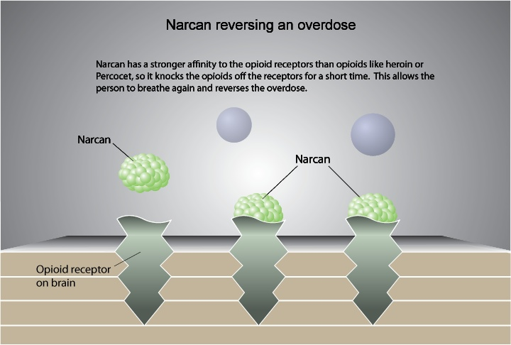

Slide 7
Myth
Naloxone is ineffective in reversing fentanyl-involved overdoses.
Naloxone is an opioid antagonist that reverses the effects of opioid overdoses including fentanyl analogues and other synthetic opioids.
Since fentanyl is faster-acting than opioids like heroin and oxycodone, the window to reverse an overdose and save a life is shorter.
Naloxone rescue must occur in a timely manner using appropriate doses of the antidote.
An overdose involving fentanyl or other synthetic opioids may require a larger dose of naloxone to reverse their effect.
https://nida.nih.gov/publications/drugfacts/fentanyl
Notes:
During an opioid overdose, every second counts, and naloxone and rescue breathing must be given as soon as possible. Cases where an overdose is mistakenly deemed “naloxone-resistant” could have occurred where naloxone rescue came too late. This scenario is especially likely because synthetic analogues trigger more rapid onset of respiratory depression and death. Drug poisonings may also involve non-opioid substances like K2, which do not respond to naloxone reversal.

Slide 8
Myth
People who are addicted to drugs need tough love and harsh consequences.
Tough love often involves withholding assistance when a person is using a substance.
While such actions may be rooted in a desire to motivate the person or force the person to get help, they are also at risk to backfire and potentially contribute to further problems.
https://www.shatterproof.org/blog/care-and-compassion-over-tough-love
Notes:
Author Bill Milliken first introduced the expression "tough love" in his book, Tough Love, published in 1968. It was used to describe a type of parenting in which a child experiences some negative emotions or consequence as part of a learning process.

Slide 9
Overdose risk from accidentally inhaling or touching fentanyl
Always wear nitrile gloves when illicit drugs may be present and change them properly when they become contaminated.
Wear respiratory protection if powdered illicit drugs are visible or suspected.
Avoid performing tasks or operations that may cause illicit drugs to become airborne.
Do not touch the eyes, nose, or mouth after touching any surface that may be contaminated, even if wearing gloves.
Wash hands with soap and water after working in an area that may be contaminated, even if gloves were worn. Do not use hand sanitizer or bleach.
https://www.cdc.gov/niosh/topics/fentanyl/risk.html
Notes:
During an opioid overdose, every second counts, and naloxone and rescue breathing must be given as soon as possible. Cases where an overdose is mistakenly deemed “naloxone-resistant” could have occurred where naloxone rescue came too late. This scenario is especially likely because synthetic analogues trigger more rapid onset of respiratory depression and death. Drug poisonings may also involve non-opioid substances like K2, which do not respond to naloxone reversal.

Slide 10
Case Study
A woman in her late 20s or early 30s whom outreach workers had heard about for weeks but had yet to meet.
Like many of the women they encountered in their work, this one was unhoused, was attached to a possibly abusive man and was using heroin.
Unlike the others, though, she was also about five months pregnant.
Notes:
Successful engagement: she and another woman were picking through bags of donated clothes at the back of the van.

Slide 11
PRONTO Best Practice Guidance for Post-Overdose Outreach January 2023
This document is the result of three years of work by the PRONTO Study team and a panel of 13 national policy and program experts to develop recommended guidance for post-overdose outreach programs. The aim was to create evidence-informed best practice guidance for post-overdose outreach programs useful to agencies that create, lead, manage, or fund post-overdose outreach programs nationwide with the goal of reducing the risks of subsequent overdose.
PRONTO Projects (prontopostoverdose.org)
Notes:
Successful engagement: she and another woman were picking through bags of donated clothes at the back of the van.

Slide 12
Resources
Changing The Narrative is a network of reporters, researchers, academics, and advocates who offer fact-checked, and evidence-based information on news and controversies. https://www.changingthenarrative.news/
SAMHSA Overdose Prevention Toolkit offers strategies to health care providers, communities, and local governments for developing practices and policies to help prevent opioid-related overdoses and deaths. Access reports for community members, prescribers, patients and families, and those recovering from opioid overdose. https://store.samhsa.gov/product/Opioid-Overdose-Prevention-Toolkit/SMA18-4742
https://www.rcorp-ta.org/resources/pronto-study-partnerships-post-overdose-outreach-best-practice-guidance-post-overdose-outreach
Notes:
Myths: This brief summary is a tool for peers and others. The 6 page document describes myths and misunderstandings surrounding methadone and presents the scientific evidence supporting MAT, and provides valuable links to resources on Methadone maintenance treatment, neo-natal withdrawal, and stigma.

Slide 13
Thank You!
The purpose of RCORP is to support treatment for and prevention of substance use disorder, including opioid use disorder, in rural counties at the highest risk for substance use disorder.
AJ Ernst, PhD
(301) 509-5851
aernst@jbsinternational.com

