Slide 1

Post-Acute Sequelae of COVID-19
Behavioral Health ECHO
January 31, 2023
Department of Medicine
University of Hawaii John A Burns School of Medicine
Dominic Chow, MD, PhD, MPH
Notes:
0100-0105 (Mia Taylor) TCMP & CCC Teams

Slide 2
Disclosures
no financial disclosures among speakers

Slide 3
Objectives
Learn about the magnitude of Post Acute Sequelae of COVID-19 (PASC) or “Long COVID”
Understand the Possible Pathophysiologic Mechanisms
Appreciate the symptoms PASC – specifically pulmonary, cardiac, neurologic, and psychiatric complications
Recognize the Potential Treatments

Slide 4
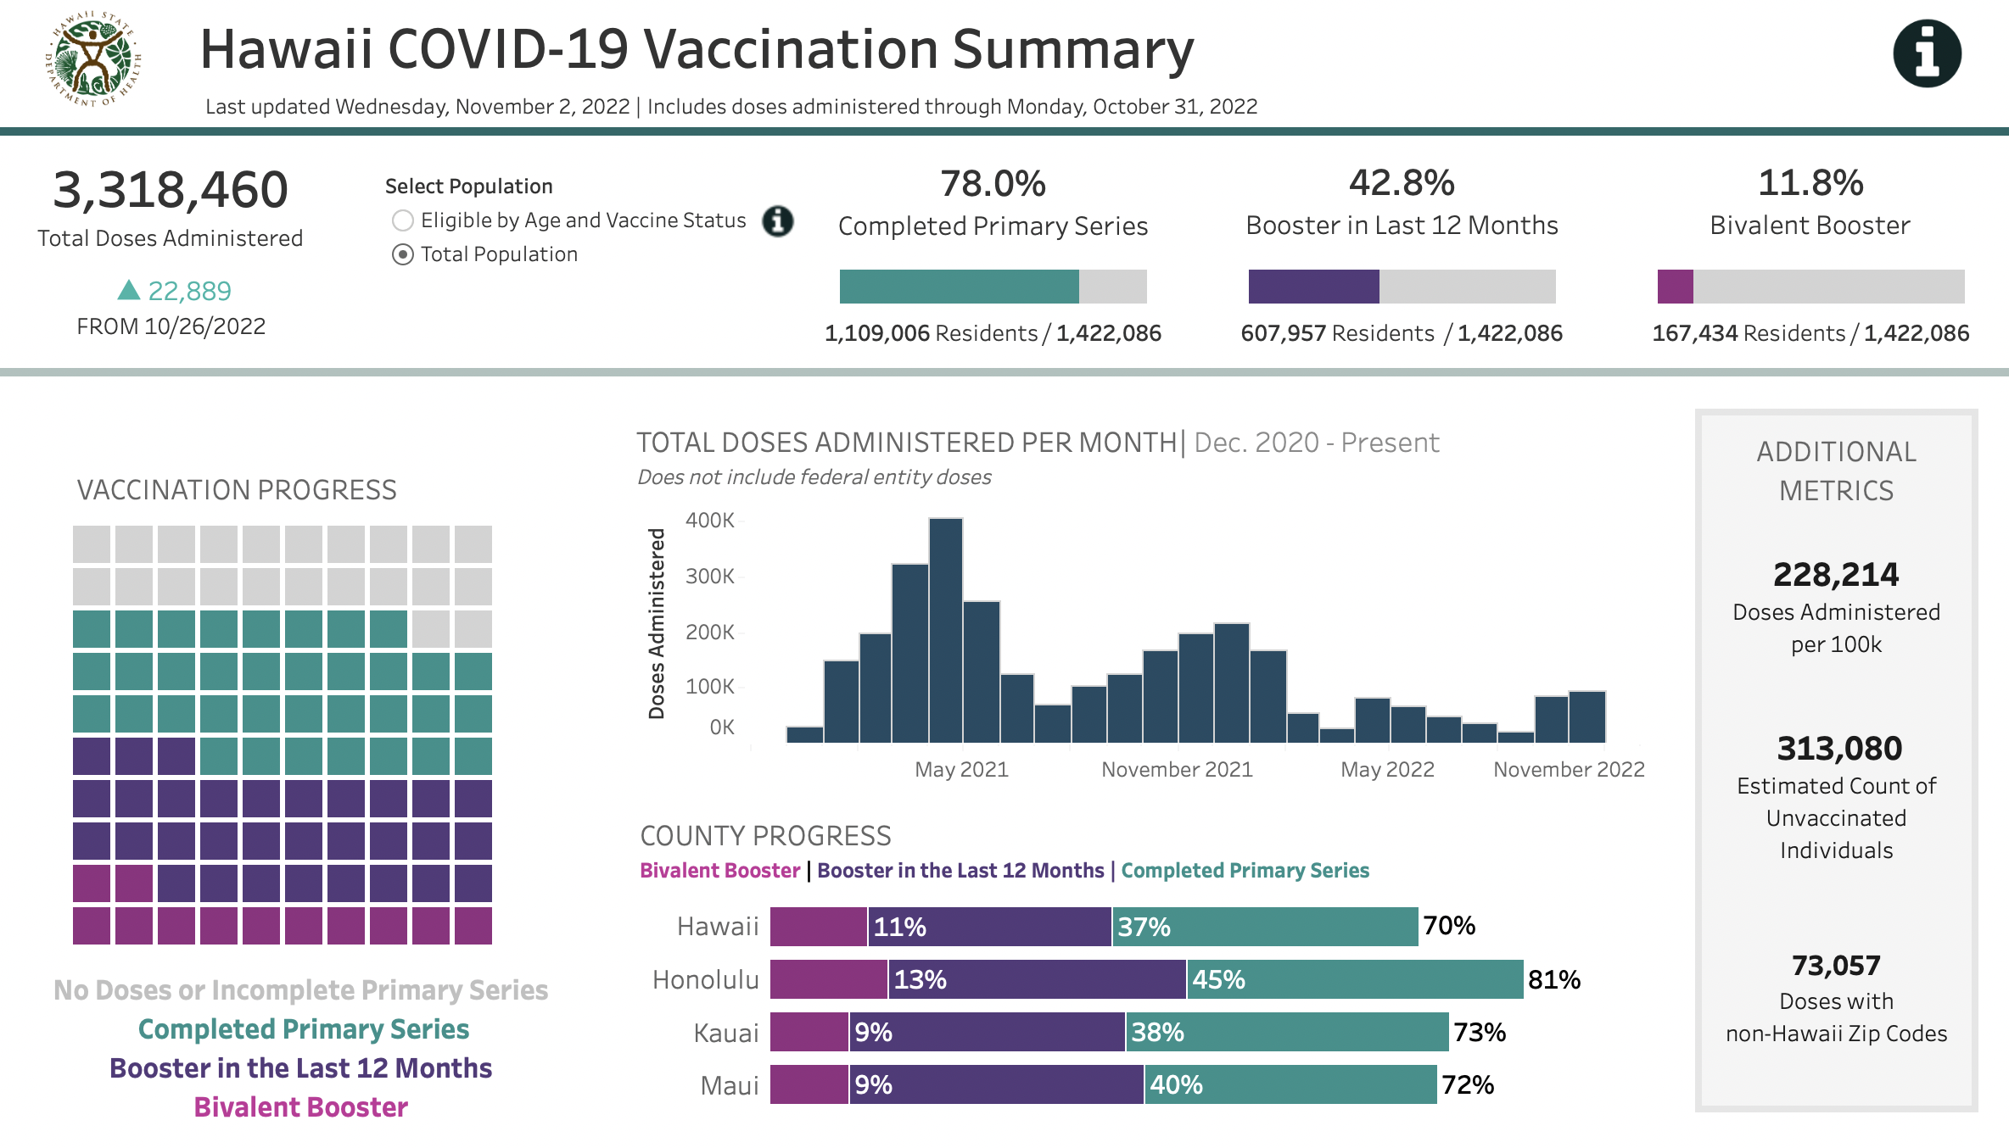
COVID-19 Timeline
December 31, 2019 ~ Clusters of pneumonia reported in Wuhan, China
January 11, 2020 ~ First death in China reported
January 21, 2020 ~ First US case reported
March 06, 2020 ~ Hawaii’s first case of COVID-19, cruise to Mexico on Grand Princess Ship
March 31, 2020 ~ Hawaii’s first death, Oahu man who traveled to Las Vegas
Dec 2020 ~ First Vaccines given in Hawaii
November 24, 2021 ~ First cases of Omicron
October 26, 2022
https://health.hawaii.gov/coronavirusdisease2019/

Slide 5
Cases of Acute COVID-19
 | Global | U.S. | Hawai'i (HiEMA data)
Confirmed Cases | 657,977,736 | 101,094,670 | 373,514
Deaths | 6,681,433 | 1,091,184 | 1765
New Cases | 430,167 in 24 h | 470,699 | 1316
January 6, 2023
https://covid19.who.int
https://covid.cdc.gov/covid-data-tracker/#cases_totalcases
https://health.hawaii.gov/coronavirusdisease2019/current-situation-in-hawaii/

Slide 6
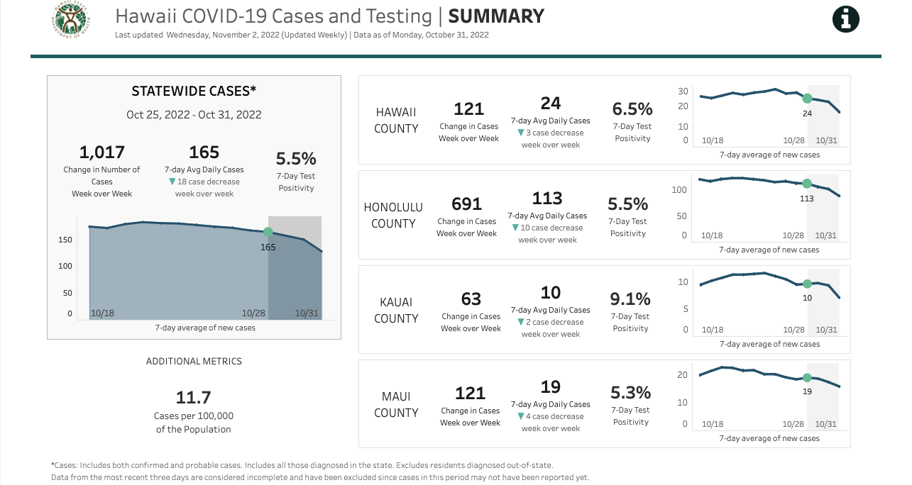
Hawaii Current Situation

Slide 7
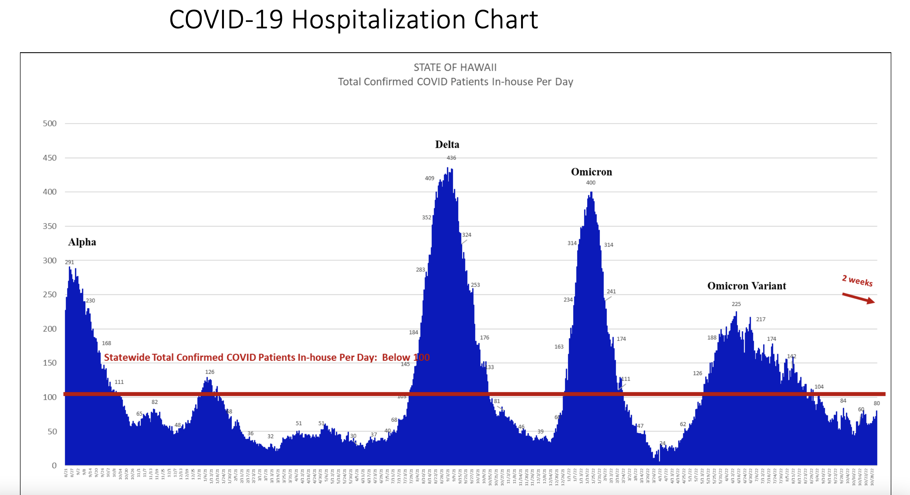
COVID Surge

Slide 8
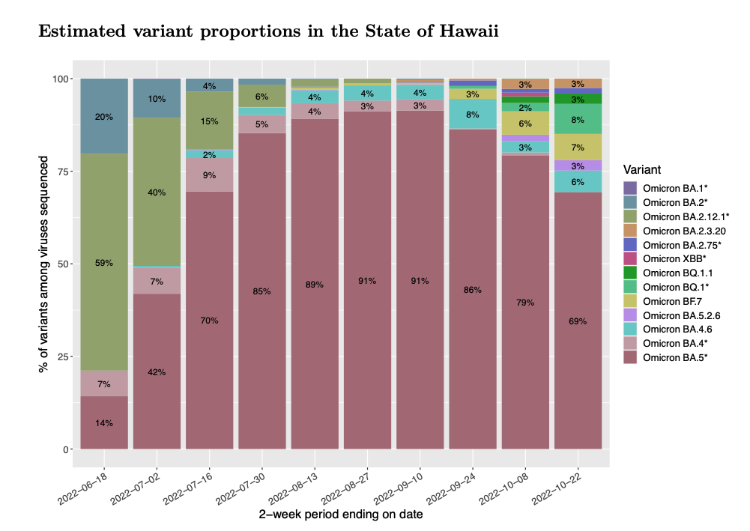
Winter 2022 Surge
Concept of Triple Surge
COVID (new sub variants BQ1 and BQ1.1)
Influenza
Respiratory Syncytial Virus
Notes:
In New Jersy 24% are BQ1 where as Hawaii is 2%

Slide 9
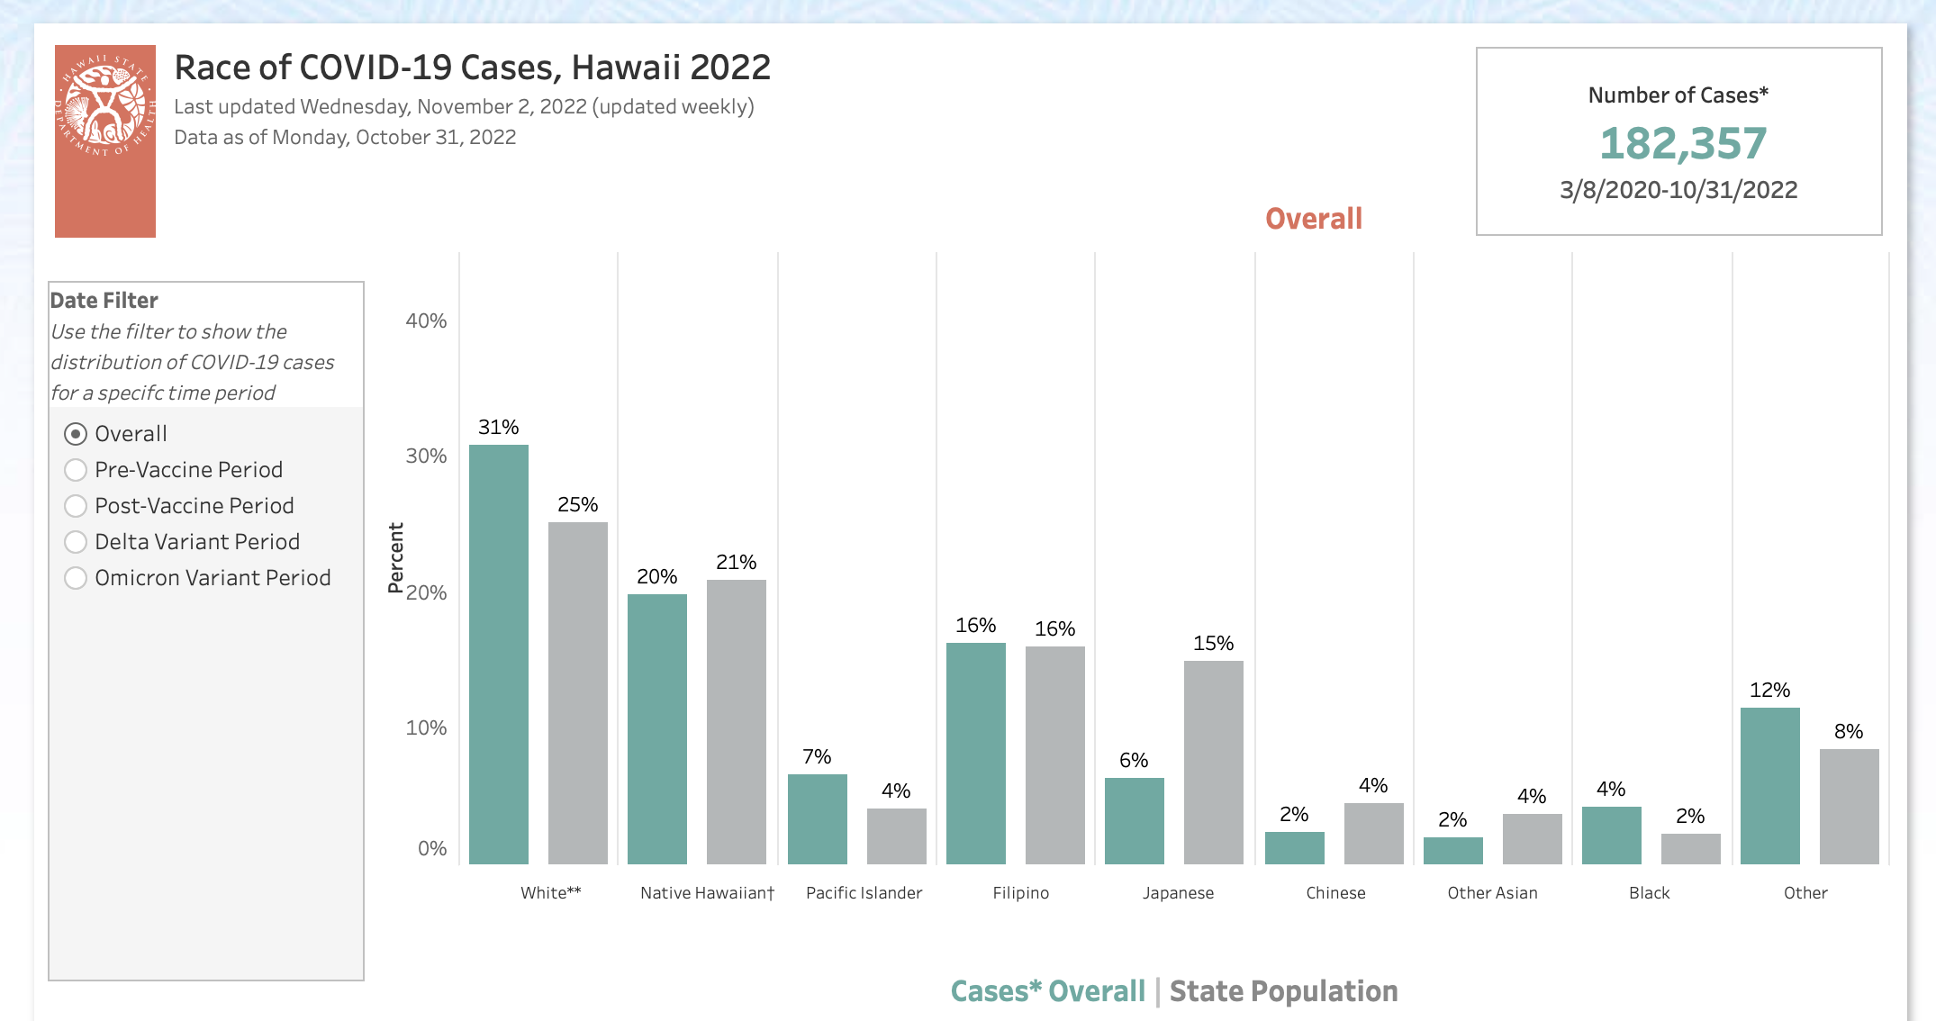
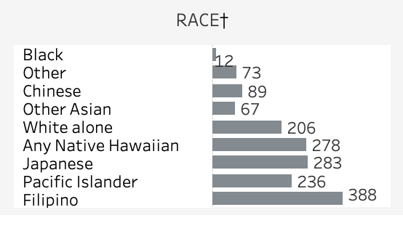
Mortality
Notes:
Filipinos account for 24% of deaths while comprising 16% of the population
Pacific Islanders account for 14% of deaths while comprising 4% of the population
The reason for going over the racial/ethnic make up in acute COVID will allow us to understand the impact that we will see with PASC.

Slide 10
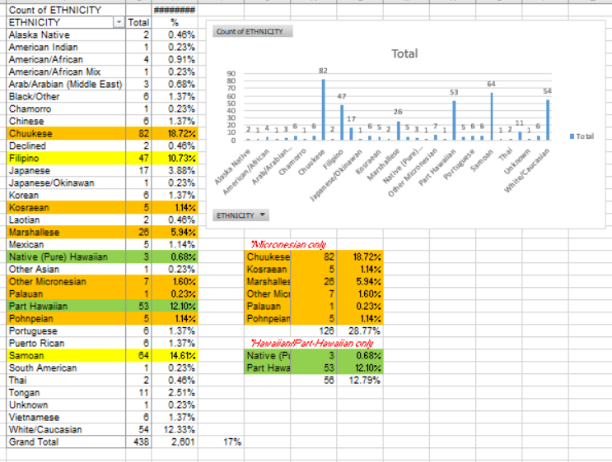
Queen Emma Clinics
December 2021
Notes:
0105-0115 (Igno, Chow) COVID Care Clinic IN-DEPTH

Slide 11
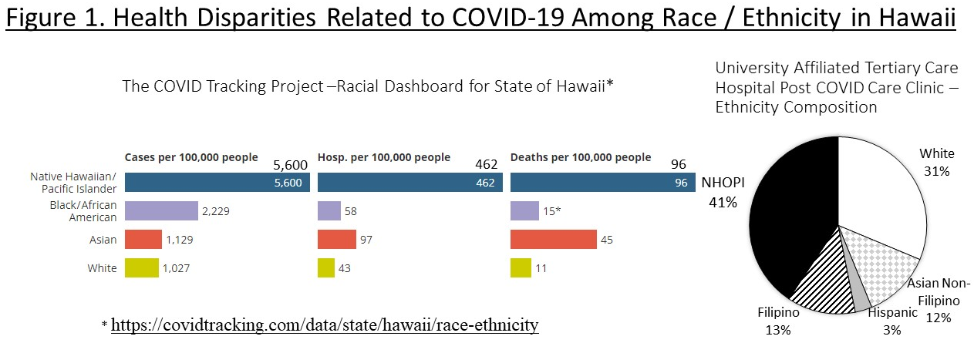

Slide 12
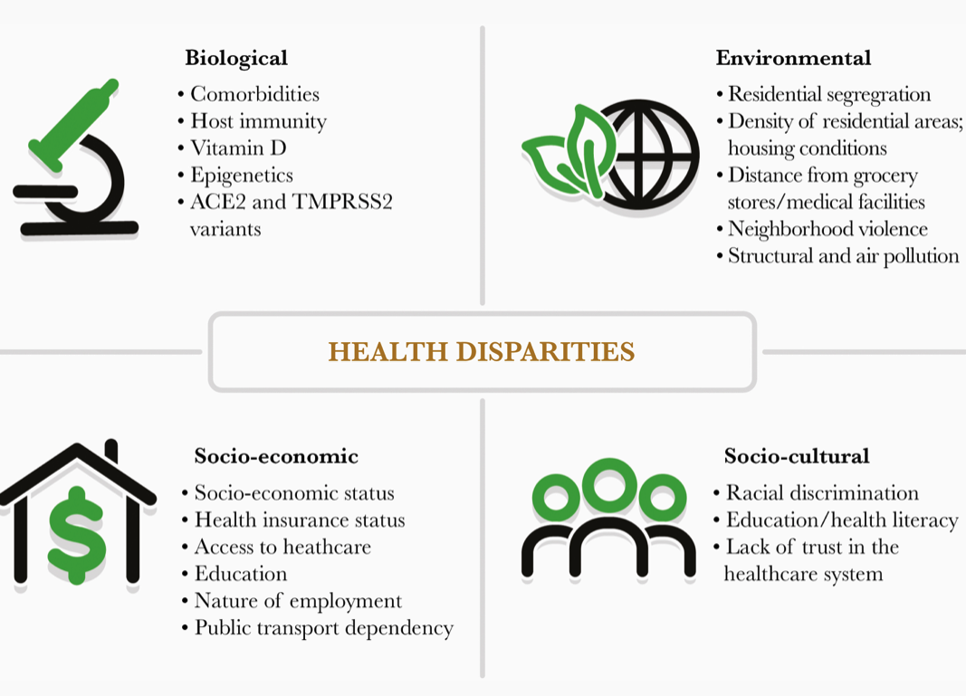
Saini et al OpenForum ID (2021):8;3

Slide 13
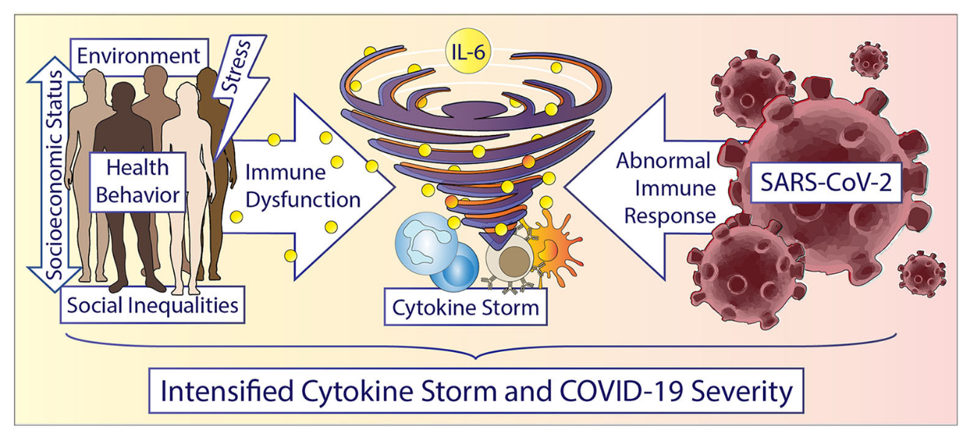
Baumer et al Front Public Health (2020) 8:559312

Slide 14


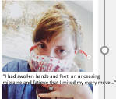
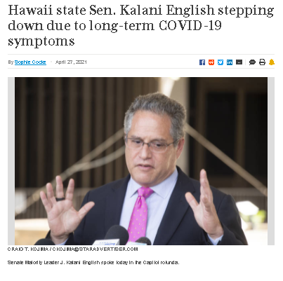
The Next Epidemic…
Post Acute Sequelae of Sars-COV-2 (PASC) – “Long COVID”
10-40% of ALL COVID infections
Duration unknown, possibly permanent
High degree of disability

Slide 15
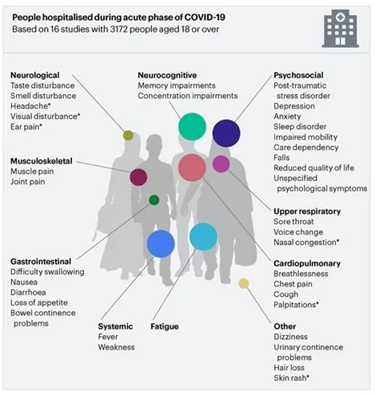
Symptoms of Long COVID
Top Symptoms:
  Fatigue
  Dyspnea
  Anxiety
  Concentration / Cognitive Changes

Slide 16
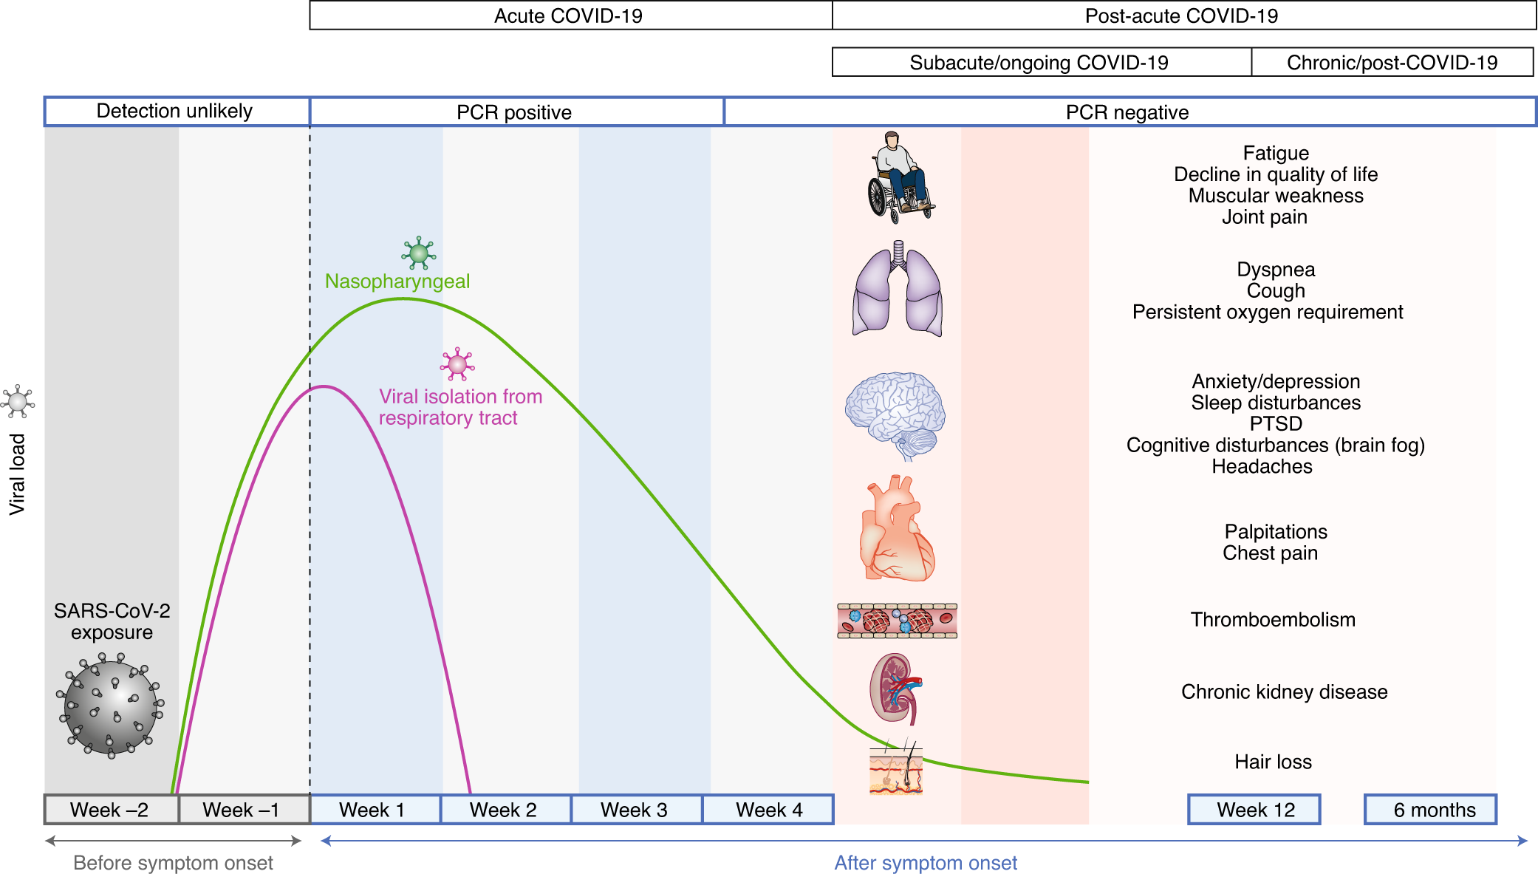
Nalbandian A, Nature Medicine volume 27, pages601–615(2021)

Slide 17
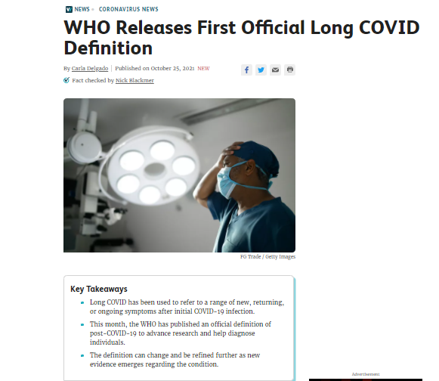
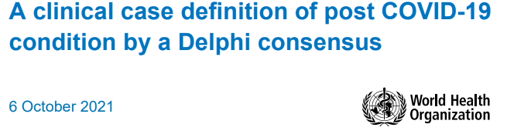

Slide 18
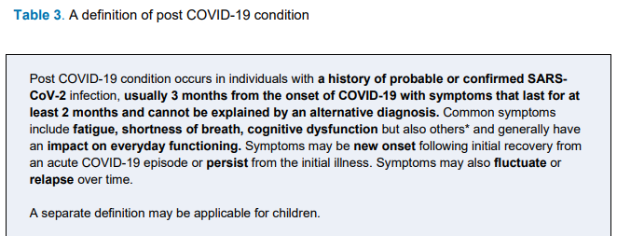
WHO Definition:
CDC Definition: Post-COVID conditions are a wide range of new, returning, or ongoing health problems people can experience four or more weeks after first being infected with the virus that causes COVID-19. Even people who did not have COVID-19 symptoms in the days or weeks after they were infected can have post-COVID conditions. These conditions can present as different types and combinations of health problems for different lengths of time.

Slide 19
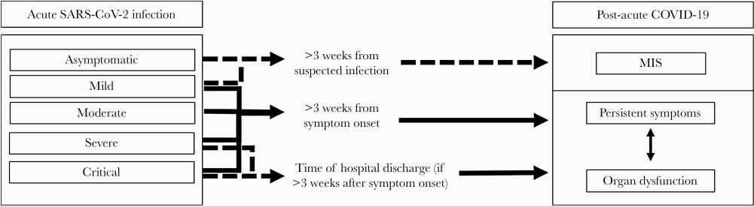
There is likely a relationship between organ dysfunction and persistent symptoms that is not yet completely understood.

Slide 20
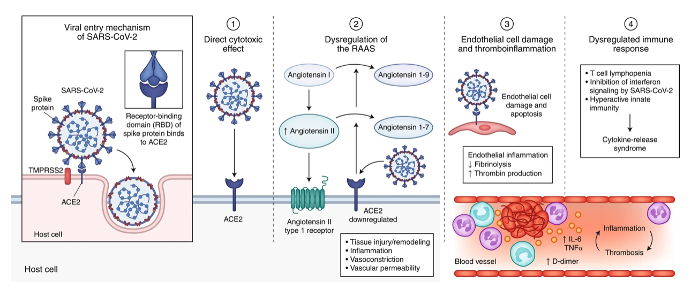
SARS- CoV2 Mechanisms
Gupta et al Nature Med volume 26, pages 1017–1032 (2020)
Notes:
0105-0115 (Igno, Chow) COVID Care Clinic IN-DEPTH

Slide 21
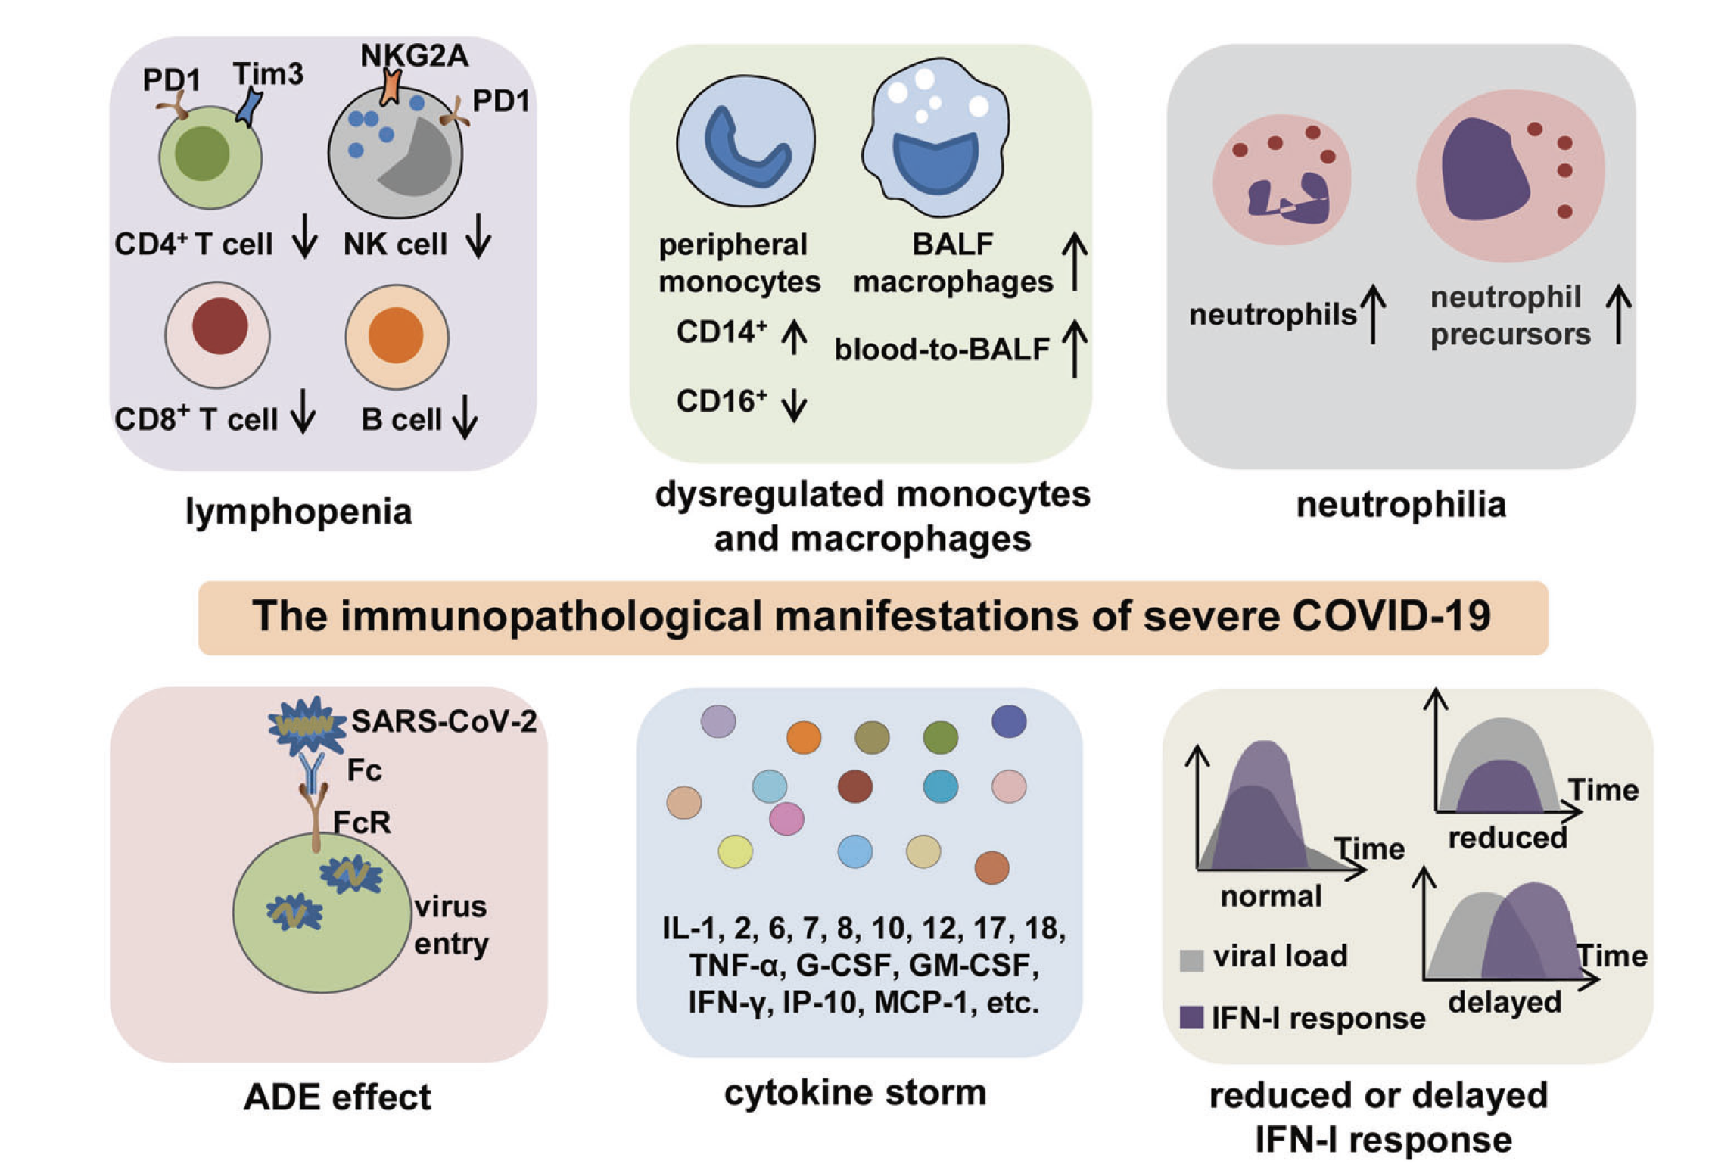
Immunopathology in severe COVID-19
Little known about
-Characterization of innate immune cells in long-term consequence of COVID-19
-A detail of monocyte/macrophage function in PASC development and persistence.
Nat Med. 2021 Apr;27(4):601-615.

Slide 22
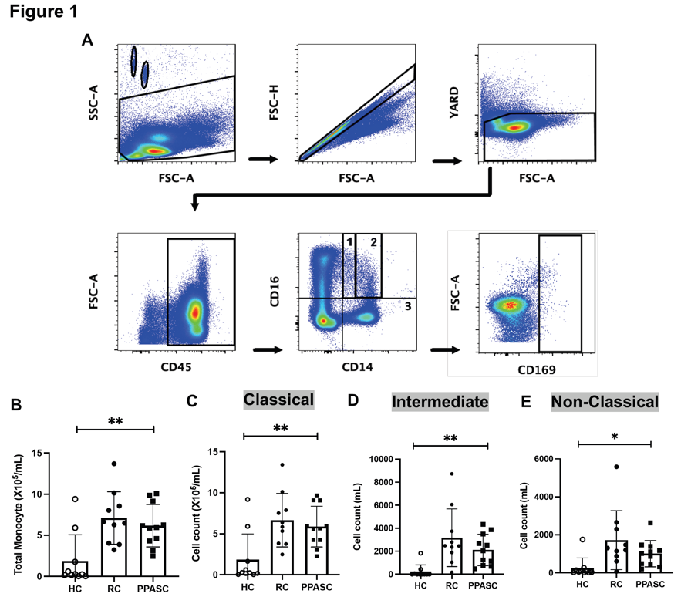
Potential Mechanisms of Long COVID
Autoantibodies
  Woodruff M, medRxiv, 2021.09.21.21263845
Post viral transcripts
  Proal Front. Microbiol., 23 June 2021
Viral Reservior
  Nature Methods volume 18, pages449–453 (2021)
Monocyte activation
  Patterson BK, bioRxiv, 2021.

Slide 23
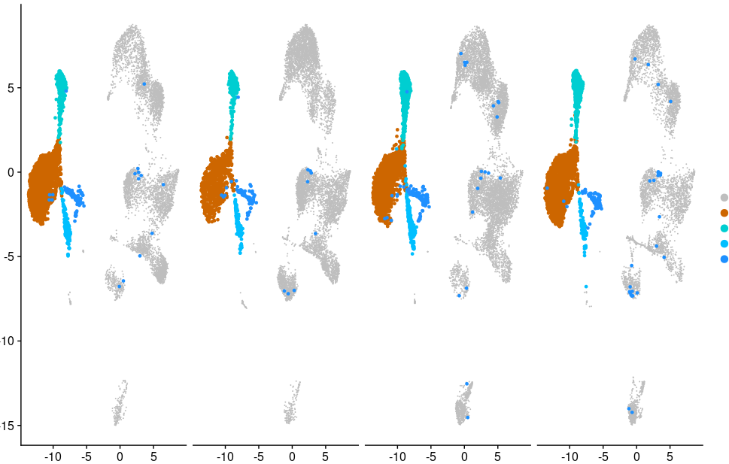
Single Cell Analysis of PBMCs Showed Enriched CD16⁺ Monocytes in Pulmonary PASC (PPASC)
Potential Mechanisms of Long COVID
HC-1
HC-2
PPASC-1
PPASC-2
2
1
4
UMAP_1
3
UMAP_2
1:CD14⁺ monocytes
2:CD16⁺ monocytes
3:Monocyte-derived Dendritic cells
4:Monocyte/macrophage doublet cells

Slide 24
Comparison of CD169⁺ Monocytes Among Groups

Slide 25
Correlation between CD169⁺ Monocyte and DLCOc%

Slide 26
Correlation between CD169⁺ Non-Classical Monocyte and D-dimer

Slide 27
Complications of PASC
Cardiovascular
  Myocarditis, myocardial infarction, cardiac arrest, arrhythmias
Pulmonary
  Fibrosis/inflammation, pulmonary embolism, shortness of breath, chronic cough
Neurologic
  Headache, seizure, strokes, cognitive dysfunction, encephalitis
Psychiatric
  Depression, anxiety, fatigue, PTSD, dysexecutive syndrome (“brain fog”)

Slide 28
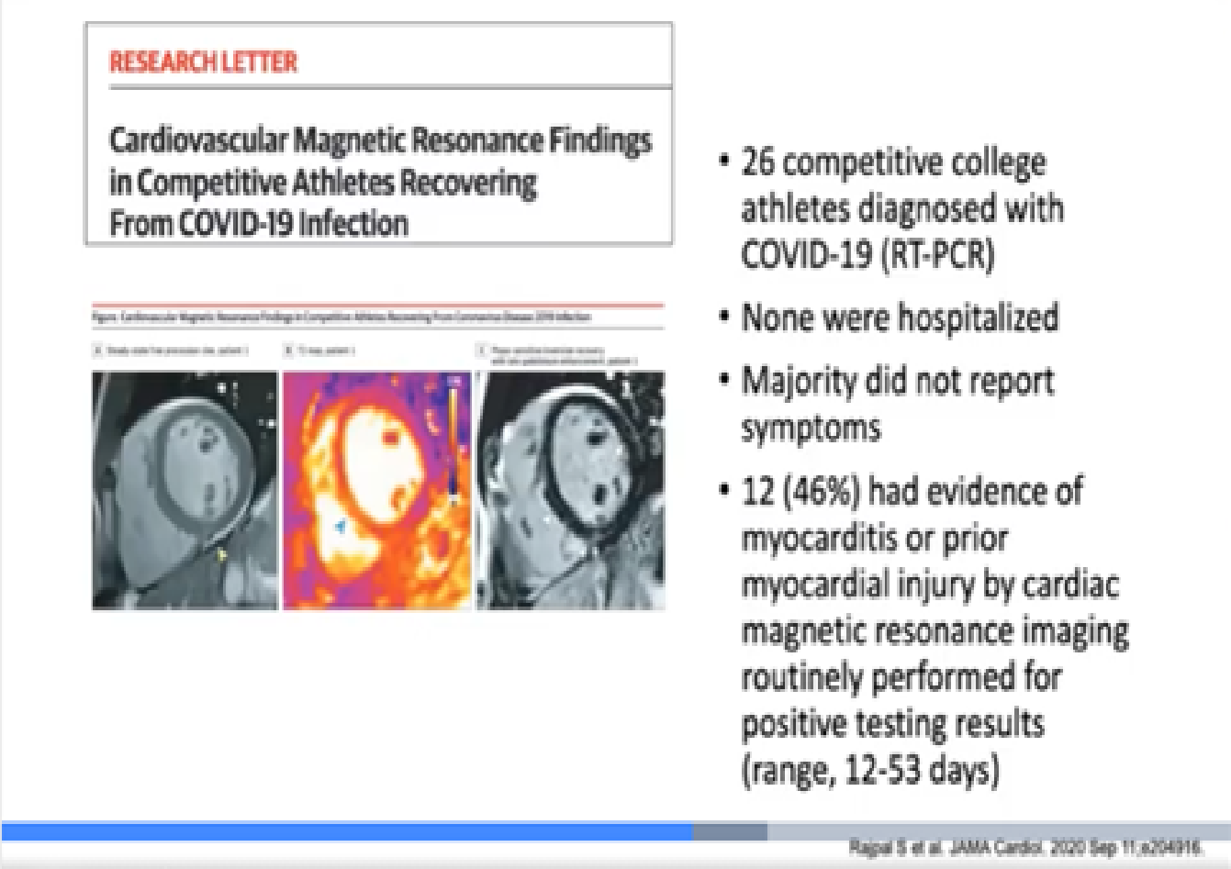
Notes:
0105-0115 (Igno, Chow) COVID Care Clinic IN-DEPTH

Slide 29
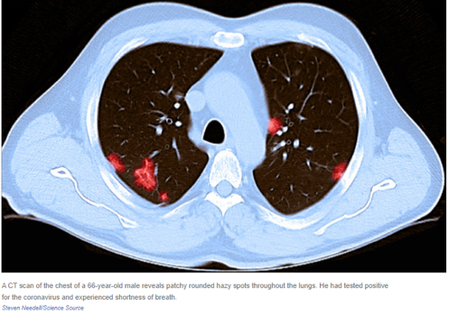
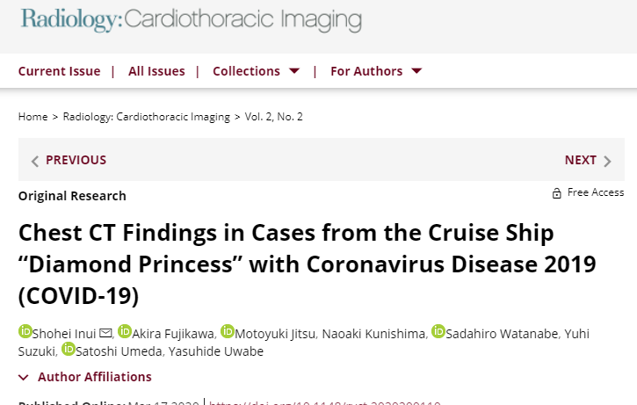
Pulmonary Sequela Common
Asymptomatic cases showed more ground glass opacity (GGO) over consolidation (83%), while symptomatic cases more frequently showed consolidation over GGO (41%).
This study documented a high incidence of subclinical CT changes in cases with COVID-19. Compared to symptomatic cases, asymptomatic cases showed more GGO over consolidation and milder extension of disease on CT.
Notes:
0105-0115 (Igno, Chow) COVID Care Clinic IN-DEPTH

Slide 30
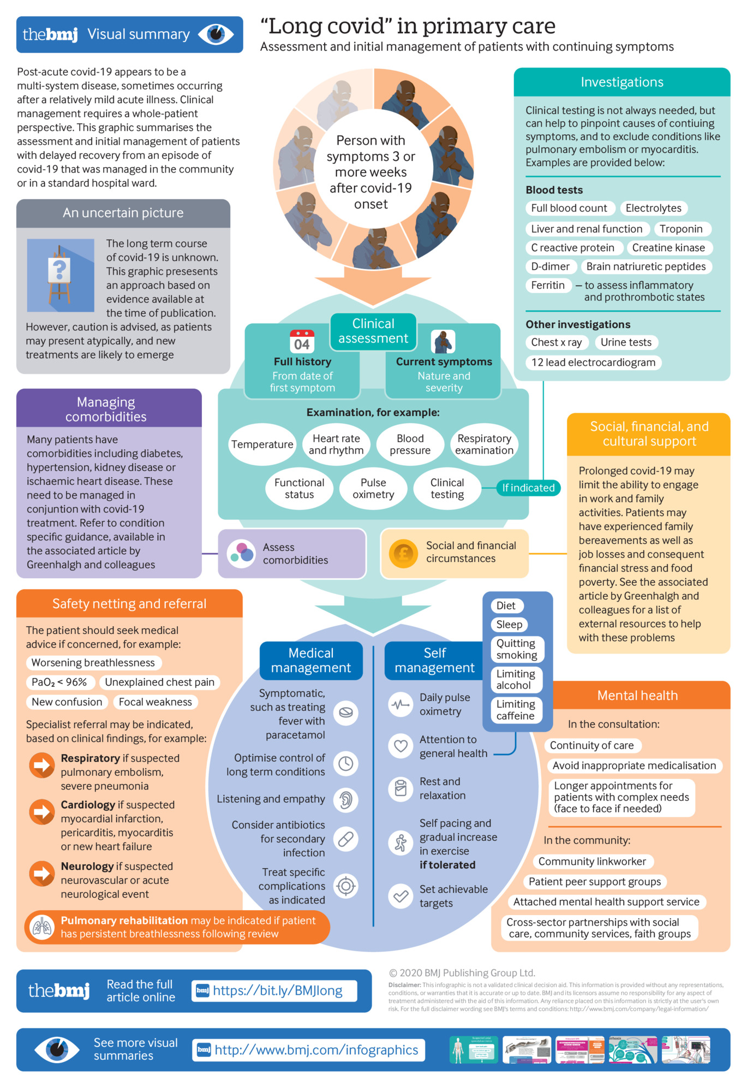
Long COVID in Primary Care
Highly variable
No current guidelines on treatment
Long term disability

Slide 31
'Long-COVID': a cross-sectional study of persisting symptoms, biomarker and imaging abnormalities following hospitalisation for COVID-19
In those discharged with elevated biomarkers, 30.1% and 9.5% had persistently elevated d-dimer and C reactive protein, respectively. 38% of chest radiographs remained abnormal with 9% deteriorating.
Thorax. 2021 Apr;76(4):396-398. doi: 10.1136/thoraxjnl-2020-215818.

Slide 32
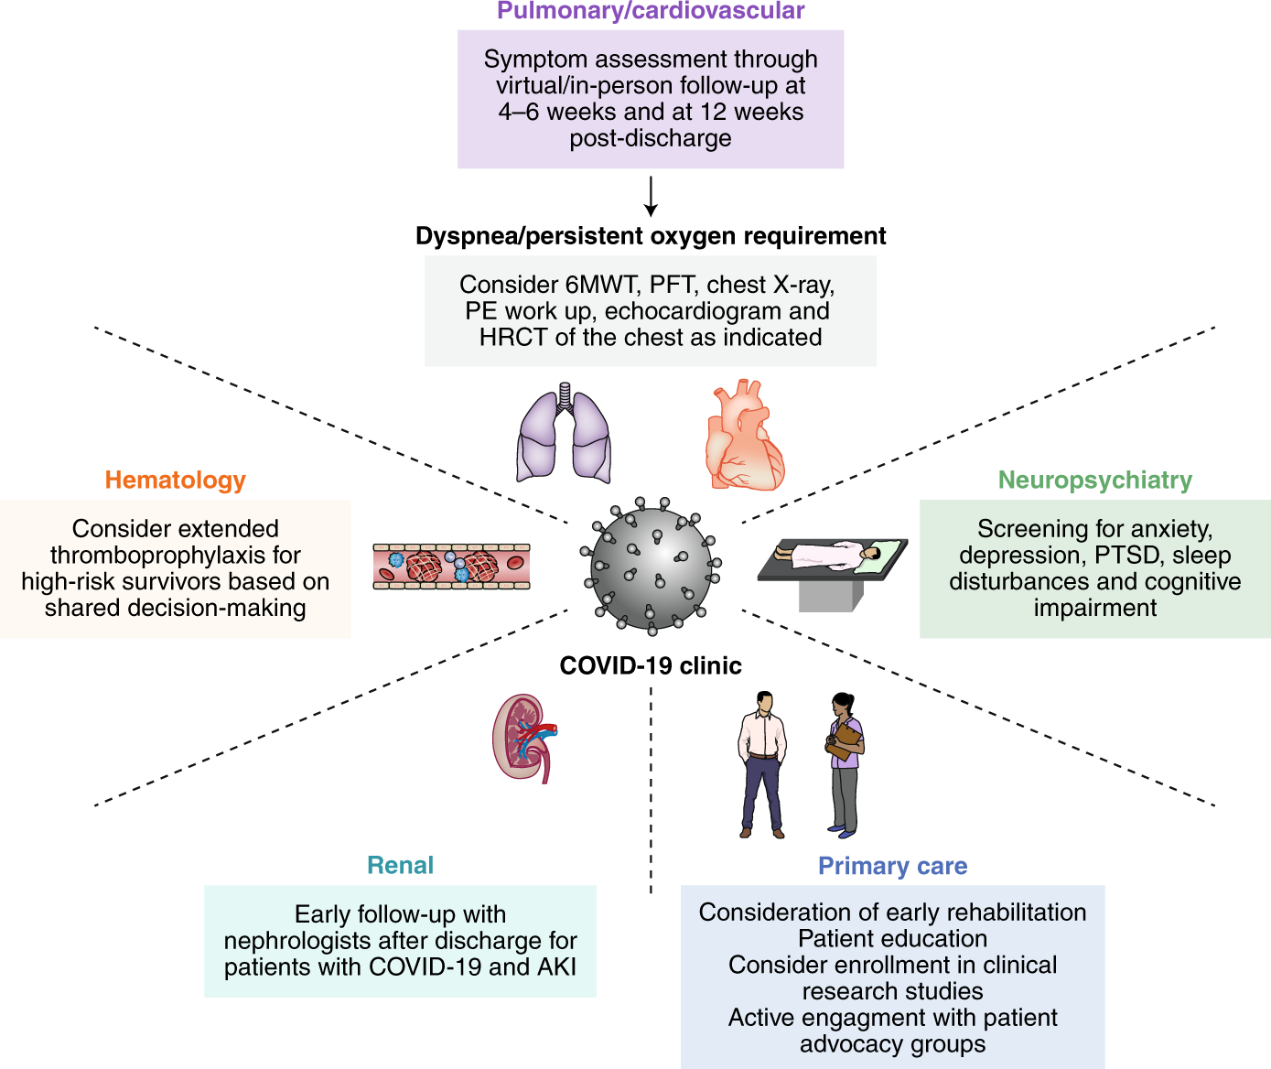
Post COVID Care
Nalbandian A, Nature Medicine volume 27, pages601–615(2021)

Slide 36
The Queen’s Medical Center
Post COVID Care Paradigm
Clinical
Local Studies at Queens
COVID Seroprevalence Study
  Myra W. and Jean Kent Angus Foundation
Telmisartan – Inpatient / Ambulatory
RECOVER COHORT NETWORK
Research
Occupational and Student Health Services
Education
Notes:
0105-0115 (Igno, Chow) COVID Care Clinic IN-DEPTH

Slide 37

Long COVID Treatment
Early in the disease course – No clinical guidelines
May provide insight into complications in the future
  Cardiovascular - Referral to Cardiology
    Primary / secondary prevention
  Pulmonary – Referral to Pulmonary
  Neuro/psych – Referral to Neurology and Psychiatry
    Cog Rehab
  Other – GI, Rheumatology and Nephrology Services
May help in getting your patients into seeing the subspecialists more quickly
May help in coordinating care with PT/OT, social services
Clinical trials
Notes:
0105-0115 (Igno, Chow) COVID Care Clinic IN-DEPTH

Slide 38
Current Therapies – Symptoms Targeted
Fatigue / Chronic fatigue syndrome
Get vaccinated and boosted
Exercise target of 80% Max heart rate
Improve sleep
Antihistamine therapy to address MAST cell activation
Selective serotonin reuptake inhibitors (SSRIs) / Serotonin and norepinephrine reuptake inhibitors (SNRIs)
Counseling
Aspirin, antiplatelet therapy and Statin
Low Dose Naltrexone (LDN)

Slide 39
Current Therapies - Pulmonary disease
Exercise / deep breathing
Oxygen supplementation of <88% RA or drop of 5% drop from baseline
Inhaled cortical steroids / Long acting beta agonist (PRINCIPLE, STOIC phase 2)
ACEI/ARB ?
Trials looking at antifibrotics nintedanib, pirfenidone (PINCER, NINTECOR, ENDCOV-1)
Oral steroids – May help if early interstitial lung disease / abnormalities
Herbal Supplements
  Allium sativum, Althaea officinalis, Andrographis paniculate, Commiphora molmol, Cymbopogon citratus, Echinacea sp, Eucalyptus globulus, Hedera helix, Justicia pectoralis, Magnolia officinalis, Malva sylvestris, Mikania glomerata, Pelargonium sidoides, Pimpinella anisum, Platycodon chinensis, Polygala senega, Scutellaria baicalensis, Silybum marianum, Thymus vulgaris, Cinchona
Ann Am Thorac Soc. 2021 May;18(5):799-806.

Slide 40
Telmisartan / ACEI / ARB Studies
Fewer Deaths in Hospitalized COVID Patients on an ACEI or ARB.
  MedRxiv.org
Fewer Respiratory complications
  Hippisley-Cox. Heart. 2020 Oct;106(19):1503-1511.

Slide 41
Nasal Congestion / Chronic Cough
MAST cell activation
  Moderate to high dose antihistamine (H1 and H2 blockers)
  Pinto MD. The Journal for Nurse Practitioners, https://doi.org/10.1016/j.nurpra.2021.12.016

Slide 42
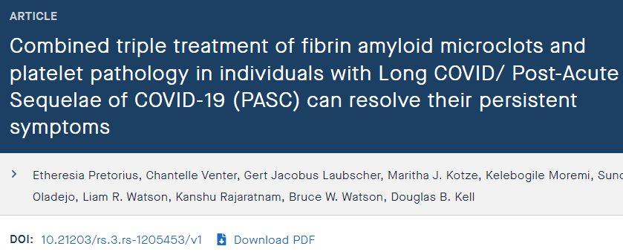
Current therapies
Brain Fog
Cog Rehab, reminders, supportive therapy
Antiplatelet therapy
Stimulants – Modafinil
Anxiety
Counseling
SSRI / SNRI
Benzodiazepine
Medical Marijuana / CBD
Under-Review in Nature – STIMULATE Study

Slide 43
Current therapies
Postural orthostatic tachycardia syndrome (POTS) – reclassified as “Post COVID tachycardia syndrome”
Exercise on recumbent bicycle
Oral rehydration
Increase salt intake
? Mineralocorticoids/ BB/ Midodrine
? anti-inflammatory drug colchicine
Thrombotic events / Endotheliitis
NOAC
Aspirin
? Aphersis (plasma exchange)

Slide 44
Current therapies
Loss of smell and taste
Cog Rehab using essential oils and foods
Flonase
Dymista

Slide 45
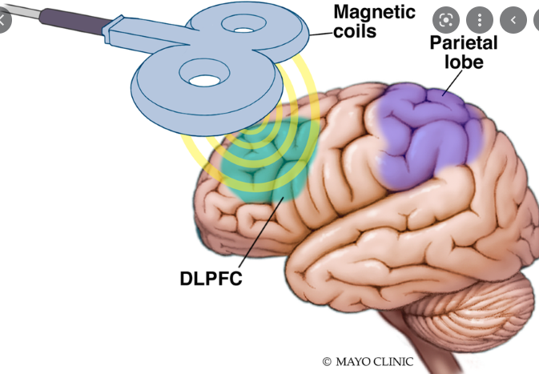
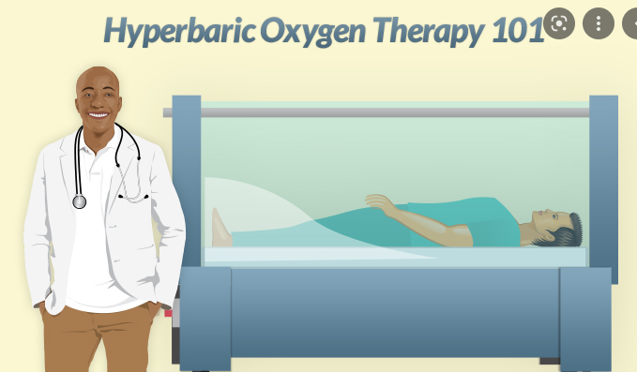
Potential Therapies
Antivirals
  Pfzier – PAXLOVID
  Merck – Molnupiravir
  ? Tollovid (herbal protease inhibitor)
Mast cell inhibitors: Covid-19 hyperinflammation and post-Covid-19 illness may be rooted in mast cell activation syndrome
Inhaled Telmisartan
Stem Cell Therapy (Hope Biosciences Stem Cell Research Foundation)
Transcranial Magnetic Stimulation
Hyperbaric Oxygen Therapy

Slide 46


COVID-19 Community Ambulatory Recovery and Evaluation (CARE) Center

Slide 47
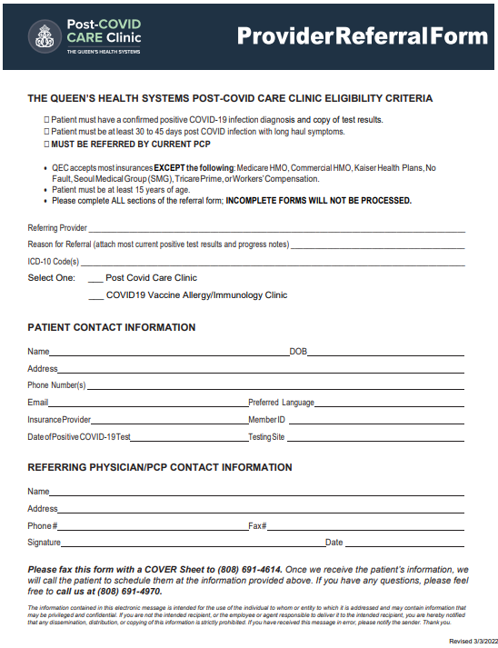
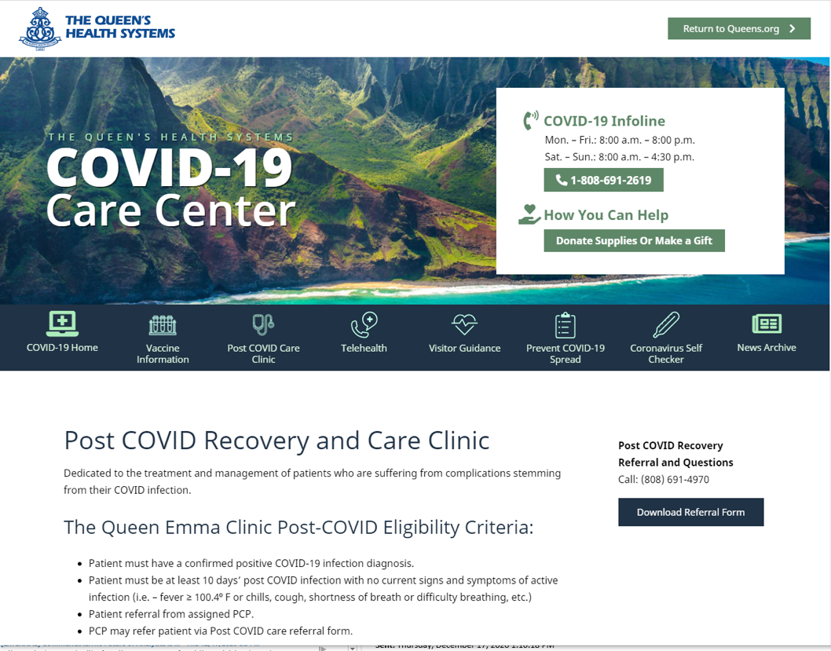
PCCC Website
PCCC Referral Form
Vaccine Immunology Clinic
Notes:
0105-0115 (Igno, Chow) COVID Care Clinic IN-DEPTH

Slide 48

Mahalo
Special Thanks
Our Patients and Staff
Gehan Devendra, MD
Juwon Park Ph.D.
Cecilia Shikuma M.D.
Myra W and Jean Kent Angus Foundation
Our Staff and our Patients

Slide 49
JABSOM Studies call 808-723-0040 covid@hawaii.edu
PASC in Hawaii
  5-year prospective study that seeks to understand the role of monocytes in the development and persistence of PASC and the effect of underlying health disparities.
  Enrolling individuals with effects of PASC, recovered individuals and those who have never been infected.
    Particular interest in ensuring that our local population at risk (Native Hawaiians, Other Pacific Islanders and Filipinos)

