Slide 1
UH JABSOM and Hawaii State Rural Health Association
conducted through Hawaiʻi/Pacific Basin Area Health Education Center
welcome you :
Behavioral Health ECHO
“Ketamine Clinical Uses and
Thoughts on Mechanisms”
Speaker:
Michael Pasquale, D.O. FAAPS
Medical Director - Ketamine Clinic of Hawaii
January 17, 2023
The speaker and planners (Drs. Dan Alicata and Kelley Withy, and Summer Mochida-Meek)
have no relevant financial relationships with ineligible companies.

Slide 2
Ketamine -Clinical Uses and thoughts on mechanisms
Ketamine Clinic of Hawaii
Dr Michael Anthony Pasquale D.O. FAAPS

Slide 3
Ketamine Clinic Of Hawaii
Established 2013
First Clinic in the State of Hawaii
Over 3800 treatments sessions , 723 Individuals Avg 5.5 sessions per pt
- Treatment resistant depression 442
- Chronic Pain ( CRPS) 202
- PTSD 49
- Addictions 16
- mixed disorders Including bipolar / anxiety disorders 14

Slide 4
Medical Director Dr Michael Pasquale D.O. FAAPS.
Background
Philadelphia College of Osteopathic Medicine 1987
NYU General Surgery Program completed 1993
EVMS/ NYU Plastic Surgery Residency completed 1996
International Institute of Reconstructive Microsurgery Fellowship
Clinical Professor several Osteopathic Medical Schools presently
Assistant Professor NYU General Surgery 1992, 1993
20 years hospital Staff QMC , Kapiolani , Hilo Hospitals , now private surgical/ antiaging / wellness clinic “Infinity Life Center”
Teach Plastic Surgery China , Korea , Japan since 2002 , Hold a Chinese medical license , Hawaii medical License
Medical Director Ketamine Clinic of Hawaii and Stem Cell treatment Center Hawaii

Slide 5
Why did I start the ketamine clinic of Hawaii ?
Friend with Severe Depression , ECTs monthly looking for alternatives
Observed Success and delved in deeper
There was no ketamine clinic here and a need
My exp with Ketamine as anesthetic, and critical care
My experience as a neural microsurgeon –CRPS patients, peripheral nerve surgery.
NO exp in mental health , but took referrals from mental health care professionals

Slide 6
History of Ketamine
First used as an anesthetic in the 1960s, extensively used in Vietnam War.
It was first reported to have antidepressant properties in 2000, when it was demonstrated that an intravenous (IV) administration of a sub-anesthetic ketamine dose resulted in a reduction of MDD symptoms rapidly and continuing to 72 h after treatment. (Berman RM, Cappiello A, Anand A)
Nasal Ketamine Spray was rushed to approval in 2019 as an antidepressant

Slide 7
What is ketamine ?
A dissociative anesthetic, a psychedelic , hallucinogenic ?
NMDA receptor antagonist
General Anesthetic
Analgesic
AntiDepressant
Party drug ?
Horse tranqulizer ?

Slide 8
What is NMDA receptor and what do they do?
The N-methyl-D-aspartate (NMDA) receptor is a receptor of glutamate, the primary excitatory neurotransmitter in the human brain. It plays an integral role in synaptic plasticity, which is a neuronal mechanism believed to be the basis of memory formation.
Notice the “ basis of memory formation” and the term “synaptic plasticity”
Noone is 100% sure despite PET scans and extensive study at this point but we are getting there
How does it work ?

Slide 9
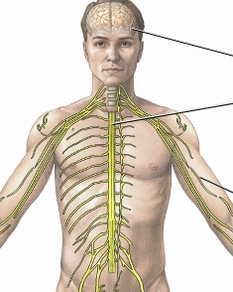
An easy way to visualize how ketamine works
1. Example of CRPS and microsurgery I experienced as a microneural surgeon.
- Abnormal EMG before surgery
- Normal EMG after surgery
2. Example of Phantom Limb Pain
- No foot , No limb
Where is pain then ?

Slide 10
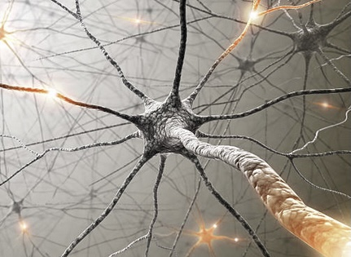
How to visualize how ketamine works part 2
Its central based ---after time , for pain the cutoff is about 2 years
My concept:
Chronic condition leads to error in brain “ homeostasis “
That its to say a semi permanent rewiring to the “new normal”.
Unfortunately, the new normal is pathological
Ketamine ( recall slide on NMDA and neuroplasticity) allows the brain to be “re-wired” .
That is to say new synaptic connections to form.

Slide 11
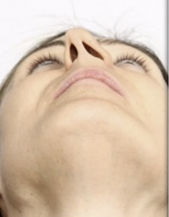
How to visualize how ketamine works part 3
Lesson from Plastic Surgery
Septal deformity ie crooked nose
This leads to why patients need “touch up treatments.

Slide 12
Our protocols
Pain patients we take with no referral as I am qualified
4 hour treatment or more low dose
Mental Illness patients have psychiatric clearance
1 hour treatment
All patients have a licensed nurse exp in ketamine in room and continuously monitored BP, O2 Sat, HR, EKG if indicated as in older patients
Complete Crash Cart, ventilator etc available
For research all patients have an appropriate scale such as pain scale , depression scale taken each visit.

Slide 13
Our ongoing research

Slide 14
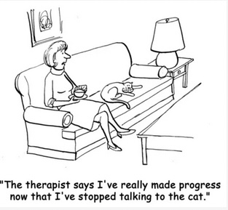
Personal Random Thoughts
Nasal Spray and Lozenges.
Who is qualified to provide ketamine therapy ?
Potential for abuse.

Slide 15
Question and Answers
Contact INFO:
Dr Michael Pasquale
808-945-5433
dr1@infinitylifecenter.com
www. ketamineclinichawaii.com

