Slide 1
UH JABSOM and Hawaii State Rural Health Association
conducted through Hawaiʻi/Pacific Basin Area Health Education Center
welcome you :
Behavioral Health ECHO
“Understanding Confidentiality
and Minor Consent in Hawaii”
Speaker: Colleen Fox, PhD, CSAC, CPS, CCS
January 10, 2023
The speaker and planners (Drs. Dan Alicata and Kelley Withy, and Summer Mochida-Meek)
have no relevant financial relationships with ineligible companies.

Slide 2
UNDERSTANDING CONFIDENTIALITY AND MINOR CONSENT IN HAWAII
Colleen Fox, PhD, CSAC, CPS, CCS, CSAPA
Director of Adolescent Services, Hina Mauka

Slide 3
Today’s Presentation
Background
Hina Mauka’s Teen CARE programs for youth
Substance Misuse Prevention, Substance Use Disorder Treatment, and Intensive In-Home Therapy
Funding sources include ADAD, CAMHD, and the Judiciary.
Objectives
Differentiate between a minor’s ability to consent to services and confidentiality
Understand what health services a minor can consent to and at what age
Disclosures
I have no conflicts of interest to disclose

Slide 4
Guide Development
Modeled after sections of California guide
Collaborated with:
Karissa DeWeerd, MSW Practicum Student
Dina Shek, JD, Legal Director of the Medical-Legal Partnership for Children in Hawaii at the Law School
Rebecca Grennon, MS, Law Student
Disclaimer: The information in this document does not, and it not intended to, constitute legal advice; instead, all information, content, and links are for general informational purposes only. It may not include the most up-to-date information.

Slide 5
Informed Consent
It is the responsibility of the health professional to provide information about the benefits, risks, and alternatives to any recommended treatment.
Informed consent includes 5 essential elements:
Authority to Consent
Information and Knowledge
Understanding
Voluntariness
Documentation

Slide 6
Confidentiality
A set rules or ethics limiting access to the information a patient has revealed to their healthcare provider
Consent vs Confidentiality
Even if a minor can consent to a healthcare service, the service may not be confidential and could be redisclosed to the minor’s parents or guardians

Slide 7
Drug and Alcohol Treatment
A minor can consent to Substance Use Disorder treatment without consent or authorization by a parent, guardian, or custodian (HRS)
Parents are not financially responsible, but the youth is (HRS)
Written consent by minor client required for provider to disclose information shared by client (CFR 42 Part 2)
Applies to those who work in a federally-assisted program
The information cannot be further redisclosed
Cannot confirm or deny if someone is a patient without a written consent
In Hawaii we need a consent signed by the minor to share information, including to parents

Slide 8
Mental Health Services
A minor, 14 years or older, may consent to outpatient mental health services without the consent, knowledge or participation of their parents or legal guardians, upon consultation and agreement of their licensed therapist.
Neither the minor nor their parents or legal guardian may be held liable for payment for these services.
Parental consent required for medication and for out of home care.

Slide 9
SUD Tx vs Mental health Treatment
SUD Treatment
CFR 42 Part 2 + HIPAA
CFR prohibit any further disclosure of the record
Youth consents to family involvement
Consent based on cognitive ability to provide informed consent
Need special court order and hearing to gather information for criminal prosecution
Mental Health Tx
HIPAA
May be subject to redisclosure and loss of privacy
Therapist determines family involvement
Consent at age 14 or older
Traditional court order sufficient

Slide 10
Emergency Shelter
A minor, any age, may consent to emergency shelter and related services if the provider:
Can’t reach parents
Believe they would be subject to harm if went home

Slide 11
Contraception
A minor may access emergency contraception (EC) at a pharmacy, family planning center, or online without parental permission.
A person of any age may buy condoms at a pharmacy, drugstore, vending machine, family planning clinic, or online without a prescription or parental permission.

Slide 12
Family Planning & Pregnancy
There is no age requirement for buying a pregnancy test. A minor does not need a prescription from a health care provider or permission from a parent to get a pregnancy test.
A minor, 14 years or older, may consent to receive medical care for a pregnancy.
Doctors or health care providers may inform a minor’s parent or guardian about services provided, but they are not required to.

Slide 13
STI/HIV Testing & Treatment
A minor, 14 years or older, does not need consent from a parent or guardian to get tested or treated for HIV or a sexually transmitted infection (STI).
Doctors or health care providers may inform a minor’s parent or guardian about services provided, but they are not required to
Abortion
A minor, 14 years or older, does not need to get permission or consent from a parent or guardian to have an abortion.

Slide 14
Parental Notification
Healthcare providers are not required to notify parents or guardians and can provide confidential services. Entities that provide confidential services to youth 14 and older include:
Planned Parenthood provides access to contraception, abortion, and STI testing.
DOH funded Family Planning Health Clinics provide access to contraception, and STI testing.
Diamond Head Clinic, and other DOH testing sites, offer HIV/STI testing and treatment. Hawai'i offers both anonymous and confidential HIV testing services.

Slide 15
Primary Medical Care & Services
A minor may consent to receive primary medical care if they are “without support,” that is, not under the care, supervision, or control of a parent, custodian, or legal guardian
The minor can ask to prevent health insurance billing information from going to a spouse, parent, custodian, or guardian

Slide 16
Hawaii Age of Consent for Sex
The age of sexual consent is how old a person needs to be in order to be considered legally capable of consenting to sex.
At 16 years of age, a person may legally consent to sexual activity
Teens 14 and 15 years old may consent to sexual activity with a person who is less than five years older.
Under the age of 14 cannot consent
Notes:
Sexual consent is different than informed consent. But it’s something that’s important to understand when you work with kids.
The concept of the age of consent refers to the legally defined age at which a person is deemed mature enough to engage in sexual activity.
At 16 years of age, a person may legally consent to sexual activity with another person who has also reached the age of consent (at least 16).
Hawai'i law has an age gap provision that intends to avoid penalizing sexual activity among certain teens. Persons at least 14 and 15 years old can consent to sexual activity with a person who is less than five years older. This part of Hawaii law recognizes that some teens can be in a consensual sexual relationship with one another even if they are younger than 16.
Persons under the age of 14 cannot consent to sexual activity under any circumstances.

Slide 17
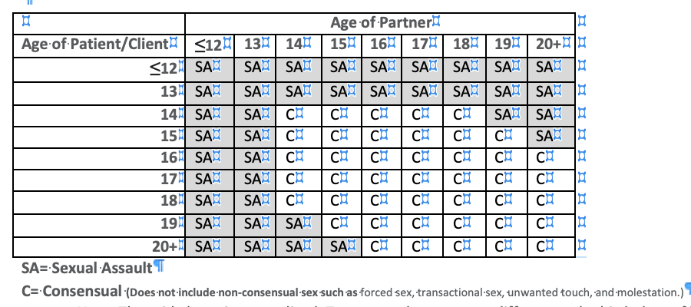
Age of Consent - Hawaii

Slide 18
Substance Use Disorder Counselors and exception to federal restrictions on nondisclosure
Federal restrictions on nondisclosure within substance use disorder treatment does not apply to reporting of suspected child abuse or neglect.
Child abuse or neglect is defined by Chapter 350, HRS as:
"The acts or omissions of any person who, or legal entity which, is in any manner or degree related to the child, is residing with the child, or is otherwise responsible for the child's care, that have resulted in the physical or psychological health or welfare of the child, who is under the age of eighteen, to be harmed, or to be subject to any reasonably foreseeable, substantial risk of being harmed.”
“The acts or omissions of any person that have resulted in sex trafficking or severe forms of trafficking in persons…The term "sex trafficking" means the recruitment, harboring, transportation, provision, obtaining, patronizing, or soliciting of a person for the purpose of a commercial sex act.”
Notes:
Substance use disorder counselors, cannot disclose reported sexual activity or sexual assault without a consent from the client, unless the sexual activity constitutes child abuse.
CFR 42 Part 2 has an exception for reporting child abuse. Child abuse includes 1) physical and psychological harm by a family or household member or 2) sex trafficking of a minor.

Slide 19
Sexting
Sexting falls under child pornography laws
Pictures of a person under 18 engaged in sexually explicit conduct is a crime.
A felony for adults to sext with a minor
A petty misdemeanor for minors to sext with other minors.

Slide 20
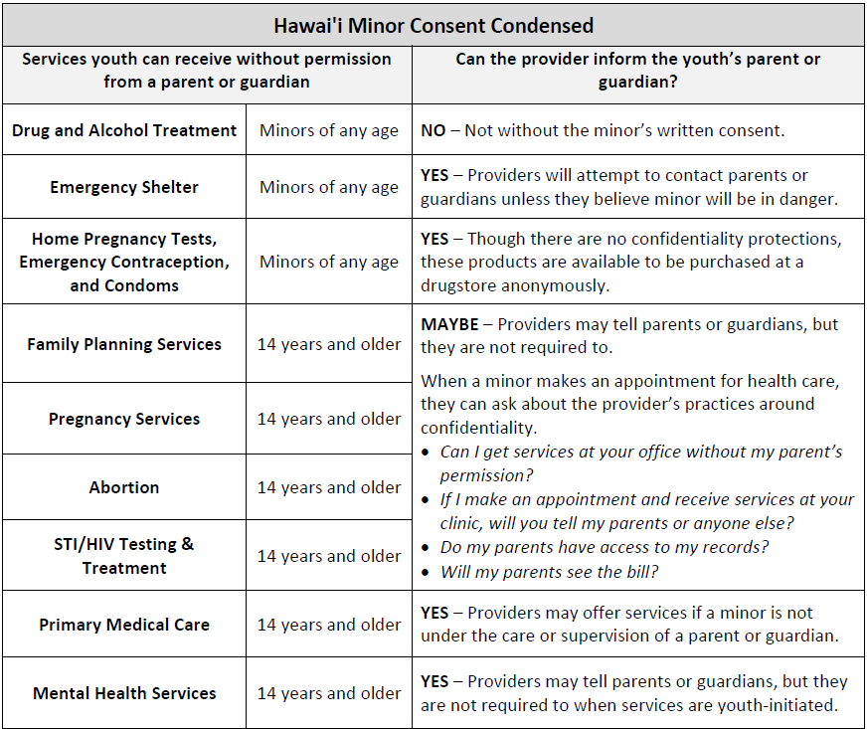

Slide 21
