Slide 1
Medical Conditions Manifesting As Mental Health Problems Dr. Paul Beighley Hawai’i Department of Health I have no actual or potential conflict of interest in relation to this presentation

Slide 2
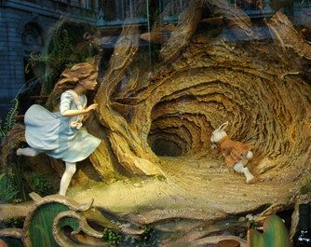
A few rabbit holes …
Functional vs Organic
Medical model
Biopsychosocial model
The lists ….

Slide 3
Functional vs Organic Disease
Organic disease = health condition with an observable and measurable disease process, such as inflammation or tissue damage.
Organic disease = validated and quantified through the standardized biological measures known as biomarkers.
Functional disease = symptoms but whose disease process is either unknown or unable to be measured by current scientific means.

Slide 4
Functional vs Organic Disease
The term ‘functional’ has been criticized as overly simplistic and imprecise … yet … clinicians find it useful in communicating clinical conditions
Epilepsy/seizures, migraine headaches, and Alzheimer's were once considered ‘functional’ disorders
‘Functional’ and ‘organic’ may have loaded social meanings
Distinction is cited as one of the main distinguishing characteristics of patients seen by, and referred to, psychiatrists and neurologists

Slide 5
Functional vs Organic Disease
‘Functional’ disorders are classified by their symptomatic profile despite a lack of biomarkers. Examples include:
Irritable bowel syndrome (IBS)
Chronic fatigue syndrome (CFS)
Fibromyalgia
Temporomandibular joint pain (TMJ)
Gastroesophageal reflux disorder (GERD)
Interstitial cystitis
And, of course, psychiatric diagnoses described in DSM-V

Slide 6
The medical model criticism
Critiques reference the “medical model,” a term that has multiple meanings but has almost always been used pejoratively.
Over the last 6 decades, many published commentaries, from both within and outside the medical community, have criticized medicine’s characterization and management of mental illness and disability.
Disability scholars and self-advocates espoused an alternative “social model,” which redefines disability as a product of an unaccommodating society, rather than an individual and medical problem.

Slide 7
MEDICAL MODEL OF PSYCHIATRY
Diagnostic Constructs are functional vs organic – WHAT IT LOOKS LIKE NOT WHAT CAUSES IT
The medical model co-exists with non-medical approaches and perspectives, and psychiatrists work in an interdisciplinary context with other models and professionals
The medical model attempts to help determine the risks and benefits of a somatic treatment, prognosis of diagnosis, and offer patients options to include medications as appropriate
The medical model recognizes limitations in diagnosis and treatment options
The medical model supports the autonomy of the patient in decision making but recognizes deficits in judgement may need to be considered in the determination of capacity of the patient

Slide 8
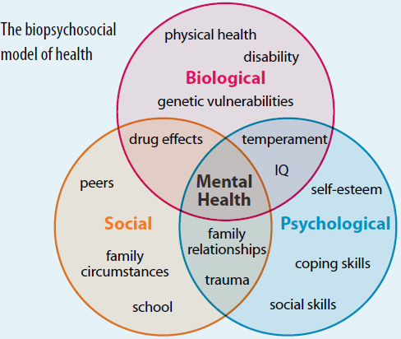

Slide 9
A 70 YEAR OLD WITH PSYCHOMOTOR RETARDATION … ?
70-year-old male with diagnosis of schizophrenia, until the last year stable on antipsychotic medication living at a group home
Gradual decreasing physical activity and withdrawal
No change in reality testing, delusional beliefs, hallucinations
A biopsychosocial approach ….

Slide 10
Biological
Nurse and psychiatrist – no new problems noted from other medical providers, no recent changes in medication or health status, vital signs stable, compliant with treatment prescribed
Is changing the medication going to help? Maybe there is more to the story ….

Slide 11
social
Case manager speaks with manager and group home. Decreased interactions, mostly stays to himself, not moving around much and seems “down”
Is there conflict and avoidance of other residents?

Slide 12
psychological
Case manager, psychiatrist and nurse notice lower self esteem, greater reliance on others.
Difficulty expressing needs due to psychiatric illness and impoverished thought/speech

Slide 13
The problem?
Further discussion and history gathering reveals the problem is poor foot hygiene with ingrown and overgrown toe nails.
Once treated, a return to previous levels of activity.

Slide 14
“When you hear hoof beats, think horse not zebra.”

Slide 15
Focus on the most likely diagnoses first
Consider some ‘organic’ medical conditions commonly have symptoms like those in functional, psychiatric diagnoses
Do not rule out rare diagnoses, always keep your mind open, and longitudinal history can be critical and should never be discounted as valuable. Good notes and records are crucial.

Slide 16
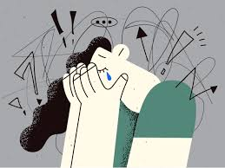
What is the horse??? What is the zebra ????
Transient anxiety symptoms
High blood pressure
Headache
Heavy sweating
Rapid heartbeat
Tremors
Pallor
Shortness of breath

Slide 17
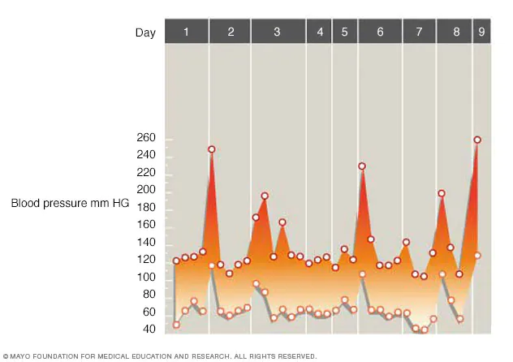
A pheochromocytoma (fee-o-kroe-moe-sy-TOE-muh) a usually noncancerous (benign) tumor that develops in an adrenal gland. It causes symptoms by secreting hormones.
Pheochromocytoma cases are 8 per 1 million people 🦓
Every year, up to 11% of Americans experience a panic attack. Approximately 2% to 3% of them go on to develop panic disorder. 🐴
But …. pheochromocytoma can be treated surgically, completely cured, and can lead to long term complications, even death, if not diagnosed
Finding the zebras is important ! ! !

Slide 18
Red Flags 🚩🚩🚩🚩🚩
Sudden onset
Medical problems
Physical symptoms
Intermittent or waxing/waning symptoms
Abnormal vital signs
Abnormal labs
Atypical presentation
Over 40 no past psychiatric history
Lack of response or atypical response to treatment
Collateral history
Speech deficits
Motor symptoms
Olfactory hallucinations
Headaches

Slide 19
Most common concerns
Delirium
Dementia
Seizures
Traumatic Brain Injury
Infectious
Metabolic
Medication/Intoxication/Supplements

Slide 20
More common concerns
Delirium Tremens/withdrawal
Stroke or brain bleeding
Multiple Sclerosis
Wernicke-Korsakoff Syndrome
Abnormal Blood Sugar
Intoxication

Slide 21
Psychosis
Psychosis versus delirium or “altered mental status”
Present in ways that are not typical
Age
Onset
Type of hallucinations
Course

Slide 22
Depression
Pseudodementia
Thyroid disease
Neoplasm
Apnea

Slide 23
Mania
Intoxication
Thyroid
Delirium

