Slide 1
Chronic Pain Management
Cherie Chu Pharm.D, BCCCP
Associate Professor of Pharmacy Practice
University of Hawai’i at Hilo
The Daniel K Inouye College of Pharmacy
Acknowledgments: Chad Kawakami, Pharm. D

Slide 2
Disclosures
No disclosures or conflicts of interest

Slide 3
Learning Objectives
Distinguish
Identify
Describe
Distinguish between acute and chronic pain
Identify potential barriers to optimal chronic pain management
Describe the impact of multiple comorbidities, such as cognitive impairment, kidney, lung, and cardiovascular disease on the selection of appropriate pharmacotherapy.

Slide 4
Pain- What is it to you?
“An unpleasant sensory and emotional stimulus associated with actual or potential tissue damage or described in terms of damage”
“Pain is whatever the patient says it is, whenever the patient says it does”
Crit Care Med 2018; 46:e825-873
Notes:
Pain often is so subjective, however, that many clinicians define pain as whatever the patient says it is.
The best care is achieved when the patient comes first.

Slide 5
Epidemiology of the Epidemic
Over 50-100 million people in the US live with chronic pain
7.5% with “high impact pain” limiting life or work activities on most days
Estimated economic burden of chronic pain exceeds $500 billion annually
In one year 25 million Americans will experience acute pain and 1/3 will experience severe chronic pain at some point in their lives
Frequently underestimated and inappropriately treated
Institute of Medicine: Relieving Pain in America, A Blueprint for Transforming Prevention, Care, Education, and Research. Washington, DC: National Academies of Science; 2011
MMWR Morb Mortal Wkly Rep. 2018;67(36):1001-1006.
Vital Heal Stat 10. 2014;(260):1–161.
Notes:
Unfortunately, despite much public attention, pain often remains inadequately or inappropriately treated.6,7
Pain is the number one reason why pts seek care in the ED

Slide 6
Pathophysiology
Pain involves complex interactions within the peripheral and central nervous system in response to stimuli that produces pain
Pain also has complex interactions with other biological processes (nociception) impacted by individual psychological and social determinates
Pain can be physiologic and protective (adaptive) or pathophysiologic and harmful (maladaptive)
J Clin Invest. 2010;120(11):3742–3744.

Slide 7
Adaptive Pain
Pain experienced from noxious stimuli involving temperature extremes, trauma, or chemical irritation
Evolutionary mechanism to prevent actual or potential tissue injury
Pain due to tissue damage (trauma or surgery) creates sensitization at and adjacent to the site of injury and engages the immune system (inflammatory pain)

Slide 8
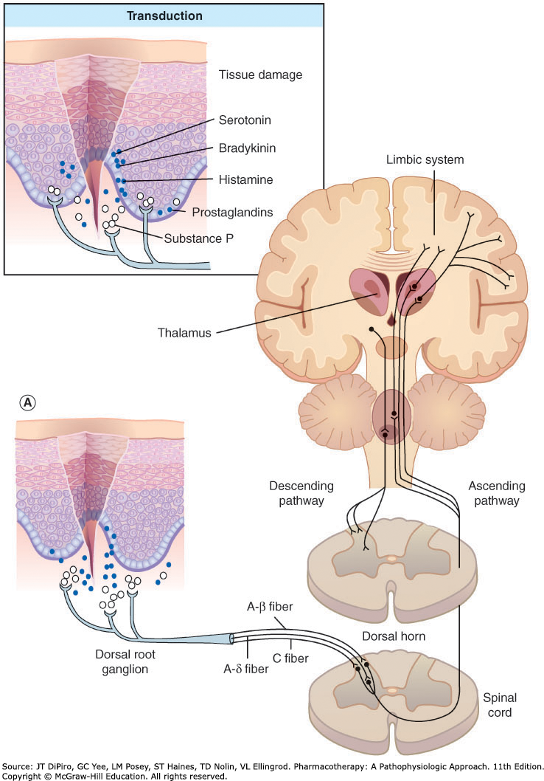
Physiologic Pain Process
Involves
Transduction
Conduction
Transmission
Modulation
Perception
Notes:
Transduction
First step in the pain sensation involves stimulation of specialized nerve fibers known as nociceptors.
Found in both somatic and visceral structures
Determine noxious and innocuous stimuli
Release / activation of numerous cytokines and chemokines that sensitize and/or activate the nociceptors in response to noxious stimuli.
Conduction
Nociceptor activation leads to conversion of chemical signal to electrical signal
Voltage-gated sodium channels
Generates action potentials conducted along primary afferent A-δ and C-polymodal nerve fibers to the dorsal horn of the spinal cord
A-δ: large-diameter, myelinated (sharp, well-localized pain)
C fibers: small-diameter unmyelinated (aching, poorly localized pain)
Transmission
Nociceptive pain fibers synapse in the spinal cord where electrical signal is converted back to chemical signal
Release glutamate and substance P via N-type voltage-gated calcium channels
Pain signal reaches brain through spinal cord to the thalamus.
Thalamus is the relay station that passes the impulses to higher cortical structures where pain can be processed further
Modulation
Brain and spinal cord modulate pain through several processes.
Pain modulated through neurotransmitters
Glutamate and substance P make signals stronger and pain more intense
Endogenous opioids (enkephalins and β-endorphins), γ-aminobutyric acid (GABA), norepinephrine, or serotonin decrease pain^{1,2}
Other receptor types also influence
blockade of N-methyl-D-aspartate (NMDA) receptors may increase the mu (μ)-receptors’ responsiveness to opiates.³
Perception
Complex interplay between the ascending excitatory and descending inhibitory pathways contribute to developing the conscious pain experience
Takes place in higher cortical structures
Cognitive and behavioral functions can modify pain.^{1,2}
Relaxation - improve
Distraction - improve
Meditation - improve
Depression – worsen
Anxiety – worsen

Slide 9
Maladaptive (Pathologic) Pain
Pain is disengaged from noxious stimuli or healing
Chronic pain is a result of damage or abnormal functioning of the peripheral – and / or central nervous system
Notes:
Adaptive inflamation
Prolonged duration can cause neuronal hyperexcitability
Shift from acute to chronic pain

Slide 10
Chronic Pain
States are often a simultaneous mix of the following mechanisms:
Nociceptive
Neuropathic
Centralized
Pain reported does not jive with physical exam findings or imaging
Results in undertreating or inadequate pain relief
J Am Med Assoc. 2014;311(15):1547

Slide 11
Mechanism- Chronic Pain
Nerve damage causes changes in neurotransmission leading to increased pain
Pain circuits rewire producing a mismatch between pain stimulation and inhibition
Chronic Pain
Episodic or continuous pain transmission (burning, tingling, shock-like, or shooting)
Exaggerated painful response to normally noxious stimuli (hyperalgesia)
Painful response to normally non-noxious stimuli (allodynia)
Notes:
Peripheral changes may include: alteration in nociceptive nerve fiber sensitivity, alteration of sodium channels, collateral sprouting of nerve fibers
Central changes may include: hyperexcitability of central neurons or central sensitization, NMDA-glutamate receptor activation, central disinhibition

Slide 12
Chronic Pain Types
Intermittent
Migraines
Continuous
Arthritis (osteoarthritis / rheumatoid arthritis)
Mixed Nociceptive / Neuropathic Pain
Failed low back pain
Neuropathic pain
Diabetic polyneuropathy, post-herpetic neuralgia
Central Pain Syndromes (Dysfunctional Pain Syndromes)
Fibromyalgia, Irritable bowel syndrome, interstitial cystitis
Notes:
Neuropathic pain – ongoing peripheral nerve injury
Diabetic polyneuropathy, post-herpetic neuralgia
Central Pain Syndromes (Dysfunctional Pain Syndromes) – no nerve injury or inflammation exists but centrally mediated disturbance in pain processing
Fibromyalgia, Irritable bowel syndrome, interstitial cystitis

Slide 13
Presentation- Chronic Pain
General – Can appear to have no noticeable suffering
Symptoms - sharp, dull, shock-like, tingling, shooting, radiating, fluctuating in intensity, and varying in location. Can change over time.
Signs:
Hypertension, tachycardia, diaphoresis, mydriasis, and pallor are seldom present.
Comorbid conditions are often present (insomnia, depression, and anxiety)
Labs:
Pain is always subjective, there are no specific tests for pain
Best diagnosed based on patient description and history

Slide 14
Assessing Pain
Thorough history is critical to evaluation of patient with chronic pain to determine reasonable pain goals
Multiple different methods
Notes:
Pain impact Questions:
Social and recreational functioning: How often do you participate in pleasurable activities,
such as hobbies, going out to movies or concerts, socializing with friends, and travel? Over the
past week, how often has pain interfered with these activities?
Mood, affect, and anxiety: Has pain interfered with your energy, mood, or personality? Are
you readily tearful?
Relationships: Has pain affected relationships with family members/significant
others/friends/colleagues?
Occupation: Has the pain required that you modify your work responsibilities and/or hours?
When was the last time you worked, and (if applicable) why have you stopped working?
Sleep: Does pain interfere with your sleep? How often over the past week?
Exercise: How often do you do some sort of exercise? Over the past week, how often has pain
interfered with your ability to exercise?
ADL IADL impact:
Is the patient able to perform activities of daily living?
• Can they brush their teeth, comb their hair, or bathe?
• Can they manage using the toilet and cleaning without assistance?
• Can they feed themselves?
Is the patient ambulatory?
• Do they need an assist-device (eg, cane, brace, walker, crutch)?
• Has their ambulation changed since the pain started?
• How far can the patient ambulate?
How fast can they walk (eg, how long does it take the patient to get from the parking lot to
your office, compared to your own time?)
Is the patient able to dress independently?
• Able to put his/her own shoes and socks on?
• Can the patient put a shirt on himself?
• If the patient wears a bra, is she able to put it on by herself?
Is the patient able to manage household chores, including shopping, cooking, bill paying?
• Is the patient able to drive a car?
• Can the patient get in and out of a car with relative ease?
• Is the patient able to get up and down from sitting on a chair or toilet?
BPI - The BPI assesses pain location, intensity, and pattern as well as patient beliefs and
the impact of pain on the patient’s quality of life.
McGill Pain Questionnaire - includes a
selection of descriptive words to characterize qualities of pain, a pain intensity scale, a
questionnaire on the use of analgesic medications and prior pain experience, and a human
figure drawing [10]. Specific words selected to characterize the pain quality may suggest a
particular pathophysiology (eg, burning, dysesthetic, or electric-shock-like pain may imply
neuropathic pain).
Patient Perceptions and psychological factors:
Patients should be asked about possible maladaptive behavioral patterns that may influence the
course of pain rehabilitation. Of particular concern is history related to underlying psychological
disorders (eg, depression, anxiety) or a history of substance abuse, including prescription drugs.
A patient's specific beliefs about their pain and their prior healthcare experiences should be
understood [16]. It is crucial to determine the patient's expectations for treatment and to educate
and counsel patients with respect to how realistic these expectations and goals are. A significant
mismatch or gap between expectations and reality will lead inevitably to frustration for both patient
and clinician.

Slide 15
PQRSTU Method
P- precipitating and palliating: What brings it on/ worsens pain? Relieves it? If drugs, ask which ones? What was the response? Side effects?
Q- quality: describe it in your own words?
R- region and radiation: Where? Does it move?
S- severity: Rate it! What is it at your best or worst? On average? After medications? (consider non-verbal indicators of pain)
T- temporal: Constant or waxing and waning? Events in a day? Duration? Increasing frequency and/or duration?
U- you: How is the pain affecting your life? Sleep? Appetite? Ambulation? Mood?
Also, helpful to assess patient perceptions and psychological factors – personal and family history, support system. Expectations for treatment?

Slide 16
Assessment in Geriatrics / Cognitive Impaired
Often undertreated
May have difficulty communicating pain and are
Deficits in vision, hearing, and cognition are common and need to be identified
Select appropriate pain assessment instruments
PAINAD (Pain Assessment in Advanced Dementia)¹
Checklist of Nonverbal Pain Indicators (CNPI) ^{2,3}
1. J Am Med Dir Assoc. 2003 Jan-Feb;4(1):9-15.
2. J Am Geriatr Soc. 1998;46(9):1079
3. Pain Manag Nurs. 2000;1(1):13.

Slide 17
Assessment in Geriatrics / Cognitive Impaired
General Strategies
Observe for behaviors that may indicate pain
Query family / caregiver on medical history, predominant mood and affect, and physical and social functioning
Medication History – Consider “Brown Bag” and ask about herbal and dietary supplements and OTC medications

Slide 18
Treatment Principles
Include both nonpharmacologic and pharmacologic in concert with a multidisciplinary team
Desired Outcomes:
Depends on the type of pain and should be tailored to individual patients and circumstances
Chronic vs acute pain
Simple interventions such as education can reduce patient distress
Psychological techniques have proven effective in reducing pain-related disability and improving global functioning
Medication is not the sole focus of treatment in chronic pain
BMJ. 2015;350:h444
NCCN Clinical Practice Guidelines in Oncology: Adult Cancer Pain. 2018.

Slide 19
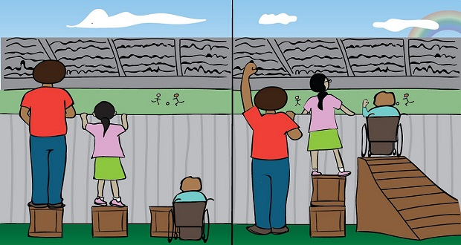
Undertreated Populations
Pediatric and geriatric patients
Cultural or communication factors
History of substance abuse
Neuropathic pain
Racial/ethnic minorities
Females
EQUALITY
EQUITY
Notes:
Equality does equal equity
Equality means each individual or group of people is given the same resources or opportunities. Equity recognizes that each person has different circumstances and allocates the exact resources and opportunities needed to reach an equal outcome.

Slide 20
Nonpharmacologic Therapy

Slide 21
Treatment – Nonpharmacologic
Exercise
Physical therapy
Diet
Weight loss
Electroanalgesia
Interventional approaches
Bonacre OUT, Clothier AW. Integrative Pain Management. Oxford: Oxford University Press; 2016

Slide 22
Treatment – Complementary and Integrative Approaches
Tai Chi
Yoga
Acupuncture
Massage
Mindfulness
Biofeedback
Manipulation
Evidence varies with different types of pain and conditions
Explore. 2018;14(3):177–211

Slide 23
Pharmacologic Therapy

Slide 24
Pharmacologic Options
Non-opioids | Opioids | Co-analgesics (Adjuvant agents)
Non-opioids Acetaminophen NSAIDs Systemic and Topical | Morphine, oxycodone Hydrocodone, hydromorphone Methadone, fentanyl Tramadol Codeine, meperidine Buprenorphine | Tricyclic antidepressants SNRI, SSRI Gabapentin / Pregabalin Other anticonvulsants Anti-arrhythmics Capsaicin Ketamine Skeletal muscle relaxants

Slide 25
Acetaminophen (Tylenol®)
Indication:
Mild to moderate non-inflammatory nociceptive pain
Generally, very safe in the elderly
Role in therapy
Self-limiting conditions such as headache, mild to moderate musculoskeletal pain, dental pain
Low back pain
Osteoarthritis (first-line)
Opioid sparing
Mechanism of action
Not well defined
Analgesic- effects in CNS via activation of inhibitory pathways
Anti-pyretic- inhibition of hypothalamic heat-regulating center
Notes:
Does nothing for neuropathic pain

Slide 26
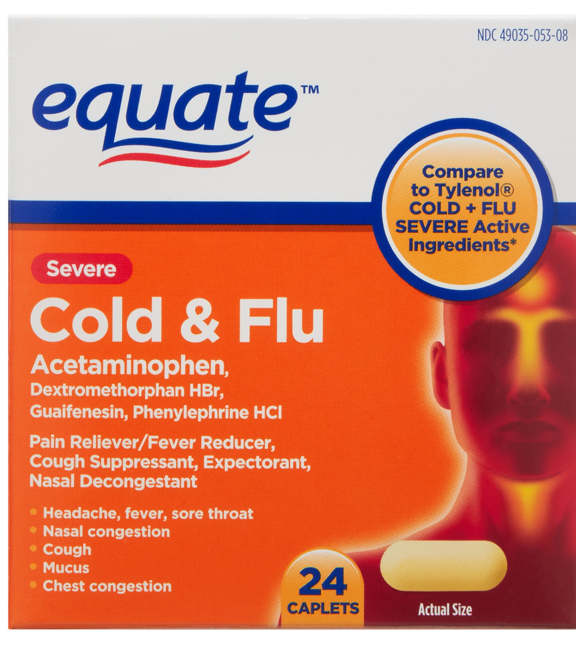
Acetaminophen Adverse Effects
Hepatotoxicity with acute and chronic use
Acute: single doses of 7.5 – 15 gm
Chronic: cumulative doses > 4gm/day
Risks for hepatotoxicity
High doses
Heavy alcohol consumption, fasting, or malnutrition
Patient-related variables
Alcoholic liver disease
Alcohol use (> alcoholic drinks per day)
Careful with combination products (cold medicines)

Slide 27
Mechanism of Acetaminophen Toxicity
Acetaminophen is metabolized by three pathways:
Glucuronidation (40-65%)
Sulfation (20-40%)
N-hydroxylation: forms NAPQI
N-acetyl-p-benzo-quinone imine (NAPQI)
Highly reactive intermediate
Usually combines with glutathione, then excreted (good thing)
With large acetaminophen ingestion, pathways become saturated and glutathione stores depleted
NAPQI concentrations increase, causing hepatoxicity

Slide 28
Acetaminophen Dosing for Geriatrics
Starting dose: 500 mg q6h
Maximum daily dose 2,000 - 3,000 mg per day
If significant liver disease or heavy alcohol use (relative contraindication)
Use cautiously in renal disease

Slide 29
NSAIDs… the list goes on….
Aspirin
Salsalate
Diflunisal
Choline magnesium trisalcylate
Ibuprofen
Naproxen
Fenoprofen
Ketoprofen
Flurbiprofen
Oxaprozin
Indomethacin
Tolmetin
Sulindac
Diclofenac
Etodolac
Meclofenamate
Mefenamic acid
Piroxicam
Meloxicam
Nabumetone
Celecoxib

Slide 30
NSAIDs
Indication:
Fever, pain, inflammation
Treatment of mild to moderate pain that may be inflammatory in nature
Role in therapy:
Acute and chronic pain
Muscle, joint, bone / dental, post-operative pain
Opioid-sparing effect
Mechanism of action:
Block the enzyme cyclooxygenase (COX), resulting in blockage of prostaglandin synthesis

Slide 31
NSAIDs in Older Adults
Stronger than acetaminophen but can cause significant harm
Use with caution – only use lowest dose for shortest duration… if at all
Second line to acetaminophen and then only in highly select individuals

Slide 32
NSAIDs Adverse Effects and Interactions
Renal dysfunction
GI Bleed
Platelet dysfunction
Fluid retention
Worsen hypertension and heart failure
Drug-drug interaction with aspirin
Topical NSAIDs appear safe and effective in older adults' short term, but longer-term studies are lacking^{1,2}
J Pain Res. 2011;4:159–167.
J Am Osteopat Assoc. 2013;113(2):123–127.

Slide 33
Coanalgesics
Can be used as the sole agent or in combination with opioids
Particularly useful in treating patients with neuropathic pain or mixed pain syndromes

Slide 34
Neuropathic Pain Guidelines
 | EFNS | NICE | Canadian Pain Society | NeuPSIG
First Line | Duloxetine Gabapentin Pregabalin TCA Venlafaxine Lidocaine Topical Carbamazepine Oxcarbazepine | Amitriptyline Duloxetine Gabapentin Pregabalin Capsaicin Carbamazepine | Gabapentin Pregabalin Duloxetine Venlafaxine TCA Carbamazepine | Gabapentin Enacarbil Pregabalin Duloxetine Venlafaxine TCA
Second Line | Tramadol Opioids Capsaicin |  | Tramadol Opioids Lidocaine Cream / Topical | Capsaicin Lidocaine topical Tramadol
Third Line | Strong Opioids |  | Cannabinoids | Botox Strong opioids
Fourth Line | Lamotrigine Cannabinoids |  | Other opioids Lacosamide Lamotrigine Botox Lidocaine topical
Pain Ther. 2017; 6(Suppl 1):35-42.
Notes:
NeuPSIG – Neuropathic Pain Special Interest Group
EFNS – European Federation of Neurological Societies

Slide 35
Tricyclic Antidepressants (TCAs)
Secondary Amine
Nortriptyline, desipramine
Tertiary Amine
Amitriptyline, imipramine
Doxepin, clomipramine
Mechanism of Action:
Increase neurotransmitter availability - decrease reuptake of norepinephrine and serotonin
Enhances descending inhibitory pathway
Inhibit sodium channels
Inhibit and L-type calcium channel
J Clin Pharmacol. 2012;52(1):6–17.

Slide 36
TCAs – Adverse Effects
Most extensively studied medications for neuropathic pain BUT on the AGS Beers Criteria ®
Sedation, weight gain
Orthostatic hypotension, tachycardia, arrhythmia, conduction disturbances
Significant anticholinergic adverse effects:
Constipation
Urinary retention
Dry mouth
Cognitive impairment
Tachycardia
Blurred vision
Note: desipramine and nortriptyline have less adverse events than amitriptyline

Slide 37
TCAs
Drug Interactions
MAOI, SSRIs, anticholinergic agents, antiarrhythmics, clonidine, lithium, tramadol, agents that prolong QTc
Amitriptyline, nortriptyline, desipramine
Starting dose: 10 – 25 mg po qhs
Usual effective dose: 50 – 150 mg po qhs
Wouldn’t go above 50 – 75 mg in the elderly

Slide 38
SNRIs - Duloxetine
Duloxetine
Painful diabetic neuropathy
Major depressive disorder
General anxiety disorder
Fibromyalgia
Chronic Musculoskeletal pain
Dose:
Start with 20 – 30 mg per day
Increase to 60 mg per day (no benefit with 60 mg bid)

Slide 39
SNRI - Duloxetine
Adverse effects
Nausea
Dry mouth, somnolence, fatigue, bleeding (Beers List – Anticholinergic)
Constipation, decreased appetite, hyperhidrosis
Precautions
Hepatotoxicity, serotonin syndrome, neuroleptic malignant syndrome
Activation of mania/hypomania, suicidality
Seizures, effect on BP, narrow angle glaucoma
Avoid in CKD (CrCl < 30 mL/min)
Drug Interactions
Avoid potent CYP 1A2 inhibitors, caution with 2D6 inhibitors
Duloxetine moderately inhibits 2D6

Slide 40
Other SNRIs
Venlafaxine
Not as good as duloxetine
Longer time to therapeutic dose
Less patients achieve therapeutic dose
Less adverse effects
Associated with more withdrawal symptoms
Milnacipran
Flynn K, Atkinson T, Baker J. Comparison of venlafaxine and duloxetine: Measuring clinical impact of time to therapeutic dose (TTD) among patients achieving therapeutic dosing for pain. Presented at: PAINWeek 2016; September 6-10, 2016; Las Vegas, Nevada.

Slide 41
Calcium Channel ꭤ2-δ Ligands
Gabapentin
Seizures
Postherpetic neuralgia
Restless leg syndrome
Pregabalin
Management of pain associated with diabetic neuropathy, postherpetic neuralgia, fibromyalgia, neuropathic pain associated with spinal cord injury
Mechanism of action:
inhibition of voltage-gated calcium channels specifically by binding to the presynaptic α2δ subunit
decreased release of excitatory neurotransmitters glutamate, norepinephrine, and substance P
Pain. 2007;132(3):237–251

Slide 42
Calcium Channel ꭤ2-δ Ligands
Few drug interactions
May potentiate opioids, alcohol, benzodiazepines
Adverse effects
Dose-dependent dizziness, ataxia, sedation, diplopia
Nausea, dyspepsia, weight gain, peripheral edema
Precautions
Lower doses in elderly and renal insufficiency
Take away to minimize adverse effects and enhance adherence to therapy – “Go low and Go slow”

Slide 43
Calcium Channel ꭤ2-δ Ligands- Gabapentin
Dosing
Slower titrate in elderly, medically fragile, renal insufficiency
Starting dose:
100 mg at bedtime
then 100 mg bid
then 100 mg tid etc…
Increase to next titration when not feeling tired or groggy
Usual effective dose for elderly 300 – 1800 mg daily
Renal failure 100 – 300 mg qhs

Slide 44
Calcium Channel ꭤ2-δ Ligands- Pregabalin
Dosing
More straightforward
Starting dose 150 mg/day in 2-3 divided doses
Increase to 300 mg/day after 3-7 days, then by 150 mg/day every 3-7 days as tolerated
Reduce dosage in renal impairment
Provides analgesia more quickly than gabapentin
Time to titrate to a full dosage is less
More euphoria (Class V)

Slide 45
Topical Lidocaine (Lidoderm®)
5% lidocaine patch is approved for the treatment of post-herpetic neuralgia (applied to intact skin)
Efficacy demonstrated in other disease states with peripheral neuropathy
Mechanism:
Amide-type local anesthetic agent thought to stabilize neuronal membranes by inhibiting the ionic fluxes required for the initiation and conduction of impulses
Penetration of lidocaine into intact skin after application of LIDODERM® is enough to produce an analgesic effect, but less than the amount necessary to produce a complete sensory block

Slide 46
Topical Lidocaine (Lidoderm®)
Useful for well-localized pain
FDA approved dosage schedule is 12 hours on, 12 hours off
Up to 3 patches are approved for simultaneous use
Patches may be cut and shaped for application to affected areas
Lidocaine does not accumulate with normal hepatic function
Do not apply to burned, broken or inflamed skin; may result in increased absorption and possible toxicity
Caution with severe hepatic disease

Slide 47
Drug Selection Process
Diagnosis – Problem identification
Patient specific factors and pain goals
May include risk assessment for substance abuse
Screener and opioid assessment for patients with pain (SOAPP)
Opioid risk tool (ORT)
Treatment options
Monitoring parameters
Safety and efficacy
Medication adjustments

Slide 48
Geriatric Selection Recommendations
Carefully consider patient specific parameters and therapeutic goals and balance with risks of pharmacologic therapy
Opiates are not recommended as first-line therapy in chronic pain
Opiates may be considered after careful consideration of risks and patient discussion

Slide 49
Summary
Optimal outcomes in managing chronic pain require a multimodal approach (pharmacologic, physical medicine, behavioral medicine, and neuromodulation, and interventional approaches) operating in concert
Choice of initial therapy depends on accurate evaluation on the cause of pain (neuropathic vs nociceptive)
Neuropathic pain consider antidepressants or pregabalin or gabapentin. Opioids are second-line
Role of opioids in chronic pain is controversial

Slide 50
Questions?
chucheri@hawaii.edu

