Slide 1
Community Empowerment Resources A 501(c)(3) Non-Profit Organization

Slide 2
Good Afternoon!
Aliman Sears: CEO and Co-Founder
Mary Krieger: Director of Programs
Fayez Rumi: CFO
Claire Fujita: COO
Website: cerhawaii.org

Slide 3
1.
Foundations of CER
Culture and Philosophy

Slide 4
Mission: To provide progressive and inclusive health care, empowering individuals to lead fuller lives.

Slide 5
Motto: CER is a Team of Mindfully Respectful Professionals

Slide 6
Who are We?
Founded in 2007
Behavioral Health + Primary Care
Case Management Population: SMI Adults
Clinic population: SMI Across the Lifespan
CARF certified
Partner with 5-Minute Pharmacy for island-wide Pharmacist / Medication services

Slide 7
Three Main Programs
Community-Based Case Management
Integrated Health and Wellness Clinic
Crisis Stabilization Center

Slide 8
2.
Community-Based Case Management

Slide 9
Community Based Case Management: Services
Case Manager & Multi-Disciplinary Clinical Treatment Team
Psychiatric Stability
State and Federal Benefits
Legal Coordination (PO, State Courts)
Interpersonal Relationships
Medical Stability
Housing Referrals and Retention
Activities of Daily Living
Personal Growth / Leisure & Community

Slide 10
Community Based Case Management Outcomes
Increase Quality of Life
Decrease Recidivism
Medical/Psychiatric Care
1
3
5
2
4
6
Increase Community Tenure
Decrease Hospitalizations
Decrease Homelessness

Slide 11
Community-Based Case Management
How to access services:
Call the Hawaii CARES line
(808) 832-3100
Request case management services, and the CARES line will refer the client for an eligibility determination through AMHD.

Slide 12
3.
Integrated Health and Wellness Clinic
1110 University Ave, Honolulu, HI 96826
(808) 942-7884

Slide 13
6 Psych Prescribers
2 Therapists
1 Psychologist
1 Primary Care Provider

Slide 14
Integrated Health and Wellness Clinic
PSYCHIATRIC CARE
Lifetime Coverage
Medication Management
Psychotherapy
PRIMARY CARE
Physicals
Wound Care
Diabetes Treatment
Counseling
Suboxone/Vivitrol
Toxicology
SUBSTANCE ABUSE TREATMENT
Neuropsych Testing
ADHD
Cognitive Function
TESTING

Slide 15
Keeping Our Intake Process Simple
Medications
5 Minute Pharmacy delivers medications to the patient. Injections can also be administered in the community.
Step 3
New Clients
Intake packet and referral form found on our website. Our clinic will contact the patient to schedule.
Step1
Step 2
Telehealth
Zoom invites are sent to the patient. Clinic calls the patient after the appointment to schedule the follow up.

Slide 16
Accepted Insurances
Medicare
All QUEST plans
Kaiser with PCP referral
Group Plans
PPO

Slide 17
4.
Ekolu
Crisis Stabilization Center

Slide 18
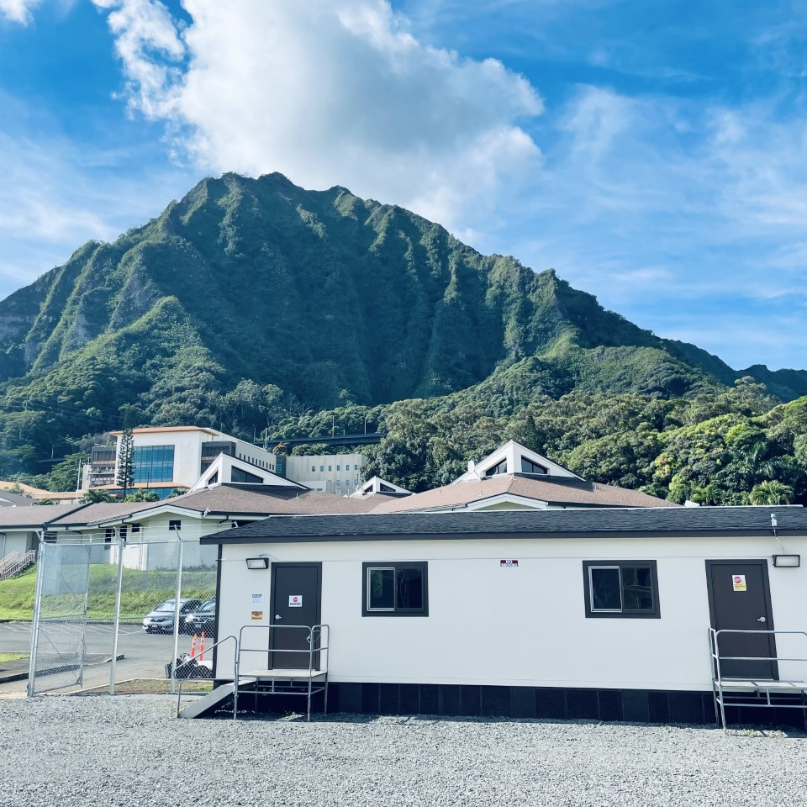
Crisis Stabilization Ekolu
Ekolu focuses on coping skills, crisis stabilization, symptom/medication management, and skill building to help the consumer maintain themselves in the community.

Slide 19
Ekolu Clients
Clientele
Ekolu is designed for persons who are experiencing increased symptomology, crises, or other conditions that negatively impact the mental or behavioral health of the persons served.
This includes individuals from the following referral areas...
VA
Community Hospitals
Legal/Correctional Reintegration
Hawaii State Hospital/ACT26
Substance Abuse Treatment Facilities
Domestic Abuse Shelters
AMHD CBCM and Ohana CCS Programs
Outreach Services
Other Facilities/Programs

Slide 20
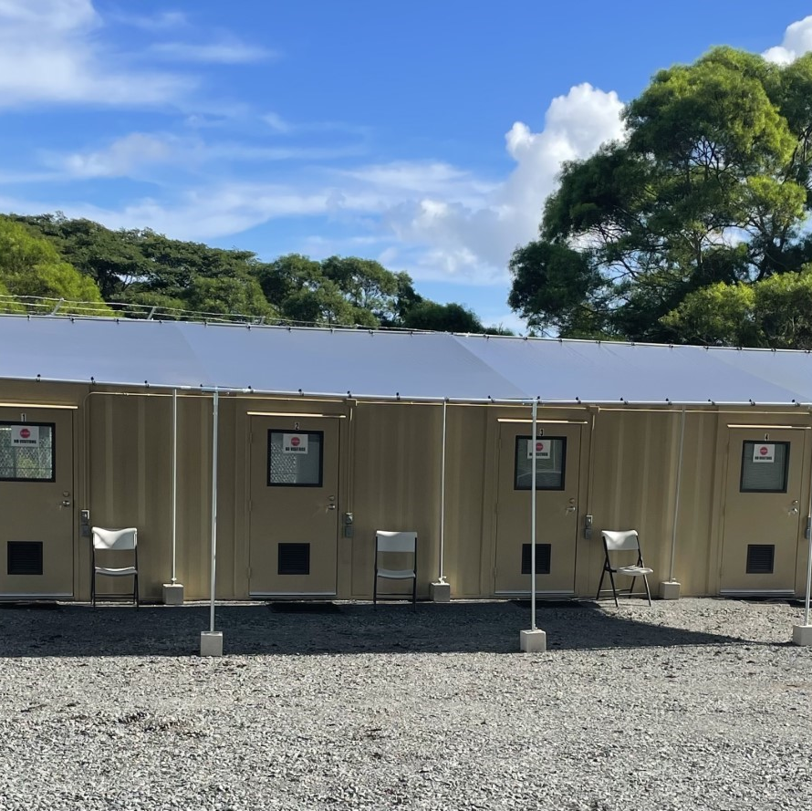
Crisis Stabilization Ekolu
How to access services:
Call the Hawaii CARES line
(808) 832-3100
The Crisis Team at Hawaii CARES will appropriately place the client for services .

Slide 21
Case Review Scenario
18-year-old on Oahu goes to the ED for suicide attempt (taking grandmother’s Ativan prescription). She has trouble with substance use in the past and tox screen is positive for THC, meth, opioids, benzos. Otherwise, healthy, no prior admissions. She lives with grandmother because mother left island to move to Vegas with her new husband.
Patient had a breakup with her 22-year-old boyfriend (who supplies substances for use) before suicide attempt. Grandmother doesn’t feel she can take care of patient at home anymore since patient met this boyfriend and has been ditching school and not coming home some nights.
Exam:
Vitals Normal, Patient Cooperative, Fixated on Boyfriend

Slide 22
Referral Process to Ekolu SICM Program
Client is referred to Ekolu SICM Program, either by self or ED staff, through the CARES Line 808-832-3100.
Upon receiving the referral, SICM staff calls the POC on the referral to gain additional information. Staff will speak with the individual being referred to confirm the client meets criteria.

Slide 23
Pre-Admission Criteria
The following is reviewed with POC and/or client to confirm
Ekolu is a voluntary program – client must confirm they want to come to Ekolu
Able to complete ADLs independently or with minimal prompting
Fully ambulatory – able to walk on uneven ground, stairs and ramps
Non-smoking facility – If client is a smoker, client should come with nicotine patch (if possible)

Slide 24
Admission
Welcome client to Ekolu and begin intake
Intake process
Consists of assessments (CSSRS, TM48, CAGEAID, DENVER, Biopsychosocial) to determine client’s needs.
Consents are gathered to allow CER to obtain client’s records, speak with stakeholders, and to link client to services needed.

Slide 25
Admission
In this case, we would want to get a consent to speak with grandma and get the records from the ED as well as any community providers she has seen.

Slide 26
Assign Client to a Field Case Manager (FCM)
The FCMs have very small caseloads to allow for intensive services to be provided during the 14 day stay.
The FCM would be responsible for taking client off property to appointments related to her psychiatric stability and discharge planning.
The FCM will follow the case from day 1 to discharge.

Slide 27
Assign her to a Field Case Manager (FCM)
The FCM will work with the client to create a Treatment Plan.
The Treatment Plan will consist of goals and interventions designed to increase client’s stability in the community. The following areas are addressed:
Psych, medical, benefits, SUD and Legal (if applicable)

Slide 28
Linking to Services
PSYCH/Therapy/PCP: Client will be referred to a psychiatric provider, therapist, and primary care physician through CER’s Integrated Clinic. By linking to CER’s Clinic, all psychiatric evaluations, medication management, PCP and therapy appointments will be conducted via telehealth during client’s stay with the onsite assistance of an Ekolu RN.
If the client has providers in the community that she has already built a relationship with, the CER case manager will schedule the appropriate appointments and link client to the community to see her existing providers.

Slide 29
Linking to Services
In this case a psych provider and therapist would be appropriate. A PCP would be needed to obtain a physical assessment needed for housing or treatment placement at discharge.

Slide 30
Benefits
The CER CM will apply client for benefits through General assistance, SNAP, and Medquest (unless client already has benefits).
CM will also (when appropriate) begin client’s application for SSI benefits.

Slide 31
Housing
CER will link client to appropriate housing options such as:
AMHD group homes
Clean and sober homes
Care Homes
Boarding Homes
Independent living
In this case, it is very important to find placement so that client is not returning to grandma’s house where she has access to prescriptions.

Slide 32
SUD Treatment
CER will link client, when appropriate, to outpatient and residential SUD treatment facilities. For this case, residential SUD treatment would be the best option, however, if client refuses then we would attempt IOP treatment coupled with stable housing.
Poailani
Hina Mauka
QCS
Sand Island

Slide 33
Primary Purpose of Ekolu
To stabilize the crisis, increase quality of life, and plan discharge to maintain stability in the community.

Slide 34
Ekolu Services
Intensive Case Management Services/Linking:
Medical/Psychiatric
Vital Documents
Case Management (after discharge)
Housing
Benefits
Community Resources
Substance Abuse Tx
Forensic Peer Specialist Support
Onsite Program Activities:
Mental Health Recovery Groups
Substance Abuse Recovery Groups
Art/Music/Dance/Crafts Activities
Health and Wellness Activities
Activities of Daily Living Workshops
Notes:
Medical/Psychiatric
Linking to psychiatric and therapeutic community providers
Linking to medical services and primary care providers
Vital Documents
Assistance in obtaining vital documents and identification (birth certificates, social security cards, state issued identification cards)
Case Management
Linking to Case Management services and housing providers
Housing
Linking to appropriate level of care, including, AMHD housing, substance use treatment, care homes, etc.
Benefits
Linking to insurance coverage
SSI/SSDI
GA
Community Resources
Connecting to various community resources (food banks, Catholic Charities, Community Clearing House, Legal Aid Society, and Disability Advocacy).
Substance Abuse
Referrals to substance abuse treatment facilities and treatment programs
Linking to support groups
Onsite Activities
Mental health recovery group activities (coping skills, mindfulness, etc.)
Group Therapy
Art/Music/Dance
Sports (toga, cornhole, etc.)
Misc. Games/Activities

Slide 35
DAILY PROGRAM SCHEDULE
TIME | EVENT
0700-0800 | AM Medications/ Wellness Checks (RN)
0800-0900 | Breakfast, ADLs Morning Routine
0900-0930 | House Meeting/Announcements
0930-1030 | Morning Activity
1030-1130 | Recreation Time
1130-1230 | Lunch
1230-1400 | Afternoon Activity (Sunday- Down Time)
1400-1415 | Wellness Checks
1415-1500 | Afternoon Activity (Friday- RN Activity)
1500-1600 | Afternoon Activity (Monday and Tuesday- Group Therapy with LHMC/CSAC)
1600-1700 | Recreation Time
1700-1800 | Dinner
1800-1900 | ADLs Evening Routine
1900-2000 | PM Medications (RN), Wellness Checks (CM)
2000-2100 | Evening Activity
2100-0700 | Quiet Hours
Activity Type | Topics
Mental Health Recovery Groups | Anxiety, Boundaries, Coping Skills, Crisis Planning, Decision Making, Depression, Emotional Regulation Balloon, Empowerment, Family Dynamics, Meditation, Mindfulness Groups, Positive Affirmation, PTSD, Stress Ball, Transition/Coping with Change, Trauma, Triggers, Values/Beliefs
Substance Abuse Recovery Groups | 12 Step, Coping Skills, Decision Making, NA/AA Meetings, Recovery/Sobriety Support, SA Resource, Stick Meeting, Triggers
Art/Music/Dance/Crafts Activities | Art Therapy, Auto Biography, Bubble Therapy, Karaoke, Movie Night, Music Therapy, Rock Painting, Seasonal Crafts, Tie Dye, Walking to Music
Health and Wellness Activities | Bean Bag Toss, Bedtime Yoga, Cornhole, Egg Drop, Fit On, Football, Frisbee, Makahiki Games, MK Fit, Soccer, Spike ball, Stretching/Yoga, Volleyball
ADLs | Personal Hygiene, Room Cleaning

Slide 36
CBCM Linking
Upon DC all persons admitted to Ekolu are provided with a 90-day temporary case management authorization with CER by the Adult Mental Health Department (unless they already have community-based case management).
CER will coordinate for one of our CBCM CMs to come to Ekolu and complete intake.

Slide 37
Disclaimer
As a voluntary facility, the individual has to choose to accept the interventions, linking and treatment proposed by Ekolu. They have the right to refuse any and all services, however, when planning treatment and discharge, our staff first identifies the “ideal” treatment and discharge plan.

Slide 38
Thank You
Any Questions?
CER Agency Contact Information:
CER Office/Clinic Phone: (808) 942-7884
Fax: (808) 942-7885
Web: www.cerhawaii.org
Office Hours: M-F, 8:00am – 4:00pm
General E-mail: info@cerhawaii.org
Hawaii CARES (Oahu): (808) 832-3100
Notes:
Any questions?

Slide 39
Team Presentation
Aliman Sears CEO
asears@cerhawaii.org
Claire Fujita COO
cfujita@cerhawaii.org
Fayez Rumi CFO
frumi@cerhawaii.org
Mary Krieger Director of Programs
mkrieger@cerhawaii.org

