Slide 1
Can Food Be Addicting?
November 1, 2022
James Westphal, M.D.
Copyright 2022 Beacon Health Options
Notes:
How to change Photos in this PPT:
Select photo
Right click > Format Picture
Select Fill > Picture or Texture fill
Select replacement photo from desired destination
To resize: Select Format Picture > Crop > Fill . Then you can position and resize the source photo as needed using white anchor points around the gray box.

Slide 2
Audience Participation
A food craving is an intense desire to eat a specific food when not hungry.
Have you ever experienced a food craving? Yes or No
If yes, what food or foods?
Do you think some foods are addictive? Yes or No
Do you think that some people can become addicted to food?
Yes or No

Slide 3
Learning Objectives
Review relative effectiveness of evidence based obesity treatments on weight loss and health outcomes.
Understand the concept of food addiction and its limitations.
Understand the simplicity of the incentive sensitization model of addiction as applied to obesity and its assessment both in research and clinical settings.
Learn to apply the model to brief assessments and treatment of patients who are overweight or obese.

Slide 4
Obesity Definitions
Obesity is defined by the World Health Organization as “abnormal or excessive fat accumulation that presents a risk to health.”
The Obesity Medicine Association defines obesity as a “chronic, relapsing, multi-factorial, neurobehavioral disease, wherein an increase in body fat promotes adipose tissue dysfunction and abnormal fat mass physical forces, resulting in adverse metabolic, biomechanical, and psychosocial health consequences.
https://obesitymedicine.org/what-is-obesity/

Slide 5
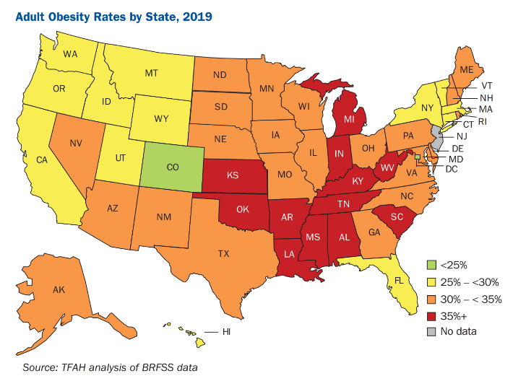
Obesity Was Common Among Adults Pre-COVID
The US adult obesity prevalence
was 42.4% in 2017 – 2018.
From 1999 –2000 through
2017 –2018, US obesity
prevalence increased from
30.5% to 42.4%.
During the same time, the
prevalence of severe obesity
increased from 4.7% to 9.2%.
https://www.cdc.gov/obesity/data/adult.html

Slide 6
Obesity Was Common Among Youth Pre-COVID
In the past 3 decades, the prevalence of childhood obesity has more than doubled in children and tripled in adolescents (Hales, Carroll, Fryar, Ogden, 2017).
The latest data from the National Health and Nutrition Examination Survey show that the prevalence of obesity among US children and adolescents was 18.5% in 2015-2016 (Sanyaolu, Okorie, Qi et al., 2019).

Slide 7
COVID Increased Symptoms Among The Majority Of People with Obesity and Eating Disorders
Meta‐analysis aimed to examine the pooled prevalence of symptomatic behaviors and mental health deterioration amongst individuals with eating disorders (EDs) and obesity during the COVID‐19 confinement.
Results: A total of 26 studies met inclusion criteria (n = 3399, 85.7% female).
The pooled prevalence of symptomatic deterioration in EDs was 65%.
The pooled prevalence of increased weight in obesity was 52%.
More than half of the participants experienced depression and anxiety.
Conclusions: The majority of individuals with EDs and obesity reported symptomatic worsening during the lockdown.
Sideli, Coco, Bonfanti et al., 2021

Slide 8
The Economic and Health Care Burden of Obesity
The economic burden of obesity, and the chronic diseases for which it is a contributing factor, has reached record economic heights.
In 2016, chronic diseases driven by the risk factor of obesity and overweight accounted for $480.7 billion in direct health care costs in the U.S.,
An additional $1.24 trillion in indirect costs due to lost economic productivity.
The total cost of chronic diseases due to obesity and overweight was $1.72 trillion, equivalent to 9.3 % of the U.S. gross domestic product (GDP).
Obesity as a risk factor is by far the greatest contributor to the burden of chronic diseases in the U.S., accounting for 47.1 % of the total cost of chronic diseases nationwide.
Waters & Graf, 2018

Slide 9
Evidence Based Obesity Treatment
Obesity (BMI: 30 kg/m2 or larger) is a chronic disease.
First line treatment is diet with an energy deficit of 500 kcal/day and a low energy density.
Pharmacotherapy provides an option for adults with overweight and obesity to reduce their bodyweight if lifestyle modifications fail.
In adults who are overweight and obese, phentermine-topiramate and glucagon-like peptide 1 (GLP-1) receptor agonists proved the best drugs in reducing weight (Shi, Wang, Hao et al., 2022).
The American Gastroenterological Association strongly recommended the use of pharmacotherapy in addition to lifestyle intervention in adults with overweight and obesity (BMI 30 kg/m2 , or 27 kg/m2 with weight-related complications) who have an inadequate response to lifestyle interventions.
Grunvald, Shah, Hernaez et al., 2022

Slide 10
Evidence Based Obesity Treatment (2)
The American Gastroenterological Association suggested the use of semaglutide 2.4 mg, liraglutide 3.0 mg, phentermine-topiramate ER, and naltrexone-bupropion ER (based on moderate certainty evidence), and phentermine and diethylpropion (based on low certainty evidence), for long term management of overweight and obesity (Grunvald, Shah, Hernaez et al., 2022).
Glucagon-like peptide 1 (GLP-1) medications stimulate the secretion of insulin and slow the release of glucagon, influencing blood sugar control.
GLP-1 medication also help with weight loss by acting on the body's “set point,” reducing appetite and increasing satiety.
https://www.joincalibrate.com/resources/glp-1s-and-weight-loss

Slide 11
Bariatric Surgery
Surgical intervention is more effective than conservative treatment with respect to reduction of bodily fat, improvement of obesity-associated diseases, and lowering mortality.
Controlled studies indicate that, within 1 to 2 years, a weight loss of 9 to 13.5 pounds can be achieved by diet, 4.5 to 6.5 pounds by exercise, and 44 to 88 pounds by bariatric surgery (Wirth, Wabitsch, Hauner, 2014).

Slide 12
Bariatric Surgery Improves Health Outcomes
Obesity increases the incidence and mortality from some types of cancer.
To investigate whether bariatric surgery is associated with lower cancer risk and mortality.
Conclusions: bariatric surgery compared with no surgery was associated with a significantly lower incidence of obesity-associated cancer and cancer-related mortality (Aminian, Wilson, Al-Kurd et al., 2022).
Bariatric surgery significantly improves cardio-metabolic risk factors.
To investigate the relationship between bariatric surgery and incident major adverse cardiovascular events (MACE) in patients with type 2 diabetes and obesity.
Conclusions: Among patients with type 2 diabetes and obesity, bariatric surgery, compared with nonsurgical management, was associated with a significantly lower risk of incident MACE.
Aminian, Zajichek, Arterburn et al., 2019

Slide 13
Health Outcomes May Be Dependent On Both Amount Of Weight Loss And Method
To determine the minimum amount of weight loss required to see a reduction in major adverse cardiovascular events (MACE).
Obesity is an established risk factor for morbidity and mortality, the minimum amount of weight loss to have a meaningful impact on cardiovascular health and survival is unknown.
The risk of MACE decreases after approximately 10% of weight is lost in the surgical group and approximately 20% in the nonsurgical group.
For all-cause mortality, the threshold for benefit appeared to be approximately 5% weight loss after surgery and 20% in the nonsurgical group.
Conclusions: in our analysis, the effect of surgery was still present after accounting for weight loss, which may suggest the presence of weight-independent beneficial effects of bariatric surgery on MACE and survival.
Aminian, Zajichek, Tu et al., 2020

Slide 14
Bariatric Surgery is the Most Effective Treatment for Obesity, However
Weight loss peaks about one year post surgery, after that approximately 50% regain weight (Magro, Geloneze, Delfini et al., 2007; King, Hinerman, Courcoulas, 2020).
Weight regain affects long term outcomes.
In long term follow up studies. only 67% of surgically treated patients achieved weight loss consistent with long term improvement in their health quality of life (Karlsson, Taft, Rydén, et al., 2007).
In addition, approximately 20% of surgically treated patients develop new onset alcohol or drug use disorders (King, Chen, Courcoulas et al, 2017; Cerón-Solano, Zepeda, Lozano et al., 2021).
In a recent meta analysis, addiction substitution was associated with poorer treatment outcomes (Kim, Hodgins, Garcia et al., 2021).

Slide 15
Obesity Treatment Can Be Improved.
Is There a Neglected Addictive Component to Obesity?
The Concept of Addiction to Foods is Over 130 Years Old.

Slide 16
Food And Addiction Timeline
1890 – Chocolate labeled as addictive in Journal of Inebriety.
1958 – Food Addiction proposed as a disorder, based on similarity of binge eating and drinking in Quarterly Journal of Alcohol Studies.
1960 – Overeaters Anonymous first meeting in Hollywood, California, heavily influenced by Gamblers Anonymous, organized 3 years earlier in Southern California.
1993 – Chocolate addiction described in Appetite.
2009 – Yale Food Addiction Scale developed based on DSM IV substance dependence diagnostic criteria, the only current assessment.
2013 – DSM 5 adds diagnosis of Binge Eating Disorder.
2016 – Yale Food Addiction Scale 2.0, revised for DSM 5 criteria that added craving indication for substance dependence.

Slide 17
Food Addiction is Highly Prevalent and Clinically Stable
15% prevalence in nationally representative sample of US adults (Schulte & Gearhard, 2019).
11.1% prevalence in six studies of healthy weight adults (Pursey, Stanwell, Gearhardt et al., 2014).
12% prevalence for youth community samples,
19% for overweight/obese youth samples (Yekaninejad, Badrooj, Vosough et al, 2020).
Yale Food Addiction Scale assessed food addiction diagnosis and symptom scores were found to be relatively stable over 18-months in a non-clinical population of predominantly female, young adults.
Pursey, Collins & Stanwell, 2016

Slide 18
Food Addiction (FA)
The concept of FA is a recurring issue in the clinical description of abnormal eating.
The FA concept and obesity are not recognized as eating disorders and are not included in the DSM-5. Obesity is included in ICD-11.
FA is frequent in the overweight or obese, but its relationship with other co-occurring disorders, such as binge eating and bulimia is unclear.
There is currently no validated therapy for FA in obese patients.
FA is often underdiagnosed and untreated,
FA may partly explain modest results of obesity treatment and addiction substitution and weight regain after obesity surgery.
Constant, Moirand, Thibault et al., 2020

Slide 19
Food Addiction To Date is Not Clinically Useful
The problem with Food Addiction may be that it is based on DSM substance dependence criteria developed from the clinical observation of alcohol dependent patients in the 1970’s before the neurobiological basis of addiction was developed (Gross & Edwards, 1976; Rapaport, Tipp & Schuckit, 1993).
Studies found that DSM substance use disorder criteria may measure only one dimension, severity (MacCoun, 2013).
These findings are consistent with one study that proposed food addiction as a comorbidity and obesity severity indicator (Brewerton, 2017).

Slide 20
Our Current Conceptual Understanding Of Addiction Is Based On An Outdated Clinical Model.
Can We Understand Obesity Better With A Contemporary Neurobiological Model?

Slide 21
The Incentive Sensitization Model of Obesity
Purpose of review: The current article discusses five neural vulnerability theories for weight gain and reviews evidence from prospective studies using imaging and behavioral measures reflecting neural function, as well as randomized experiments with humans and animals that are consistent or inconsistent with these theories.
Recent prospective imaging studies examining predictors of weight gain and response to obesity treatment, and repeated-measures imaging studies before and after weight gain and loss have advanced knowledge of etiologic processes and neural plasticity resulting from weight change.
Overall, data provide strong support for the incentive sensitization theory of obesity.
Stice & Yokum 2021

Slide 22
What is Incentive Sensitization?
Rewards are both ‘liked’ and ‘wanted’, and those two words seem almost interchangeable.
The brain circuitry that mediates the psychological process of ‘wanting’ a particular reward is dissociable from circuitry that mediates the degree to which it is ‘liked’.
Incentive salience or ‘wanting’, a form of motivation, is generated by large and robust neural systems that include mesolimbic dopamine.
Berridge and Robinson, 2016

Slide 23
Reward Processing for Substance Addictions And Obesity Are Identical
Meta analysis on 87 studies mapping the functional magnetic resonance imaging (fMRI) response to cues in participants with obesity, substance addiction and non-substance (or behavioral) addiction.
Participants with obesity and substance addictions exhibited similar fMRI hyperactivity in the amygdala and striatum when processing either general rewarding stimuli or the problematic stimuli (food and drug-related stimuli, respectively). See next slide.
Non-substance addictions exhibited alterations in the right amygdala, this cluster did not overlap with the ones found for obesity and substance addictions.
García-García, Horstmann, Jurado et al., 2015

Slide 24
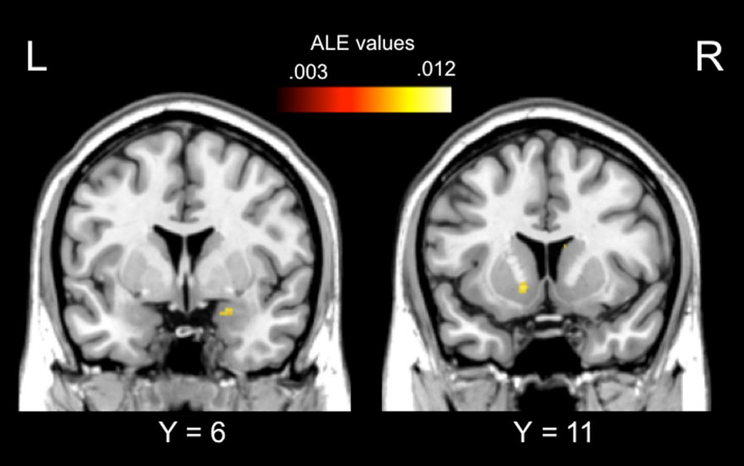
Convergent alteration between participants with obesity and
participants
with substance
addictions during the processing of the problematic stimuli (food in obesity; drug
-related stimuli in
substance addictions)
in the amygdala and
in the striatum.
García-García, Horstmann, Jurado et al., 2015

Slide 25
What is Incentive Sensitization? (2)
By comparison, ‘liking’, or the actual pleasurable impact of reward consumption, is mediated by smaller and fragile neural systems, and is not dependent on dopamine.
The incentive-sensitization theory posits addiction to be excessive amplification of psychological ‘wanting’, triggered by cues, without an amplification of ‘liking’.
This is due to long-lasting changes in dopamine-related motivation systems of susceptible individuals, called neural sensitization.
The evidence has continued to grow in support the incentive-sensitization theory.
Berridge and Robinson, 2016

Slide 26
Liking Versus Wanting Neural Systems
Wanting: dark arrows
Liking: light arrows

Slide 27
Incentive Sensitization and Food Intake
Sensitization is a basic property of the nervous system whereby repeated exposure to a stimulus results in an increase in responding to that stimulus.
This increase in responding contributes to difficulty with treatment of substance use, as stimuli associated with substance use become signals or triggers for drug craving and relapse.
Our work over the past decade has applied the theoretical framework of incentive sensitization to overeating.
We have shown, in several studies, that lean adults do not commonly demonstrate behavioral sensitization after repeated exposure to snack food, but a subset of obese adults reliably does.
Temple, 2016

Slide 28
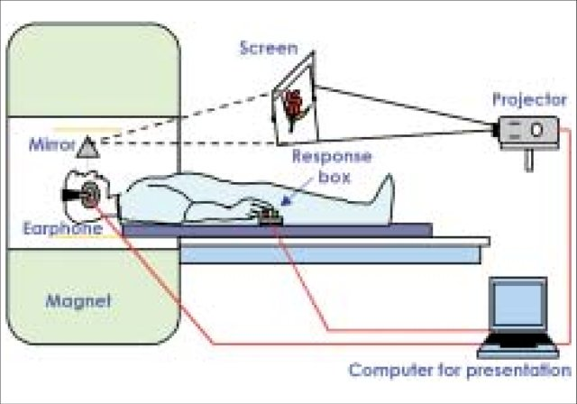
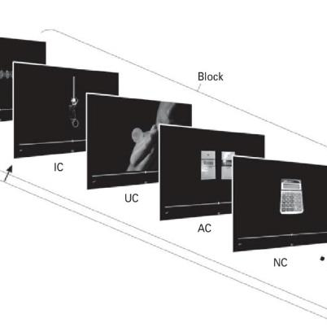
Assessing Brain Sensitivity Through Cue Induced Reactivity
Cue reactivity: human neuroimaging studies suggest that cue reactivity is strongly associated with indices of drug use, including addiction severity and treatment success (Jasinska, Stein, Kaiser et al., 2014).

Slide 29
Incentive Sensitization and Food Intake (2)
This review will discuss change in behavioral response to repeated consumption of snack food in obese individuals and apply the framework of incentive sensitization to high fat/high sugar snack foods.
Data suggests that behavioral sensitization to repeated administration of snack food is predictive of weight gain (Temple, 2016).
Via incentive sensitization, 'wanting' selectively becomes higher, especially when triggered by reward cues when encountered in vulnerable states of stress.
Emerging evidence suggests that some cases of obesity and binge eating disorders may reflect an incentive-sensitization brain signature of cue hyper-reactivity, causing excessive 'wanting' to eat.
Morales & Berridge, 2020

Slide 30
Cue Reactivity And Eating
Meta-analysis on the predictive effects of food cue reactivity and craving on eating and weight-related outcomes.
Across 69 reported statistics from 45 published reports representing 3,292 participants, we found an overall medium effect of food cue reactivity and craving on outcomes (r = 0.33, p<0.001; approximately 11% of variance),
Suggesting that cue exposure and the experience of craving significantly influence and contribute to eating behavior and weight gain.
Overall, the present findings suggest that food cue reactivity, cue-induced craving and tonic craving systematically and prospectively predict food-related outcomes.
Boswell & Kober, 2016

Slide 31
Obesity Psychotherapy
Empirical research examining the efficacy of treatments for food addiction is lacking, and greatly needed (Nightingale & Cassin, 2019).
CBT is very effective and may be superior for eating disorders (Linardon, Wade, de la Piedad Garcia et al., 2017).
CBT is an effective treatment for binge eating disorder (Striegel-Moore, Wilson, DeBar,et al., 2010).
CBT may be a more effective treatment for patients with obesity co-occurring with binge eating.
CBT outperformed behavioral weight loss treatment in short- and long-term binge-eating outcome and led to lower longer term abstinence than self-help treatment (Hilbert, Petroff, Herpertz et al., 2019).

Slide 32
Food Cravings Clinical Assessment
Food cravings are the central clinically observable feature of the incentive sensitization model of obesity.
There are several brief self report instruments to assess food craving (Meule, 2020).
However, a simple clinical assessment can identify patients with weight problems who may have an addictive component.
“Do experience food cravings that lead you to overeat?”

Slide 33
Food Cravings Treatment
Social support mediates cravings (Fogelman, Hwang, Sinha et al., 2021).
Cognitive Behavioral Therapy for Eating Disorders, Overeaters Anonymous and other interventions that increase social support can reduce cravings and stress triggered cravings.

Slide 34
Overeaters Anonymous
The idea of OA came to founder Rozanne S. at a Gamblers Anonymous (GA) meeting she attended with a compulsive gambling friend in 1958.
As GA members shared their stories, she heard her story, not of gambling, but of compulsive overeating.
She knew then that the Twelve Step and Twelve Tradition program founded by Alcoholics Anonymous (AA) and modeled by GA offered her a chance to change her life and reduce her 152-pound body to a size that would fit her 5-foot, 2-inch frame.
Not until 1960, when her weight had increased to 161 pounds (73 kg), could she find other people who shared her convictions.
Today, about 6,500 OA groups meet each week in over 75 countries. With 60,000 members worldwide divided into ten geographic regions and a virtual region, OA helps thousands of compulsive eaters find new life in recovery.
https://oa.org/find-a-meeting/?type=0

Slide 35
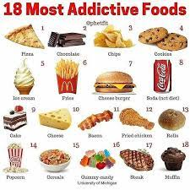
Addictive Foods
Results of Schulte, Avena, Gearhardt (2015).
The 18 most addictive foods.

Slide 36
Addictive Foods
Participants: 120 undergraduates participated in Study One and 384 participants participated in Study Two.
Measurements: In Study One, participants (n = 120) completed the YFAS followed by a forced-choice task to indicate which foods, out of 35 foods varying in nutritional composition, were most associated with addictive-like eating behaviors.
Using the same 35 foods, Study Two utilized hierarchical linear modeling to investigate which food attributes (e.g., fat grams) were related to addictive-like eating behavior (at level one) and explored the influence of individual differences for this association (at level two).
Schulte, Avena, Gearhardt, 2015

Slide 37
Addictive Foods (2)
Results: In Study One, processed foods, higher in fat and GL, were most frequently associated with addictive-like eating behaviors. In Study Two, processing was a large, positive predictor for whether a food was associated with problematic, addictive-like eating behaviors.
Conclusion: The current study provides preliminary evidence that not all foods are equally implicated in addictive-like eating behavior, and highly processed foods, which may share characteristics with drugs of abuse (e.g. high dose, rapid rate of absorption) appear to be particularly associated with "food addiction.“
Schulte, Avena, Gearhardt, 2015

Slide 38
Main Points
The US obesity epidemic was accelerating among adults and youth before COVID with major public health and economic consequences.
Evidence based obesity treatment, other than bariatric surgery, provides very modest results.
Bariatric surgery is only effective in the long term in 67% of patients because of weight regain, with approximately 20% developing new onset alcohol or drug use disorders after surgery.
The current concept of food addiction is based on substance dependence type criteria and is currently assessed by the Yale Food Addiction Scale 2.
Food Addiction is found frequently in the overweight or obese population, and identifies a subgroup of the obese.

Slide 39
Main Points (2)
Food addiction may explain the modest results of obesity treatment and addiction substitution and weight regain after bariatric surgery.
Some cases of obesity and binge eating disorders may reflect an incentive-sensitization brain signature of cue hyper-reactivity and craving.
Cognitive Behavioral Therapy for Eating Disorders, Overeaters Anonymous and other interventions that increase social support can reduce cravings.
Limited evidence supports that food processing, especially with snack foods increases food cravings.

Slide 40
808-695-7700
www.beaconhealthoptions.com

Slide 41
Appendix

Slide 42
Brain Reward and Perception of Taste
Brain reward systems are active participants, not just passive conduits, in the act of eating.
The pleasure of sweetness arises within the brain, generated actively by neural systems that paint the pleasure onto the sensation to generate a ‘liking’ reaction, as a sort of ‘pleasure gloss’.
We may be used to thinking of sweet tastes as innately pleasant, but their pleasure is not contained in the intrinsic detail of their sensation but rather in their evolved ability to act as keys that unlock activation of brain ‘liking’ systems (Berridge & Kringelbach, 2008).
This is evident by considering that if the ability to unlock hedonic brain systems is lost, a sweet taste loses its pleasure while remaining sweet as ever (Berridge, 2009).

