Slide 1

Care of Dementia-related Behavior in Primary Care Setting
Brett Lu MD PhD
Clinical Associate Professor of Psychiatry, University of Hawaii
Queen’s Medical Center
Honolulu, HI USA
brettlu@yahoo.com
No conflicts of interest to disclose

Slide 2
Care of Dementia-related Behavior in Primary Care Setting
Dementia prevalence/type
Dementia screening
Dementia-related behavior
Treatment of dementia-related behavior
Medical assessment
Non pharmacological (no psych meds)
pharmacological (psych meds)

Slide 3
How Common is Dementia?
40
32%
30
Prevalence (%)
20
16%
10
8%
2%
4%
0
1%
60-65
65-70
70-75
75-80
80-85
>85
Age (Year)
2015: 5 million with Alzheimer’s dementia in US
2030: 8 million
2050: 14 million
http://www.alz.org/ri/in_my_community_59331.asp
Clinical Neuroscience Research Associates (©CNRA, 2000), www.therubins.com; Hurd 2013

Slide 4
Dementia Types
Frontotemporal Dementia
(compulsive behaviors, personality changes)
MSA/PSP/CBD
Vascular Dementia (stroke)
Dementia with Lewy Bodies
( cog. fluctuation, visual halluc., parkinsonism)
VD + DAT
Dementia of the Alzheimer’s type (DAT)
DAT + DLB
5%
10%
~60%
10%
10%
5%
Barker 2002, Morris 1994, Small 1997
Notes:
Differentiation of the various dementias is challenging. Dementia can result form numerous disorders, and many treatable conditions may mirror Alzheimer’s-type dementia. It should be kept in mind that the dementia syndrome may have more than one etiologic factor in the elderly patient.
Although available data show variable prevalence of the differential diagnosis of dementia, it is estimated that 65% of cases are due to Alzheimer’s disease (AD), 5% to vascular dementia, 10% to AD plus vascular dementia, 7% to dementia with Lewy bodies (DLB), 5% to AD plus DLB, and the remaining 8% to other dementias (Small et al, 1997; Morris, 1994; American Psychiatric Association, 1997).
AD and vascular dementia (VaD) are easily confused because they share many symptoms. The onset of AD is gradual, while VaD begins abruptly and progresses in a stepwise manner. Deterioration in a broad range of intellectual abilities is seen in AD patients, with motor abilities unaffected until advanced stages of the disease; focal signs and symptoms are generally absent. Brain CT of AD patients is usually normal or shows early brain atrophy, unlike the VaD patient in which the CT scan may show evidence of stroke or stroke-related change. Individuals with VaD frequently have an underlying vascular disorder (e.g., hypertension or heart disease) while AD patients do not.
The differential diagnosis is likely context specific with, for example, higher rates of other dementias in state mental health hospitals, higher lewy body ds in Neurology clinics, etc.

Slide 5
Lewy body dementia (LBD)
Underdiagnosed, second most common dementia
cognitive fluctuation, visual hallucinations (early, most common, 60%), REM sleep disorder, parkinsonism (later)
pathology and behavioral treatment similar to PDD
Treatment for psychosis/aggression:
-neuroleptic sensitivity (poor response to risperidone)
-quetiapine
-cholinesterase inhibitors (donepezil, rivastigimine)
-pimavanserin (Nuplazid)
5-HT2A inverse agonist (decrease visual pathway act)
effective for psychosis in PD, consider for LBD
Burn 2006, Cummins 2014, Zahodne 2008

Slide 6
Care of Dementia-related Behavior in Primary Care Setting
Dementia types/prevalence
Dementia screening
Dementia-related behavior
Treatment of dementia-related behavior
Medical assessment
Non pharmacological (no psych meds)
pharmacological (psych meds)

Slide 7
Memory Decline Stages
Normal
Age-Associated Memory
Impairment
Mild Cognitive Impairment
Dementia
Cognitive Function
Time
Notes:
Note Dementia is not an inevitable consequence of aging, but is clearly more prevalent with advancing age.

Slide 8
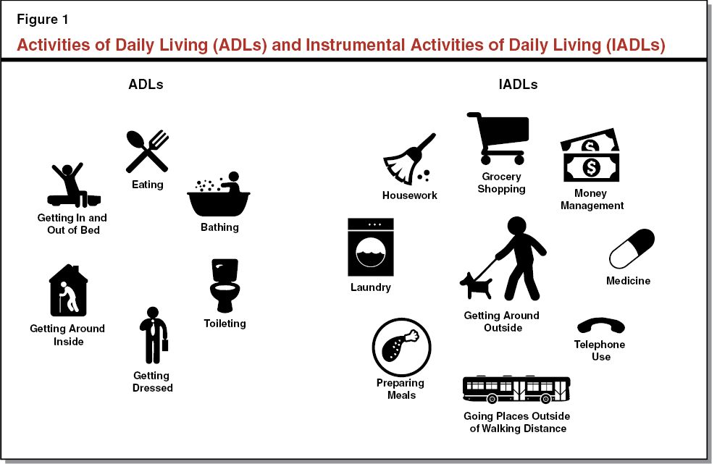
Stages of Memory Decline
Mild Cognitive Impairment (MCI):
cognitive decline, below 5th percentile on testing
no loss of ADLs (activities of daily living)
10-15% per year progress to dementia
address reversible risk factors of cognitive decline
Dementia:
cognitive decline AND
loss of ADLs
https://lao.ca.gov/Publications/Report/3509

Slide 9
Cognitive Screening Tools
For dementia:
Mini-Cog
screen for dementia, short, anyone can use w/ minimal training
MMSE (Mini Mental Status Exam)
screen for dementia, up to 10min, copyrighted
For MCI:
SLUMS (St. Louis University Mental Status Exam)
better screen for MCI, up to 10min, anyone can use
MOCA (Montrell Cognitive Assessment)
better screen for MCI, up to 15min
license fee

Slide 10
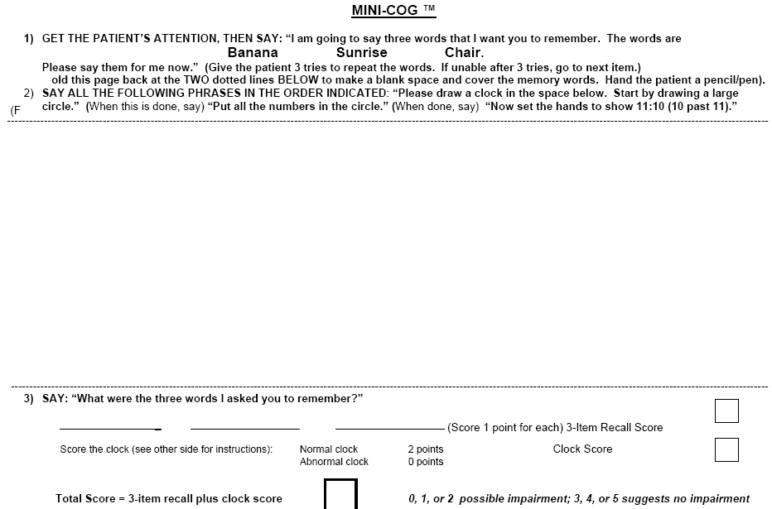
Mini-Cog
-three word recall and a clock draw
-better than PCPs in detecting early dementia
-reliable in those with limited English or education
Borson 2000,
Galvin 2012

Slide 11
Care of Dementia-related Behavior in Primary Care Setting
Dementia types/prevalence
Dementia screening
Dementia-related behavior
Treatment of dementia-related behavior
Medical assessment
Non pharmacological (no psych meds)
pharmacological (psych meds)

Slide 12
Behavioral and Psychological Symptoms of Dementia (BPSD)
Present in 60-98% with dementia
Premature institutionalization/higher mortality
Suffering for caregivers

Slide 13
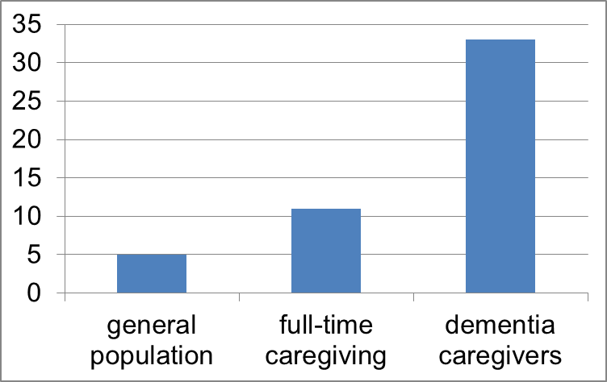
Caregiver Burnout: the “Invisible Patient”
High risk of Depression:
especially in:
Female
Less education
In the same home
Lack of choice
Consequences of burnout:
poor mental/physical health
institutionalization of patients
care negligence, abuse
Get help, take a break, adult day programs
Prevalence(%)
of Depression
Adelman 2014; Covinsky 2003, NSDUH 2007

Slide 14

Behavioral and Psychological Symptoms of Dementia (BPSD)
Depression
20-40%
Psychosis
hallucinations/delusions
25%
Agitation
often persistent
Anxiety
Apathy
Altered circadian rhythms
disrupted sleep patterns
Clear description of a symptom cluster helps to facilitate
specific and effective treatment

Slide 15
Psychosis in Dementia
Misidentification of caregivers/surroundings
Paranoid delusions: lost items, accusations, poison
Visual hallucinations: stalkers, stranger in the house
Increases with dementia progression (~25%)
Leads to physical aggression, institutionalization, and higher risk of death
Leonard 2006, Lopez 2013, Steinberg 2006

Slide 16
Depression in Dementia
20% in Alzheimer’s
20% - 40% in Vascular dementia
50% in Parkinson’s Disease dementia
Leads to physical aggression, higher risk of death, and faster memory decline
Often do not or not able to state “I am depressed/sad..”:
Irritable, angry/rejecting help/making little effort to engage
Alexopoulos 1988, 2002; Kumar 2013, Leonard 2006
Fiske 2009, Manepalli 2011

Slide 17
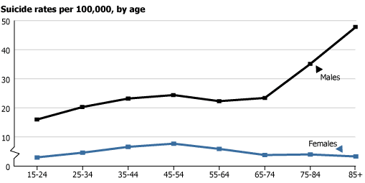
Suicide Rates in the US by Age Groups
Females more likely to attempt (X3): overdose
Males more likely to succeed (X4): firearms
Older males: Increased suicide rates shortly after dementia diagnosis, especially in those with mental illness
National Center for Health Statistics, Health, United States, 2005, Seyfried 2011

Slide 18
Geriatric Depression Scale (GDS):
To be read out loud to the patient
Not valid for
moderate or severe
dementia

Slide 19
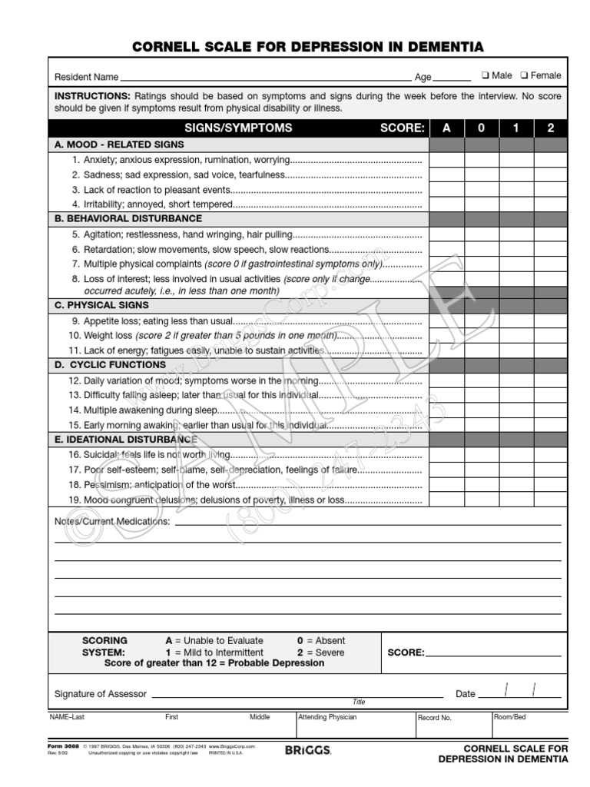
Cornell Scale for Depression in Dementia (CSDD:
To be done with a
caregiver who knows the
patient well
for
moderate or severe
dementia

Slide 20
Care of Dementia-related Behavior in Primary Care Setting
Dementia types/prevalence
Dementia screening
Dementia-related behavior
Treatment of dementia-related behavior
Medical assessment
Non pharmacological (no psych meds)
pharmacological (psych meds)

Slide 21
Medical Causes of BPSD
  delirium: acute onset (within a few days) of behavioral symptoms, w/ poor attention
  UTI? Sepesis? Pneumonia? CNS event?
  New meds (anticholinergic)?
  Constipation: aggression risk in dementia
Pain decreased agitation with acetaminophen
role of opioids still controversial/individualized
Leonard 2006
Husebo 2011, 2014

Slide 22
Care of Dementia-related Behavior in Primary Care Setting
Dementia types/prevalence
Dementia screening
Dementia-related behavior
Treatment of dementia-related behavior
Medical assessment
Non pharmacological (no psychy meds)
pharmacological (psych meds)

Slide 23
Maintaining Quality of Life in Dementia
non-pharm approaches
Quality
of Life
+ appropriate medications
no treatment
non-pharm approaches
+ inappropriate medications
Symptom Severity

Slide 24


Non-Medication Approaches for Dementia Behavior
Identify and address
triggers/unmet needs
Basic care:
Speak calmly/gentle touch
Use gestures/written words
Approach patient from front
Safety: grab bars
conceal exits/lethal means
Routines/Recreations:
  More individualized tasks
Courtesy of Manoa Cottages
Ballard 2009, Beier 2007, Cook 2012, Gerdner 1993, Kong 2009, Rowe 1999

Slide 25
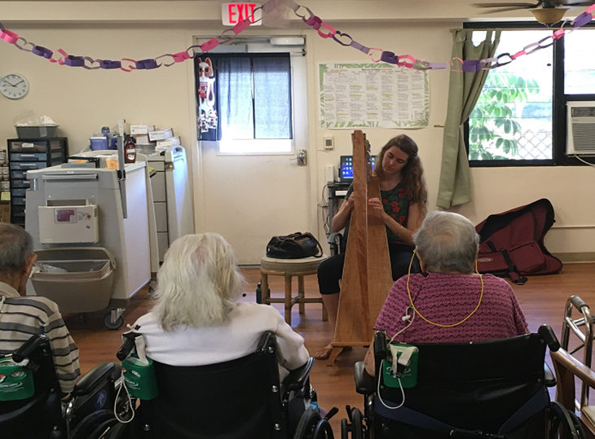
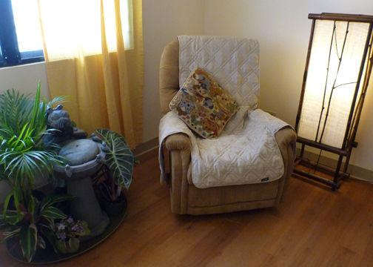
Non-Medication Approaches for Dementia Behavior
Sensory stimulation:
Music, familiar to patient,
plants, animals, massage,
aromatherapy
Courtesy of Manoa Cottages

Slide 26

Non-Medication Approaches for Dementia Behavior
Paranoia/Hallucinations
avoid confrontation
reassurance/validate followed by distraction
Depression/Cognitive Decline
physical and mental activities
community resource/day programs
808-768-7700

Slide 27
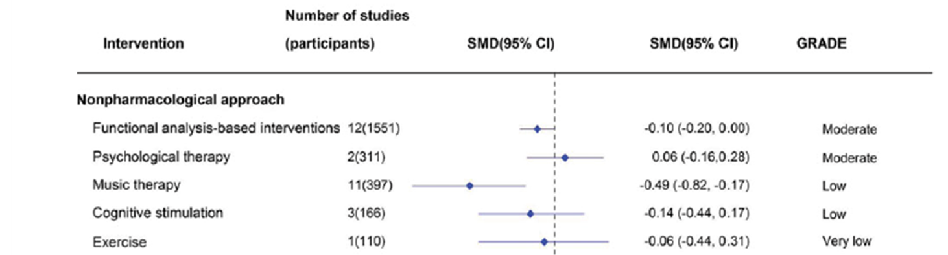
Evidence for non-med interventions so far…
NO ADVERSE EFFECTS
No clear evidence in reducing agitation or aggression in nursing homes. Exception is that music may be effective.
Jutkowitz 2016
intervention effective
Dyer 2017

Slide 28
Care of Dementia-related Behavior in Primary Care Setting
Dementia types/prevalence
Dementia screening
Dementia-related behavior
Treatment of dementia-related behavior
Medical assessment
Non pharmacological (no psych meds)
pharmacological (psych meds)

Slide 29
Medications for Dementia-related Behavior
  No “FDA-approved” medication for behavior in dementia
  Identify surrogates for informed consent
  Use meds with higher benefit/risk ratio
Higher
Risk
benzodiazepines
antipsychotics
mood stabilizers
antidepressants
(SSRIs)
prazosin
dementia meds
Lower
Risk
Lower Benefit
Higher Benefit

Slide 30
Symptom-based Medication Options for BPSD
Paranoia
mild citalopram, prazosin, sertraline, escitalopram
severe risperidone, olanzapine, aripiprazole, quetiapine
Depression antidepressants
Apathy cholinesterase inhibitors (ChEI), methylphenidate
buproprion
Anxiety/Agitation
mild citalopram, trazodone, prazosin, ChEI/memantine
severe risperidone, olanzapine
quetiapine, benzos, valproate, gabapentin, buspirone
Sexual Aggression citalopram, risperidone
Insomnia melatonin, doxepin, trazodone, mirtazepine
PRNs
mild behaviors trazodone
emergency IM haloperidol, IM olanzapine
Second line options in italics
Desai 2012

Slide 31
Honolulu Medication Algorithm for Behavioral Symptoms in Dementia
apathy
donepezil/rivagstimine
methylphenidate
depression
irritability
anxiety
mild
citalopram
escitalopram sertraline
if depression w/o psychosis
other antidepressants:
mirtazepine, SNRIs
mod/severe
hallucinations
paranoia
quetiapine
valproic acid
gabapentin
benzodiazepines
risperidone*
olanzapine*
aripiprazole*
mod/severe
trazodone
memantime
*avoid in Parkinson’s/
Lewy Body dementia
agitation
aggression
mild
mod/severe
prazosin
prn trazodone
prn risperidone,
olanzapine, quetiapine
insomnia
melatonin/
ramelteon
trazodone
doxepin
gabapentin, zolpidem,
temazepam
updated (June 2020) per evidenced-based benefit to risk ratio, Lu 2016

Slide 32
Citalopram
a selective serotonin reuptake-inhibitor (SSRI), with minimal P450 enzyme inhibition
consider if symptoms of depression/anxiety
emerging evidence of anti-inflammatory properties:
decrease risk of memory decline/mortality: post cva/covid
related hospitalization
decreased psychosis, irritability, anxiety, agitation
as effective and better tolerated than risperdone
mild sedation (11% of effect).
Some evidence for:
escitalopram (Lexapro, 5-20 mg), S enantiomer of citalopram
Leonpacher 2016, Newell 2016
Ballard 2009, Ho 2016, Seitz 2011, Sink 2005

Slide 33
citaloparam
Hyponatremia/SIADH (first 2 weeks after starting, female)
QT prolongation? (recommended up to 20mg for elderly,
Although effective dose is 30mg)
Leonpacher 2016, Schneider 2016
trazodone
antagonist at post-synaptic 5HT2A, weak SSRI
As effective (50-250mg) as haloperidal for agitation in dementia
especially for repetitive behavior and verbal aggression
Prn alternative to benzos or antipsychotics
Sultzer 1997

Slide 34
III Atypical antipsychotic
risperidone (Risperdal)
olanzapine (Zyprexa)
quetiapine (Seroquel)
aripiprazole (Abilify)
aripiprazole (5-15mg)
less potent
less cognitive impairment, less sedation
risperidone (0.5 to 2 mg)
strong D2 antagonism, highly effective for psychosis, high extrapyramidal (EPS) risk
olanzapine (5-10mg)
sedating, appetite stimulation
anticholinergic
quetiapine
limited evidence for anxiety/insomnia ONLY
at lower dosage (<100mg), higher: sedation
Ballard 2009; Maher 2012; Schneider 2005, 2006

Slide 35
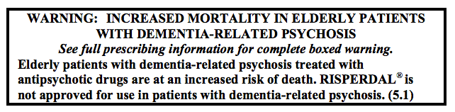
Weighing the benefit and risk of medications
Example: risperidone (Risperdal) in dementia
Potential Benefit:
30-70% chance of reducing physical agression
Potential Risk:
risk of death increased from 3% to 4%
If doing well, can consider decreasing/stopping every 6 months. (hallucinations often resolve within a few months)
Katz 1999
Haupt 2006

Slide 36
benzodiazepines
Use/duration increase with age
Age 80: female 12%, male 7%, 94% rx not from psychiatrists
Possible reasons:
PCPs shouldering bulk
of geriatric mental health
care
not comfortable
prescribing psychiatric
medications
Olfson 2014

Slide 37
Benzodiazepines
no consistent evidence in BPSD
falls, tolerance, pneumonia risk
increases risk of cognitive decline, dementia
-may be reversible if stopped
paradoxical disinhibition (1-60%)
risk factors: very young, very old, CNS injury, delirium, h/o aggression/poor impulse control
Taipale 2017
Ettcheto 2020
Beritbart 1996; Paton 2002, Tampi 2014

Slide 38
Responsible Medication Use = Better Long-term Outcomes
When used for disruptive behaviors (psychosis, aggression, agitation), antipsychotics use in dementia not associated with greater nursing home admission rate or risk of death
Lopez 2013
Rather, it is the debilitating levels of depression, psychosis, aggression that accelerate cognitive/physical decline, poorer quality life, and premature institutionalization
“judicious use of pharmacological interventions, including antipsychotics, is appropriate, necessary, and ethically justified…”
Desai 2012

Slide 39
Questions?

Slide 40
Medication management of dementia-related behavior in primary care setting: when and how
Brett Y. Lu MD/PhD, Department of Psychiatry, University of Hawaii
This handout is intended as a quick information guide for practitioners in primary care setting on how to assess and address dementia-related behavior, including prescribing medications when needed.
Primary care providers (PCP) are increasingly tasked with managing challenging dementia-related behavior, especially with the growing aging population and lack of access to geriatric behavioral specialists in the US. Many are expecting such “crisis in geriatric mental health” to worsen. For example, in Honolulu, there has been a trend of more behavioral emergency services being disproportionately allocated to elderly patients (ref. 1),
Dementia-related behaviors, often referred as behavioral and psychological symptoms of dementia (BPSD), are found in majority of patients with dementia. BPSD predicts higher mortality, increases risk of institutionalization, hastens institutionalization, and leads to high degree of depression and suffering for caregivers (ref. 2). BPSD can be broken down into definable symptom clusters as specific targets for treatment (Figure 1).

Slide 41
Figure 1
Behavioral and Psychological
Symptoms of Dementia (BPSD)
Psychosis*
hallucinations/delusions
25%
Anxiety
Depression*
irritability
20-40%
Agitation
often persistent
Altered circadian rhythms
disrupted sleep patterns
*associated with physical aggression and mortality in dementia
Apathy
Clear description of symptom helps to
facilitate specific and effective treatment

Slide 42
In a typical primary care setting, addressing BPSD-related complaints effectively usually involves the following steps.
1st: Obtain clear description of behavior
Inquire caregivers regarding type of behavior, together with duration, time of day, and triggers from caregivers. Solicit patients’ own narrative without confrontation.
Determine what symptom clusters in BPSD are present.
2nd: Address reversible/treatable medical causes
Screen or delirium, often presenting with acute behavioral symptoms, and treat promptly underlying medical etiology, such as UTI. Minimize pain, constipation, and neuropsychiatric side effects of medications, such as anticholinergics.
3rd: Optimize behavioral, or non-pharmacological, intervention (ref. 3)
Reinforce simple/calm speech, approach from front, and gentle touch during care. Ensure sufficient sensory stimulation such as music. Explore outside resources/day programs to help lessen caregiver burnout.
4th: Consider medications for quality of life
Distressing, dangerous symptoms such as physical aggression and suicidal thoughts warrant medication consideration, for safety and quality of life (ref. 4). Select meds based on benefit/risk ratio (Figure 2) with surrogate informed consent.

Slide 43
Figure 2
Honolulu Medication Algorithm for Behavioral Symptoms in Dementia
apathy
donepezil/rivagstimine
methylphenidate
depression
Irritability
anxiety
mild
citalopram
escitalopram sertraline
if depression w/o psychosis
other antidepressants:
mirtazepine, SNRIs
mod/severe
hallucinations
paranoia
quetiapine
valproic acid
gabapentin
benzodiazepines
risperidone*
olanzapine*
aripiprazole*
trazodone
memantime
*avoid in Parkinson’s/
Lewy Body dementia
agitation
aggression
mild
mod/severe
prazosin
dextromethorphan/quinidine
prn trazodone
prn risperidone,
olanzapine, quetiapine
insomnia
melatonin/
ramelteon
trazodone
gabapentin, zolpidem,
temazepam
doxepin
updated (June 2018) per evidenced-based benefit to risk ratio, Lu 2016

Slide 44
General medication guidelines for BPSD
  No “FDA-approved” medication for BPSD
  Start with low dose to ensure tolerability and increase in small increments
  May need up to 2-6 weeks for sustained improvement.
  During this time if target behavior persists, may not necessarily be “medication side effects” or “medication not working.”
  Side effects usually present as clear and persistent change from baseline, such as sedation, confusion, motor symptoms, or gastrointestinal effects
  Consult geriatric medicine or geriatric psychiatrist if patient difficult to treat
  Some medication considerations:
  -SSRIs often first line for BPSD but beware of hyponatremia
  -prazosin, BPH med crossing blood brain barrier, often effective for aggression
  -dementia medications can confer small improvement in depression/anxiety
  -antipsychotics can be highly effective in severe cases, as long as lowest effective dose used and side effects carefully monitored
  -still limited evidence for benzodiazepines and valproate in BPSD, watch for sedation and disinhibition

