Slide 1
Hawaii’s Opioid-Fentanyl Crisis: What more can we do?
Hawaii State Rural Health Association
September 27, 2022
Kevin Kunz, MD, MPH
Hawai’i Island Community Health Center
Hawaii Island Fentanyl Task Force

Slide 2
No Conflicts of Interest Employed at Hawaii Island Community Health Center Member, Hawaii Island Fentanyl Task Force No affiliations with any for-profit entity

Slide 3
Outline of this Presentation
Introduction and Warm-up
Community activation
Bridge, Bridge, Bridge
Workforce Development

Slide 4
Outline of this Presentation
Introduction and Warm-up
Community activation
Bridge, Bridge, Bridge
Workforce Development

Slide 6
Death is a Crude Measure of Health…
3%
14%
All Other Causes

Slide 7
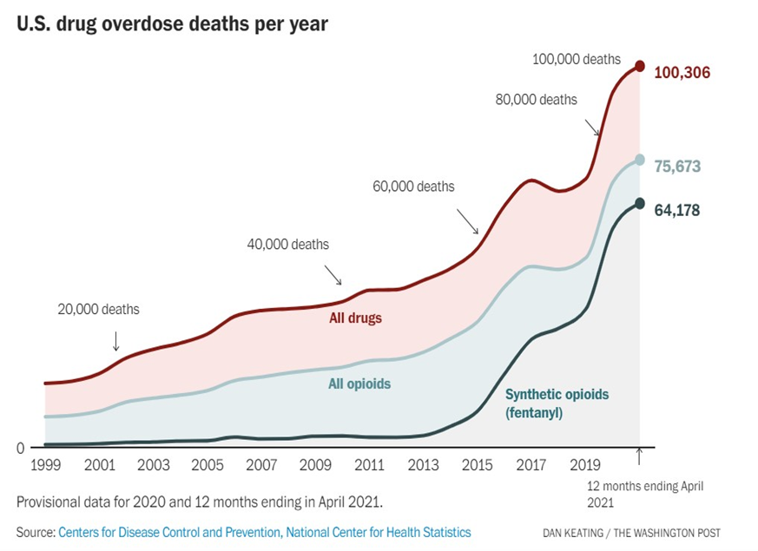
A Pandemic
Within A
Pandemic

Slide 8
43 Years of Exponential Drug Overdose Deaths

Slide 9
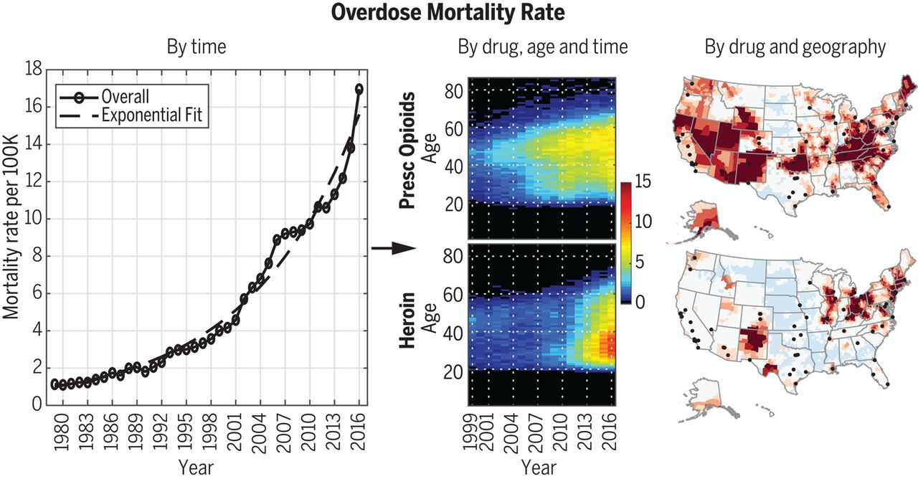

Slide 10
SORRY, BAD NEWS
We will never treat, harm reduce, incarcerate or bury our way out of our drug problem.
So what should we do about this? (hint: last slide)

Slide 12
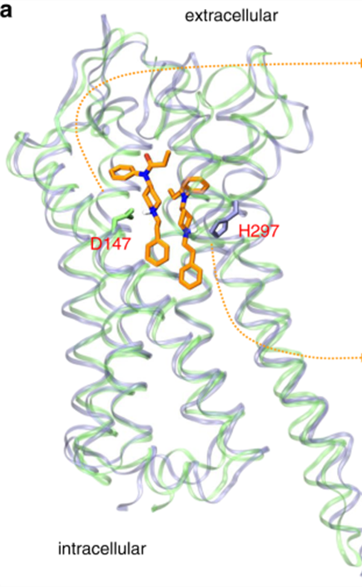
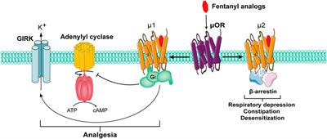
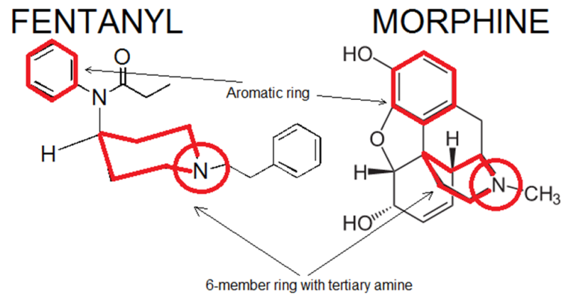
Published: 12 February 2021
How μ-opioid receptor recognizes fentanyl
Quynh N. et al
Nature Communications
vol. 12, Article #:984 (2021)

Slide 13
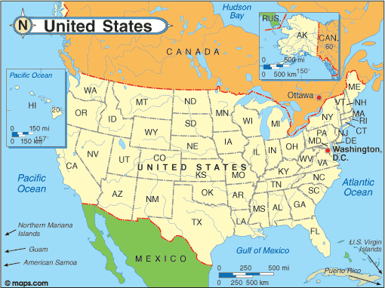
FENTANYL
ICE

Slide 14
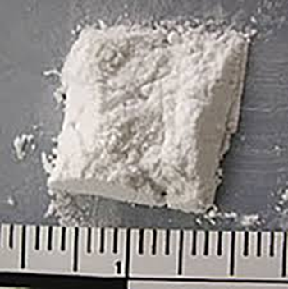
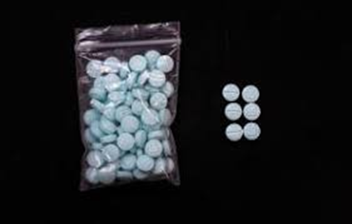
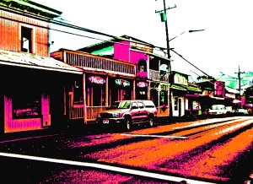
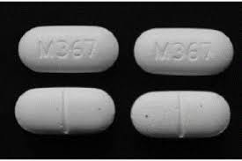
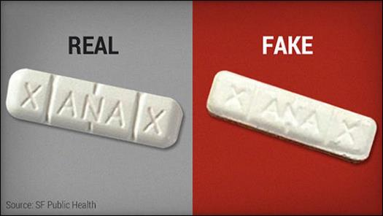
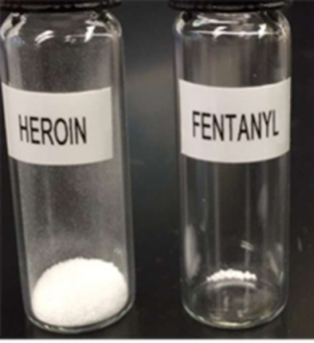
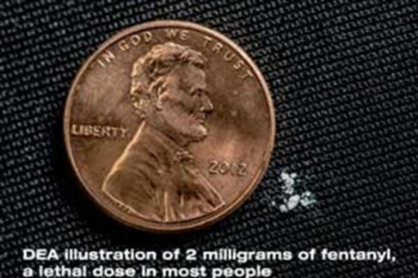
Street Fentanyl
Fake oxycodone
Norco, Vicodin
What’s the
lethal dose?
Real Rx Oxycodone 40-80 mg

Slide 15
Fentanyl is now the #1 cause of death
for Americans in each age group from18 to 45.

Slide 16
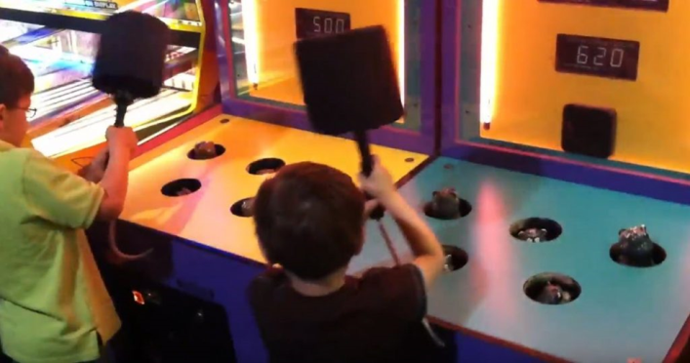
And what about….
Modifications on existing addictive substances?
Xylazine
Nitidines
Gabapentinoids
Etc.
“Whack a Mole”

Slide 17
Addiction is a Pediatric Disease
The brain is still “growing” until about 25 years of age.
Impulse control and weighing consequences of actions: red circle
Judgement is the last function to develop
90% of adults with addiction began using drugs before they were 21 years old.

Slide 18
Outline of this Presentation
Introduction and Warm-up
Community activation
Bridge, Bridge, Bridge
Workforce Development

Slide 19
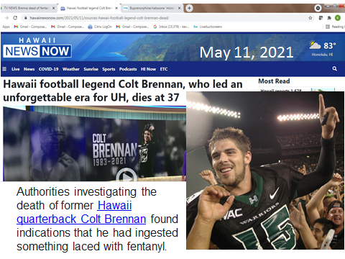
Colt Brennan died of an overdose, testing positive for fentanyl, ice and alcohol.

Slide 20
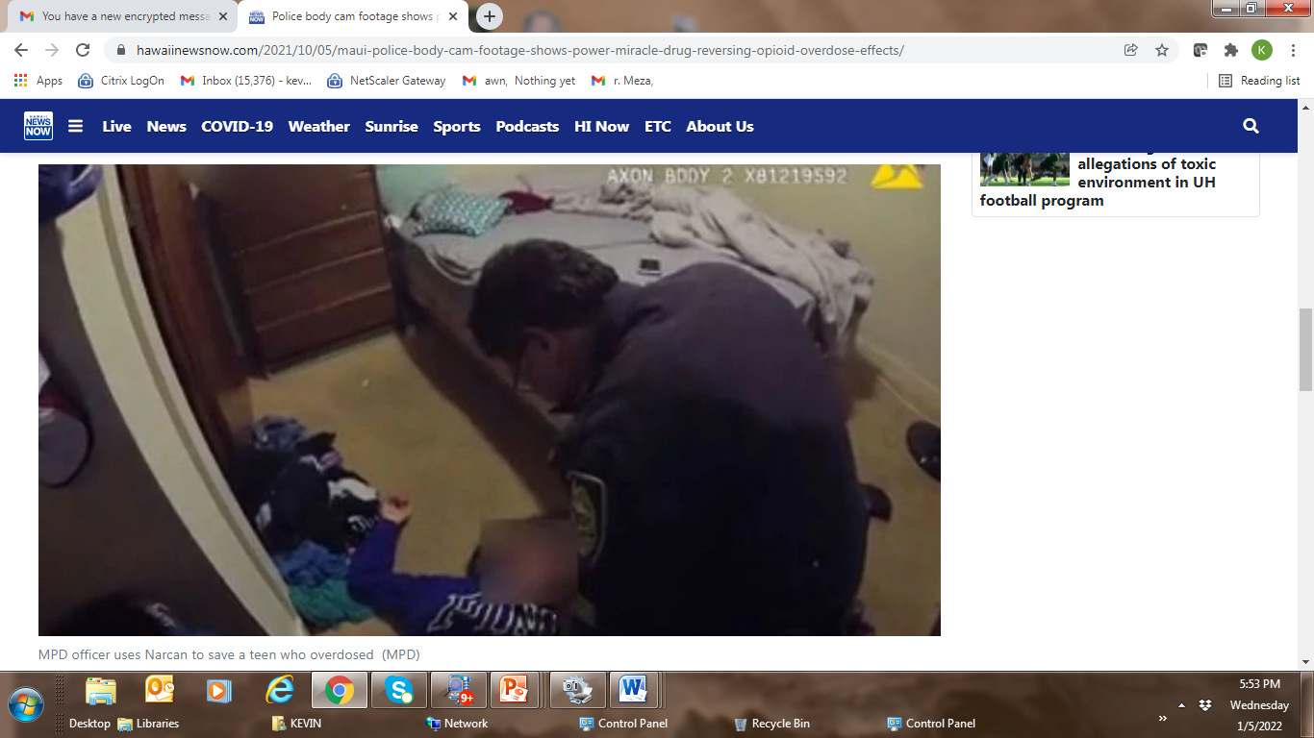
Maui Teen’s opioid overdose reversed with Narcan
by a MPD Officer, October, 2021

Slide 21
Fentanyl Education and Awareness Summit
SUD Health Professionals
Hawaii Police Department
Hawaii Island EMS
County of Hawaii
DOE
DOH
Treatment Programs
Community Organizations
Recovery Groups/Personal Stories
Media
February 22, 2022

Slide 22
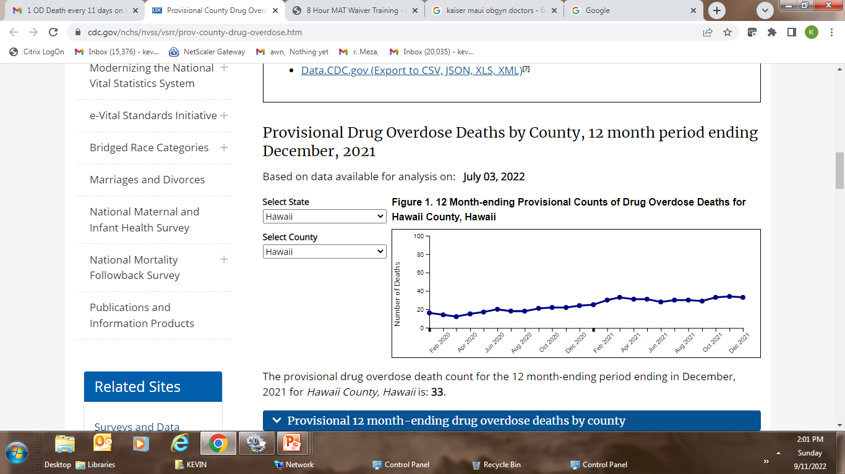
https://www.cdc.gov/nchs/nvss/vsrr/prov-county-drug-overdose.htm
Maui, Hawaii Island : each with 1 OD death q 11 days
Honolulu: 1 OD death q 2 days
Kauai: 1 OD death every 18 days
33 deaths
In 2021

Slide 23
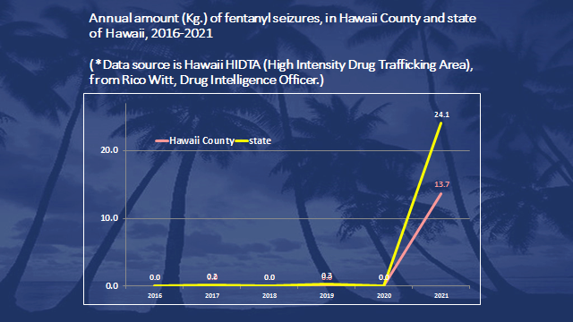
State total 53 lbs
Big Island total 30 lbs
The Big Island is home to 14% of the state’s population, yet 57% of the fentanyl confiscated in
the entire state was from our island. And since 2 mg of fentanyl can be a lethal dose in a
non-opioid-tolerant user, 30 lbs could kill 6.8 Million people. Cyanide is not as deadly.
Source: HIDTA and Dr. Dan Galanis, Hawaii Department of Health

Slide 24
Hawaii Tribune-Herald
Thursday, August 4, 2022
Police finish overdose probe: 14-year-old West Hawaii girl died after sniffing substance containing fentanyl
The Hawaii Police Department has confirmed its investigation into the fatal fentanyl overdose of a 14-year-old West Hawaii girl was routed to the county prosecutor’s office last month.
The teenager died in November 2021 after reportedly recording herself sniffing a substance while using the TikTok social media app.
Reported 9 months after the her tragic death….

Slide 25
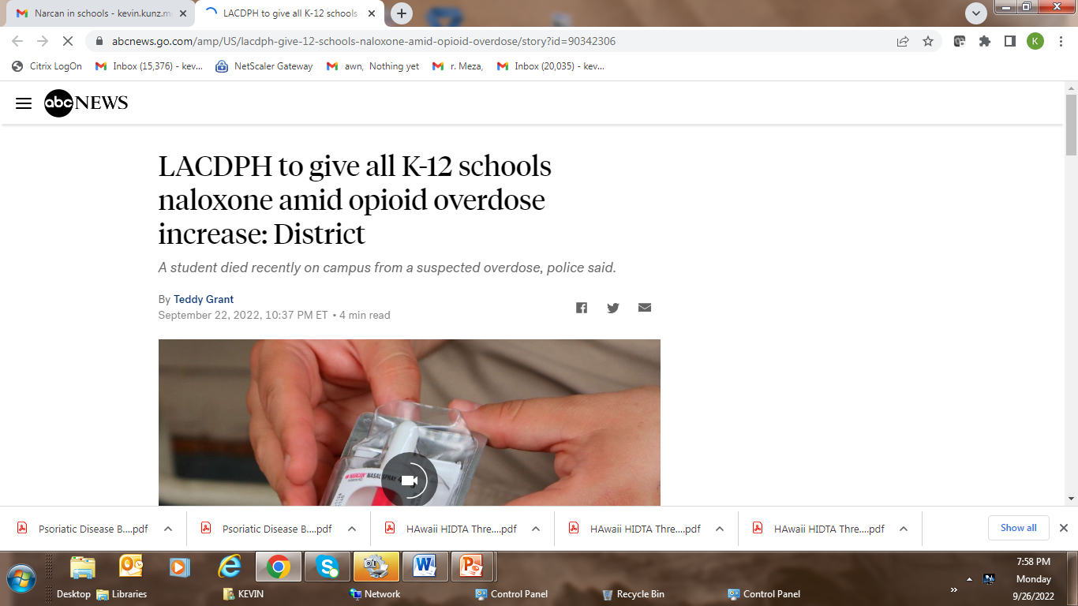

Slide 26
September 26, 2022
Hawaii HIDTA
Threat Bulletin
Hawaii HIDTA has received information that recently, a shipment of suspected powdered fentanyl was smuggled into and distributed on Hawaii Island along with a large amount of rainbow-colored counterfeit pills containing suspected fentanyl. The suspected powdered fentanyl has resulted in a high number of overdoses, with multiple
fatalities.
SITUATION:
Dangerous High-Potency Powdered Fentanyl
(

Slide 27
Outline of this Presentation
Introduction and Warm-up
Community activation
Bridge, Bridge, Bridge
Workforce Development

Slide 28
What is a Bupe Bridge?
Initiation of MOUD (buprenorphine product) when and where the person with OUD presents in crisis, and is then given a tight “bridge” referral to a community waivered provider.
“Treat the patient where they present”

Slide 29
Bridge Examples
Emergency Departments
Hospitalized OUD patients being discharged
Judicial System
EMS: follow Narcan administration with Bupe (example: Maine)
IOP, Residential programs
Programs seeing or treating OUD patients should have a tight connection with a community MOUD provider.
Evidence based Bridge Protocols are available

Slide 30
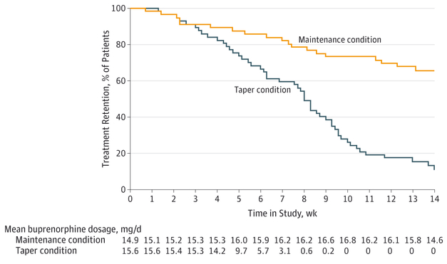
Treatment Retention
and Buprenorphine Dosage

Slide 31
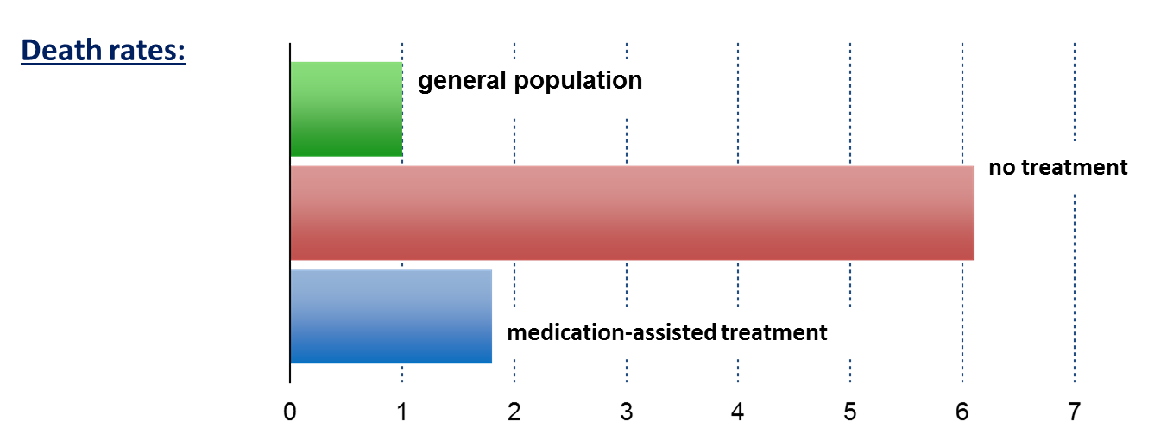
Benefits of MOUD: Decreased MortalityMAT: Decreased Mortality Mortality
Standardized Mortality Ratio
Dupouy et al., 2017
Evans et al., 2015
Sordo et al., 2017
Notes:
Speaker Notes:
Key Point #1: Patients out of treatment died at about 6 times the rate of people in the general population, while medication-assisted treatment with methadone brought this to less than 2 times.
Key Point #2: Retention in methadone and buprenorphine treatment is associated with substantial reductions in the risk for all cause and overdose mortality in people dependent on opioids.

Slide 32
Outline of this Presentation
Introduction and Warm-up
Community activation
Bridge, Bridge, Bridge
Workforce Development

Slide 33
Who is the “workforce”
Who is responsible for addressing this crisis?
All health care professionals
All providers with prescriptive privileges – PROCURE THE DEA WAIVER FOR BUP
State and County employees
Teachers, churches, community organizations
Persons in recovery, supporting others
YOU ARE RESPONSE ABLE.

Slide 35
BAD NEWS & GOOD NEWS
We will never treat, harm reduce, incarcerate or bury our way out of our drug problem.
So what should we do about this?

Slide 36
Prevention, Treatment, Recovery
Prevention Works: remember the brain slide
Support Recovery: persons in recovery are very capable and the largest workforce available
So what should we do about this?

Slide 37
Mutual Support Groups
Alcoholics Anonymous
Founded in 1935
Based on a 12-step model of sobriety with a fundamental evoking of God or a Higher Power
Narcotics Anonymous
Founded in 1947
Also based on a 12-step model of sobriety
Cochrane Reports
“Alcoholics Anonymous and other 12‐step programs for alcohol use disorder”
John F Kelly, Keith Humphreys, Marica Ferri 11 March 2020
“In conclusion, clinically‐delivered TSF interventions designed to increase AA participation usually lead to better outcomes over the subsequent months to years in terms of producing higher rates of continuous abstinence”.
Notes:
Speaker Notes:
Mutual support groups have supportive evidence and can provide a support network for patients in recovery
Many patients with opioid use disorder attend AA meetings
Notably, some Mutual Help groups reject MAT—encourage patients to find groups which accept MAT.

Slide 38
Pau

